Slide 1
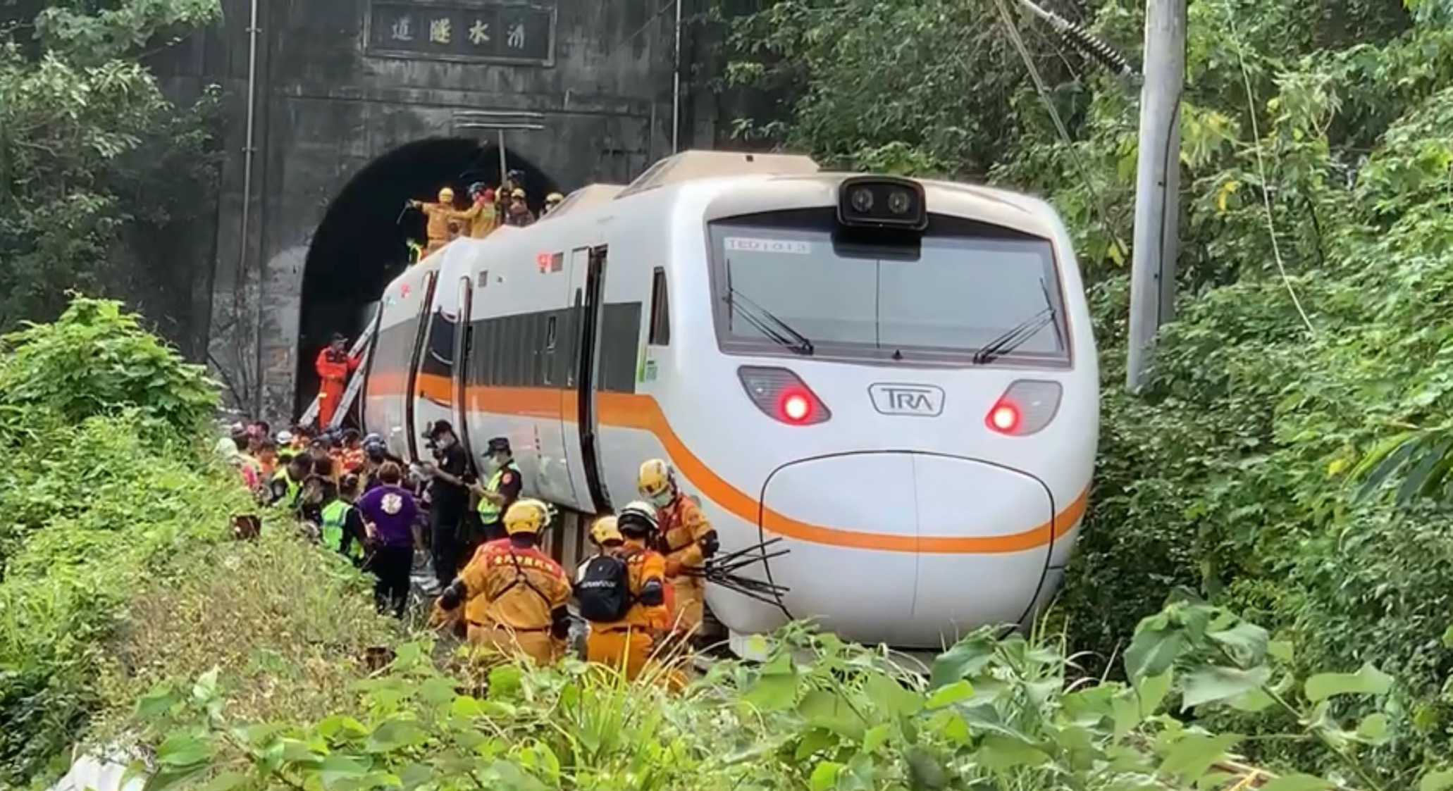
Last MCI in Taiwan. Lessons Learned , and Recommendations for Emergency Response
Sheng-Wen Hou MD, MPH
Shin-Kong Wu Ho-Su Memorial Hospital
EMS medical director, Taipei Fire Department
Secretary General, Taiwan Society of Disaster Medicine

Slide 2
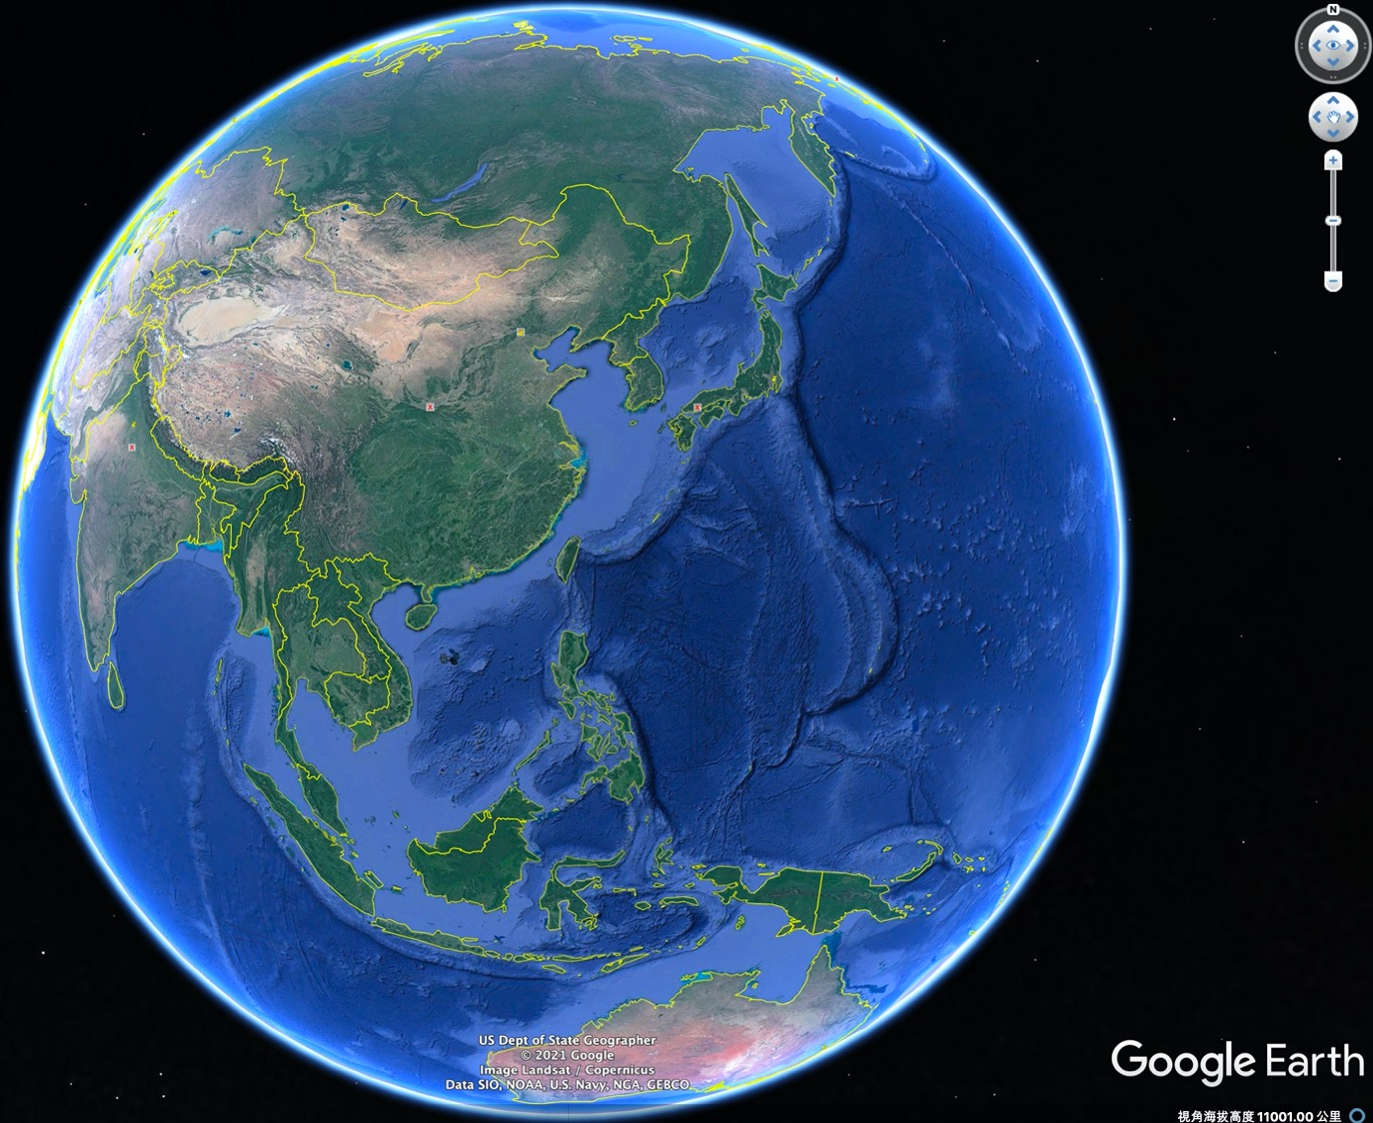
24.217165°N 121.688439°E

Slide 3
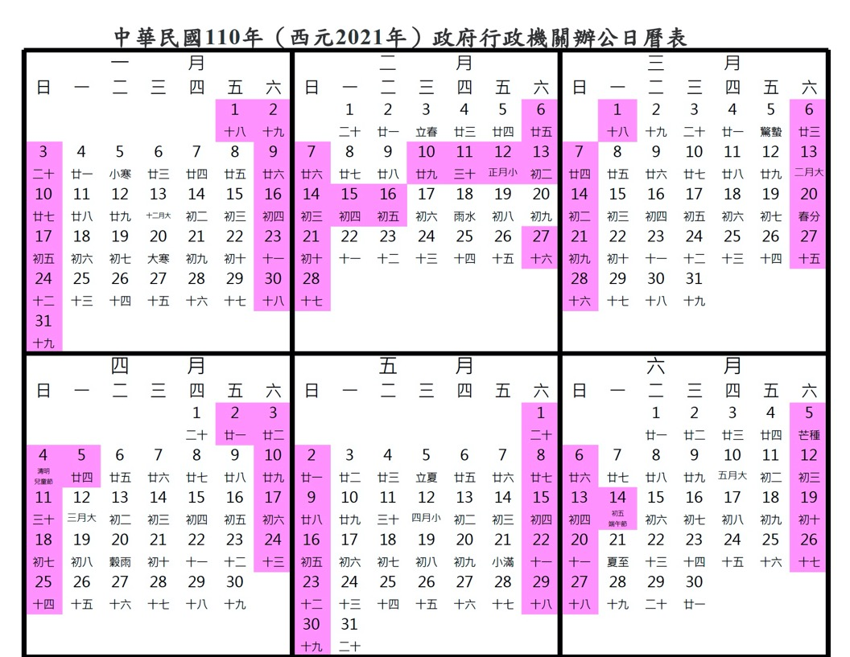
Date: April 2nd, 2021
24.217165°N 121.688439°E

Slide 4
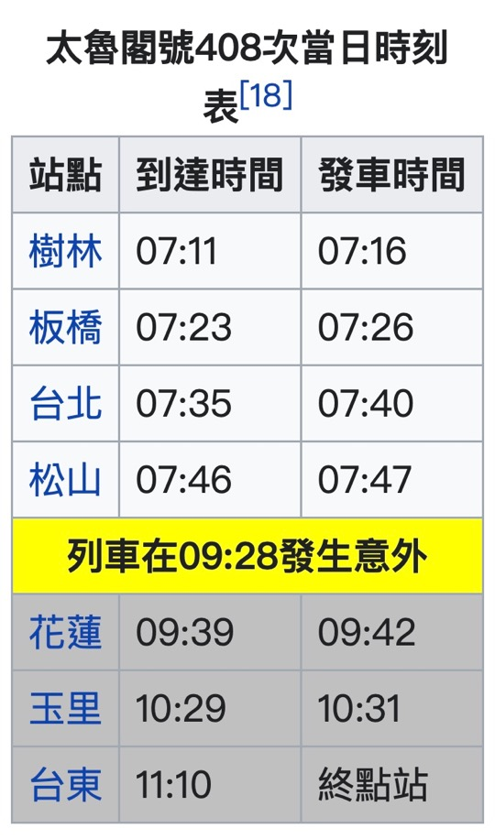
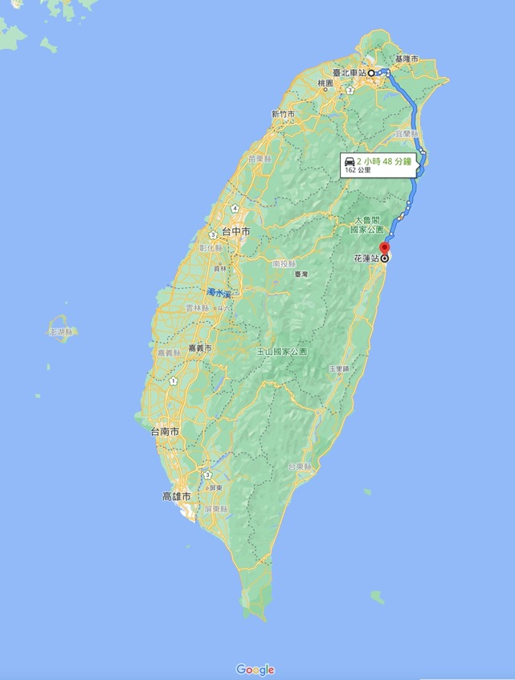
Time：9:28 AM
2h48m by car, if no traffic jam.
2h04m
24.217165°N
121.688439°E

Slide 5
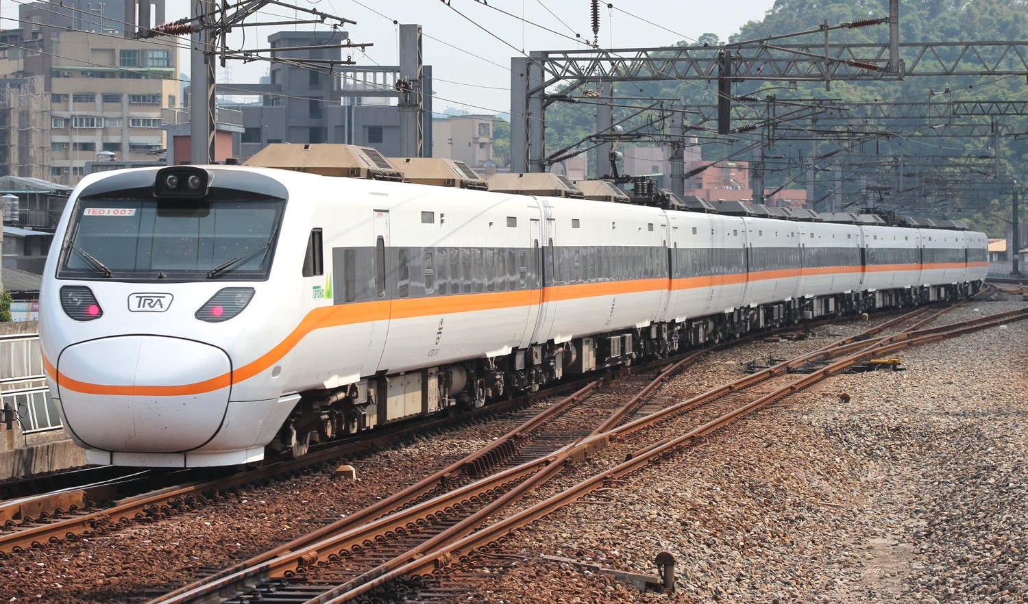
24.217165°N 121.688439°E
498 passengers
49 dead
247 injured
Photo credit: Rsa - Rsaが, CC BY-SA 3.0, https://commons.wikimedia.org/w/index.php?curid=27632578

Slide 6
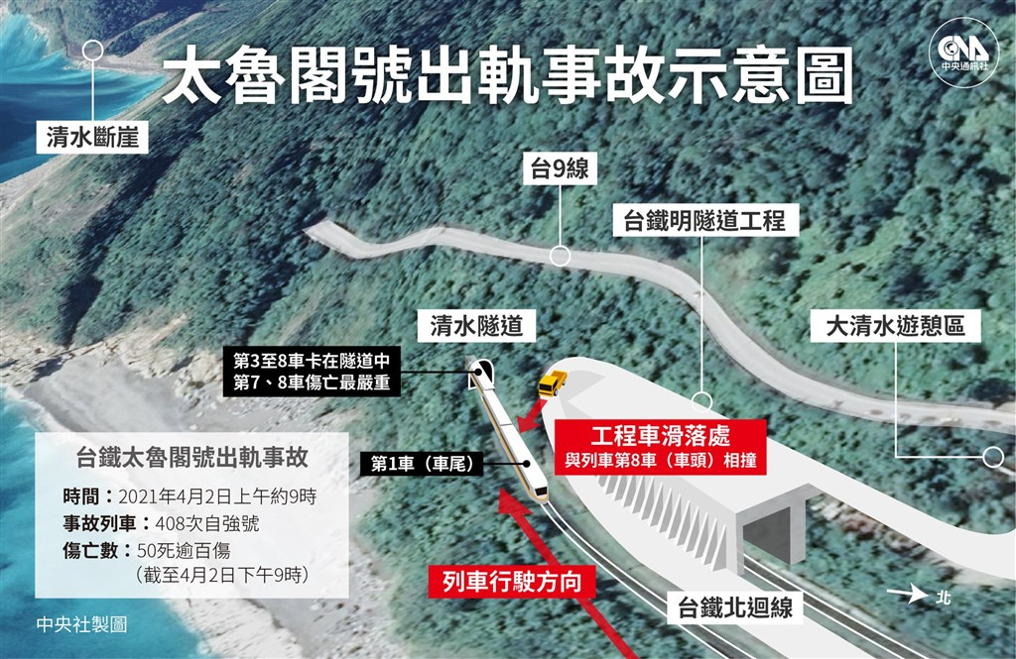
24.217165°N 121.688439°E

Slide 7
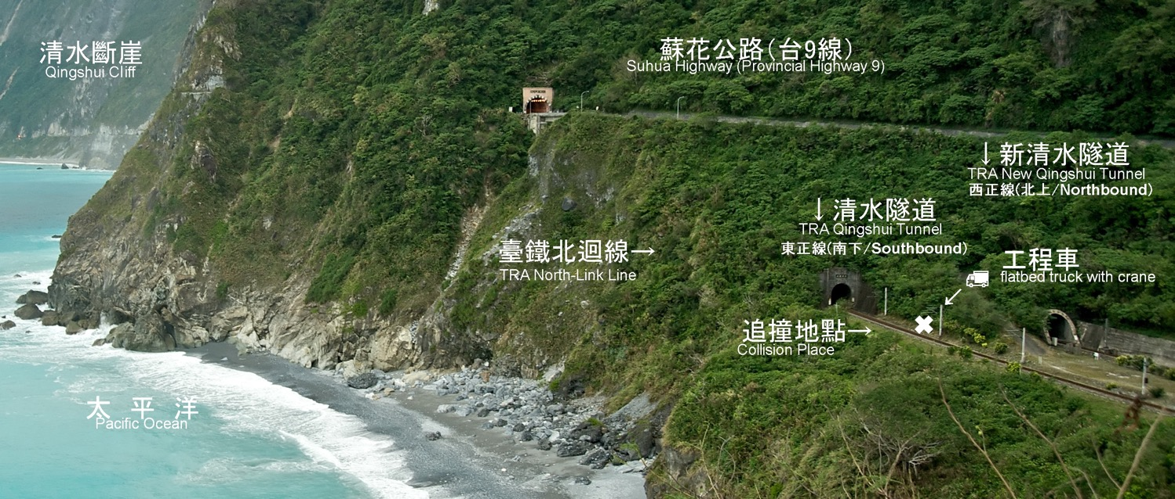
24.217165°N 121.688439°E
South
North
2 km long
This is a historical picture, so the northbound railway was not yet covered by protective tunnel.

Slide 8
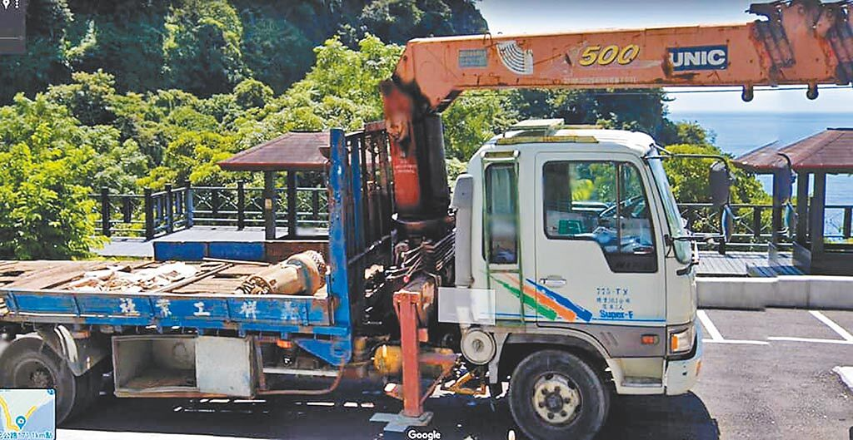
24.217165°N 121.688439°E

Slide 9
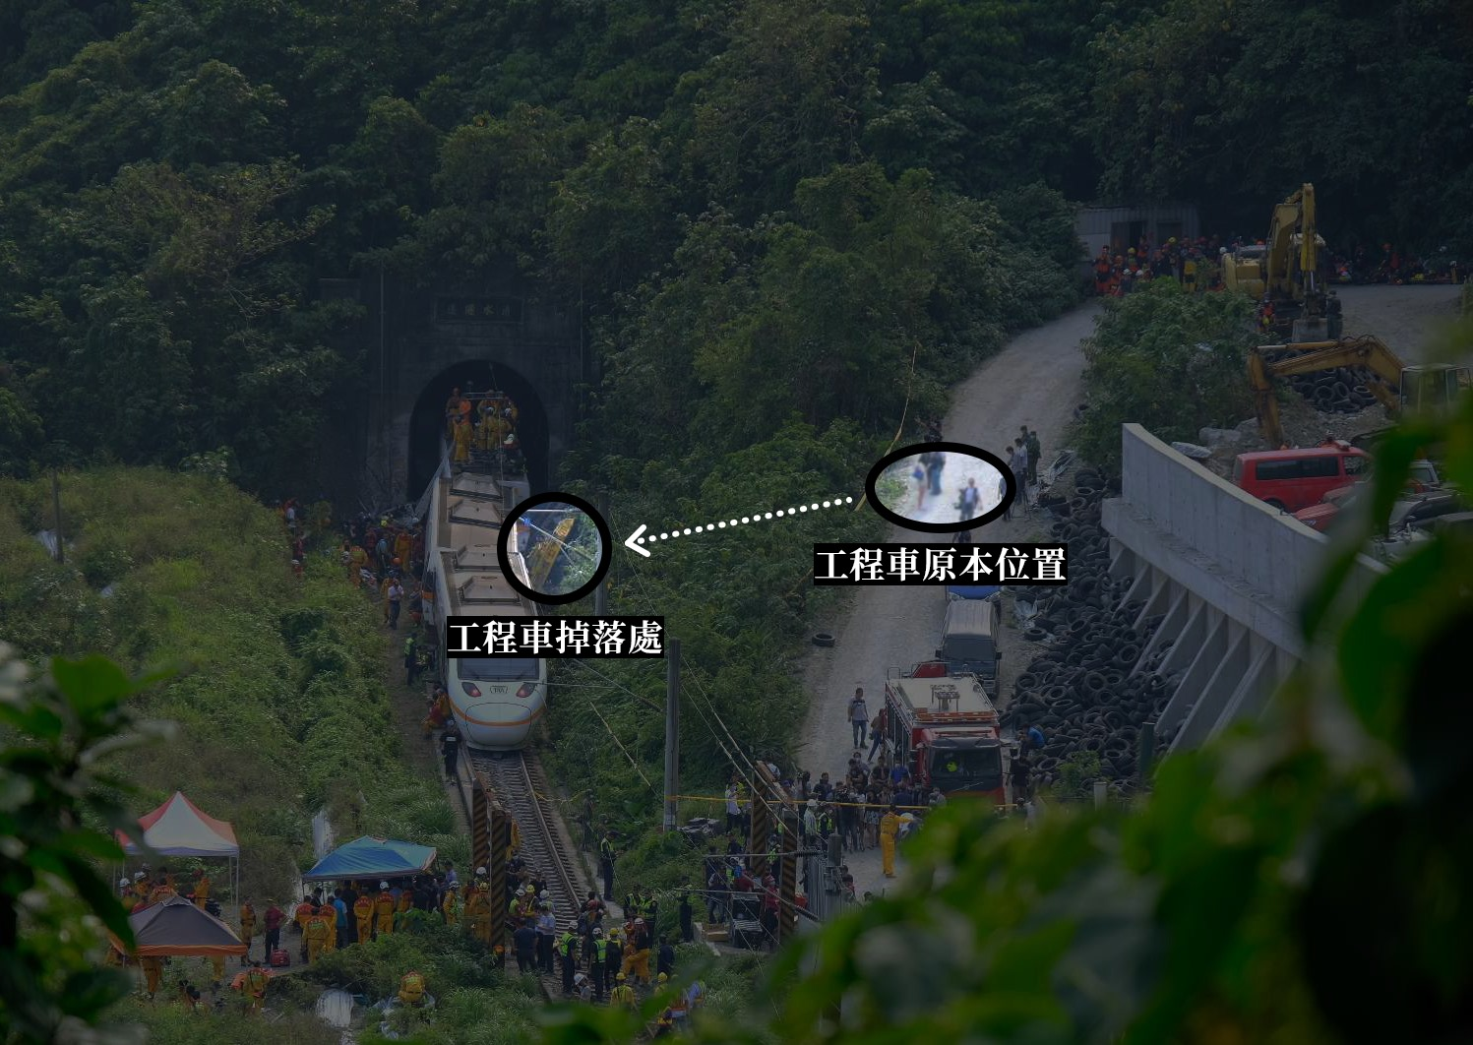
24.217165°N 121.688439°E

Slide 10

https://youtu.be/8FFsaO7GvvI

Slide 11
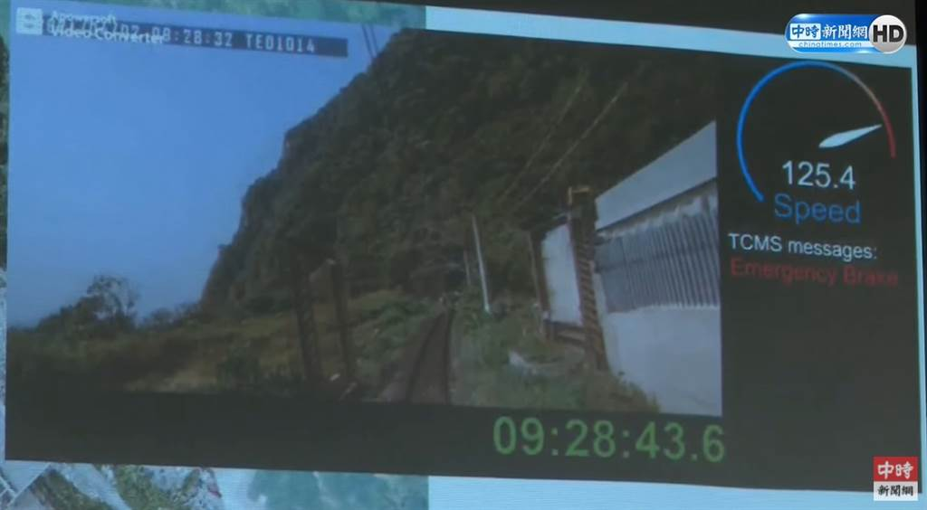
From the “black box”
24.217165°N 121.688439°E

Slide 12
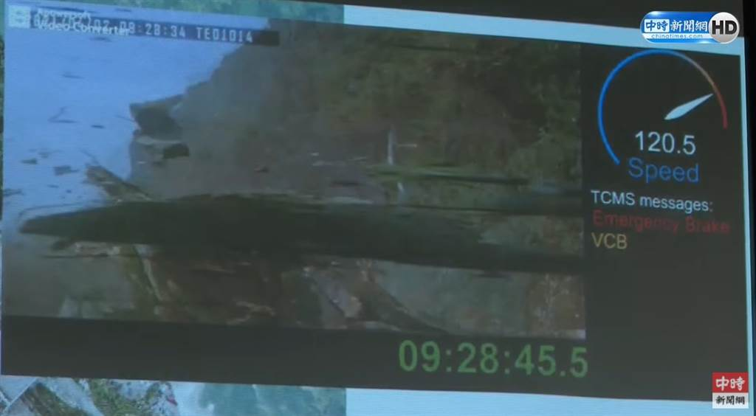
From the “black box”
24.217165°N 121.688439°E

Slide 13
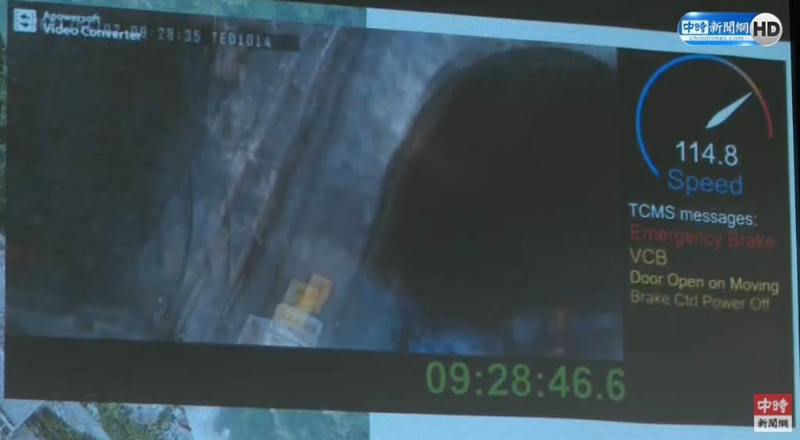
From the “black box”
24.217165°N 121.688439°E

Slide 14
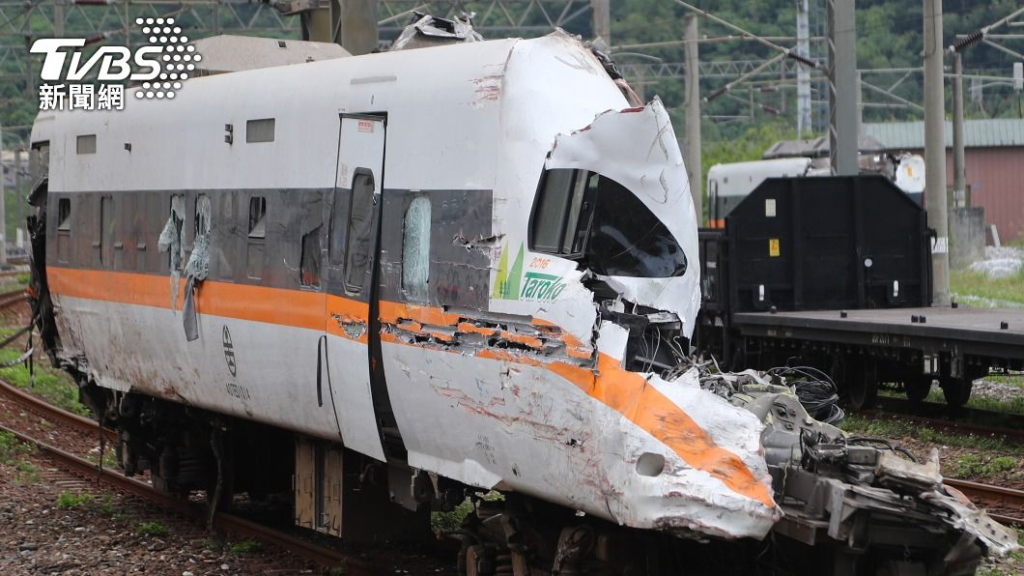
Car 8 (Front)
24.217165°N 121.688439°E

Slide 15
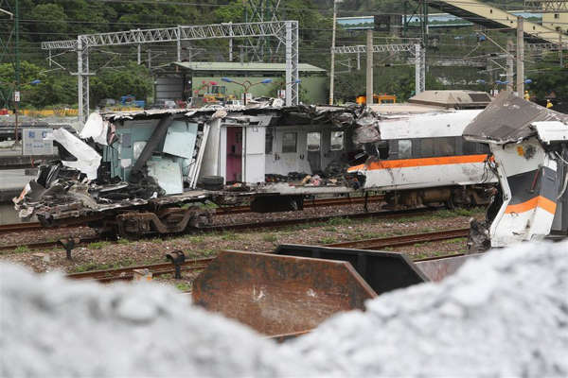
Car 8 (Front)
24.217165°N 121.688439°E

Slide 16
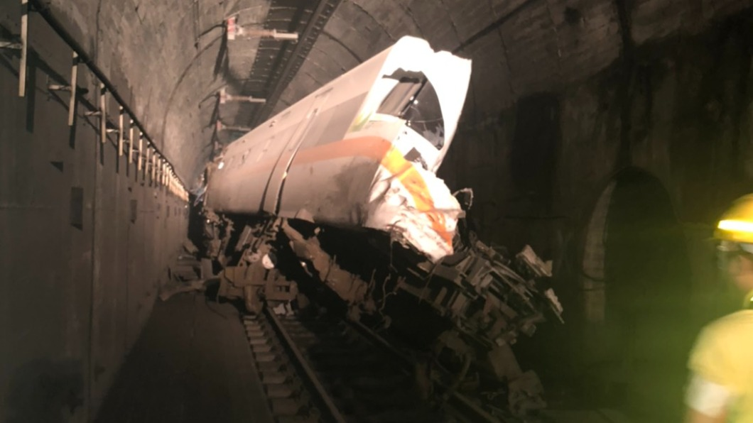
Car 8 (Front)
24.217165°N 121.688439°E

Slide 17
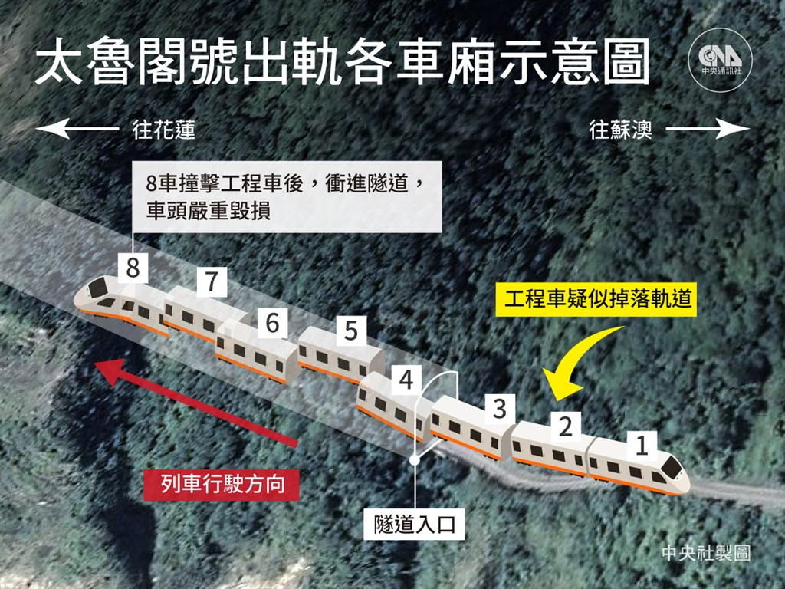
South
CCP
North
CCP

Slide 18
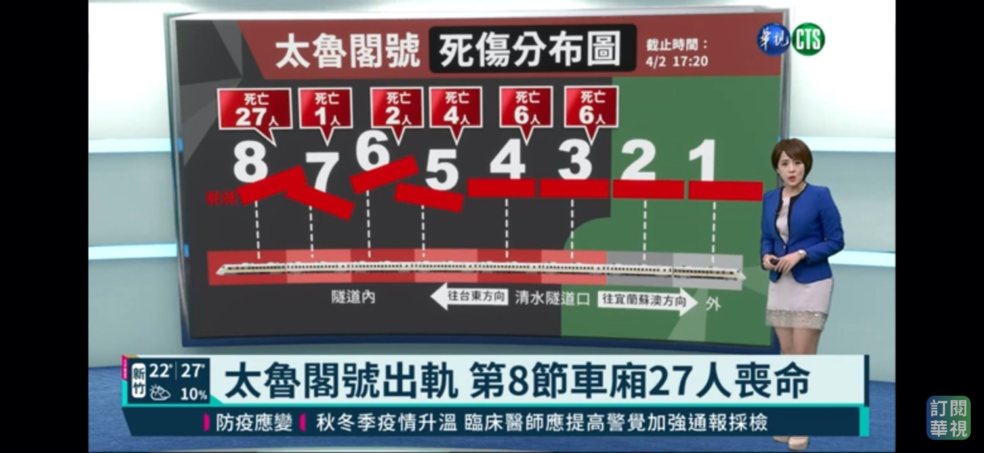

Slide 19
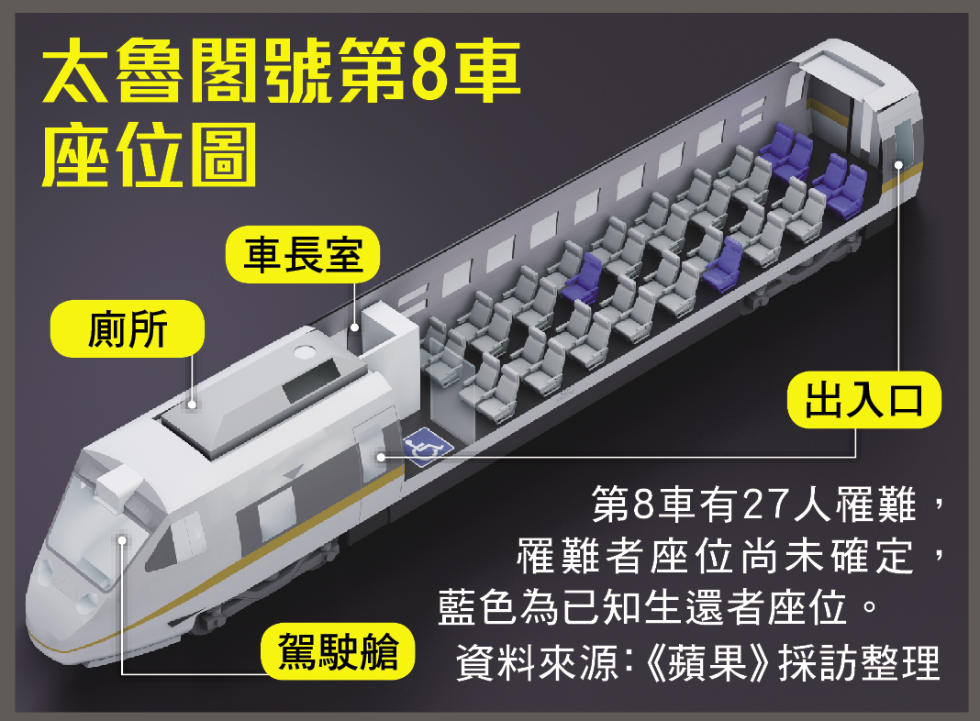

Slide 20
Dispatch
Collision happened at 9:28 am
9:31 first call from a female passenger
9:35 multiple calls received by Hualien 119.
9:37 12 vehicles dispatched (6 ambulances, 6 fire trucks)
9:42 The first ambulance on scene
9:46 MCI declared by health department
9:54 Yilan County EMS actively offered help.
9:55 Taipei City EMS actively offered help.
10:09 New Taipei City EMS actively offered help.

Slide 21
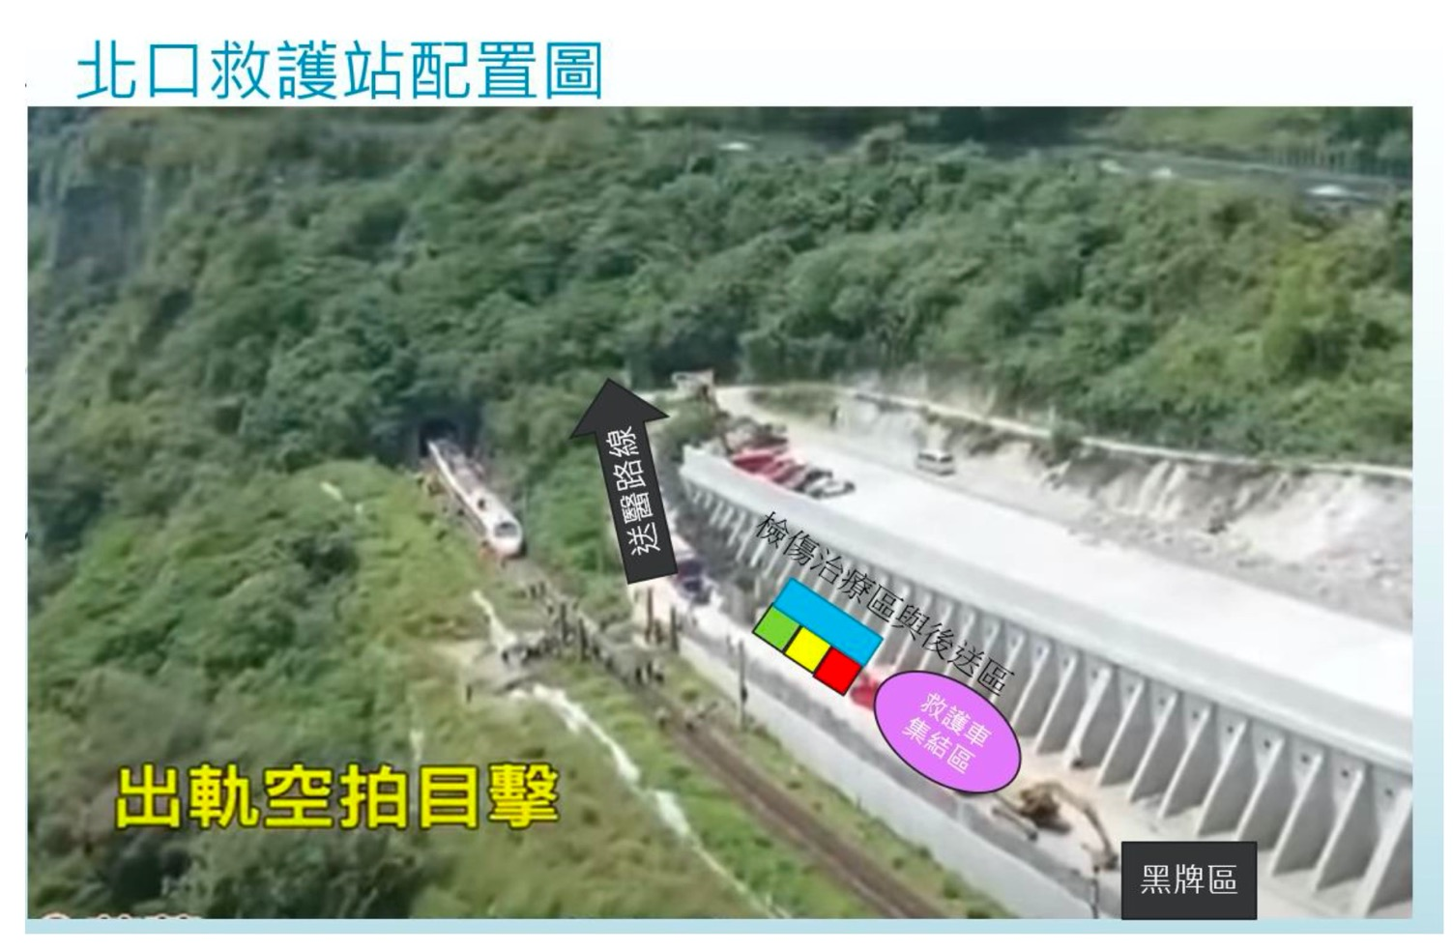
North CCP

Slide 22
6 ambulances at scene
One of them is paramedic and lead the initial phase operation.
9:42 The first ambulance on scene
Order passengers move up to highway 9.
One OHCA patient was brought to a hospital by a private ambulance.
10:33 command post established
11:14 First wave of 6 ambulances left.

Slide 23
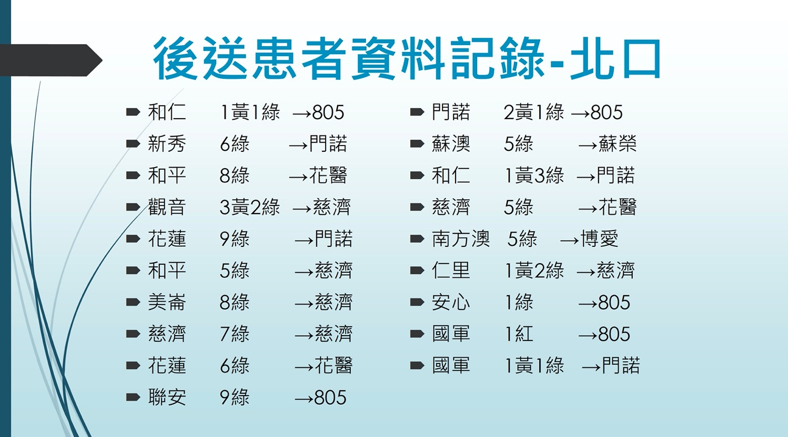
Y
Y
G
Y
Y
Y
R
Y
North CCP (incident site)
First 6 ambulances on scene shipped 1 yellow, 38 green tagged patients.
Total 1 red, 9 yellow, 83 green tagged patients were collected.

Slide 24
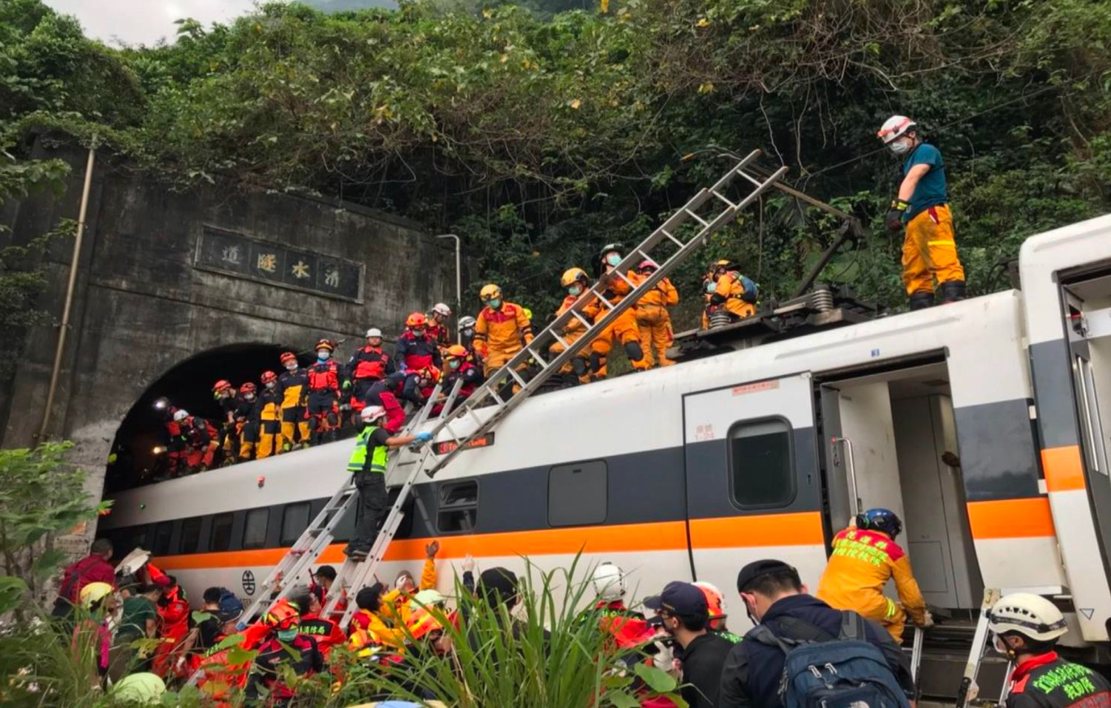

Slide 25
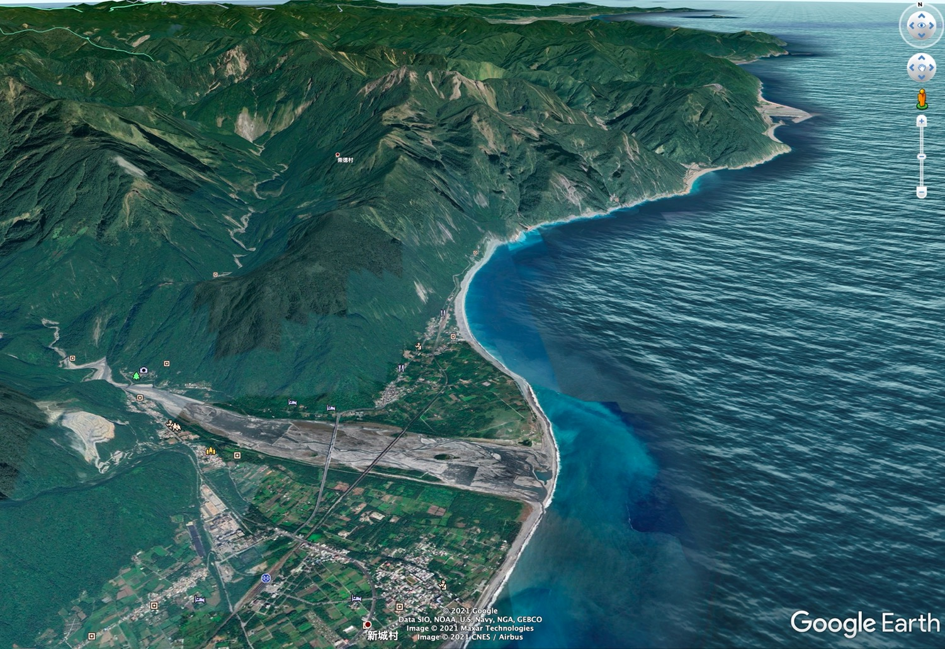
North
Tunnel entrance (incident)
CCP - North
Tunnel exit
Nearest train station
CCP-South
14 miles to the level one trauma center
Another train station which is more ambulance friendly
-28 bodies were placed here and was brought to morgue later
South

Slide 26
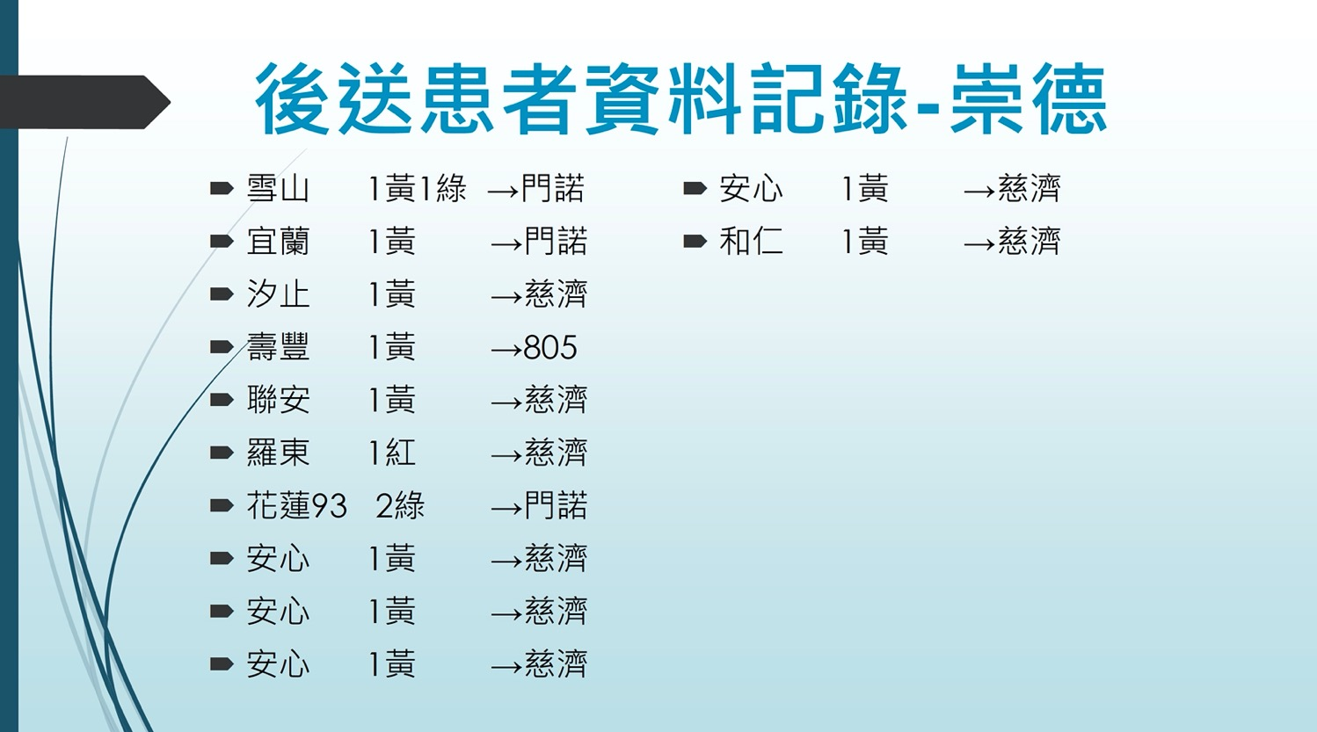
Y
G
R
G
South CCP (崇德 train station)
12 patients were brought to this CCP by diesel train.
2 patients walked the whole tunnel and arrived by themselves.

Slide 30

Safety Officer not presented in this station. Northbound trains bypassing this little station without any warning.

Slide 31
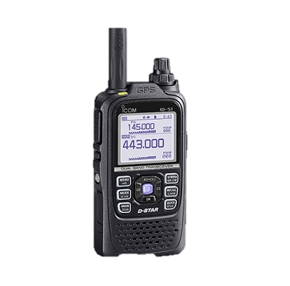
Lack of proper communication was noted during train transport.

Slide 32
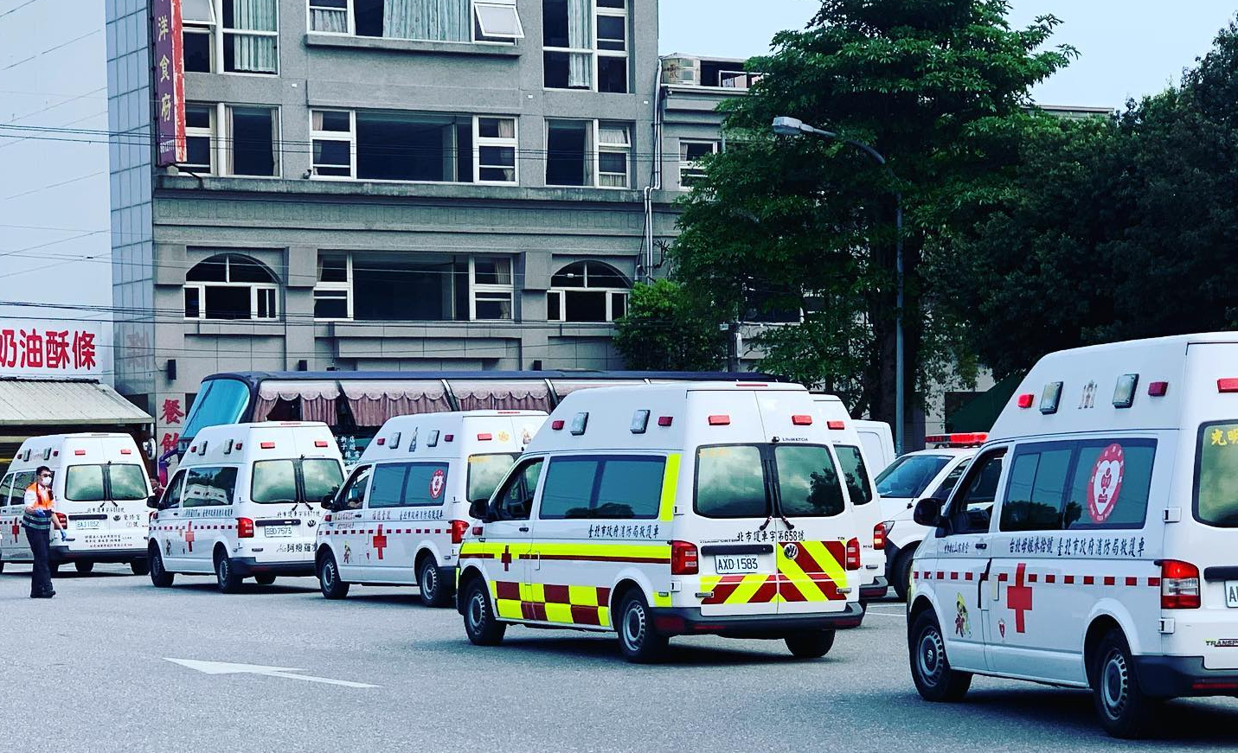
EMS transportation by train is possible but must take accessibility into account.
28 bodies were transported by train to this station.

Slide 33
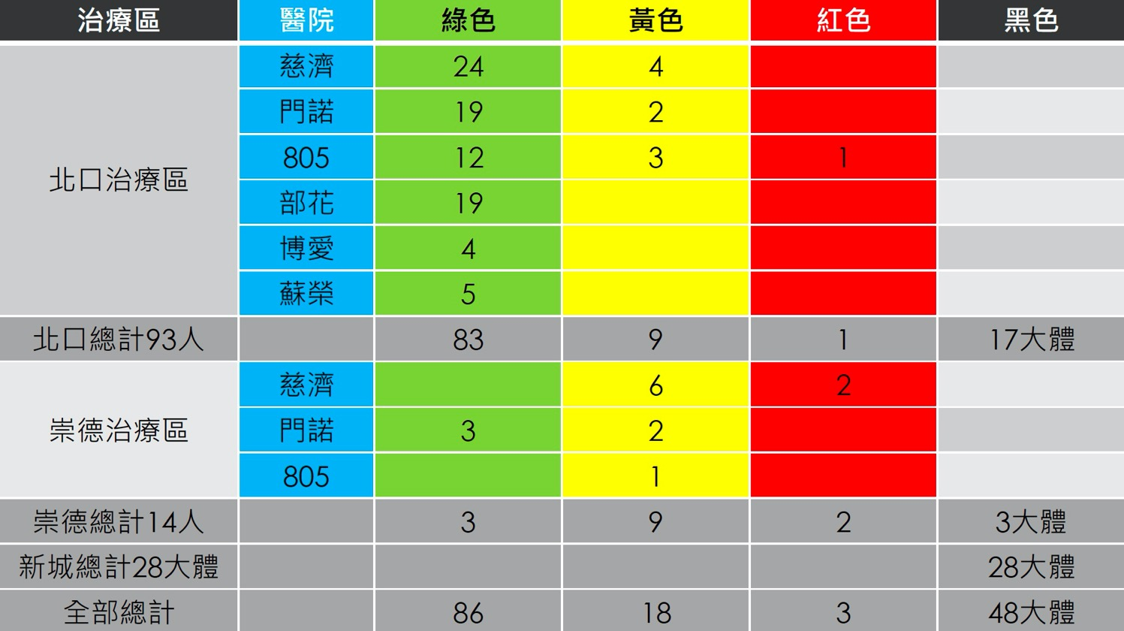
Hospital
North
South

Slide 34

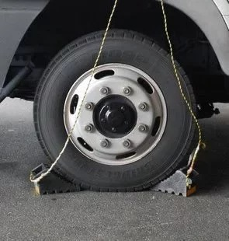
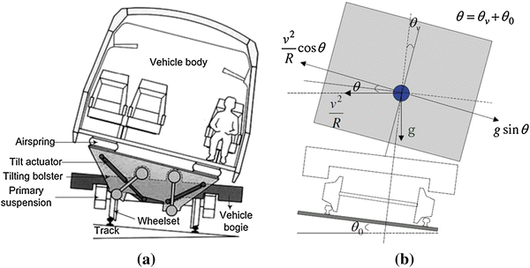
Injury Prevention

Slide 35

Mutual Aid
Hualien County does have Mutual Aid Agreement with other Cities/Counties.
However, no pre-specified trigger criteria documented.

Slide 36
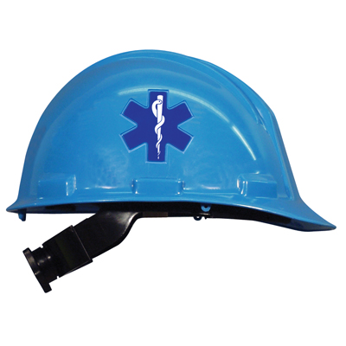
Ambulance equipment
Only few City/County EMS list helmet as standard equipment.
Fortunately, Hualien County is one of them
Loudspeaker REALLY helps!

Slide 37
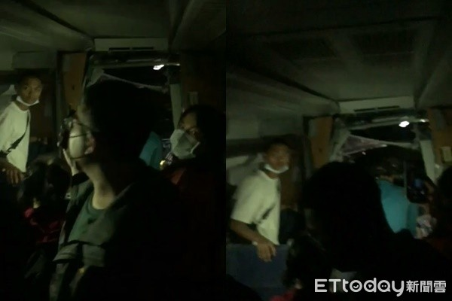
Ambulance equipment
Most EMTs have their own hat lights

Slide 38
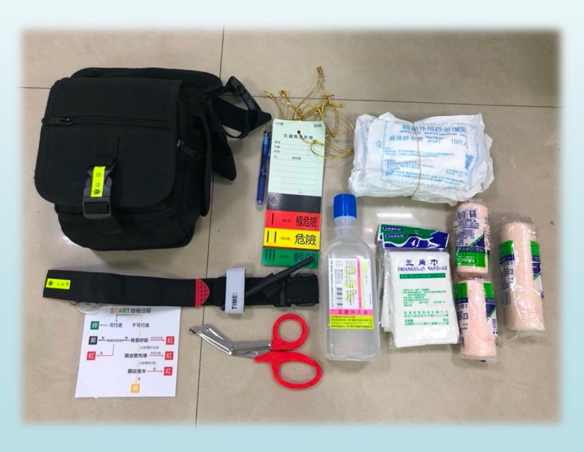
Ambulance equipment
Not every ambulance has triage package.

Slide 39
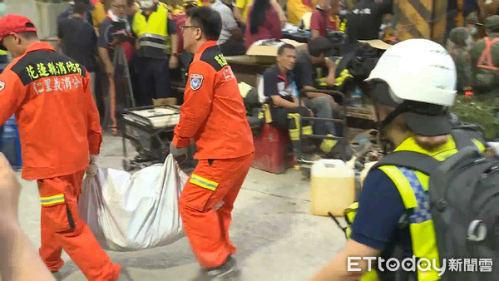
Ambulance equipment
Body bags are not durable during transport.

Slide 40
The good, the bad, and the Ugly
North CCP set up at 10:31
About 1 hour after collision
Operated by 5 paramedics.
Total operation time = 4 hour 7 minutes
107 patients were transported
155 passengers were guided to highway 9.
Patients were distributed evenly; no single hospital was overwhelmed.
Establish South CCP as soon as they acknowledge the difficult access to cars in the tunnel.

Slide 41
The good, the bad, and the Ugly
Commanders of each CCP were stressed by communication burden.
Because of the holiday, it was difficult to ask health department personnel to work together on scene.
Difficulties still exist when different organizations trying to contact each other.
Again, public morgue personnel should be on scene to manage the transportation of bodies. However, the holiday also made this impossible.

Slide 42
Safety issues
South CCP is a tiny train station, where northbound train service still passing this station at full speed without any warning.
There was no leader from the railroad company and no long-distance communication on the shuttle train.
The electricity of the southbound railroad was not totally shutdown until 11 am.
There is no pre-specified decontamination protocol and water source for SAR teams.

Slide 43
In conclusion, for railway incidents…….
“Foreign Body Invasion” did pose significant threat to train operation.
Tunnel rescue is quite unique experience
Even in daytime, light and helmet may still be required at the scene of disaster.
A good drill topic.
Transport by train may not be ideal but the only way to move victims.
Holidays DID slow down so many things…
Although the value cannot not be proved in this case, tourniquets may save lives.

