Slide 1
VA-DoD Pain Management Collaboration
Friedhelm Sandbrink MD
Acting National Program Director for Pain Management, Specialty Care Services
Director Pain Management, Washington DC VA Medical Center
No relevant financial relationships or conflicts of interest. No discussion of off-label use of drugs or devices.
The presentation is the personal opinion of the presenter and does not reflect the official views of the Department of Veterans Affairs or any other Federal Agency.

Slide 2
Objectives/Overview
The Pain Challenge
The Opioid Crisis
VA, DoD and Federal Initiatives
Comprehensive Addiction and Recovery Act (2016)
VA/DoD Health Executive Council Pain Management Workgroup
Opioid Safety Initiative/Opioid Risk Mitigation
Dashboards
VA-DoD Clinical Practice Guideline
Provider Education
Complementary and integrative health (CIH)
Stepped Care Model and Pain Management Teams at all VHA facilities
Interdisciplinary Pain Teams

Slide 3
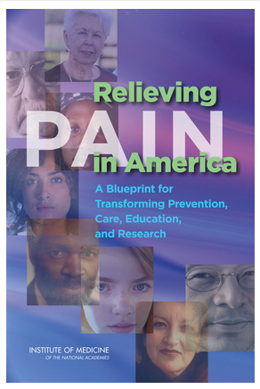
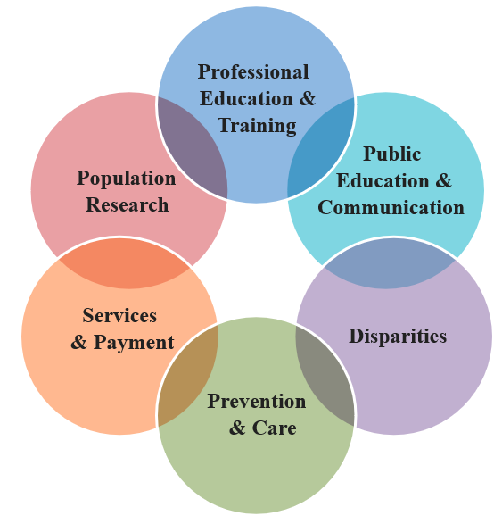
The “Pain Crisis” - Nationally
Health and Human Services (HHS)
Institute of Medicine 2011: Relieving Pain in America
A Blueprint for Transforming Prevention, Care, Education, and Research
http://www.ncbi.nlm.nih.gov/books/NBK91497/
>100 Mil in US with some form of chronic pain → 30% of adults
$565 – 635 billion cost annually (> cancer and heart disease combined)
National Pain Strategy (2016) and Implementation Workgroups (2017-)
A comprehensive, population health-level strategy for pain prevention, treatment, management, education, reimbursement, and research https://iprcc.nih.gov/sites/default/files/HHSNational_Pain_Strategy_508C.pdf
Office of the Assistant Secretary for Health in partnership with the NIH and other federal agencies.
Notes:
IPRCC Federal Advisory Committee created to enhance pain research efforts and promote collaboration across the government, with the ultimate goals of advancing the fundamental understanding of pain and improving pain-related treatment strategies

Slide 4
The Pain Challenge in VHA
In Veterans, chronic pain is common.
Veterans: more than 50% of older Veterans experience chronic pain
60% of Veterans from Middle East conflicts;
Up to 75% of female Veterans
More than 2 Mil Veterans with chronic pain diagnosis (In 2012, 1/3 on opioids)
National Health Interview Survey (NHIS) (2016)
66% of Veterans vs. 56% of non-veterans with pain in prior 3 month
Most common pain conditions in Veterans (as % of all Veterans):
Joint pain (43.6%)
Back pain (32.8% - axial 20.5%, sciatica 12.2%)
Neck pain (15.9%)
Migraine (10.0%)
Jaw pain (3.6%)
NHIS: interview of 67,696 US adults in 2010-14
}
Musculoskeletal pain conditions
Nahin RL, J. Pain 2016

Slide 5
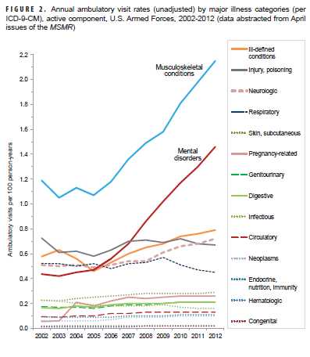
DoD: Ambulatory Visits
US Armed Forces Ambulatory visits per year by major illness categories (ICD-9)
Since 2005, steady rise in visits for
Musculoskeletal conditions
Mental Health disorders
Courtesy Eric B. Schoomaker MD PhD

Slide 6
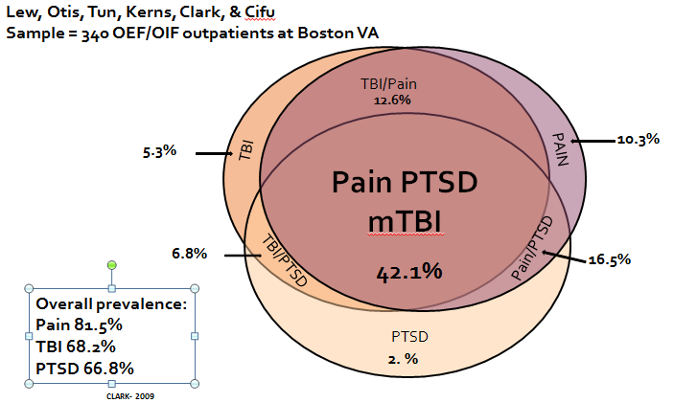
The Pain Challenge in VHA
In Veterans, chronic pain is often severe.
9.1% of Veterans vs 6.3% of non-veterans with severe pain*
7.8% of younger veterans vs 3.2% of non-veterans with severe pain
In Veterans, pain is often complex.
Service-connected injuries often result in life-long moderate to severe pain related to musculoskeletal system/nerve damage.
Co-concurrence with PTSD and TBI particularly challenging.
Nahin RL, J. Pain 2016
*Severe pain: pain which occurs "most days" or "every day" and bothers the individual "a lot,"
“The most frequently identified risk factor among Veterans who died by suicide was pain”.
Behavioral Health Autopsy Program 2015
Mental Health comorbidities are common in Veterans with chronic pain.

Slide 7
The Pain Challenge in VHA

Slide 8
The Pain Challenge in VHA
Pain severity and co-concurrence with mental health comorbidities result in high impact pain (i.e. associated with substantial restriction of participation in work, social, and self-care activities).
Integrated care: systematic coordination of medical, psychological and social aspects of health care is required.
Medical and/or mental comorbidities are often related to military service and/or require Veteran-specific expertise.
VHA: Pain Management and Opioid Safety is included in the list of “Foundational Services”
Notes:
High impact pain: associated with substantial restriction of participation in work, social, and self-care activities

Slide 9
Patient Robert B.*
32 y/o OEF/OIF Veteran recently transitioned to care in VHA CC of low back pain
Pain condition: low back pain with axial and radicular features, with significant degenerative disk disease on his spine by MRI; not surgical candidate.
Comorbidities: PTSD (severe), TBI (mild)
No illicit drug use
Longstanding high dose opioid therapy that was already initiated during active military service, with Morphine SR 45 mg TID.
At VA: Morphine dosage was gradually reduced over several months to 30 mg TID and then kept stable per patient request.
Patient is on time with refills, not early. UDS as expected.
The day after one of his opioid medication renewals, he was found by his father unresponsive in his bed at home.
Review of chart: about 2 weeks prior to his last opioid renewal, he was seen by his Mental Health provider where he complained about poor sleep and also reported worsened anxiety. He had received a new diazepam prescription at that time.
Accidental or suicidal overdose of multiple CNS depressant medications/substances.
* Case study includes minor modifications to protect anonymity

Slide 10
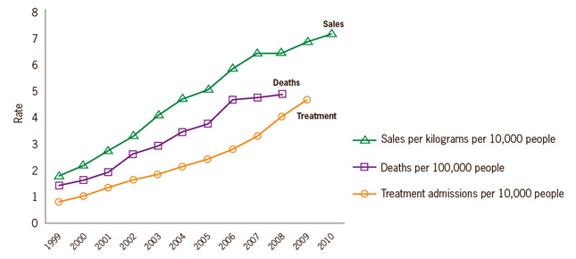
Prescription Opioid Sales, Opioid Overdose Deaths and Opioid Use Disorder
SOURCES: National Vital Statistics System, 1999-2008; Automation of Reports and Consolidated Orders System (ARCOS) of the Drug Enforcement Administration (DEA), 1999-2010; Treatment Episode Data Set, 1999-2009; http://www.cdc.gov/vitalsigns/painkilleroverdoses/infographic.html
Veterans are twice as likely to die from accidental overdose
compared to non-Veterans.
(Veterans on opioids in 2004/5, followed to FY 2008) Bohnert et al, JAMA 2011
Notes:
This chart shows the rates of prescription painkiller sales, deaths, and treatment admissions in the United States. The rate of prescription painkiller sales increased from less than two kilograms per 10,000 people in 1999 to more than seven kilograms per 10,000 people in 2010. The rate of prescription painkiller deaths from increased from less than two deaths per 10,000 people in 1999 to more than 4 deaths per 10,000 people in 2008. The rate of prescription painkiller treatment admissions increased from less than one treatment admission per 10,000 people in 1999 to more than four treatment admissions in 2009.
CDC website accessed 9/3/15
Prescription opioid overdose deaths number more than the deaths from all illegal substances combined

Slide 11
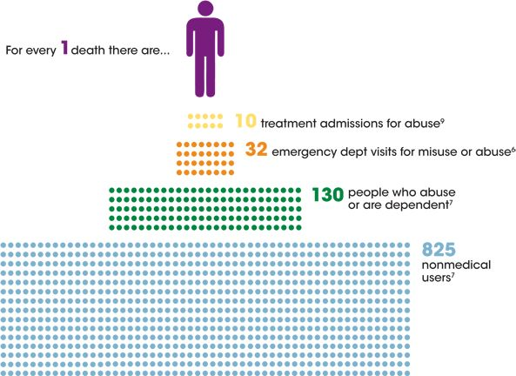
Opioid Use Disorder Epidemic

Slide 12
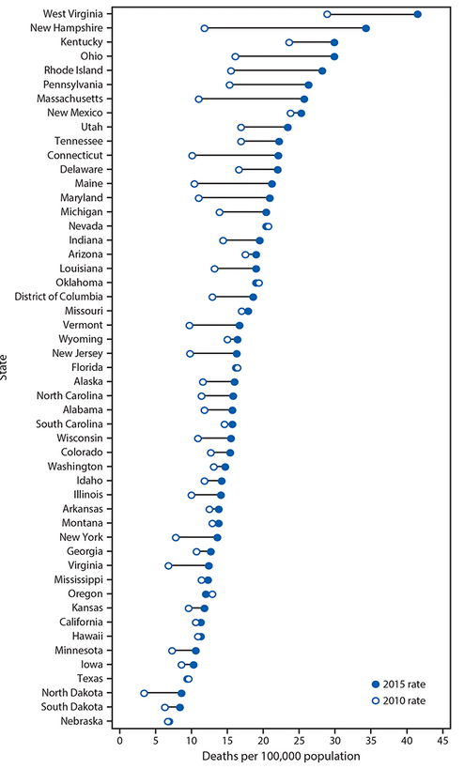
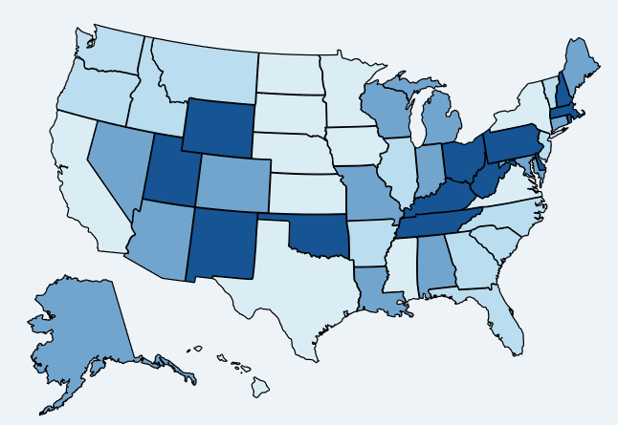


Overdose Deaths
2014
2010 to 2015

Slide 13
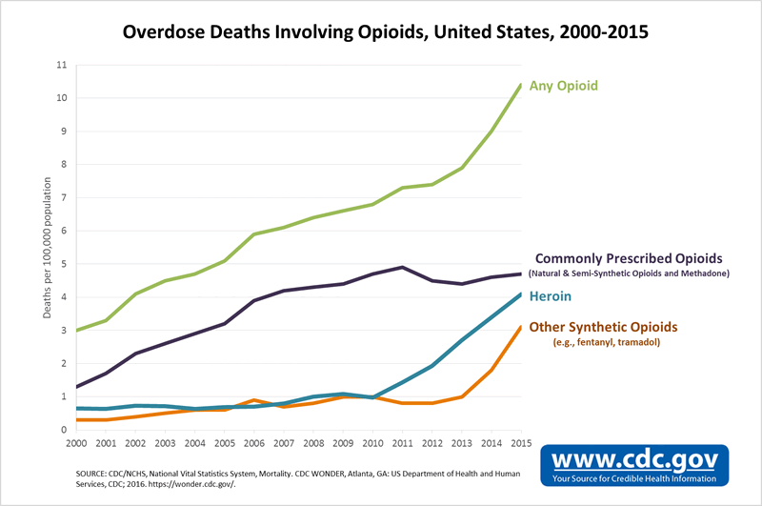
Overdose Deaths Involving Opioids

Slide 14
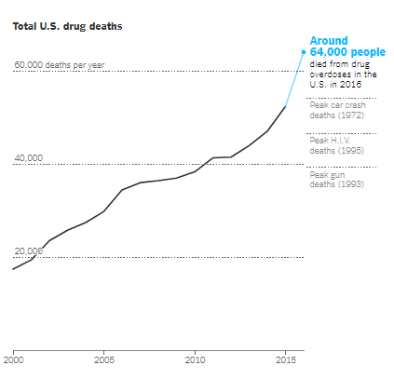
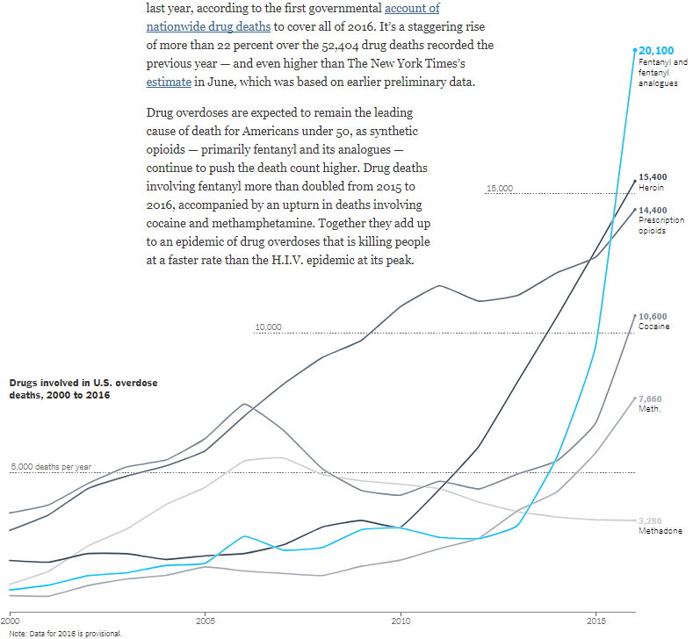

Overdose Deaths Involving Opioids 2016
CDC data
New York Times Sept. 9, 2017
The First Count of Fentanyl Deaths in 2016: Up 540% in Three Years
https://www.nytimes.com/interactive/2017/09/02/upshot/fentanyl-drug-overdose-deaths.html

Slide 15
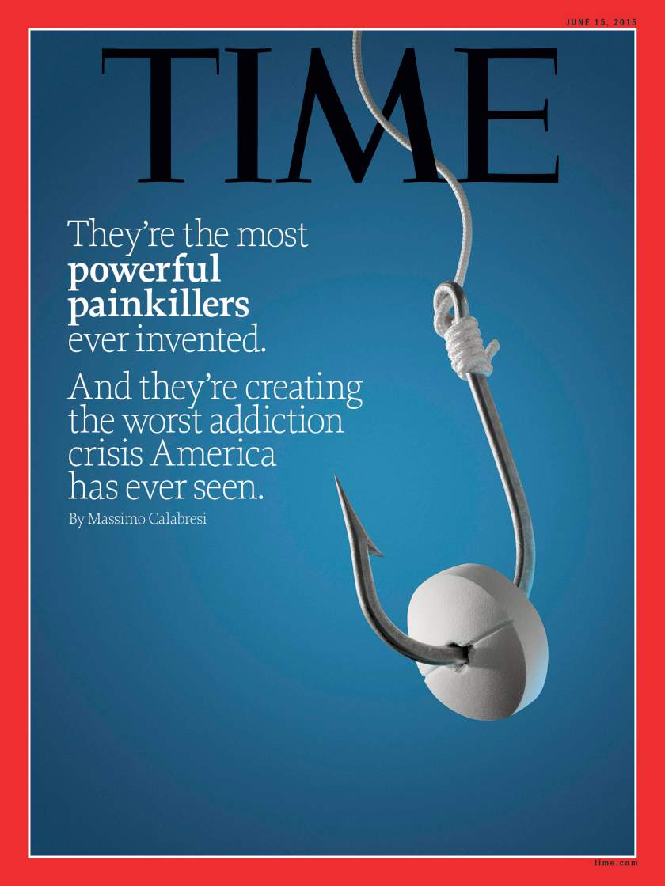
Opioid Use Disorder (OUD) Epidemic
Anyone who takes prescription opioids can become addicted to them.
In 2014, nearly two million Americans either abused or were dependent on prescription opioid pain relievers.
25-41% of patients on prescription opioids meet criteria for OUD (DSM-5).
Heroin-related deaths more than tripled between 2010 and 2014.
Among new heroin users entering treatment programs, ¾ report initiating misuse with prescription opioids.
Why America Can’t Kick Its Painkiller Problem, TIME Magazine June 4, 2015

Slide 16
Kaiser Family Foundation & Washington Post Study (2016)
“One-third of long-term users say they’re hooked on prescription opioids” By Scott Clement and Lenny Bernstein December 9, 2016, Washington Post
UNNATURAL CAUSES | SICK AND DYING IN SMALL-TOWN AMERICA: Since the turn of this century, death rates have risen for whites in midlife, particularly women.
Among long-term opioid users:
1/3 report they became addicted to, or physically dependent
Virtually all were introduced to the drugs by a doctor’s prescription
95% of long-term users began taking the drugs to relieve pain from surgery, an injury or a chronic condition.; Just 3% started as recreational users.
Family members are far more likely to say the drugs have damaged the users’ physical and mental health, finances and personal relationships.
Among uses of prescription opioids
34% reported taking opioids for fun or to get high
22% to deal with everyday stress,
12% to relax or relieve tension.

Slide 17
Risk Factors for Overdose and OUD
Risk factors are related to:
- Opioid prescribing
- Interaction with other medication/drugs
- Medical comorbidities
- Psychiatric comorbidities
“Opioid dosage was the factor most consistently analyzed and also associated with increased risk of overdose. Other risk factors include concurrent use of sedative hypnotics, use of extended-release/long-acting opioids, and the presence of substance use and other mental health disorder comorbidities.”
Park et al. J Addict Med 2016
Review of 15 articles published between 2007 and 2015 that examined risk factors for fatal and nonfatal overdose in patients receiving opioid analgesics.

Slide 18
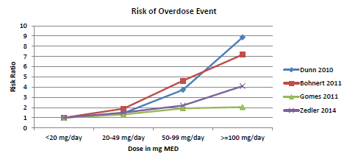
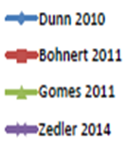
Higher Dosage Increases Risks from Opioids
Hazard Ratios(HR):
Mortality (all causes):
HR 1.64 for LA opioids
Overdose deaths (unintentional)
HR 7.18-8.9 for MED > 100 mg/d
Opioid use disorder
on long-term opioids (> 90 d)
HR 15 for 1-36 mg/d MME
HR 29 for 36-120 mg/d MME
HR 122 for > 120 mg/d MME
Edlund et al 2014

Slide 19
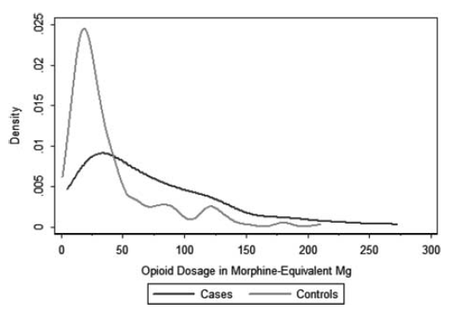
Dosage and Risk of Overdose from Opioids
“A Detailed Exploration Into the Association of Prescribed Opioid Dosage and Overdose Deaths Among Patients With Chronic Pain”
Bohnert et al, Med Care 2016
2004-2009 study
Average opioid dosages
Cases (overdose deaths):
98.1 MEDD (SD 112.7)
Controls:
47.7 MEDD (SD 65.2)
No clear cut-point in opioid dosage to distinguish between OD cases and controls.
The median for OD was 60 mg, i.e. the majority of OD were below 100 mg MEDD.
19

Slide 20
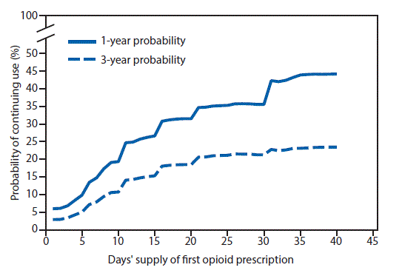
Duration Increases Risk from Opioids
Characteristics of Initial Prescription and Likelihood of Long-Term Opioid Use –
Study analyzed the first episode of opioid use; opioid-naïve, cancer-free adults
2.6% continued opioid therapy after 1 year.
For patients with at least 1 full day of opioids, the risk was 6% for continuation.
Patients with opioids for ≥1 year were more likely to be older, female, had a pain diagnosis before opioid initiation, initiated on higher doses or long-acting opioid.
For duration, the largest increments in probability of continued use were after the 5th and 31st days; the second prescription; and first scripts with 10- and 30-d supplies.
Recommendation
Treatment of acute pain for shortest durations possible, <7 d (ideally ≤3 d).
Caution when prescribing >1 wk, or authorizing a refill or second script.
Discuss long-term plan with patients.
Study of 1,294,247 patients, 2006 to 2015
Morbidity and Mortality Weekly Report. March 17, 2017 / 66(10);265–269
Notes:
"Treatment of acute pain with opioids should be for the shortest durations possible. Prescribing <7 days (ideally ≤3 days) of medication when initiating opioids could mitigate the chances of unintentional chronic use. When initiating opioids, caution should be exercised when prescribing >1 week of opioids or when authorizing a refill or a second opioid prescription ... Prescribers should discuss the long-term plan for pain management with patients for whom they are prescribing either Schedule II long-acting opioids or tramadol."

Slide 21
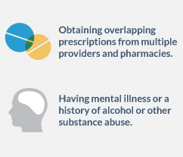
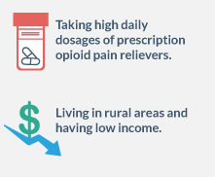
Patient Risk Factors for Harm from Opioids
Psychiatric disorders, including anxiety or depression.
Personal or family history of substance use disorder.
History of aberrant behavior/non-compliance.
Age 65 or older.
Young age (below 30).
COPD or other underlying respiratory conditions.
Renal or hepatic insufficiency.
Pregnancy.
Every patient is at risk
http://www.cdc.gov/drugoverdose/opioids/prescribed.html

Slide 22
Paradigm Shift in Pain Care
Paradigm shift away from opioid therapy for non-end-of-life pain management.
There is no completely safe opioid dose threshold below which there are no risks for adverse outcomes.
Even a short-term use of low dose opioids may result in addiction.
Realization that any initial, short-term functional benefit will likely not be sustained in most patients.
Prolonged use of opioids, especially in higher doses, may lead to central sensitization and increase in pain over time (Opioid Induced Hyperalgesia)
Patients on opioids may actually experience a functional decline in the long term, measured by factors like returning to employment.
Paradigm shift towards multimodal and integrated team-based pain care (biopsychosocial interdisciplinary care)

Slide 23
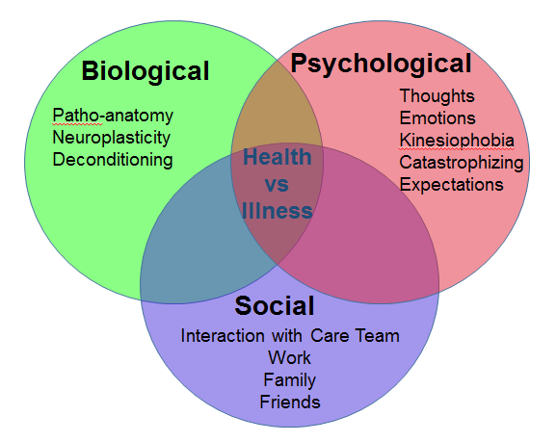
Biopsychosocial Model: “Whole Person”
Assess daily function, sleep, psychosocial-spiritual situation, social support, patient’s goals; medical and psychiatric comorbidities, substance use/abuse, suicidal ideation, etc. Include data from urine drug testing, prescription drug monitoring programs, prior records, etc.

Slide 24
Federal Medicine Pain Management Initiatives
Organizations/Groups
NIH Interagency Pain Research Coordinating Committee
VHA National Pain Office
Institutes of Medicine
as directed by
Affordable Care Act
NCCIH Council Working Group
Presidential Memorandum
DoD Pain Mgt Task Force
Military Health System
2009/2010
2011/2012
2013
2014
CARA
2015/2016
Products/Deliverables
VHA Pain Mgt Directive
2009-053
IOM
“Pain in America” Report
VHA Opioid Safety Initiative
MHS Review
National Pain Strategy
CDC Opioid Guidelines
Pain Management
Task Force Report
NCCIH: Strengthening Collaborations w/ DoD and VA: Effectiveness Research on Mind/Body Interventions
Courtesy Eric B. Schoomaker MD PhD (modified)

Slide 25
The VA Opioid Safety Initiative (OSI)
Opioid Safety Initiative (OSI) expanded nationally in FY 2013
The OSI aims to reduce over-reliance on opioid analgesics for pain management and to promote safe and effective use of opioid therapy when clinically indicated.
Comprehensive OSI strategy that includes education of providers and expanded access to non-pharmacological treatment options, in particular behavioral and complementary integrative health modalities.
OSI Dashboard makes the totality of opioid use visible within VA and provides feedback to stakeholders at VA facilities regarding key parameters of opioid prescribing.

Slide 26
The Opioid Crisis - Nationally
Presidential Memorandum: Addressing Prescription Drug Abuse and Heroin Use (Oct. 2015)
Training of all federal prescribers
Patients with OUD require access to addiction treatment incl. MAT
CDC Opioid Prescribing Guidelines (March 2016)
Guidance for primary care providers
Recommendations includes non-opioid therapy as first line therapy for pain, limit opioid therapy to short duration/low dosage if possible, and specific dosage limits (50/90 mg MEDD)
Comprehensive Addiction and Recovery Act (CARA) (July 2016)
Title IX: Jason Simcakoski Memorial Act with specific VHA mandates
Presidential Opioid Commission Report (November 2017)
56 recommendations

Slide 27
Comprehensive Addiction and Recovery Act (CARA) PUBLIC LAW 114–198—JULY 22, 2016
The CARA Bill is a comprehensive effort to address the opioid addiction epidemic.
NINE TITLES related to Pain Management, Opioid Prescribing and Opioid Safety including Opioid Use Disorder covering
(I) prevention and education;
(II) law enforcement and treatment;
(III) treatment and recovery;
(IV) addressing collateral consequences of opioid use;
(V) addiction and treatment services for women, families, and Veterans;
(VI) incentivizing State comprehensive initiatives to address prescription opioid abuse;
(VII) miscellaneous provisions;
(VIII) improvements to the Kingpin Designation Act; (narcotics trafficking; 2000)
(IX) various measures affecting the Department of Veterans Affairs (VA) = “Jason Simcakoski Memorial and Promise Act”
Deliverables: 54 specific deliverables/milestones in CARA
Approx. 28 milestones have been completed
Public Law: https://www.congress.gov/114/bills/s524/BILLS-114s524enr.pdf

Slide 28
Comprehensive Addiction and Recovery Act (CARA) PUBLIC LAW 114–198—JULY 22, 2016
Community interactions: 90-day regular meetings.
Expanded VA Patient Advocacy program.
VA/DoD Health Executive Committee Pain Management Workgroup.
System-wide implementation of the Opioid Safety Initiative.
Opioid risk mitigation strategies: PDMP, UDS, informed consent.
Opioid Overdose Education and Naloxone Distribution (OEND)
Dashboards to assess risk and monitoring opioid/pain care
VA-DoD Clinical Practice Guideline for Opioid Therapy of Chronic Pain.
Provider education in VA-DoD CPG and evidence based pain care
Reporting of providers/facilities in conflict with care standards
Expanded complementary and integrative health modalities.
Full compliance with Stepped Care Model of Pain Management
Pain Management Teams at all VA facilities.

Slide 29
CARA: VA/DoD HEC Pain Management Workgroup PUBLIC LAW 114–198—JULY 22, 2016
The VA/DoD Health Executive Council (HEC) PMWG should focus on:
VA/DoD Clinical Practice Guideline Opioid Therapy for Chronic Pain.
Opioid prescribing practices of health care providers.
(2) Ability of each Department to manage acute and chronic pain.
(3) Use of complementary and integrative health.
(4) Concurrent use of opioids and psychotropic drugs including benzos
(5) Care transition plans to address case management issues for patients receiving opioid therapy transitioning between inpatient and outpatient care.
(6) Coordination in coverage/prescribing to medications prescribed for patients transitioning from receiving health care from the DoD to VA
(7) Screen, identify, refer, and treat patients with substance use disorders who are seeking treatment for acute and chronic pain management conditions.
In addition, the HEC PMWG has to
Coordinate the activities of the working group with other relevant working groups
Consult with other relevant Federal agencies, including the Centers for Disease Control and Prevention, with respect to the activities of the working group;

Slide 30
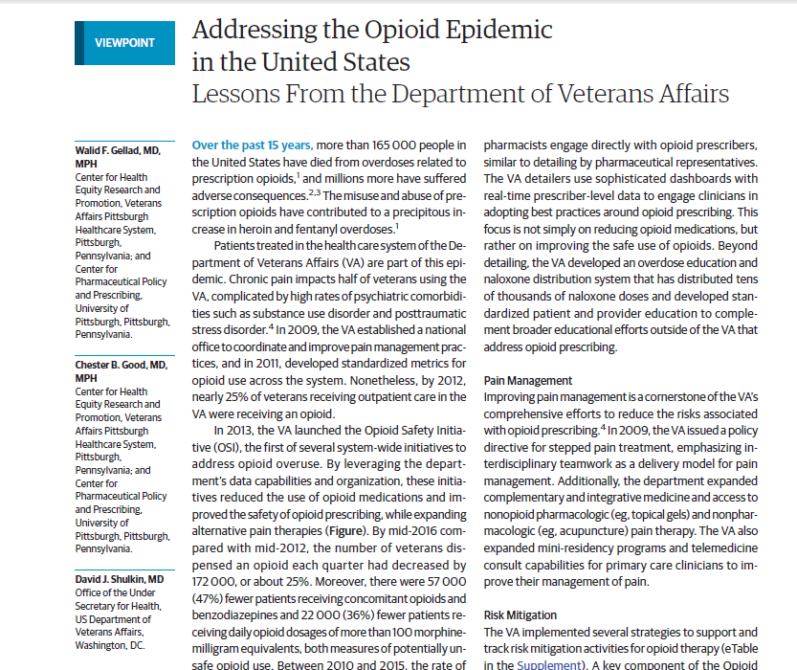
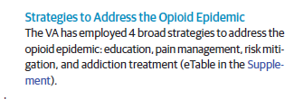
Gellad, Good CB, and Shulkin. JAMA Intern Med. 2017 May 1;177(5):611-612

Slide 31
OSI Parameters
OSI Dashboard
Opioid use overall, and Long-term opioid use
Opioid and Benzo co-prescribing
High dose >100 MEDD
UDS mandated within the last 12 months
Report for provider specialty
Report of all providers with high opioid prescribing / Outliers
Informed consent policy issued 2014, for all pts on LTOT (90 d)
PDMP checks policy issued 10/2016, at least annually, for > 5 d supply
OEND – Overdose Education and Naloxone Distribution Naloxone prescribed for all pts at risk, broad inclusion, no cost to Veteran
Timely f/u with prescriber at least q3 months
Notes:
Report of all providers with high opioid prescribing / Outliers
> 2 SD from average, currently at >27% of patients on opioids

Slide 32
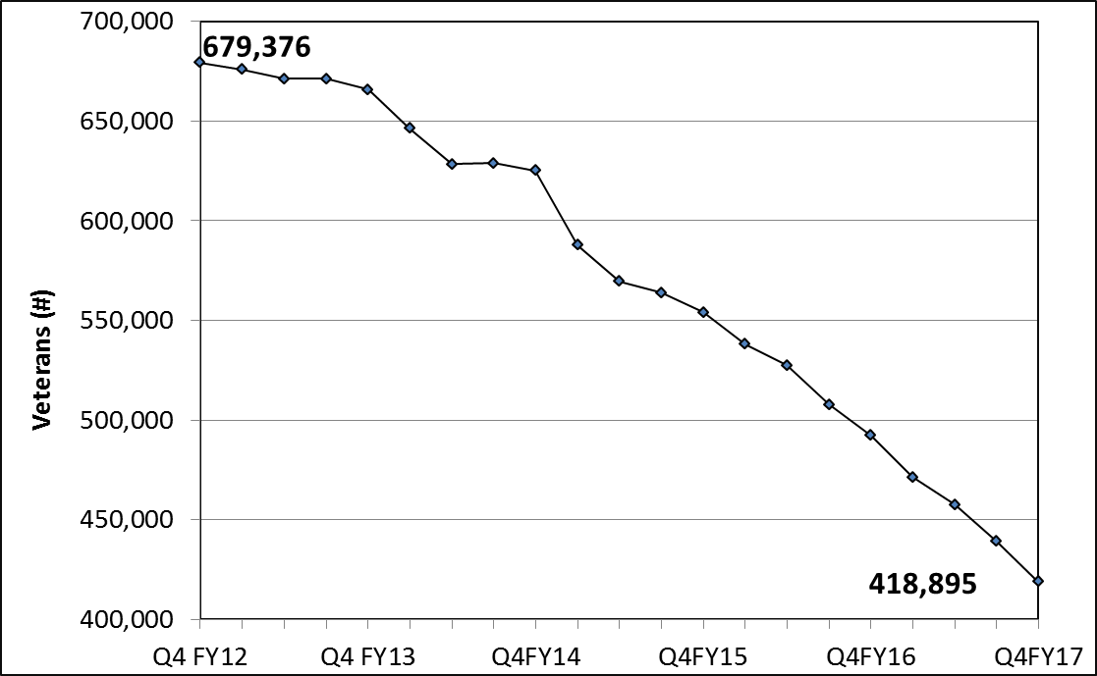
Veterans with Dispensed Opioid Medication Q4 FY2012 to Q4 FY2017
Opioid patients (excludes tramadol)
17.2%
38% Reduction
260,481 fewer Veterans
10.2%
of pts with pharmacy activity
Patients with opioid dispensed as percentage of all patients with pharmacy activity (excludes tramadol)
Each colored line represents a VAMC or VAHCS, n=146. Solid black line: National VHA for all Veterans

Slide 33
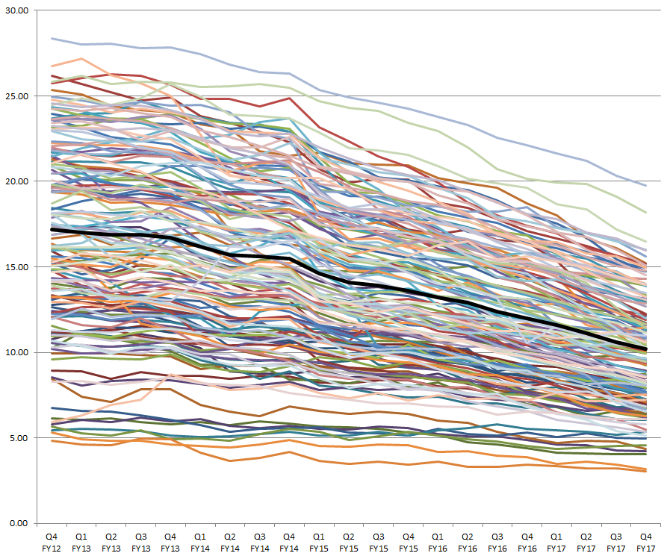
Veterans with Dispensed Opioid Medication Q4 FY2012 to Q4 FY2017
Opioid patients (excludes tramadol)
38% Reduction
260,481 fewer Veterans
17.2%
10.2%
of pts with pharmacy activity
Patients with opioid dispensed as percentage of all patients with pharmacy activity (excludes tramadol)
Each colored line represents a VAMC or VAHCS, n=146. Solid black line: National VHA for all Veterans

Slide 34
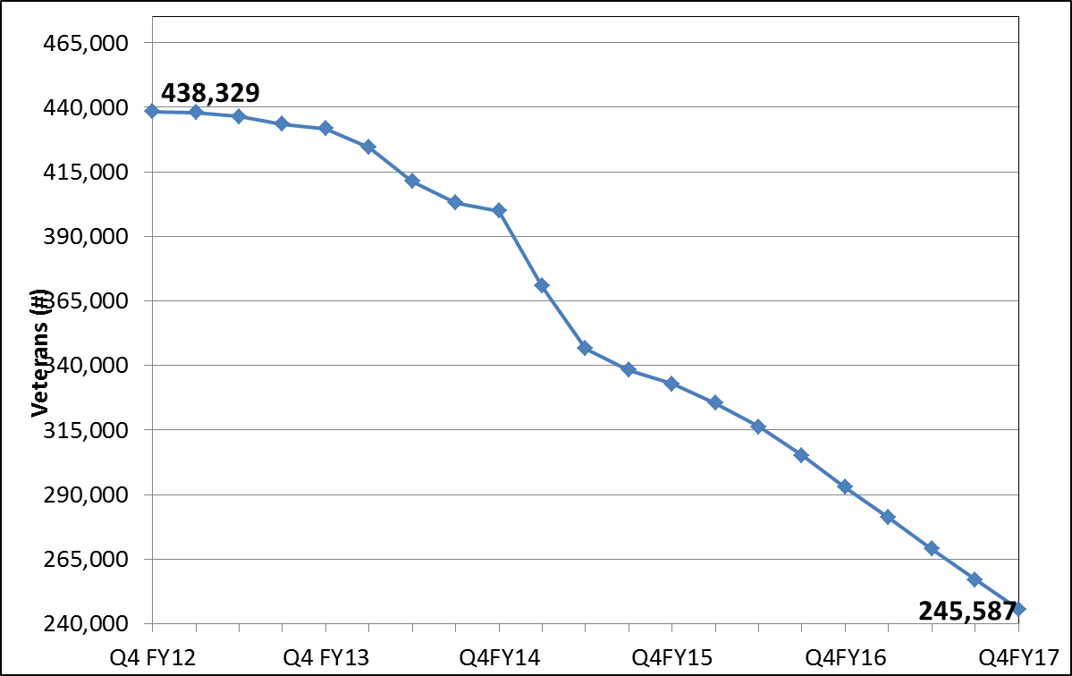
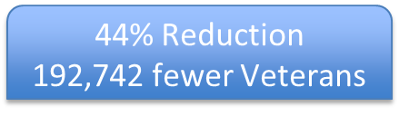

Veterans on Long-Term Opioid Therapy Q4 FY2012 to Q4 FY2017
Patients on opioid therapy (excluding tramadol) dispensed in the selected quarter and ≥90 days total cumulative supply of opioid medications in the last two quarters.

Slide 35
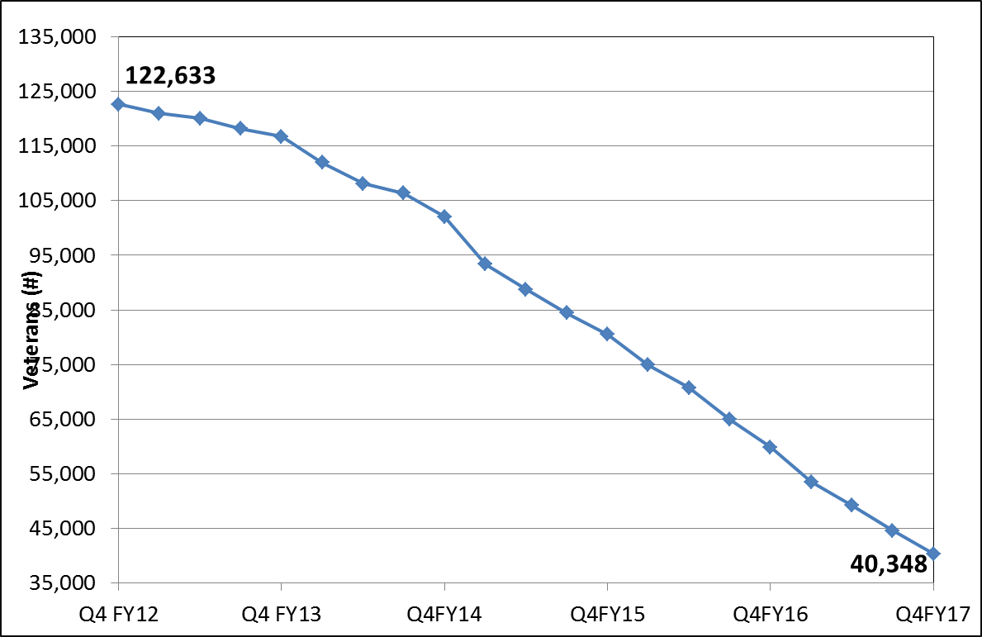
Veterans with Opioid and Benzodiazepine Q4 FY2012 to Q4 FY2017
Opioid patients (includes tramadol)
13.9%
67% Reduction
82,285 fewer Veterans
6.9%
of opioid patients

Slide 36
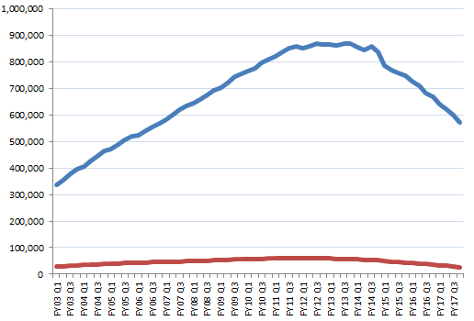


High Dose Opioid Therapy Q1 FY2003 to Q4 FY2017
869,956 Veterans in Q4 FY2013
Veterans
Veterans with opioid (incl.
tramadol)
570,768 in Q4 FY2017
60,299 Veterans in Q3 FY2011
Veterans with
high dose >100 mg
25,934 in Q4 FY2017
Q1 FY2003
Q4 FY2017

Slide 37
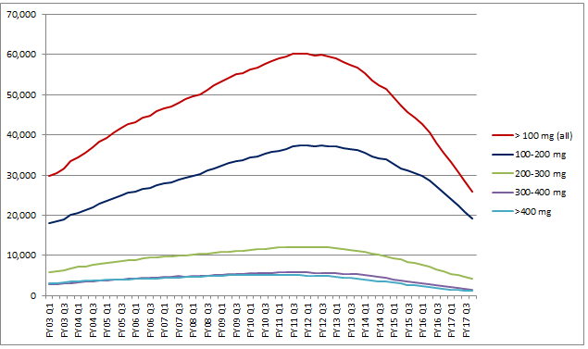
High Dose Opioid Therapy Q1 FY2003 to Q4 FY2017
60,299 Veterans in Q3 FY2011
869,956 Veterans in Q4 FY2013
Veterans
25,934 in Q4 FY2017
570,768 in Q4 FY2017
60,299 Veterans in Q3 FY2011
25,934 in Q4 FY2017
Q1 FY2003
Q4 FY2017

Slide 38
Opioid Therapy Risk Mitigation
Patients receiving long-term opioid therapy should be monitored and reassessed at least every 3 months, with greater frequency based on risk.
Always maintain vigilance for sedation, declining function, evidence of opioid use disorder or other opioid related harms.
Each follow-up interaction with the patient is an opportunity to provide education about self-management strategies and the risks associated with opioid therapy while optimizing whole person approaches to pain care and treatment of comorbid health conditions.
Essential components of Opioid Safety include:
(1) An informed consent for long-term opioid therapy.
(2) Prescription drug monitoring programs (PDMPs).
(3) Random urine drug testing.
(4) Overdose education, and naloxone distribution as appropriate (OEND).

Slide 39
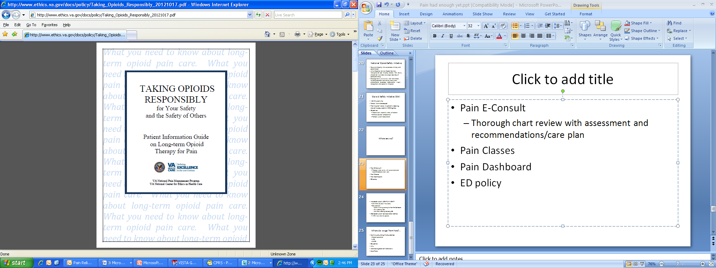
Informed Consent for Long-Term Opioid Therapy
Informed consent (via I-Med) is required for all patients on Long Term Opioid Therapy (LTOT), defined as > 90 days (excluding patients enrolled in hospice, on opioids for cancer pain, when oral consent is sufficient)
Opportunity to discuss risks of and alternatives to long-term opioid therapy with the veteran.
Provides some protection to provider and facility in case of harm to the patient related to opioid therapy.
Brochure “Taking Opioids Responsibly” should given to the patient.
November 27, 2017 report:
National Score: 86.4%
VHA Directive 1005, Informed Consent for Long-Term Opioid Therapy for Pain. May 6, 2014

Slide 40
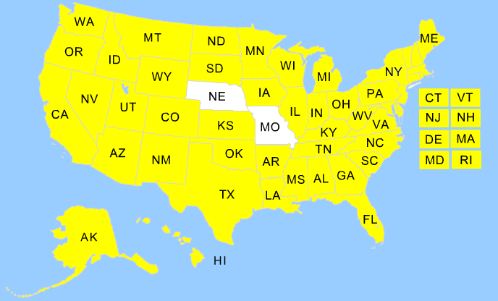
Prescription Drug Monitoring Programs (PDMP)
As of October 2017, 48 states and the District of Columbia are activated for PDMP data transmission.
States share data through PMP InterConnect
Veterans in VHA: 23.9% on controlled substances, and 12% on Opioids
From Q3 FY 2013 to Q4 FY 2017, VA providers documented > 2.3 million queries
Long-Term Opioid Therapy Patients with a PDMP within the last 365 days: 66.8% (Nov. 15, 2017)
VHA Directive 1306, Querying State Prescription Drug Monitoring Programs (PMDP). Oct. 19, 2016
MO just recently established a statewide PDMP by executive order. NE’s program has transitioned to Appriss AWARxE and work is underway to initiate transmissions; state working to implement FIPS 140-2 cryptography required for federal data sharing. VA-NSOC requires specific security documentation in order to open the firewall for outbound transmissions.

Slide 41
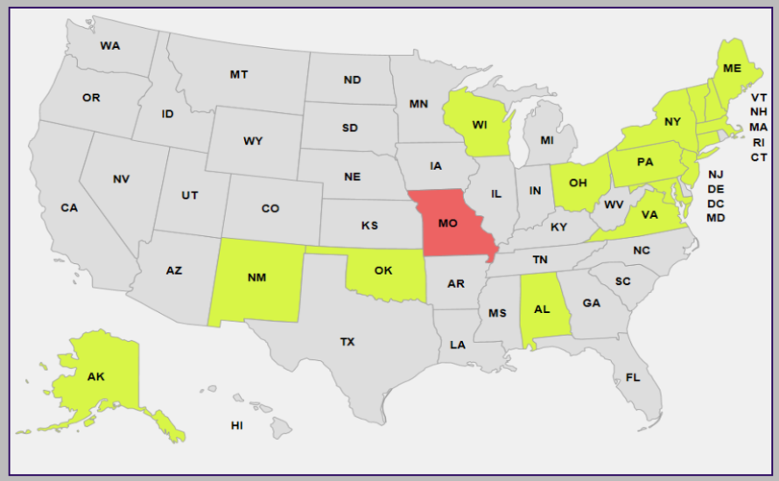
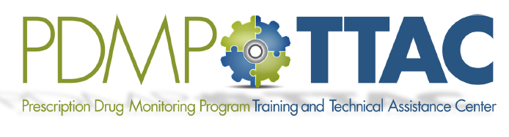
Prescription Drug Monitoring Programs (PDMP)
VHA policy:
PDMP queried for controlled substances on annual basis at a minimum.
PDMP check prior to initiating therapy with a controlled substance.
When clinical indications and patient safety concerns warrant more frequently, at the discretion of the prescriber.
Exclusions (unless contrary to applicable state law): [no other exceptions]
1) Controlled substance prescription for ≤ 5-day supply without refills
2) Any patient enrolled in Hospice care
CPRS standard note STATE PRESCRIPTION DRUG MONITORING PROGRAM
Prescribers must conform to the policies of the state of their licensure.
Academic Detailing PDMP map.
https://vaww.portal2.va.gov/sites/ad/SitePages/Pain%20Management.aspx#Videos
http://www.pdmpassist.org/

Slide 42
Veterans on LT Opioid Therapy with UDS in the Last Year
51% Increase
Q2FY17

Slide 43
Overdose Education and Naloxone Distribution - OEND
Overdose Education (OE)
Education on how to prevent, recognize, and respond to an opioid overdose.
Naloxone Distribution (ND)
FDA approved as naloxone autoinjector and nasal spray.
Dispense and train patient and caregiver/family.
Target patient populations: OUD, and prescribed opioids.
Highly successful: > 100,000 kits dispensed to > 70,000 Veterans
From May 2014 to Jan 2016, 172 overdose reversals documented
Offer naloxone when factors that increase risk for opioid overdose are present: h/o overdose, h/o SUD, higher opioid dosages (≥50 MMED), or concurrent benzodiazepine use.
No cost to patients (elimination of copays for naloxone and training, as per CARA)

Slide 44
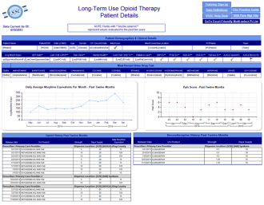
Opioid Therapy Risk Report – OTRR
Tool optimized for PACT: review their panel for all patients on long-term opioids
Included in CPRS under Tools → Primary Care Almanac.
Veteran lookup by SSN http://go.usa.gov/3DH9g
Multitude of factors that potentially increase risk incl. MH diagnoses
Opioid risk mitigation parameters including last PDMP check
Updated nightly
Individual report includes Visual display
Opioid dosage
Pain score (severity)
LTOT definition: opioid dispensed in the last 90 days and total days supply ≥ 90 days in the past 180 days

Slide 45
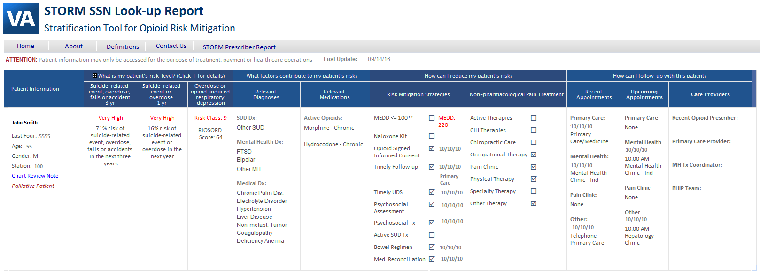
Stratification Tool for Opioid Risk Monitoring – STORM
Leverages VA national data and predictive modeling
Probability of adverse event
1 yr risk (suicide, overdose) and 3 yr risk (suicide, overdose, falls or accidents)
Overdose or opioid induced respiratory depression (RIOSORD risk class)
For patients on opioids and when considering opioid therapy (STORM SSN Lookup Report)
Updated nightly
Allows download of a “Chart Review Note” (word document)
Accessible within CPRS: Tools → weblinks → STORM panel review/STORM patient review
This is the preferred tool for Opioid Safety Reviews at facilities

Slide 46
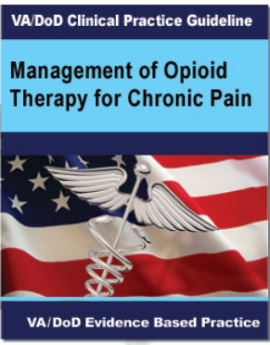
VA/DoD Clinical Practice Guideline: Opioid Therapy
“We recommend against initiation of long-term opioid therapy”. “We recommend alternatives to opioid therapy such as self-management strategies and other non-pharmacological treatments. When pharmacologic therapies are used, we recommend non-opioids over opioids”.
Recommendation against opioid therapy in patients < 30 years of age, in patients with active substance use disorder, and in combination with benzos.
Recommendation for risk mitigation strategies, including urine drug testing, PDMP, overdose education, naloxone distribution
If prescribing opioids: short duration and lowest dosage
No dosage is safe; Strong rec against of opioids to > 90 MEDD.
Opioid dosage reduction should be individualized to patient. Avoid sudden reductions; taper slowly if opioid risk>benefit
Suicide prevention in pain patients
Use multimodal pain care
Acute pain: use alternatives to opioids; if opioids ≤ 3-5 days
For OUD, offer medication assisted treatment.
https://www.healthquality.va.gov/guidelines/Pain/cot/
Updated Feb. 2017

Slide 47
Opioid Tapering Considerations
Several factors go into the speed of taper selected:
Slower, more gradual tapers are often the most tolerable and can be completed over a several months to years based on the opioid dose
The longer the duration of the opioid therapy, the longer the taper
Most commonly, tapering will involve dose reduction of 5-20% every 4 weeks
More rapid tapers may be required in certain instances like drug diversion, illegal activities, or situations where the risks of continuing the opioid outweigh the risks of a rapid taper.
SUDDEN interruption of opioid prescribing must be avoided for opioid dependent patients with few exceptions (safety issues, diversion, etc.)
F/u is recommended within 1 to 4 weeks after dosage adjustment

Slide 48
Approaching Opioid Tapering.
Patients are often scared about opioid dosage reduction, and some are desperate, especially if they have features of opioid use disorder.
Provider approach: empathetic, personalized, building trust.
Expectations should be clear and reasonable/achievable. Expectations may have be repeated and provided in written form.
The patient needs a clear plan that appears manageable and helps avoid or minimize fear or anxiety.
Integrated approach with patient buy-in and active participation leads to improved pain control and enhanced quality of life.
Close collaboration with mental health providers including addiction medicine is recommended for many patients - evaluation for OUD and, if present, referral to Medication-Assisted Treatment may be indicated.

Slide 49
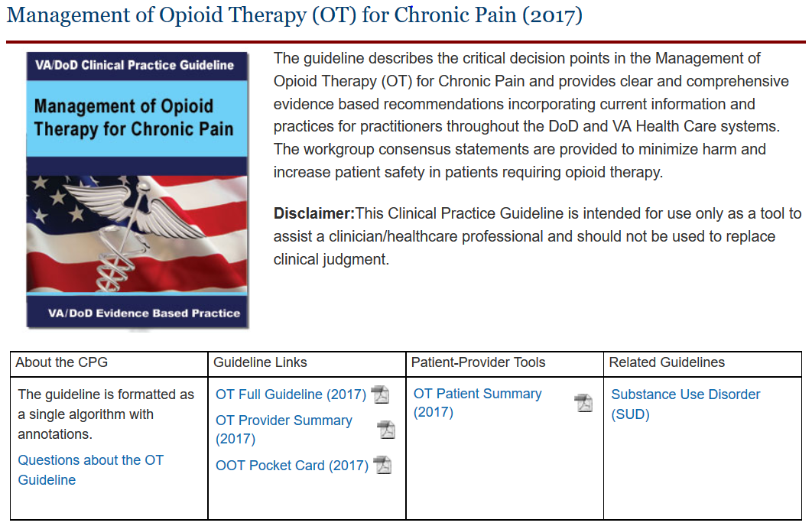
Update of the VA/DoD Opioid CPG
http://www.healthquality.va.gov/guidelines/Pain/cot/
Notes:
The complexities don’t stop there. the old CPG in 2010 had
200 recommendations many that were based on expert opinion as it was allowed in that at that time
Then we updated the guideline with evidence published from March 2009 through January’s 2016
we identified several key areas
were harms and benefits opioid therapy versus alternative therapies for chronic pain
risk mitigation strategies before and during opioid therapy , how to adjusting opioid therapy to address safety concerns including how to taper if indicated
and the evaluation of opioid use disorder in patients with chronic pain
I will tell you that having an experienced work group and experienced leaders was critical in developing these key points
without the experience the necessary the perseverance, breath and attention to detail of this CPG would’ve been lost in the sea of guideline development

Slide 50
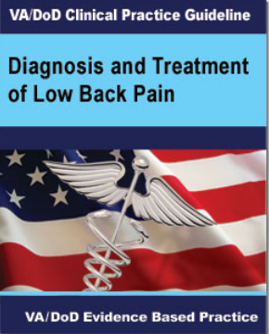
VA/DoD Clinical Practice Guideline: Low Back Pain
For chronic low back pain:
Cognitive behavioral therapy (strong for)
Mindfulness based stress reduction
Clinician-directed exercises
Exercise program, which may include Pilates, Yoga, and Tai Chi
Acupuncture
For acute/chronic low back pain: spinal mobilization/manipulation
For selected patients with chronic low back pain not satisfactorily responding to more limited approaches, we suggest offering a multidisciplinary or interdisciplinary rehabilitation program which should include at least one physical component and at least one other component of the biopsychosocial model (psychological, social, occupational) used in an explicitly coordinated manner.
https://www.healthquality.va.gov/guidelines/Pain/lbp/
Updated Sept. 2017

Slide 51

Education: Academic Detailing
Academic Detailing
In-person educational outreach
Information is provided interactively so the academic detailer can:
Understand where the provider is coming from in terms of knowledge, attitudes, and personal motivations for practice
Modify the interaction to meet the needs of the provider
Engage the provider by acknowledging their expertise and learning together rather than teaching
Uses balanced evidence-based information and tools
Delivered by a healthcare professional specially skilled in empathic persuasive communication
Over time, the educator and provider develop a trusted and useful relationship
Multiple campaigns incl. Pain Management, Opioid Safety Initiative, Opioid Use Disorder (OUD), Insomnia; Psychotropic Drug Safety Initiative (PDSI), incl. benzodiazepines.
http://www.pbm.va.gov/PBM/academicdetailingservicehome.asp
Notes:
The epidemic of prescription pain medication and heroin deaths is devastating families and communities across the country. Prescription drugs -- especially opioid pain medications -- have been implicated increasingly in drug overdose deaths over the last decade. According to the Centers for Disease Control and Prevention (CDC), the number of overdose deaths involving prescription opioids quadrupled between 1999 and 2013, with more than 16,000 deaths in 2013. In recent years, overdose deaths involving heroin have sharply increased, nearly doubling between 2011 and 2013. The CDC has identified addiction to prescription pain medication as the strongest risk factor for heroin addiction.
One of the most significant ways to address these issues is to ensure that medical professionals receive adequate training on appropriate pain medication prescribing practices, and the risks associated with these medications. The Federal Government must do more to ensure that such training is provided on an ongoing basis to health care professionals prescribing pain medications. Work is already underway to achieve this goal across executive departments and agencies, but these efforts must be accelerated given the urgency of the problem. The training of Federal health care personnel in appropriate prescribing of controlled substances should be a model for similar initiatives developed across the country.
Executive departments and agencies (agencies) shall, to the extent permitted by law, provide training on the appropriate and effective prescribing of opioid medications to all employees who are health care professionals and who prescribe controlled substances as part of their Federal responsibilities and duties.
The training must address, at a minimum, best practices for appropriate and effective prescribing of pain medications, principles of pain management, the misuse potential of controlled substances, identification of potential substance use disorders and referral to further evaluation and treatment, and proper methods for disposing of controlled substances. Training approaches may include both traditional continuing education models and models that pair intensive coaching for the highest volume prescribers with case-based courses for other prescribers. To the extent feasible, training adopted by agencies should be consistent with consensus guidelines on pain medication prescribing developed by the CDC.
(c) Agencies shall require all employees, contractors, and clinical residents and trainees described in subsection (a) of this section to complete training within 18 months of the date of this memorandum and a refresher course every 3 years thereafter.
Sec. 3. Improving Access to Medication-Assisted Treatment and Modernizing Benefit Design. (a) Agencies that directly provide health care services, contract to provide health care services, reimburse for health care services, or facilitate access to health benefits shall, to the extent available and permitted by law, review all health benefit requirements, drug formularies, program guidelines, medical management strategies, drug utilization review programs, and all other relevant policies, tools, and strategies in order to identify any barriers individuals with opioid use disorders would encounter in accessing MAT. This review also shall identify any current practices, such as use of methadone as a preferred or first-line pain management drug that are inconsistent with the goals of reducing opioid use disorders and overdoses.

Slide 52

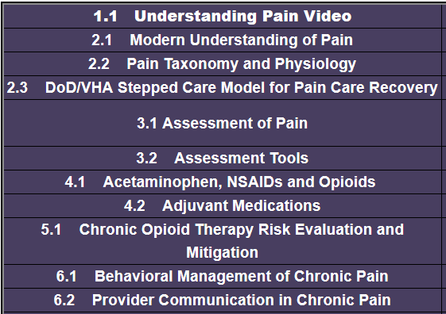
VA/DoD Joint Pain Education Project (JPEP)
The Objectives of the JPEP are to:
Standardize DoD/VHA education curriculum content, supporting materials, and a variety of commonly accessible delivery systems.
Enhance pain care transition between the DoD and VA
Commit to learning and training our providers, teams, centers, and agencies together; building a new model of pain care
31 educational modules (provider training curriculum)
Target audience:
Primary Care providers
PACT/Medical Home teams
Used for webinars
Ongoing effort to convert into self-study web training programs

Slide 53
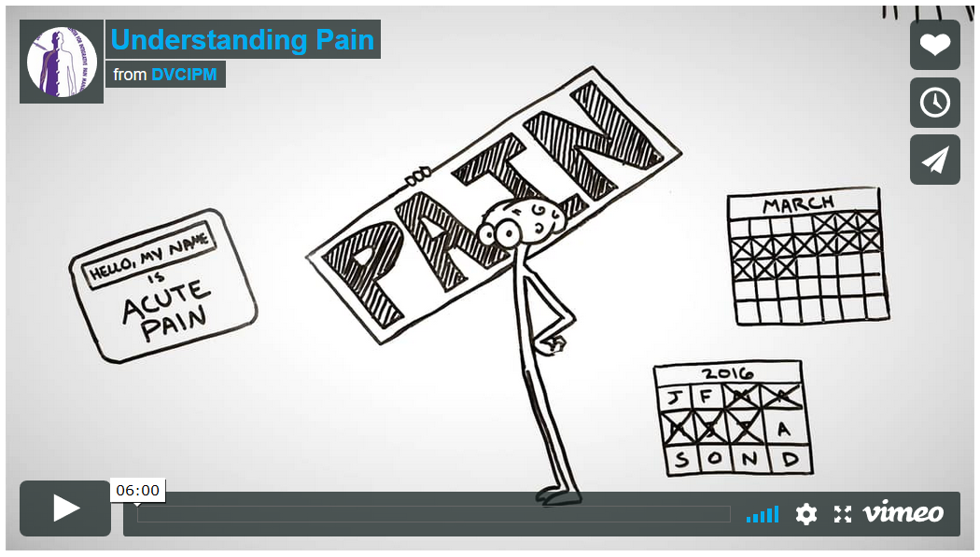
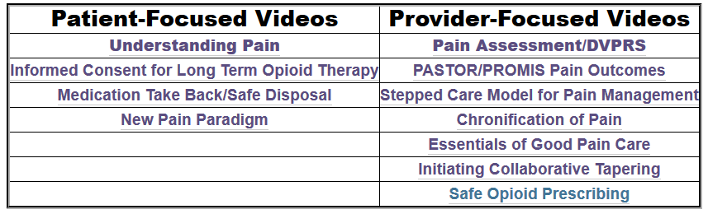
VA/DoD JPEP Educational Videos
Provider and patient education videos
www.dvcipm.org
www.vimeo.com/dvcipm
http://www.dvcipm.org/clinical-resources/joint-pain-education-project-jpep/pain-educational-videos/
DVCIPM's Vimeo page.

Slide 54
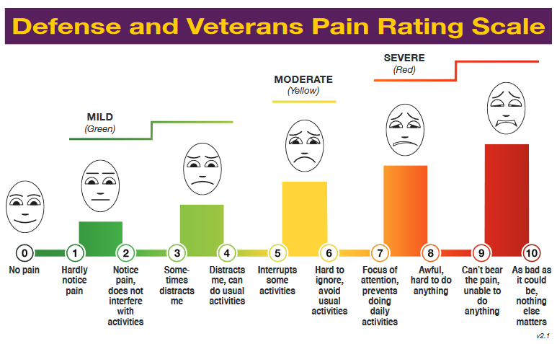
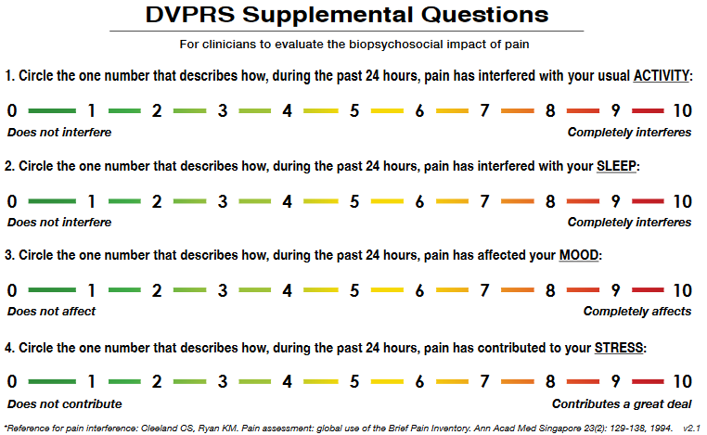
Defense and Veterans Pain Rating Scale (DVPRS): Changing the Culture of Pain Care
VA/DoD Pain Measurement
Goal: Standardized Pain Assessment Tool
A common language DoD and VHA pain assessment tool with visual cues and a common set of measurement questions—linked to function.
http://www.dvcipm.org/clinical-resources/defense-veterans-pain-rating-scale-dvprs/

Slide 55
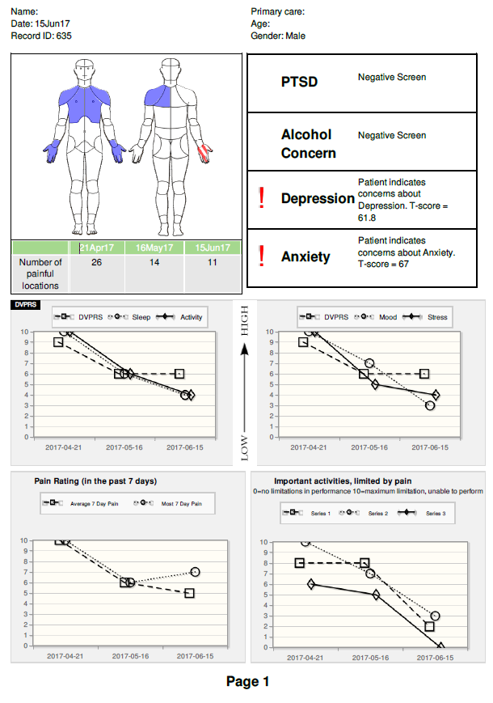

DoD: PASTOR
The Pain Assessment Screening Tool and Outcomes Registry (PASTOR) is a 20-30 minute survey that produces a comprehensive 3-page clinician report of a patient's chronic pain.
PASTOR uses instruments developed by the National Institutes of Health (NIH), collectively known as the Patient Reported Outcomes Measurement Information System (PROMIS), including Computer Adaptive Testing (CAT)
PASTOR is able to obtain scores in pain related areas such as sleep disturbance or physical function in as few as 4-6 questions each without sacrificing the precision of a classic short form.
http://www.dvcipm.org/clinical-resources/pain-assessment-screening-tool-and-outcomes-registry-pastor/

Slide 56


Acupuncture Training Across Clinical Settings (ATACS)
VA/DoD Acupuncture: ATACS
DVCIPM and VHA National Pain Management Program Office recently completed a Joint Incentive Fund acupuncture education and training program entitled, Acupuncture Training Across Clinical Settings (ATACS) over the past 3 years.
ATACS deployed certified Battlefield Acupuncture (BFA) trainers to receptive Department of Defense/Veterans Affairs (DoD/VA) medical centers to teach this technique to qualified providers and collect data to assess patient and project outcomes.
Over 2,800 providers were
http://www.dvcipm.org/clinical-resources/battlefield-acupuncture/

Slide 57
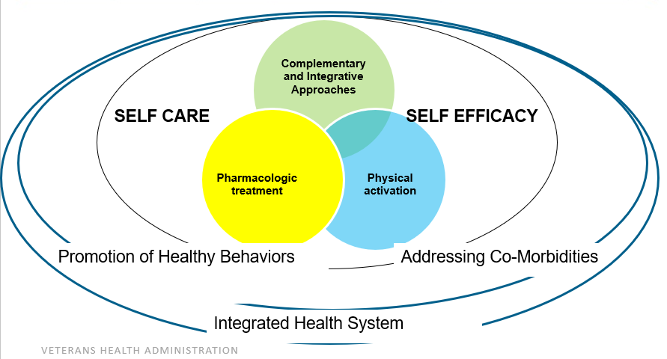
Multimodal Pain Care
Modified from Dobscha et al. JAMA 2009

Slide 58
HSR&D State Of The Art (SOTA) Conference 2016 Self Care/Active non-Pharmacologic Therapies for Pain
SOTA meeting Nov. 2016: Non-pharmacological and non-interventional pain therapy.
Preliminary report on evidence-based treatment modalities
Manual Therapies
Massage
Acupuncture
Manipulation
Cognitive Behavioral Therapy (CBT)
Aerobic Exercise
Mindfulness Based Stress Reduction (MSBR)
Coordination/ Stabilisation Exercise
Yoga
Acceptance & Commitment Therapy (ACT)
Tai Chi
Resistance Exercise
Behavioral/ Psychological Therapies
Exercise/ Movement Therapies
Health Services Rehabilitation & Development (HSR&D) State of the Art Conference (SOTA), Nov. 2016

Slide 59
Self Care/Active non-Pharmacologic Therapies SOTA 2016
State of the Art Conference for Pain Management Nov. 2016 (HSR&D):
Preliminary report on evidence-based treatment modalities.
→ Make these treatment modalities available facility-wide
Direct access from Primary Care
Avoid limiting to a particular service – Avoid ”silos” or “gatekeepers”
Algorithm-guided stepped-care
Proactive treatment monitoring by care manager
Enhance whole health self-care and lifestyle modification.
Optimize treatment of co-morbidities
Use coordinated, team-based approach.
Bridging Therapies: Short-term therapies to help patients transition from passive to more active strategies.

Slide 60
Bridging Therapies
Short-term therapies that are implemented to help patients transition from passive to more active strategies with long-term benefit.
Acupuncture
Spinal manipulation (e.g., chiropractic)
Massage
Physical modalities (e.g., provider-applied electrical stimulation, etc.)
Physical Therapy
Biofeedback
Interventional Pain Therapies in selected patients with potential benefit > risk, to aid in the implementation of active therapies
Trigger point injections
Joint injections
Nerve blocks
Spinal injections: epidural steroid injections, facet joint procedures

Slide 61
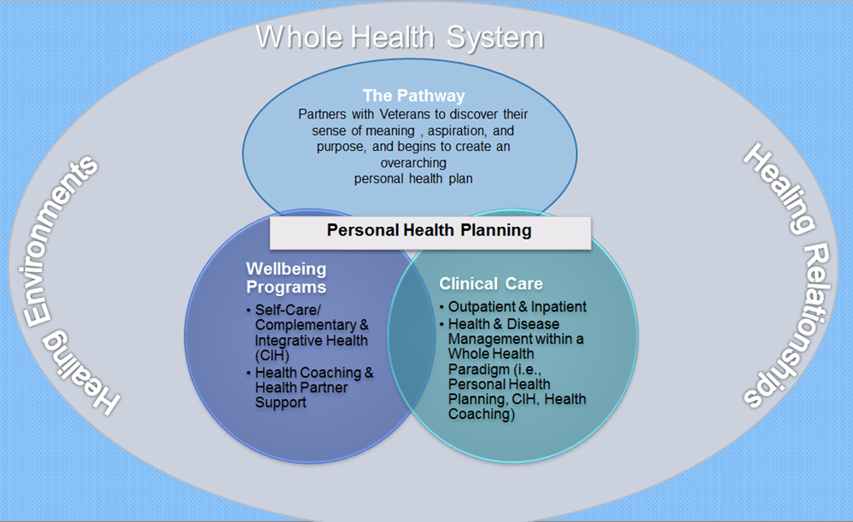
Whole Health Partnership Model in VHA
“Our “whole health” model of care is a key component of the VA’s proposed future delivery system. This model incorporates physical care with psychosocial care focused on the veteran’s personal health and life goals, aiming to provide personalized, proactive, patient-driven care through multidisciplinary teams of health professionals.” (Shulkin, 2016)
The Whole Health approach is a reorientation of the Veteran’s relationship with VA. It combines state-of-the-art conventional medicine with personalized health planning, complementary and integrative health approaches, and innovative self-care approaches.

Slide 62
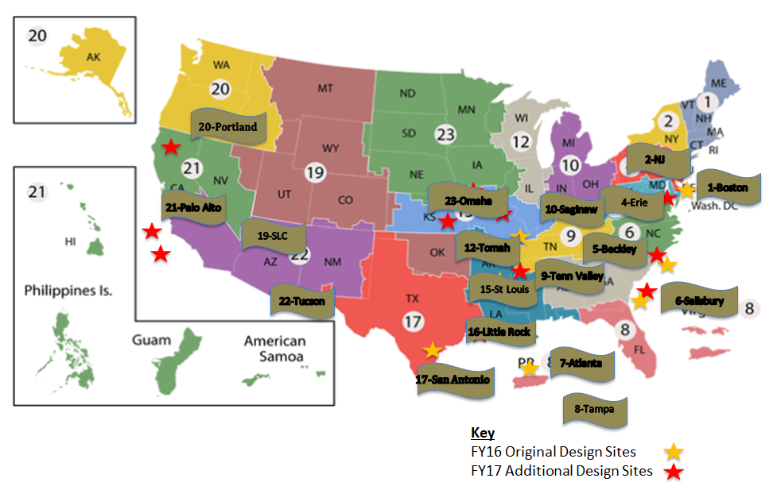
Whole Health System Flagship Sites
The Whole Health approach is a reorientation of the Veteran’s relationship with VA. It combines state-of-the-art conventional medicine with personalized health planning, complementary and integrative health approaches, and innovative self-care approaches.
11/14/2017

Slide 63
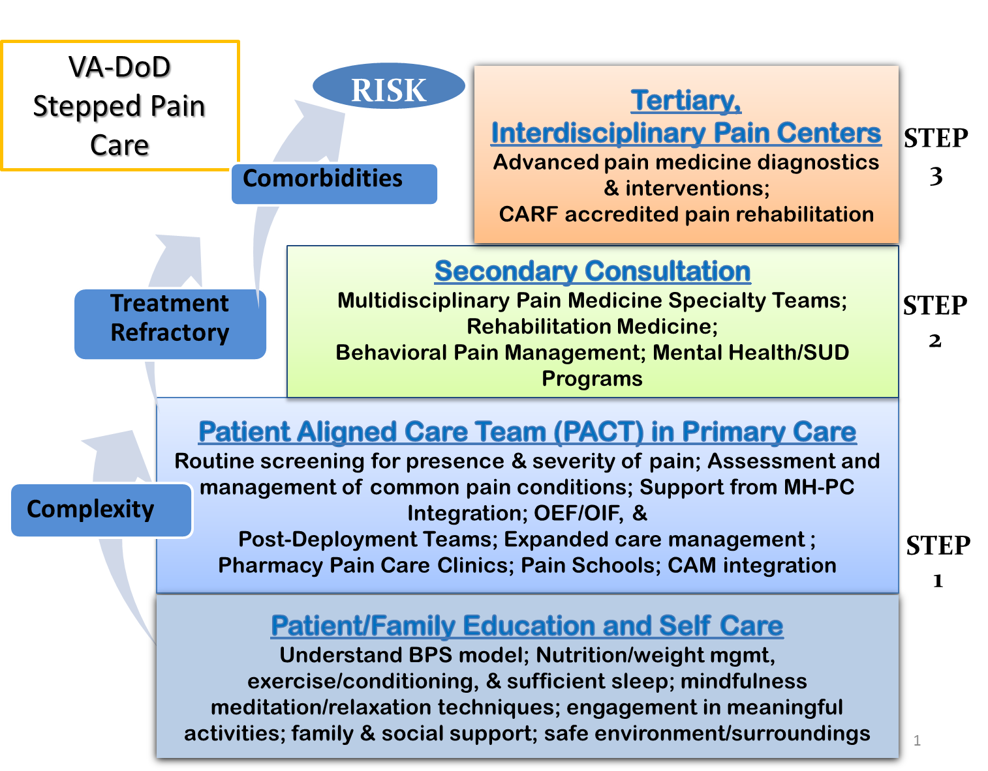
Stepped Care Model for Pain Management
Notes:
The Stepped Care Model for Pain Management, developed by VA, has been implemented within both the Veterans Health Administration (VHA) and Military Health System (MHS) with the aim of providing a continuum of effective, coordinated, and patient-centered treatment to patients with pain. With education, self-care, and whole-health approaches to wellness as the foundation, this model provides progressively more intensive biopsychosocial care within increasingly specialized settings as patients become more complex, have a greater degree of comorbidity, and present higher risk. Psychological, physical, complementary and alternative, and medication therapies are often combined to create a multimodal pain care plan. The goals of the Stepped Care Model for Pain Management include functional rehabilitation, improvement in quality of life, and prevention of the pain becoming chronic and associated deterioration in function

Slide 64
CARA Pain Teams
CARA mandates designated Pain Management Teams at all VA facilities
Developed the Pain Management Team standards and provided the information to directors regarding reporting requirements.
Veterans must have timely access to specific components of pain care that are available system-wide
Coordination between the different clinical areas is essential to promote efficient use of resources and smooth transition of the Veteran between the care areas.
Facility with higher complexity may be tasked to provide services to lower resourced facilities via tele-health/VA-ECHO, as VISN-supported hubs.
Field Data call for the collection of the Facility Director Reports on Pain Management Teams is ongoing.

Slide 65
Pain Management Teams - Requirements
The functions of the Pain Management Team (PMT) include:
Evaluation and follow-up of pts with complex pain conditions
Medication management and actual prescribing of pain meds, as needed.
OSI Reviews: Review of patients with high risk opioid prescriptions with provision of recommendations to clinical providers
At a minimum, the composition of the PMT must include:
Medical Provider with Pain Expertise
Addiction Medicine expertise to provide evaluation for Opioid Use Disorder (OUD) and access to Medication-Assisted Treatment (MAT)
Behavioral Medicine with availability of at least one evidence-based behavioral therapy.
Rehabilitation Medicine discipline.

Slide 66
Pain Management - Recommendations
Key elements of successful pain management programs to consider as resources when implementing a PMT:
Availability of e-consultation
Availability of immediate consultation for assistance with prescriptions
Pain consultation by Telehealth
Inclusion of Complementary and Integrative Health (CIH) on Pain Team
0.25 PACT Pain Champion
Interventional Pain Care
Inpatient Pain Consultation (higher complexity VAMCs)
Interdisciplinary Pain Management Case Review Forum

Slide 67
Access to Pain Management Teams
Telephone consults
Tele-health consults (CVT)
Face-to-face consults
E-Consults using CPRS
SCAN ECHO consults and continuing supervision to competency
OSI review
Inter-
disciplinary
Pain Team
Medical
Behavioral
CIH
Mental Health
Procedures
Addiction
Rehab/PT
Case Management

Slide 68
“Intensive” Care to Target Highest Risk Veterans
What are the key elements for implementing intensive primary care? A
multisite Veterans Health Administration case study”
In 2014, VHA implemented five distinct intensive primary care programs as demonstration project that targeted Veterans at highest risk for hospitalization.
Programs evolved over time, eventually converging on the following elements:
Weekly interdisciplinary team meetings was the most important key feature.
Including social workers and mental health providers was critical to address psychosocial needs of complex patients.
Chang et al. Healthcare, 2017
1) an interdisciplinary care team,
2) chronic disease management,
3) comprehensive patient assessment,
4) care and case management,
5) transitional care support,
6) preventive home visits,
7) pharmaceutical services,
8) chronic disease self-management,
9) caregiver support services,
10) health coaching, and
11) advanced care planning.

Slide 69
Opioids and Mental Health/Depression
About 60% of patients on Opioids for pain have MH dx
Patients with Pain and MH ds/depression are more likely to
Pain resistant to biomedical treatment
Receive opioids, longer duration, higher dosages
Misuse and or abuse opioids
Overdose
Suicide
Scherrer et al, 2016
1 out of 12 patients exposed to opioids developed new onset depression (controlled for other factors)
New-onset depression may develop during or after opioid use, with majority thereafter.
Opioid > 180 d with HR 1.5x
93.2% occurred after the end of the incident opioid use with Mean lag time 3.4 yrs
Opioids affects MH ds incl. depression:
New onset depression
Depression recurrence
Treatment-resistant depression
Correlation with duration of opioid therapy
Correlation with rate of dosage increases
Salas et al, Pain 2017; Scherrer et al, Pain 2015, Scherrer et al, Ann of Fam Medicine 2016
Notes:
In a study of nearly 50,000 Veterans Health Administration
(VHA) patients, opioid analgesic use of longer than 180 days,
compared with 1 to 90 days, was associated with
significantly greater risk (hazard ratio [HR] = 1.51; 95%
CI, 1.31-1.74) of a new diagnosis for depression.14 In a
prospective study of chronic pain patients, those who
increased their MED to more than 50 mg/d, compared
with nonusers, had a 2.6 times greater probability of
depression with time. These results remained after rigorous
control for confounding.
15. Scherrer JF, Salas J, Lustman PJ, Burge S, Schneider FD; Residency
Research Network of Texas (RRNeT) Investigators. Change in opioid
dose and change in depression in a longitudinal primary care
patient cohort. Pain. 2015;156(2):348-355.
The missing ‘P’ in pain management: how the current opioid epidemic highlights the need for psychiatric services in chronic pain care
Howe CQ, Sullivan MD
Gen Hosp Psychiatry, 2014;36(1):99-104
“The opioid epidemic thus reflects a serious unmet need for better recognition and treatment of common mental health problems in patients with chronic pain. Psychiatry is the missing P in chronic pain care

Slide 70


Opioids and Suicide
VA patients with chronic pain receiving opioids in FY 2004-2005 (N=123,946).
2,601 patients died by suicide before the end of 2009.
Controlling for demographic and clinical characteristics, higher prescribed opioid doses were associated with elevated suicide risk.
Compared with those receiving ≤20 mg/d
20 to <50 mg/d HR 1.48 (95% CI, 1.25-1.75)
50 to <100 mg/d HR 1.69 (95% CI, 1.33-2.14)
100+ mg/d HR 2.15 (95% CI, 1.64-2.81)
Veterans receiving the highest doses of opioid painkillers were more than twice as likely to die by suicide.
The researchers could not tell, however, whether there was a direct causal link between the pain medications and suicide risk.
→ High doses may be a marker for other factors that drive suicide, including unresolved severe chronic pain.
Ilgen et al. Pain 2016

Slide 71
Opioids and MH: SUD and OUD
Patients with SUD
More likely on opioids
More likely to be non-adherent
High risk of overdose, OUD and suicide
More likely to have opioids discontinued
Physician initiated
“Involuntary”
Im et al, 2015
Patients with SUD and opioid therapy had an increased risk of suicide attempts
Drug use disorder
OR 2.42 to 2.83
[chronic short-acting] and [chronic long-acting]
Alcohol use disorder
OR 1.99 to 1.87
[chronic short-acting] and [chronic long-acting]
Opioid effect on SUD/OUD
Risk of developing OUD is related to dose and duration of opioids
Prevalence of lifetime OUD for patients on long-term opioids 35% (Boscarino)
Very high risk for OUD in younger pts
Boscarino et al, J Addict Dis. 2011; Im et al, Gen Intern Med. 2015; Edlund et al, Clin J Pain. Jul 2014
Notes:
All patients who take opioids chronically are at risk for OUD and overdose, but especially those who are younger than 30 years of age. Six studies were identified that examined age as a predictor of OUD, respiratory/CNS depression, and/or overdose; four of the six studies were rated as moderate quality evidence.[57,81,86,87] Two were rated as low quality evidence.[56,83] Five studies demonstrated age was inversely associated with the risk of OUD and overdose.[57,81,83,86,87] One study showed that older subjects had a higher HR of overdose, but this study was of low quality.[56] Therefore, the Work Group’s overall confidence in the quality of the evidence was judged as moderate.
Similar to other risk factors, age <30 years should be weighed heavily in the risk-benefit calculus for initiating LTOT. Age <30 years is not an absolute contraindication to LTOT. There may be some situations where the benefits of LTOT clearly outweigh the risks of OUD and overdose. Hospitalized patients recovering from battlefield injuries, for example, are known to have less chronic pain, depression, and PTSD when their pain is aggressively managed starting soon after injury.[88] In those cases, LTOT may be appropriate only if risk mitigation strategies are employed and patients are titrated off LTOT as soon as it is appropriate (see Recommendations 12 and 13).
The added risk younger patients using opioids face for OUD and overdose (in comparison to older patients) is significant. Edlund et al. (2014) found subjects 18-30 years old carried 11 times the odds of OUD and overdose in comparison to those over 65 years old.[81] Conversely, Bohnert et al. (2011) found subjects older than 70 had a substantially lower chance of developing OUD or overdose (HR 0.06) in comparison to subjects in the 18-29 age category.[57]
Edlund et al. (2014) examined the claims data from a health insurance database between 2000 and 2005 to examine factors predictive of developing OUD.[81] They found that even greater than opioid dose, duration of OT was the strongest predictor of developing OUD. The OR of developing OUD ranged from 14.92 for low dose chronic prescriptions to 122.45 for high dose chronic opioid administration. A second study by Boscarino et al. (2011) examined medical records from a large healthcare system.[82] Through interviews with a random sample of patients on LTOT they examined factors associated with and the prevalence of OUD (using Diagnostic and Statistical Manual of Mental Disorders [DSM] 4 and 5 criteria). These results showed that the prevalence of lifetime OUD for patients on LTOT was 34.9% (based on DSM-5 criteria) and 35.5% (based on DSM-4 criteria).
Boscarino et al, J Addict Dis. 2011;30(3):185-194; Im et al, Gen Intern Med. 2015;30(7):979-991; Edlund et al, Clin J Pain. Jul 2014;30(7):557-564

Slide 72
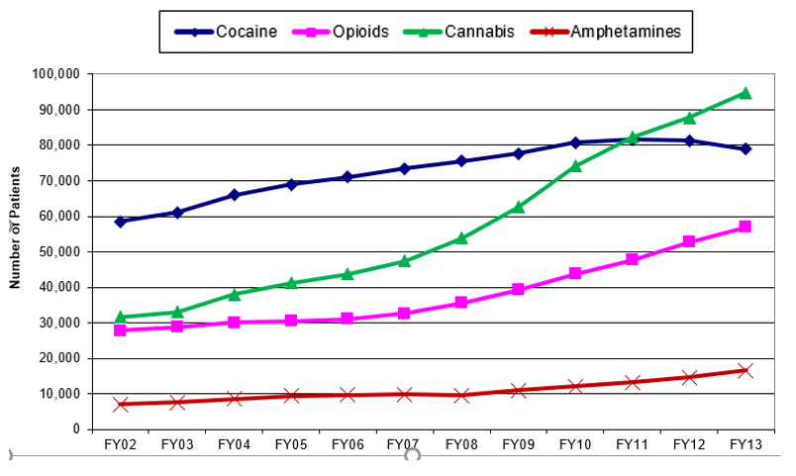
SUD and OUD in VHA
Prevalence of SUD in VHA –
10% of Veterans (600,000 in FY 2015)
AUD >> other SUD
“Diagnosed” OUD
1.1% of Veterans (FY 2015)
About 60,000 Veterans total
23,000 Veterans on MAT (2016)
What is the Prevalence of OUD in Veterans on long-term opioids?
Estimate of 25 to 40% of LOT patients?
How many truly have OUD? 10,000 to 100,000 Veterans?
How many need addiction medicine? MAT?
Notes:
DSM V criteria - Degenhardt 2015: 10% mod to severe OUD, 20% mild OUD of all LTOT pts
Opioid use disorder
on long-term opioids (> 90 d)
HR 15 for MED 1-36 mg/d
HR 29 for MED 36-120
HR 122 for MED 120 mg/d
Boscarino et al. (2011) examined medical records from a large healthcare system.[82] Through interviews with a random sample of patients on LTOT they examined factors associated with and the prevalence of OUD (using Diagnostic and Statistical Manual of Mental Disorders [DSM] 4 and 5 criteria). These results showed that the prevalence of lifetime OUD for patients on LTOT was 34.9% (based on DSM-5 criteria) and 35.5% (based on DSM-4 criteria).

Slide 73
Opioids and Mental Health
The missing ‘P’ in pain management: how the current opioid epidemic highlights the need for psychiatric services in chronic pain care
Howe CQ, Sullivan MD
Gen Hosp Psychiatry, 2014;36(1):99-104
“The opioid epidemic thus reflects a serious unmet need for better recognition and treatment of common mental health problems in patients with chronic pain. Psychiatry is the missing P in chronic pain care”
Rates and Correlates of Pain Specialty Clinic Use Nationally in the Veterans Health Administration.
Arout CA, Sofuoglu M, Rosenheck RA
Pain Med, 2017; 18(4):702-710
“Patients attending pain specialty clinics have more difficult-to-treat pain conditions and comorbid, psychiatric disorders (…), use more outpatient services, and receive a greater number of opioid prescriptions. These data support the inclusion of mental health care in the specialized treatment of chronic pain.”
Salas et al, Pain 2017; Scherrer et al, Pain 2015
Notes:
In a study of nearly 50,000 Veterans Health Administration
(VHA) patients, opioid analgesic use of longer than 180 days,
compared with 1 to 90 days, was associated with
significantly greater risk (hazard ratio [HR] = 1.51; 95%
CI, 1.31-1.74) of a new diagnosis for depression.14 In a
prospective study of chronic pain patients, those who
increased their MED to more than 50 mg/d, compared
with nonusers, had a 2.6 times greater probability of
depression with time. These results remained after rigorous
control for confounding.
15. Scherrer JF, Salas J, Lustman PJ, Burge S, Schneider FD; Residency
Research Network of Texas (RRNeT) Investigators. Change in opioid
dose and change in depression in a longitudinal primary care
patient cohort. Pain. 2015;156(2):348-355.
The missing ‘P’ in pain management: how the current opioid epidemic highlights the need for psychiatric services in chronic pain care
Howe CQ, Sullivan MD
Gen Hosp Psychiatry, 2014;36(1):99-104
“The opioid epidemic thus reflects a serious unmet need for better recognition and treatment of common mental health problems in patients with chronic pain. Psychiatry is the missing P in chronic pain care

Slide 74
Integrated Pain Care
Collaborative, interdisciplinary pain care system-wide that is truly centered around the Veteran
Everyone is part of the Pain Management Team
“No Wrong Door”
Integrative Health (CIH)
Pharmacy
Whole Health Program
Patient
PT, Exercise
Addiction Medicine
Mental Health
Pain Specialty Team
Suicide Prevention
PACT
PCMHI

Slide 75

Summary: Opioid Safety Initiative
Our S.T.O.P. P.A.I.N. Toolbox
https://www.va.gov/opa/pressrel/pressrelease.cfm?id=293
S
Stepped care model
T
Treatment alternatives/ complementary and integrative health
O
Ongoing monitoring of usage
P
A
I
N
Practice guidelines
Academic detailing
Informed consent for patients
Naloxone distribution
P
Prescription monitoring
11/14/2017

Slide 76
Summary: Pain Management Teams
In accordance with CARA, VHA is reducing reliance on opioid medication for chronic pain management, providing safer prescribing and monitoring practices, and Veteran-centric, biopsychosocial pain care.
The majority of Veterans with chronic pain conditions receive their care from Primary Care. PACT must be supported with access to patient education/self-care programs and access to non-pharmacological pain treatment modalities.
Veterans with high impact/severe chronic pain benefit from biopsychosocial pain care by an interdisciplinary pain team that works collaboratively with Primary Care. Pain Management teams at all facilities to support PACT are legislatively mandated by CARA.
Mental Health comorbidities are very common in patients with chronic pain. Integration of MH providers and access to OUD treatment within Pain teams and Primary care are essential for success.

Slide 77
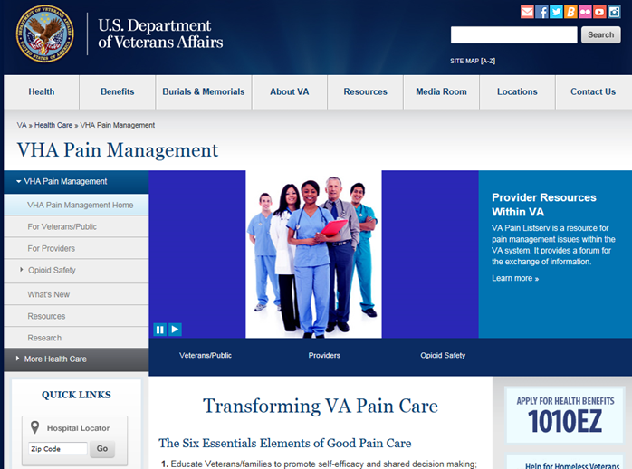
Thank You
VACO, VISN and Facility leadership
VISN POCs and all facility POCs for PAIN
OSI POCs and the OSI review committees
Pain Medicine Specialty Teams
Pain Psychologists
PACT Pain Champions, Primary Care
PBM/Pharmacy
Academic Detailing
Mental Health
Suicide Prevention
Addiction Medicine
Nursing Service
Rehabilitation Medicine
Integrative Health, IHCC and OPCC
EES, Ethics
Connected Care/Telehealth
Pain research community
Contact information:
friedhelm.sandbrink@va.gov
Phone 202-745-8145
www.va.gov/painmanagement

Slide 78
President’s Opioid Commission
The President’s Commission on Combating Drug Addiction and the Opioid Crisis (chaired by Governor Chris Christie)
Office of National Drug Control Policy (ONDCP) supports the Commission
https://www.whitehouse.gov/ondcp/presidents-commission
Interim report (draft) – July 31, 2017
Declaring a national emergency
Expanding capacity for drug treatment under Medicaid;
Increasing the use of medication-assisted treatments for OUD;
Encouraging the development of non-opioid pain relievers;
Mandating that every local law enforcement officer in the nation carry naloxone, the drug that rapidly reverses opiate overdose;
Broadening “good Samaritan” laws that shield individuals from prosecution when they report a drug overdose to first responders or law enforcement officials.
Final report (draft) – November 1, 2017

Slide 79
President’s Opioid Commission
The President’s Commission on Combating Drug Addiction and the Opioid Crisis
Chaired by Governor Chris Christie, supported by Office of National Drug Control Policy (ONDCP)
https://www.whitehouse.gov/ondcp/presidents-commission
Final report (draft) – Nov. 1, 2017: Letter to the President; 56 recommendations
“175 Americans are dying a day “
Only 10.6% of youth and adults who need treatment for SUD receive treatment
Marijuana: lack of sophisticated outcome data on dose, potency, drug-drug interactions, effectiveness, and long-term consequences of marijuana used for medical purposes.
Summary of recommendations
Federal Funding and Programs
No new funding; call for review of funding priorities and block grants to states.
Opioid Addiction Prevention
Screening, Brief Intervention and Referral to Treatment (SBIRT) for at-risk youths
Wide reaching, multi-platform television and social media outreach campaign
Prescribing Guidelines, Regulations, Education
Education and informed consent of patients prior to opioid prescription for chronic pain.
National curriculum and standard of care for opioid prescribers; collect participation data, mandate training for medical licensing.

Slide 80
President’s Opioid Commission
The President’s Commission on Combating Drug Addiction and the Opioid Crisis
https://www.whitehouse.gov/ondcp/presidents-commission
Summary of recommendations (continued)
PDMP Enhancements
Mandate that states comply with PDMP requirements, including data sharing.
PDMP data integration with electronic health records, overdose episodes, and SUD-related decision support tools for providers
PDMPs incorporate available overdose/naloxone deployment data
Supply Reduction and Enforcement Strategies
Take Back Day to inform the public about drug screening and treatment services; year-round authorized collectors and use of drug deactivation bags.
“The expectation of eliminating a patient’s pain as an indication of successful treatment, and seeing pain as the fifth vital sign … was cited as a core cause of the culture of overprescribing in this country that led to the current health crisis. This must end immediately.”
CMS remove pain survey questions entirely on patient satisfaction surveys, so that providers are never incentivized for offering opioids to raise their survey score; prevent hospital administrators from using patient ratings from CMS surveys improperly
CMS to review policies that may discourage the use of non-opioid treatments for pain.
Strengthen data collection activities enabling real-time surveillance of the opioid crisis.
Rigorous testing procedures in the investigation of drug-related deaths
Reinstituting the Arrestee Drug Abuse Monitoring (ADAM) program and the Drug Abuse Warning Network (DAWN)

Slide 81
President’s Opioid Commission
The President’s Commission on Combating Drug Addiction and the Opioid Crisis
https://www.whitehouse.gov/ondcp/presidents-commission
Summary of recommendations (continued)
Opioid Addiction Treatment, Overdose Reversal, and Recovery
Ensure that health care providers screen for SUDs and know how to appropriately counsel, or refer a patient;
Remove reimbursement barriers to substance abuse treatment incl. MAT, counseling and inpatient/residential treatment (HHS/CMS, Indian HS, Tricare, and VA).
All primary care providers employed by federal health systems should screen for SUDs and, directly or through referral, provide treatment within 24-to-48 hours.
Each physician employee should be able to prescribe buprenorphine (if that is the most appropriate treatment for the patient) in primary care settings.
Adoption of process, outcome, and prognostic measures of treatment services as presented by the National Outcome Measurement and the American Society of Addiction Medicine (ASAM).
Require health insurance industry to reimburse MH and addiction treatment;
Drug Courts in every federal district court in America; Drug Courts need to embrace the use of MAT as it clearly improves outcomes.
Recovery Support Services, including peer-to-peer programs, jobs and life skills training, supportive housing, and recovery housing
Research and Development
Engage in a comprehensive review of existing research programs and establish goals for pain management and addiction research (both prevention and treatment).

Slide 82
The Joint Commission: Pain Standards 2018
Effective January 1, 2018 - New and revised pain assessment and management standards and elements of performance, including:
A leader or a leadership team responsible for pain management and safe opioid prescribing, and developing and monitoring performance improvement activities.
Involving patients in pain management treatment planning process.
Identifying and monitoring high-risk patients with respect to opioid use.
Conducting performance improvement activities; analyzing data on pain assessment and management to identify areas that need change
Monitoring the use of opioids and assess whether they are used safely — e.g. tracking of respiratory depression, naloxone use, and duration and dose of opioid prescriptions.
Ensuring the availability of non-pharmacologic pain treatment modalities.
Screening patients for pain during emergency department visits and upon admission.
Providing education to staff and practitioners
Ensuring that staff and practitioners have access to:
Services for consultation and referral of patients with complex pain management needs
Opioid treatment programs that can be used for patient referrals
Prescription Drug Monitoring Program databases (when applicable by state law).

