Slide 1
CoVeRT:
CPR Video Review Team
George Washington University
Emergency Medicine
C. Robin Lanam, MD, MBA

Slide 2

CPR Video Review
24/7 monitoring of 3 resuscitation bays in ER
Tracking Data:
  Demographics
  Pre-Hospital EMS data (ie witnessed arrest, rhythm)
  Time to monitor and defibrillator
  Time to IV
  Pulse check times
  Use of ultrasound
  Etiologies of delayed pulse checks
47 cardiac arrest patients in initial period (first 10 months), now at ~100 patients.
IRB for both educational and clinical intervention (IRB # 031819)

Slide 3
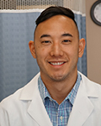
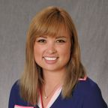


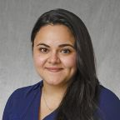

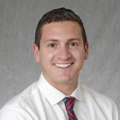
CoVeRT: Resident QI in Resuscitation
Started in 2017 by three residents and and ED/Crit Care attending (Dr David Yamane)
Only remaining resident from initial team : Dr. C. Robin Lanam
  Dr Lanam lead the team during her PGY-3 year
  Has given the most grand rounds presentations for CoVeRT – 4 video reviews and lectures.
  Helped develop 7 abstracts and poster presentations
Currently with 6 residents – 2 residents per PGY year, recruiting interns in winter.
Various process improvements in collaboration with nursing leadership – including protocol for ECMO in CPR, dual sequential defibrillation, and nursing lead ACLS.

Slide 4
CoVeRT Interventions
Immediate Feedback:
Quantitative and qualitative email feedback to physician, nursing, and technicians involved after video reviewed arrests
Systematic Improvement:
Grand Rounds video reviews identify gaps in care – in collaboration with cardiology, cardiothoracic, critical care, and emergency department nursing
  ECMO guidelines
  CPR Checklist
  End Tidal CO2
  Doppler pulse checks
  Post Cardiac Arrest Cath guidelines
  Ultrasound use in cardiac arrest
  Nursing guided ACLS – documenting RN directs epinephrine and pulse check at MD designated intervals

Slide 5
Abstracts and Cases
Data from our pilot year

Slide 6
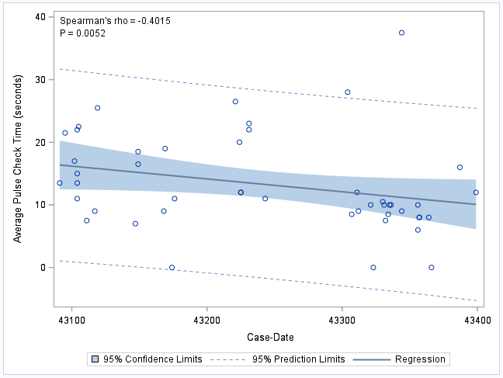
Decreasing Pauses
Pulse Check Time
Dec 2017 - Oct 2018
47 patients, OHCA, video taped resuscitations
Patients reviewed independently by 2 reviewers for concordance
Pulse check time counted in seconds
Results:
Statistically significant decrease over time
  Spearman’s rho= -0.7871, p<.01
Average pulse check time 14 seconds
Next steps:
Identify causes of lengthened pulse checks, including issues with automated CPR device, procedures, and ultrasound use.
Shortening times using “Don’t Hesit-8”, a call for end of the pulse check at 8 seconds by documenting RN
Notes:
There was a strong interrrater reliability among video reviewers ( ρ=0.9664, p-value<.0001).

Slide 7
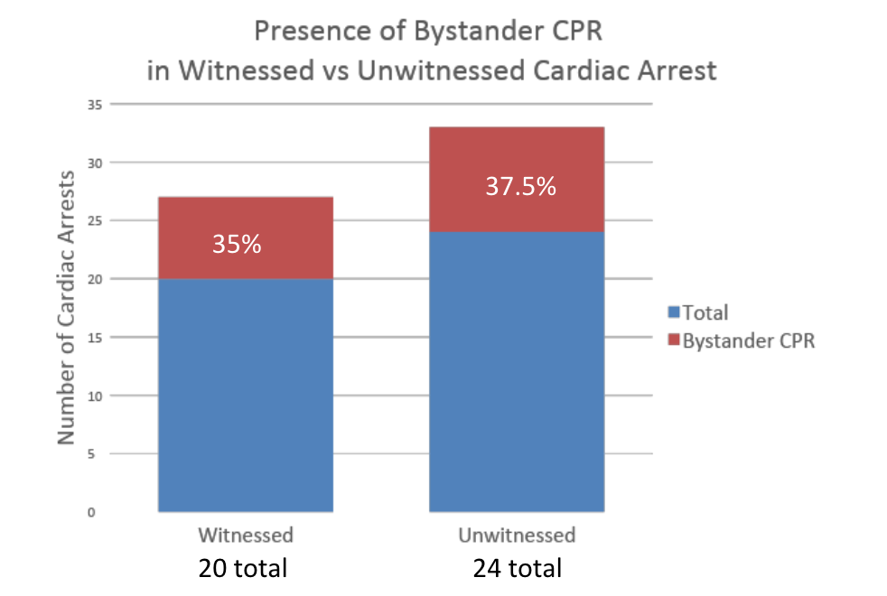


Low Rate of Bystander CPR in DC Metro
2016 American Heart Association bystander CPR rate : 46/1%
2018 GW Hospital OHCA bystander CPR rate: 36.4% overall
No difference between witnessed (35%) and unwitnessed arrest (37.5)
District of Columbia:
DC Fire and EMS runs free CPR classes
Need better community outreach and education

Slide 8
Case Reports
CPR Induced Consciousness
What is it?
Intentional movement, vocalizations, and memories during high quality CPR
Case: 65yo F, history of Afib, C/C: SOB
Arrest in ambulance triage
Vfib on initial rhythm defibrillated
Intentional movements of arms and legs during CPR, stopped when CPR was held. Many pauses in CPR due to confusion.
Patient admitted to ICU after ACLS care for 40 minutes of refractory Vfib.
The Lazarus Effect
What is it?
ROSC after termination of resuscitation
Thought to be caused by high intrathoracic pressures reducing venous return.
Case: 68yo M, ischemic cardiomyopathy w/ AICD, came from EMS as witnessed arrest
Two short episodes of ROSC during 60 minutes of resuscitation en route with EMS
PEA per EMS, asystole on arrival
Asystole on all pulse checks, TOD called after 14 minutes of ACLS in ER.
One minute after TOD, patient regains pulse, noted by RN, and confirmed by MD
Patient admitted to ICU, developed multiorgan failure

Slide 9
Abstracts and Presentations
Evan Kuhl, Carolyn Robin Lanam, David Yamane “Purposeful movements during CPR masquerading as ROSC” Poster presentation, 2018 American Medical Association Research Symposium, National Harbor, Maryland November 9th, 2018
Carolyn Robin Lanam, David Yamane “Life After Death, The Lazarus Phenomenon” Poster presentation, 2018 American Medical Association Research Symposium, National Harbor, Maryland November 9th, 2018
JLA Rabjohns, E Kuhl, CR Lanam, N Sullivan, P McCarville, D Yamane “Adult CPR Video Review Improves Resident Knowledge” Poster Presentation, 2019 American Academy of Emergency Medicine Annual Conference, Las Vegas, NV March 11th, 2019
E Kuhl, CR Lanam, JLA Rabjohns, N Sullivan, P McCarville, A Rahimi-Raber, C Payette, D Yamane. “A Unique Video-Review Curriculum to Improve Resident Education and Quality Metrics in Cardiac Arrest” Poster Presentation, 2019 CORD Academic Assembly, Seattle, WA; April 1st, 2019
JLA Rabjohns, E Kuhl, CR Lanam, N Sullivan, P McCarville, D Yamane “Adult CPR Video Review Improves Resident Knowledge” Poster Presentation, 2019 GW Research Day; Washington, DC; April 10th, 2019.
N Sullivan, C Lanam, D Yamane, E Kuhl, JLA Rabjohns, P McCarville, C Payette, A Rahimi-Saber, Pulse Check Improvement Through Video Analysis and Feedback. In: SAEM; May 14-18, 2019; Las Vegas, NV
P McCarville, C Payette, J Rabjohns, CR Lanam, A Sparks, D Yamane“The Need for Public Awareness in the Washington D.C. Community for Witnessed Cardiac Arrest.” In: Poster presentation SAEM; May 14-18, 2019; Las Vegas, NV

Slide 10
More Questions?
Contact crlanam@gwu.edu or dyamane@gwu.edu!!

