Slide 1

Piloting a Novel Medical Student Virtual Discharge Counseling Process in the Time of COVID
NYU Ronald O. Perelman
Department of Emergency Medicine
Victoria Terentiev, MD; Amber Ciardiello, MD; Sana Maheshwari, MD; Chris Kuhner, MD(c); Joshua Ross, MD(c); Chris Caspers, MD; Viraj Lakdawala, MD; Silas W. Smith, MD; Audrey Bree Tse, MD; Janelle Tiu, BBA; Ian Wittman, MD; Linda Tewksbury, MD; Stephen Stark, RN, Joanna Watterson, MD(c); Harita Reddy, MPH; Staci Mandola, RN; Kathy Peterson, RN; Nancy Conroy, MD
Victoria.terentiev@nyulangone.org

Slide 2
COVID-19
Notes:
Lets go back to the height of COVID pandemic – I think this is how most of us felt.
During the COVID pandemic, the ED has seen increasing patient volume and acuity. This is similarly a stressful time for patients and they require extra counseling on COVID related discharge instructions. I was seeing some patients bounceback for lack of understanding supportive care etc
According to The Joint Commission, approximately 80% of adverse medical events occur during care transitions, including to home. State data suggest that only 47% of New Yorkers receive adequate information about care following discharge.¹ During the COVID-19 pandemic, this problem was amplified.

Slide 3
Objectives:
    Improve patient satisfaction and to augment patient education via dedicated discharge counseling.
    Reduce provider tasks to allow clinical staff to focus on high acuity patients during a pandemic.
    Decrease COVID related patient bounce-backs via increased counseling time.
    To improve medical student professional core competencies: interpersonal and communication skills, patient care, and medical knowledge; to provide a clinical experience; and to introduce students to telemedicine.
Notes:
Initially our thought was to have student counselors but since students weren’t allowed in the clinical arena, we worked with our teleheaeth team to allow volunteer students to counsel patients virtually with one on one video.
This would do several things: Give students clinical exposure at a time when they had none and provide them a key to successful counseling, provide patients much need 1:1 counseling on supportive care, quarantine, return precautions etc and decompress nursing/providers to allow them to focus on other tasks.
Virtual discharge counselor would perform all covid counseling for COVID/Suspected COVID patients being discharged from the ED

Slide 4
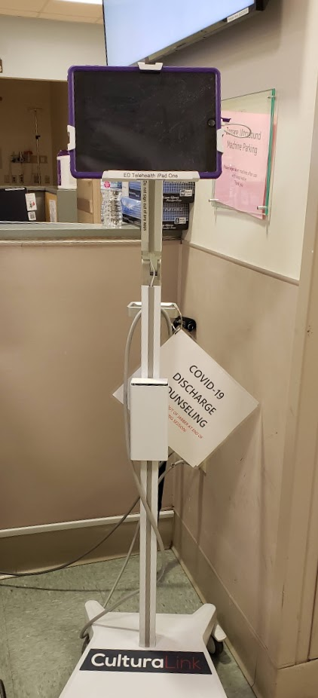
Protocol:
  All students were trained with a standardized protocol and provided with a thorough and prepared discharge script.
  Medical students were notified by nurses via secure chat once patients were ready to receive discharge instructions.
  Medical student reviewed patient chart and discharge.
  Counseling provided via secure (HIPPA-compliant) video conference, in the patient’s preferred language utilizing designated iPads.
  Student Epic chat to patient care team upon counseling completion.
  Discharge counseling documented in the EHR.
  Patient demographics, counseling duration and language were recorded.
Notes:
Counseling included previously identified critical discharge elements: diagnosis, educational content (including instructions for supportive care and quarantine), medication dosing, return precautions, follow up, and the ability to ask questions
We had departmental and institutional support for this project as well as the collaboration of operations, patient safety, telemedicine, medical education, nursing and statistical support. I believe this team effort make this project so successful and allowed us to launch and sustain it.

Slide 5
COVID-19 Discharge Instructions and FAQ’s
Introduction:
  Hello, My name is ________ - I am a medical student and will be counseling you today on your discharge. I will answer and all your questions and provide you with important information.
  Suspected COVID: Based on all of your symptoms, you very likely have Coronavirus
  vs
  Confirmed COVID: You are being discharged with Coronavirus (which was confirmed on testing)
Counseling: The patient MUST be counseled on below points
  What is Coronavirus / COVID-19?
  What are symptoms of COVID-19 infection?
  What can I take for my symptoms?
  What should I do if I have COVID-19 or have been exposed to someone who tested positive?
  Need for self-quarantine and When can I stop?
  How is COVID-19 treated?
  Precautions to return to Emergency Room?
  What can I do to better protect myself and my family?
Notes:
Example of student sheet for counseling 6-7 pgs

Slide 6
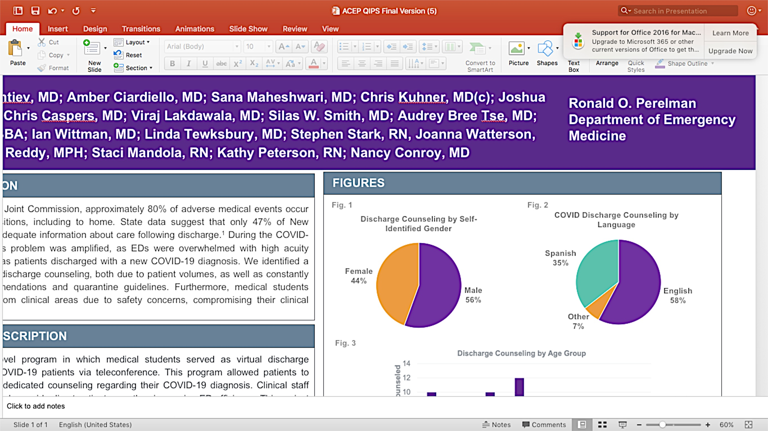
Results
Notes:
Over an 18-week period, 45 patients were counseled for a median of 20 minutes (range: 7 - 39 min).

Slide 7
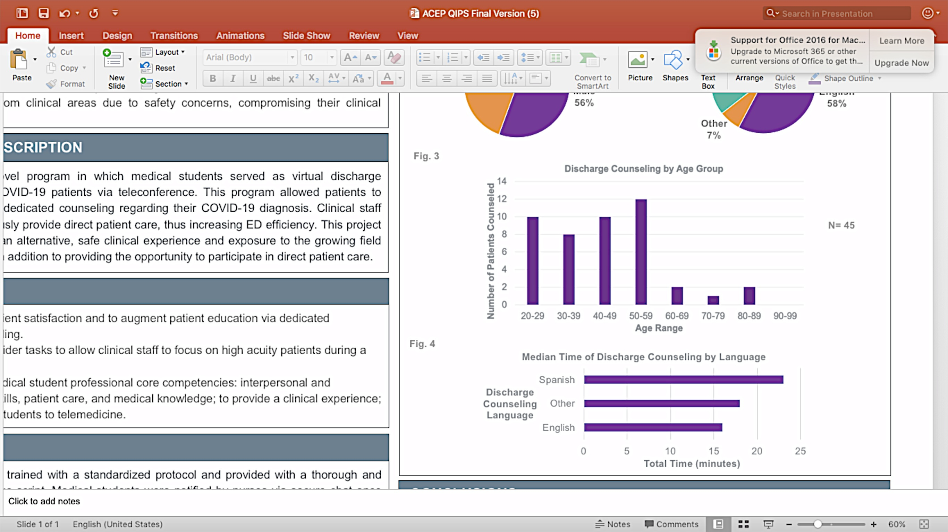
Results
23 minutes
18 minutes
p = 0.015
16 minutes
Notes:
Median times for discharge counseling were 16 minutes, 23 minutes, and 18 minutes, respectively (p = 0.015). Discharge counseling in Spanish took significantly longer than English (p = 0.017).

Slide 8
Results
The 72-hour ED revisit rate was 0%, versus 4.2% in similarly-matched, not counseled COVID-19 patients.
Notes:
Even this cohort of 45 patients we found a statistically significant increase in bounceback rate in the uncounseled group.

Slide 9
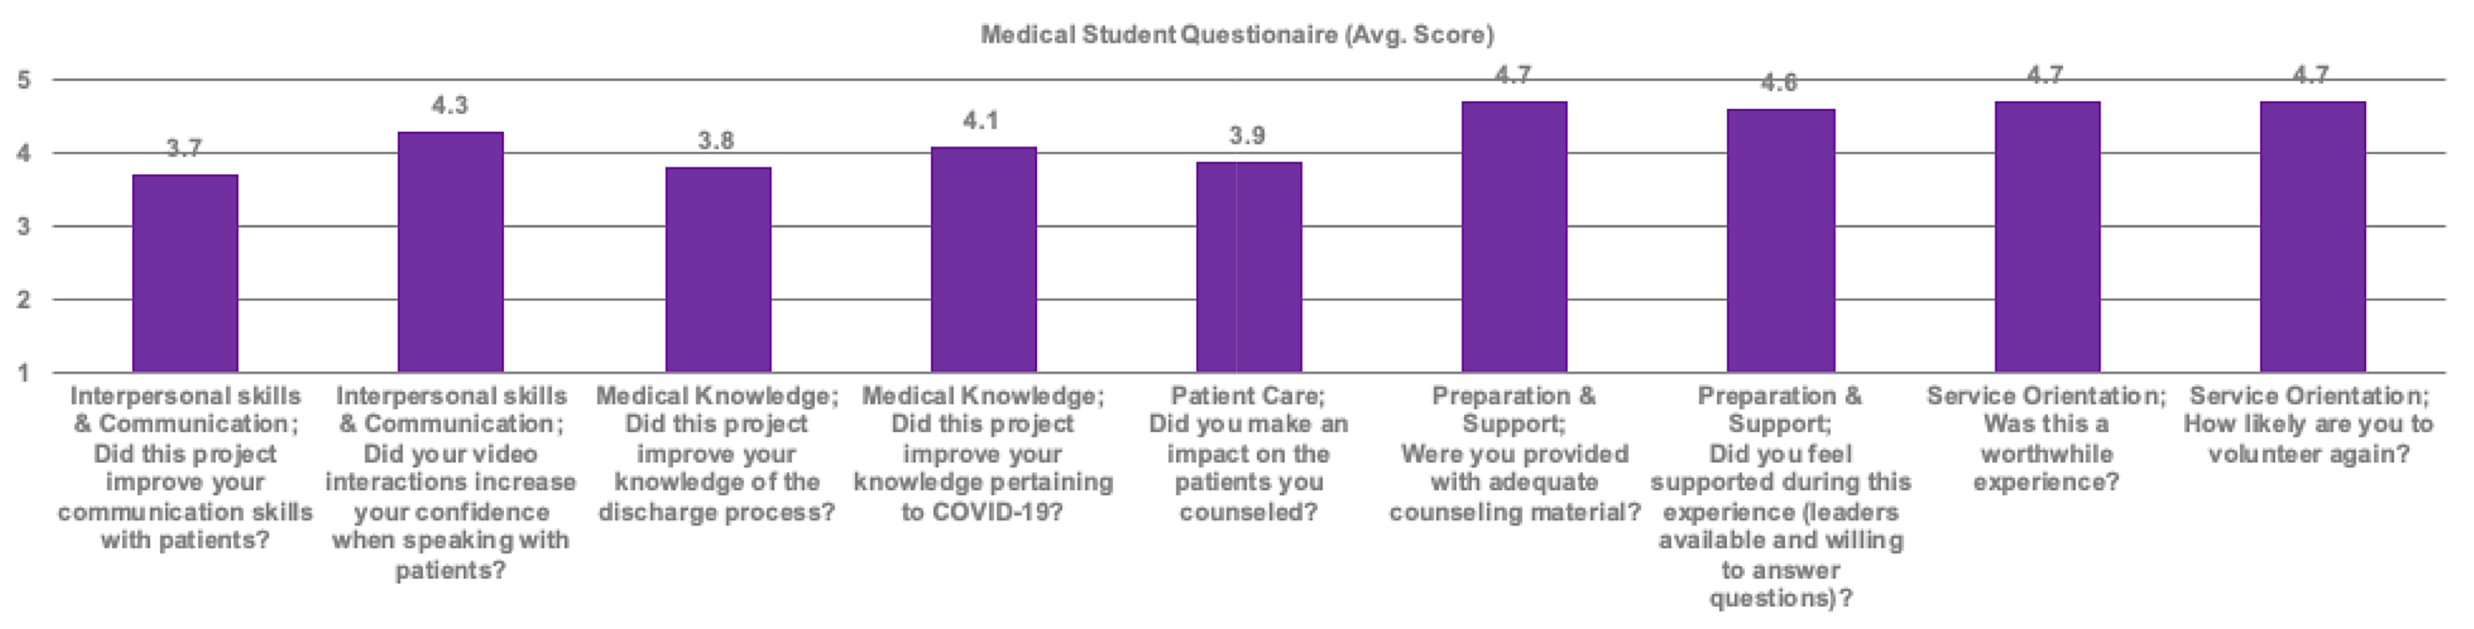
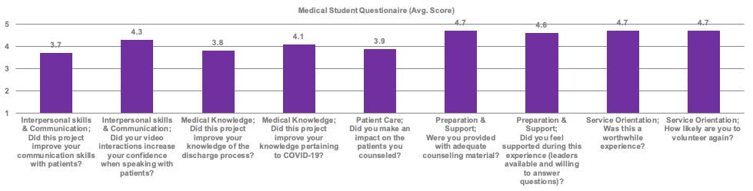
Results
Notes:
It was equally as important to us that the students engaged in the counseling have a worthwhile clinical experience and Medical we anonymously surveyed thr student involved w/ a 63% response rate.
5 = strongly agree, 4= agree, 3= neutral, 2= disagree, 1= strongly disagee
The questions were targeted at medical student core competencies such as interpersonal and communication kills, medical knowledge, patient care, and service and orientation as well as whether the students felt well supported by project leaders during this experience
Medical students believed this project increased their confidence when speaking with patients (90% strongly agreed or agreed) and that it was a worthwhile experience (100% strongly agreed or agreed). Lastly, 80% strongly agreed that they would volunteer again, and similarly, 80% indicated that this was their first telemedicine experience.

Slide 10
Conclusions
Demonstration of a novel mechanism to improve clinical efficiency during the COVID-19 pandemic by offloading discharge tasks remotely, utilizing medical students who were restricted from direct patient care.
Offered a safe clinical experience to medical students that were adversely affected by COVID-19 and served as an introduction to telemedicine.
Demonstrates feasibility to train / deploy clinical novices for flexible utilization.
Notes:
Our novel discharge program was centered on patient-driven education and improvement of the discharge process. Through this program, patients were provided with extensive counseling in their preferred language that would not otherwise be possible in an urban ED setting amidst a pandemic (or even routine ED operations). Limited English Proficiency (LEP) and limited health literacy barriers were addressed.
, showing that medical students were confident in their preparation and found that this experience improved their communication and clinical skills

Slide 11
Updates Since COVID Onset
Expanded and implemented across three additional ED sites.
Added 10 additional counseling diagnoses.
40 medical student participants and over 120 patients counseled.
Incorporated into the ED medical student elective rotations.
On-going as part of the Emergency Medicine medical student and nursing student curriculum.
Notes:
Due to its success and positive feedback it was expanded and implemented across 3 of our ED sites and additional diagnoses were added. This program is still on-going we plan to incorporate the peds ED for counseling as well.
Large part of the programs success was having faculty, resident and medical student leadership, having leadership from each category complemented creating and sustaining this program
This program will especially be valuable if a 2nd wave occurs
Additional diagnoses:
Abscess & I&D
Asthma / COPD
Back Pain
Cellulitis
DM
GERD
HA
PNA
Pyelo
UTI

Slide 12
References
  1. New York State Department of Health. Improving the discharge planning process in New York State. January 2016. Available at: https://www.health.ny.gov/press/reports/docs/discharge_plan_brief.pdf
  2. Samuels-Kalow M et al. Unmet Needs at the Time of Emergency Department Discharge. Acad Emerg Med. 2016;23(3):279-87.
  3. Schenhals E et al. Barriers to Compliance With Emergency Department Discharge Instructions: Lessons Learned From Patients' Perspectives. Intern Emerg Med. 2019;14(1):133-138.

Slide 13

Victoria Terentiev, MD:
Victoria.terentiev@nyulangone.org
Notes:
Thanks to all of the leadership and multidisciplinary team of

