Slide 1
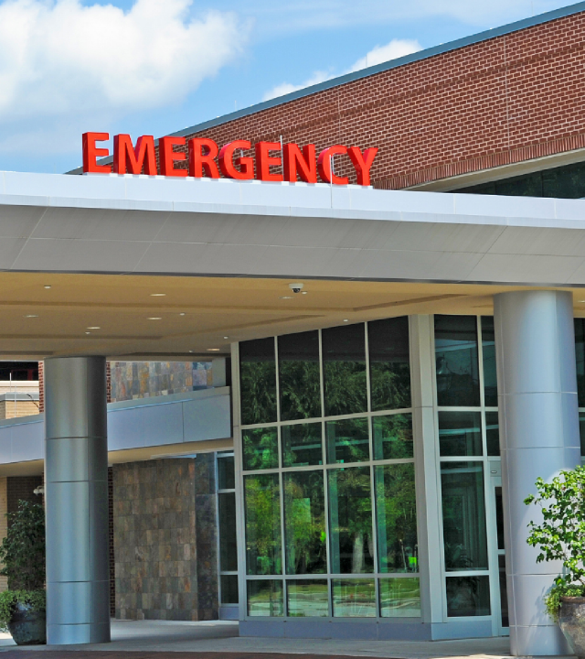



Geriatric EDs: Connecting with the Community
Kevin Biese
MD, MAT
Geriatric Emergency Department Collaborative Implementation PI
Chair, Geriatric Emergency Department Accreditation
1 | © 2020 Geriatric Emergency Department Collaborative |

Slide 2
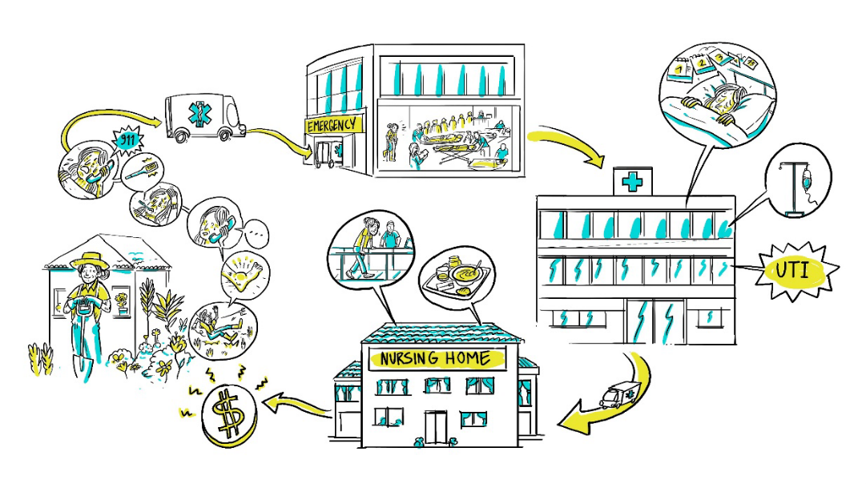

2 | © 2020 Geriatric Emergency Department Collaborative |

Slide 3
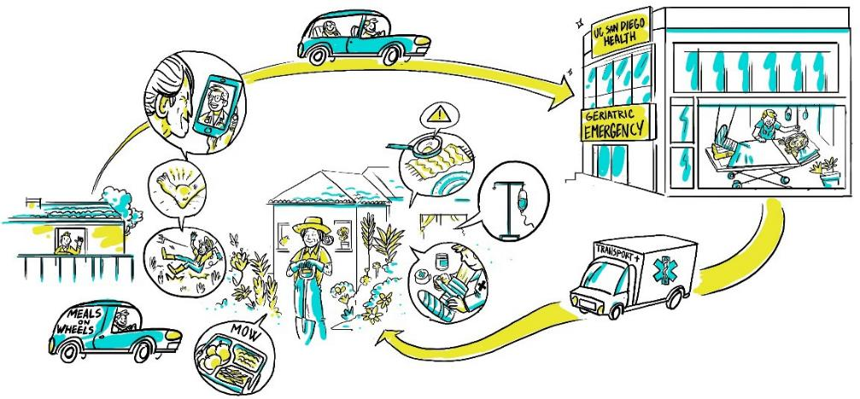

3 | © 2020 Geriatric Emergency Department Collaborative |

Slide 4
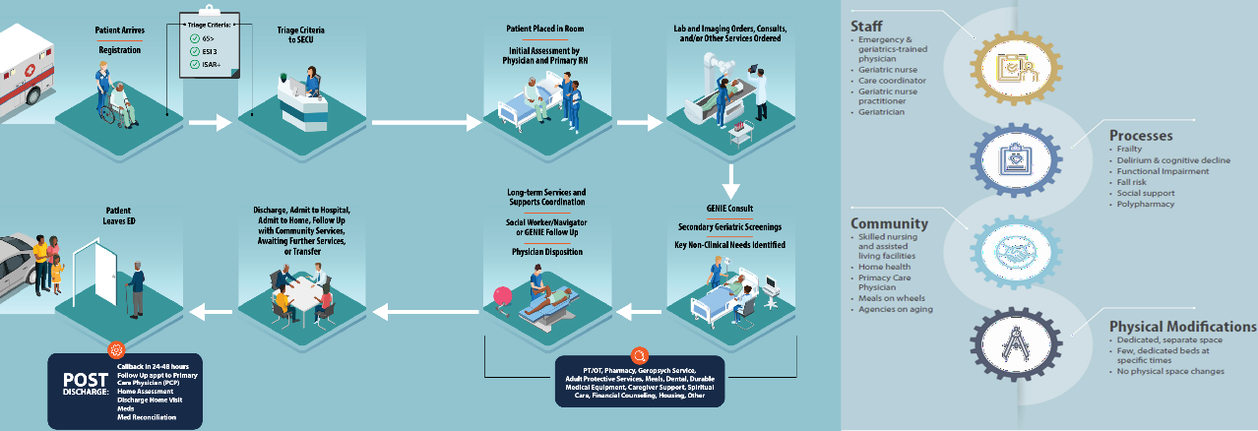


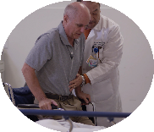

GEDs Provide Standardized and Integrated Care
4 | © 2021 Geriatric Emergency Department Collaborative |

Slide 5
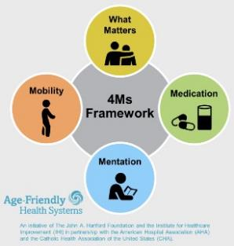

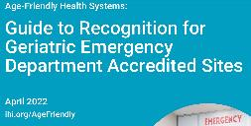

Geri ED Alignment
GEDC
Geriatric
Emergency Department Collaborative
ED Physician with Geriatrics training
Frailty
Emergency & Geriatrics trained physician
Geriatric Nurse
Poly- pharmacy
Delirium & Cognitive Decline
Staff
Processes
Geriatrician
Care Coordinator
GEDA
Geriatric Emergency
Department Accreditation
Geriatric Nurse Practitioner
AFHS
Age Friendly Health Systems
Social Support
Functional Impairment
SNFs/ALFs
Dedicate d, separate space
PCP &
Outpatient
Care
Home Health
Fall Risk
Few, dedicate d beds
No physical space changes
Community
Physical Space
Agencies on Aging
Connecting with Caregivers
Entire GED
made geriatric- friendly
Improved lighting
Meals on Wheels
Few, dedicate d beds at specific times

Slide 6
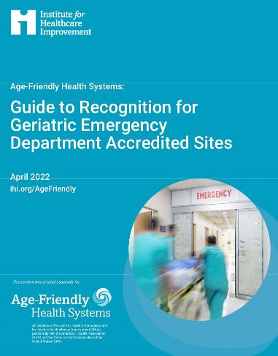
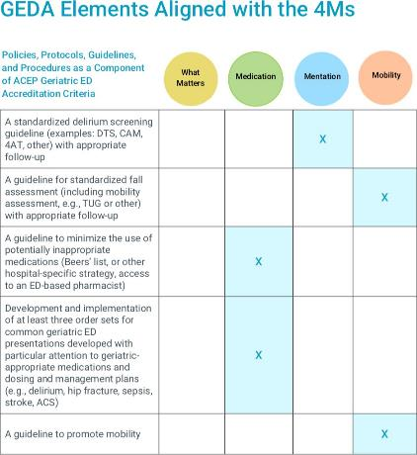
AFHS and Geri EDs

Slide 7






GEDA is created in partnership with
The Gary and Mary West Health Institute and The John A. Hartford Foundation.
Levels 1 and 2 are designed to reflect an increasing commitment to senior-specific care in the Emergency Department.
Level 3 is designed to be within reach of every hospital
7 | © 2021 Geriatric Emergency Department Collaborative |

Slide 8
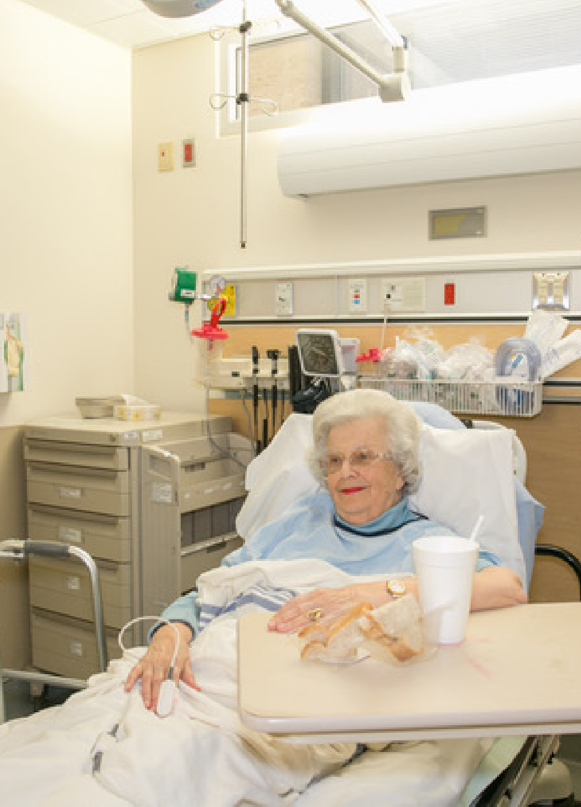


Good geriatric ED care
Level III
At least one MD and one RN with evidence of geriatric focus (champions)
Evidence of geriatric focused care initiative
Mobility aids
Food & drink 24/7
8 | © 2021 Geriatric Emergency Department Collaborative |

Slide 9
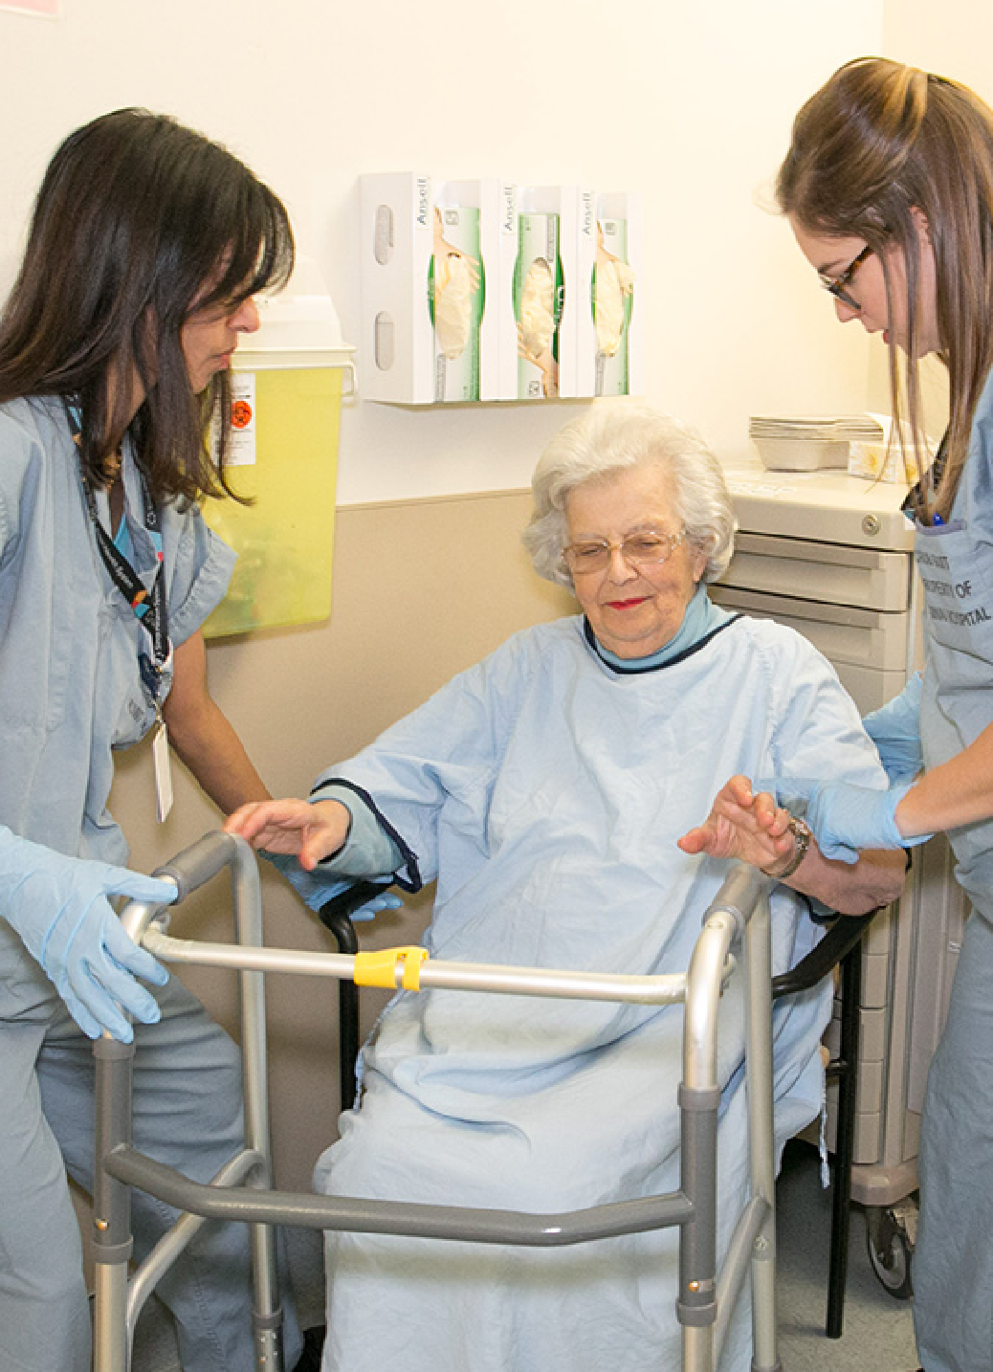


Advanced geriatric ED care
Level II
Physician & nurse champions (medical/ nurse director) with focus on geriatric EM
Geriatric-focused nurse case manager 56 hours/ week
Geriatric assessment team: 2 of PT, OT, SW or Pharmacy available in ED
Hospital executive-assigned supervision of and support for geriatric ED resources
Geriatric EM education for MDs and RNs
Demonstrable adherence to at least 10 (of 26) policies and protocols
QI process for selected policies
Tracking at least 3 of 11 outcome measures
Physical supplies and food/drink
9 | © 2021 Geriatric Emergency Department Collaborative |

Slide 10
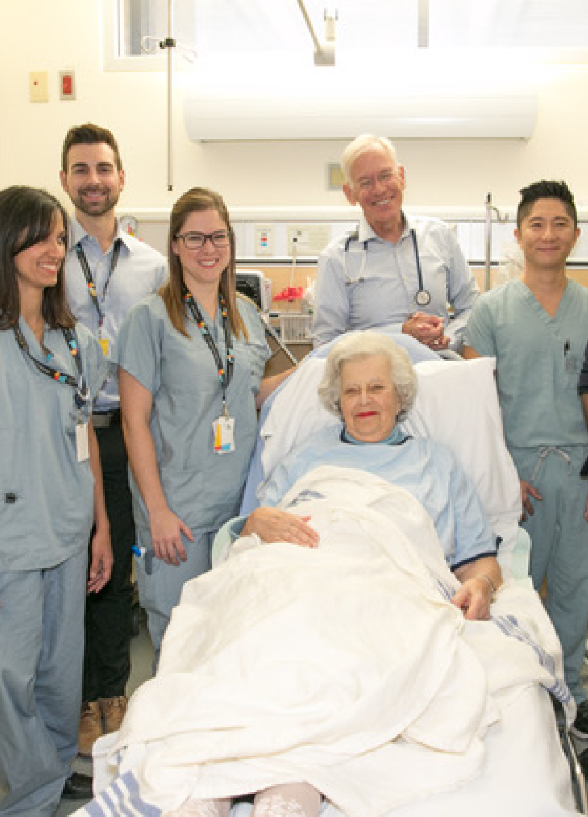


Center of excellence in geriatric ED care
Level I
Physician & nurse champions (medical/nurse director) with focus on geriatric
EM + patient advisor
Geriatric-focused nurse case manager 56 hours/ week
Geriatric assessment team: 4 of PT, OT, SW or Pharmacy available in ED
Hospital executive-assigned supervision of and support for geriatric ED resources
Geriatric EM education for MDs and RNs
Demonstrable adherence to at least 20 (of 27) policies and protocols
QI process for selected policies
Tracking at least 5 of 11 outcome measures
More physical supplies, space modifications and food/drink
10 | © 2021 Geriatric Emergency Department Collaborative |

Slide 11
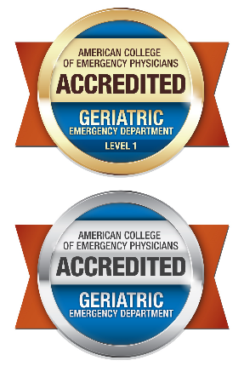



Total Accredited Sites:
27
460 Total Sites
U.S. across 46 States
9 International
Spain, Level 3
Thailand, level 3
Brazil, Level 3
Canada, Level 2 and Level 3
56
377
11 | © 2020 Geriatric Emergency Department Collaborative |

Slide 12











Connection
Exchange among Health Care Systems leading the country in Geriatric Emergency Care
GEDC/West Health
Health Care System Roundtable Members
Collaboration
Identify ways each of your teams can support the others in their Quality Improvement Initiatives
Dissemination
Explore opportunities to share Roundtable insights with other health systems interested in GEDs
Direction
Identify major trends and topics to help lead change across health systems
12 | © 2020 Geriatric Emergency Department Collaborative |
Guest Member : Prime Healthcare

Slide 13
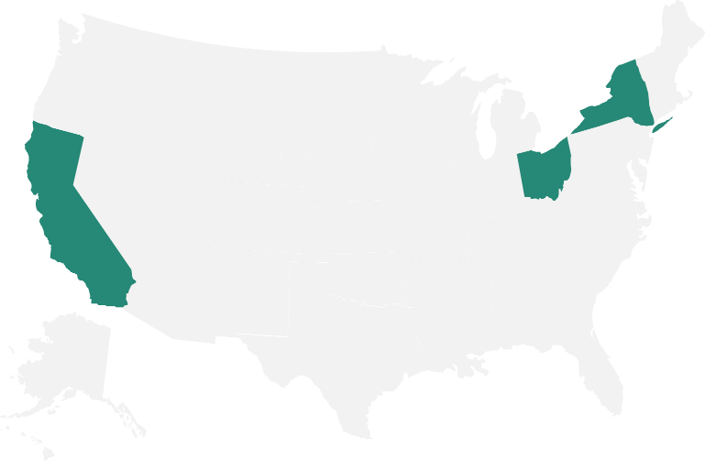
State-Wide Initiatives
Healthcare Systems Taking Action
California: 68 accredited sites
San Diego Initiative
Ohio: 36 accredited sites
Premier Health System
Cleveland Clinics
New York: 53 accredited sites
Northwell Health System
HANYS
13 | © 2021 Geriatric Emergency Department Collaborative |

Slide 14
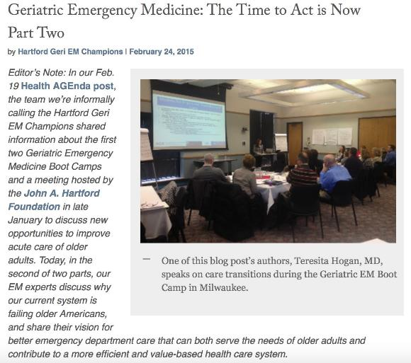

Geriatric Emergency Department Collaborative
Share best practices across Geriatric EDs
Offer QI focused interdisciplinary Bootcamps and tailored whole- team training
Care evolution through rapid- cycle PDSA
14 | © 2021 Geriatric Emergency Department Collaborative |

Slide 15









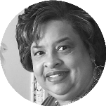



PLUS
a growing number of GEDC Partner Hospitals and Healthcare Systems dedicated to improving ED care for older adults.
Learn More:
Gedcollaborative.com
/partnership
15 | © 2021 Geriatric Emergency Department Collaborative |

Slide 16

Our Mission
We bring best practice into action.
We transform and evaluate interdisciplinary best practice in geriatric emergency medicine, and then build and distribute practical, evidence- based clinical curriculum and quality improvement tools that support sustainable, quality care for older adults.
gedcollaborative.com
@theGEDC
Our Vision
A world where all emergency departments provide the highest quality of care for older patients
16 | © 2021 Geriatric Emergency Department Collaborative |

Slide 17



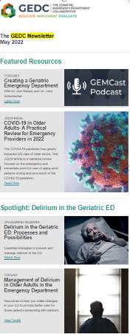
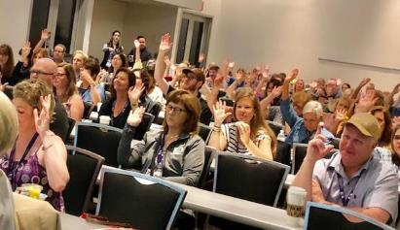
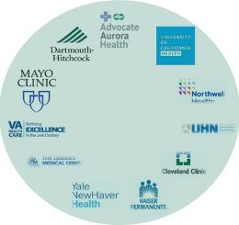
GEDC Resources and Dissemination
GEMCast
Blog Post
Toolkits
Webinars (Live & On-demand)
Skills Fair Modules
Geri-EM
JGEM
HCS Roundtable

Slide 18

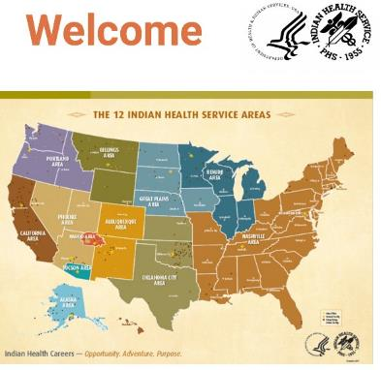
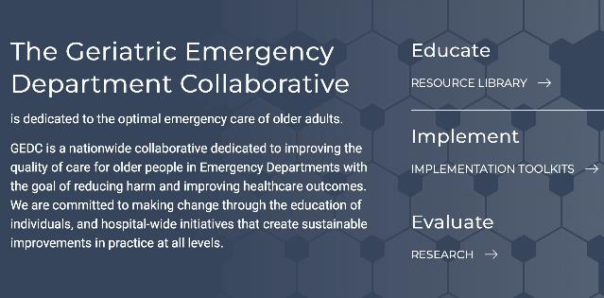
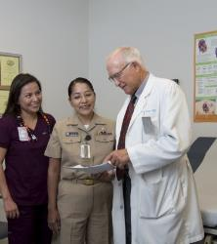

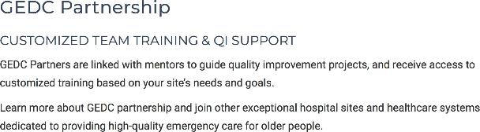
GEDC Geri ED Education

Slide 19
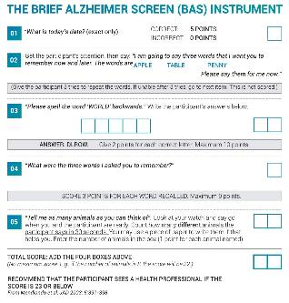

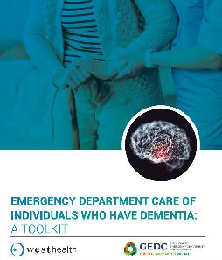
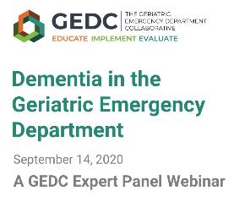
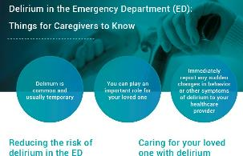
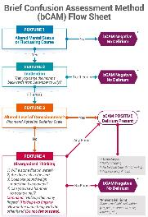
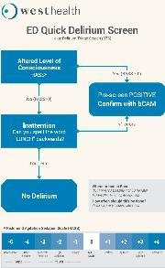
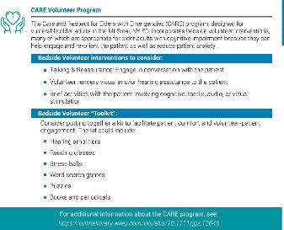


Dementia & Delirium Resources

Slide 20

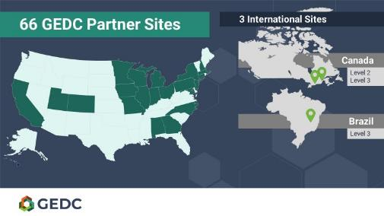
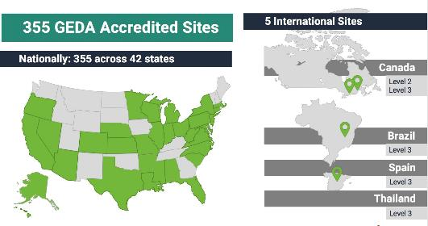








Synergy
Greater Patient Satisfaction
Lower Costs
16.5% Reduced risk of readmission
LOWER RISK Of 30-day fall-related ED revisits
© 2019 The Geriatric Emergency Department Collaborative

Slide 21

















Collaborating Partners

Slide 22





DECREASE READMISSIONS
Recent update from SE US site:
13 Estimated Readmissions Prevented over first 3 months
DECREASE ED REVISITS IN HIGH-RISK POPS.
Midwest GED site: 9% decrease in ED revisits
JAGS article: PT in the ED associated with reduced 30- and 60-day revisits (p<0.001).
INCREASE MARKET SHARE
Actual case: Urban safety net hospital seeking more Medicare patients.
Actual case: Hospital in competitive area w/ many
“snowbirds” seeks differentiation
BETTER CONSENSUS MANAGEMENT
CFO of academic system in NE: “I am tired of seeing the air-
ambulance fly over us because we are on diversion. This can help us put our beds to better use.”
INCREASE STAFF SATISFACTION
Result seen at multiple health systems across all levels of accreditation
What can a
Geriatric Emergency Department do
for my hospital?
22 | © 2021 Geriatric Emergency Department Collaborative |

Slide 23
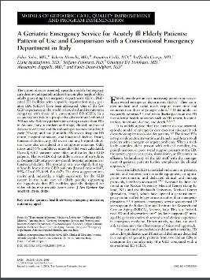
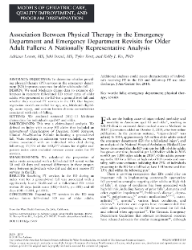
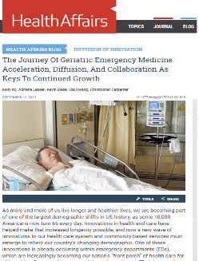


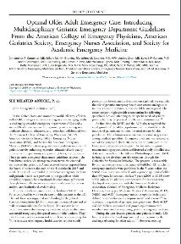
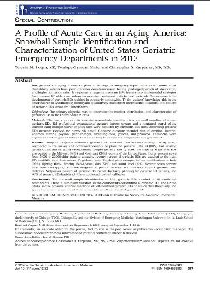
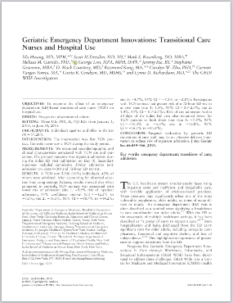
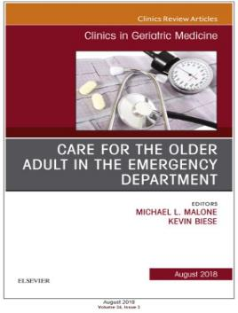
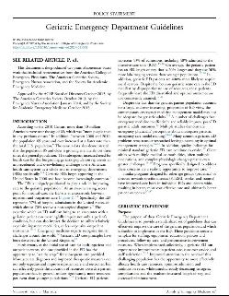
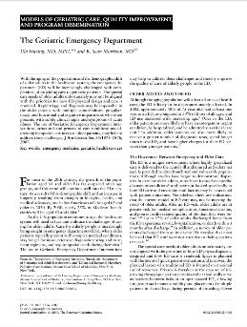
A growing body of literature supports Geriatric EDs
as a solution
23 | © 2020 Geriatric Emergency Department Collaborative |

Slide 24
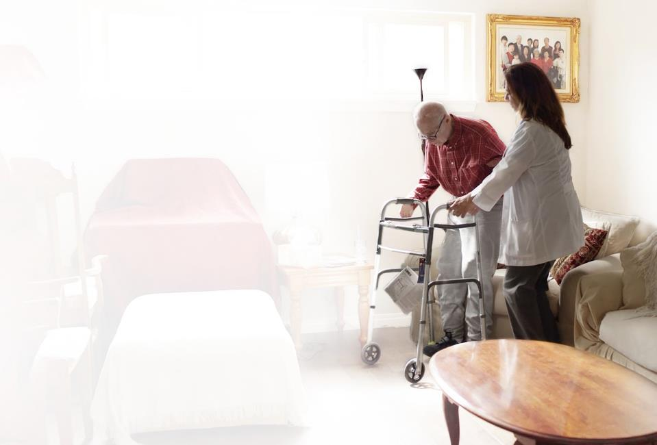
Healthcare System GED ROI
Patient Care / Market Share
Census Management
Portal to Value-Based Care
24 | © 2020 Geriatric Emergency Department Collaborative |

Slide 25

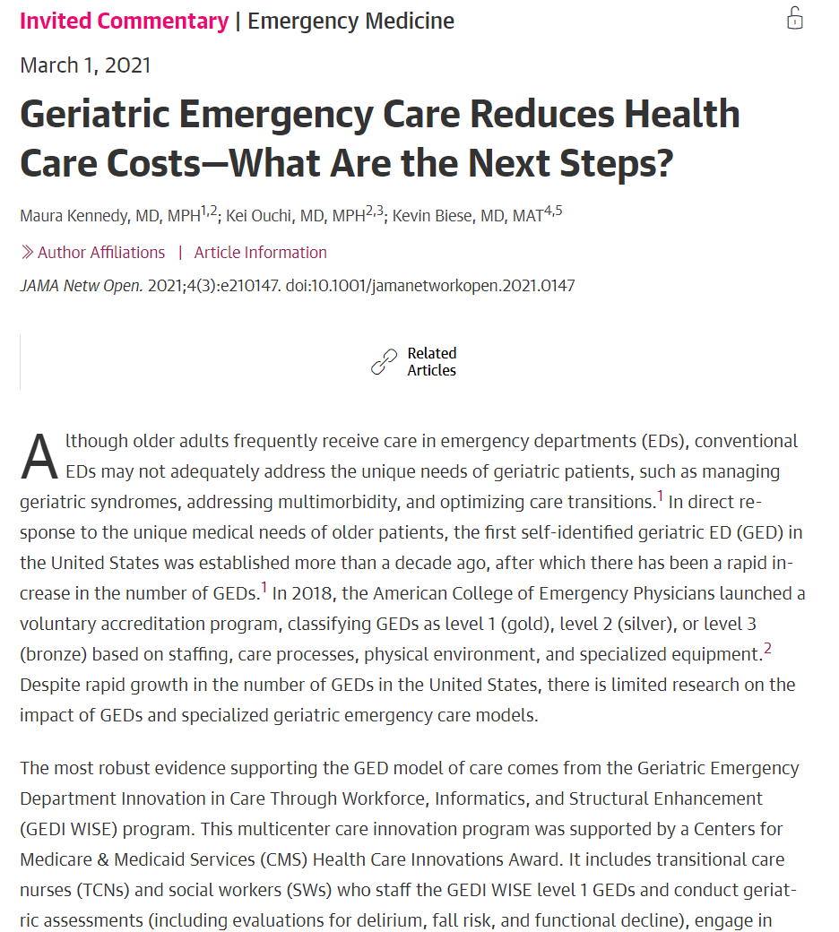
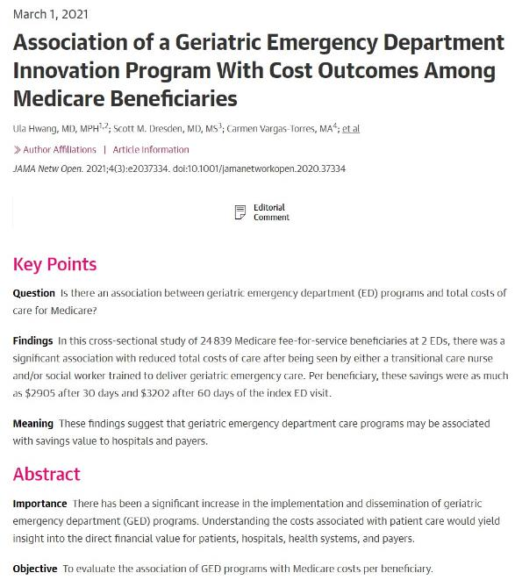
https://jamanetwork.com/journals/jamanetworkopen/fullarticle/2776801
https://jamanetwork.com/journals/jamanetworkopen/fullarticle/2776803
25 | © 2020 Geriatric Emergency Department Collaborative |

Slide 26



GEDs and VBC share similar goals
Up to 16.5% reduced risk of hospital admission₅ and 17.3% of readmission₆
$3,202 savings per Medicare beneficiary after 60 days₇
Lower Costs
Improve Quality
Decreased odds of 30 and 60 day fall- related ED revisit with PT services₈
Improve Experience
87.3% satisfaction with the clarity of discharge information and perceived wellbeing₉
21 studies showcasing improved experience across a variety of interventions₁₀
26 | © 2021 Geriatric Emergency Department Collaborative |

Slide 27

ACOs and GEDs can partner to improve the cost and care trajectory for older adults.
ED
60% of older adults admitted to hospital come through the ED₁
ACOs
Lower odds of preventable ED visits₂
Reduce Unnecessary Admissions
High use of evidence-based care coordination strategies₃
Connect to Services
ED makes decisions with tremendous cost implications (average admit >$22,000 vs. discharge)₁
Standardize Care
Improved preventative care quality performance₄
27 | © 2021 Geriatric Emergency Department Collaborative |

Slide 28

Geriatric Emergency Department |  | Reference s
Goal | Provide senior-focused emergency care to prevent avoidable hospitalizations; improve patient outcomes and satisfaction; reduce iatrogenic complications, readmissions and penalties. | Koehler , et al., 2009 Hwang, et al., 2018 Caplan, et al., 2014
Target Population | Seniors experiencing a medical emergency
Outcomes/ Source of Hospital ROI | Potentially reduce penalties for readmissions & preventable errors; increase patient satisfaction scores
Source of Societal ROI mergency Department C | Potentially reduce ED crowding and time on divert status; improve patient outcomes and reduce iatrogenic complications / functional ol_{d}lab_{e}o_{c}ra_{l}t_{i}iv_{n}e_{e}|
28 | © 2020 Geriatric E
28

Slide 29

Geriatric Emergency Department |  | Resources
Goal | Provide senior-focused emergency care to | Aldeen, et al., 2014 Wallis, et al., 2018 Conroy, et al., 2014 Keyes, et al, 2014 Wright, et al., 2014 Hwang, et al, 2018
 | prevent avoidable hospitalizations; improve
 | patient outcomes; reduce low or negative
 | margin Medicare patients; and, backfill beds
 | with high-margin admissions
Target | Seniors experiencing a medical emergency
Population
Outcomes/ | Potentially reduce penalties for
Source of | readmissions & preventable errors;
Hospital | increase patient satisfaction scores
ROI
Source of | Reduce seniors’ need for ED and hospital care; improve patient outcomes and reduce iatrogenic complications / functional decline; provide a more senior-friendly care lla_{e}b_{x}or_{p}at_{e}ive_{ri}|_{ence}
Societal
ROI
rgency Department Co
29 | © 2020 Geriatric Eme
29

Slide 30

Geriatric Emergency Department |  | Resources
Goal | Provide senior-focused emergency care to | Aldeen, et al., 2014 Keyes, et al, 2014 Hwang, et al, 2018 Mion, et. al, 2003 Cossette , et al., 2015 Guttman , et al., 2004
 | prevent avoidable hospitalizations; improve
 | patient outcomes; backfill beds with high-
 | margin admissions; and, attract new
 | consumers to our system
Target | All seniors
Population
Outcomes/ | Increase patient satisfaction scores and
Source of | clinical outcomes; build reputation in the
Hospital | community
ROI
Source of | Improve patient outcomes and reduce iatrogenic complications / functional decline ollaborative |
Societal
ROI
ergency Department C
30 | © 2020 Geriatric Em
30

Slide 31

Geriatric Emergency Department |  | Resources
Goal | Provide senior-focused emergency care to prevent avoidable hospitalizations; improve patient outcomes and satisfaction; and potentially reduce ED revisits among high-risk groups (e.g., falls, dementia) | Jacob- sohn, et al., 2019 Lesser , et al., 2018
Target Populatio n | Seniors experiencing a medical emergency
Outcome s/ Source of Hospital ROI | Potentially reduce penalties for readmissions & preventable errors; increase patient satisfaction scores
Source of Societal ROI mergency Departm | Potentially reduce ED crowding and time on divert status; improve patient outcomes and reduce iatrogenic complications / functional decline ent Collaborative |
31 | © 2020 Geriatric E
31

Slide 32

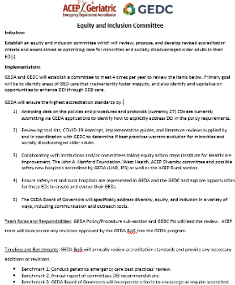
Diversity, Equity, Inclusion
EDs take care of those with no other place to go…
An opportunity to enhance DEI
GEDA GEDC Diversity, Equity, and Inclusion Committee

Slide 33

Generously supported by
33 | © 2021 Geriatric Emergency Department Collaborative |

Slide 34




Thank You

