Slide 1
The Emergency Response to
Africanized Honey Bees
Bryan E. Bledsoe, DO, FACEP

Slide 2
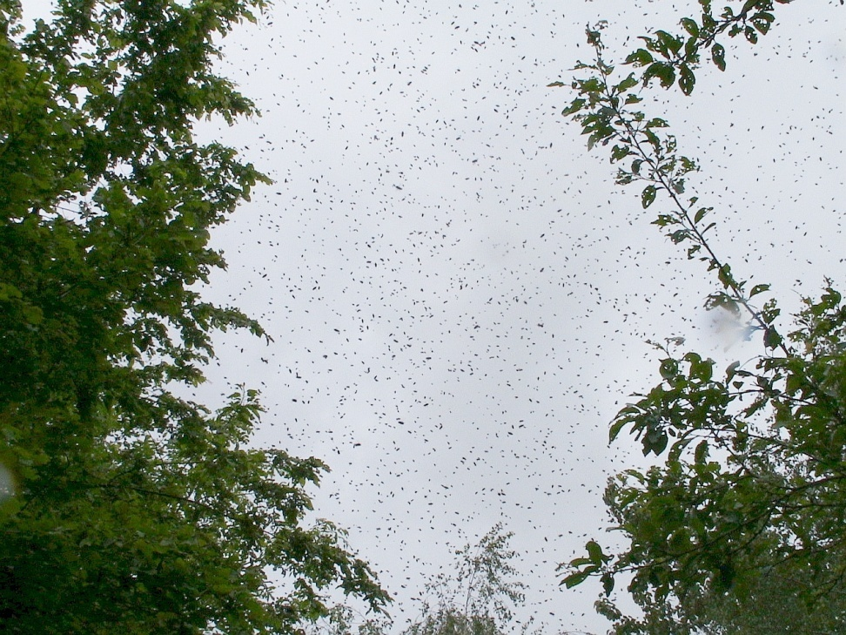
Africanized Honey Bees
Africanized honey bees (AHBs) are quickly becoming a significant risk for emergency personnel.

Slide 3

Africanized Honey Bees
AHBs entered south Texas in 1990.
Migrating at a rate of ~ 100-200 miles per year.

Slide 4
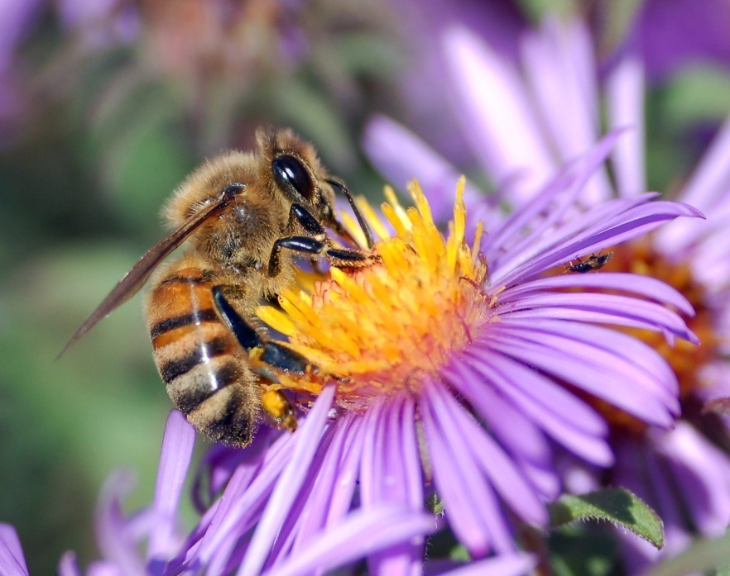
Africanized Honey Bees
Bees and wasps are insects in the order Hymenoptera.
Found on every continent except Antarctica.

Slide 5
Africanized Honey Bees
Major Bee and Wasp Types found in the United States
Bees:
  Western (European) Honey Bees
  Africanized Honey Bees
  Bumblebees
  Carpenter Bees
Wasps:
  Paper Wasps
  Yellow Jackets
  Mud Daubers
  Hornets

Slide 6
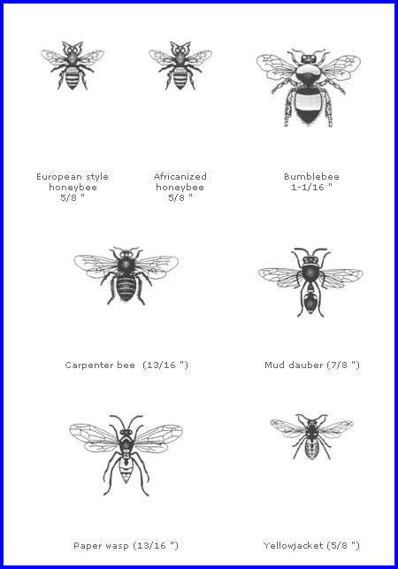
Africanized Honey Bees

Slide 7
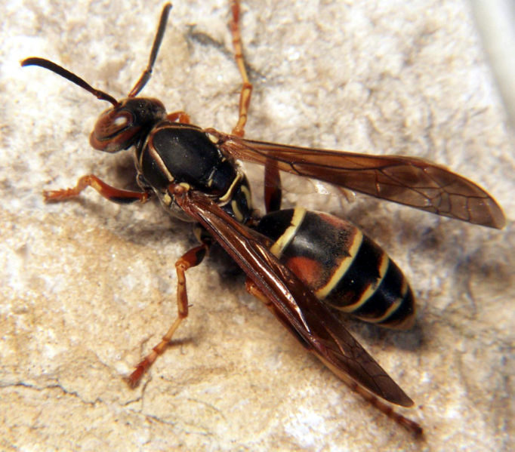
Africanized Honey Bees
Paper Wasps:
  0.75-1.0 inch long.
  Gathers wood fibers.
  Only attack if threatened.
  Beneficial insect.

Slide 8
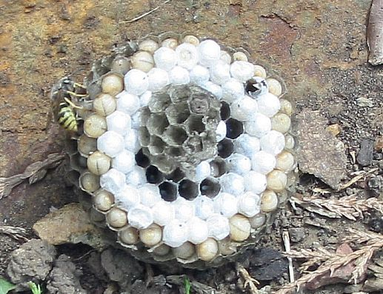
Africanized Honey Bees
Paper Wasp Nest

Slide 9
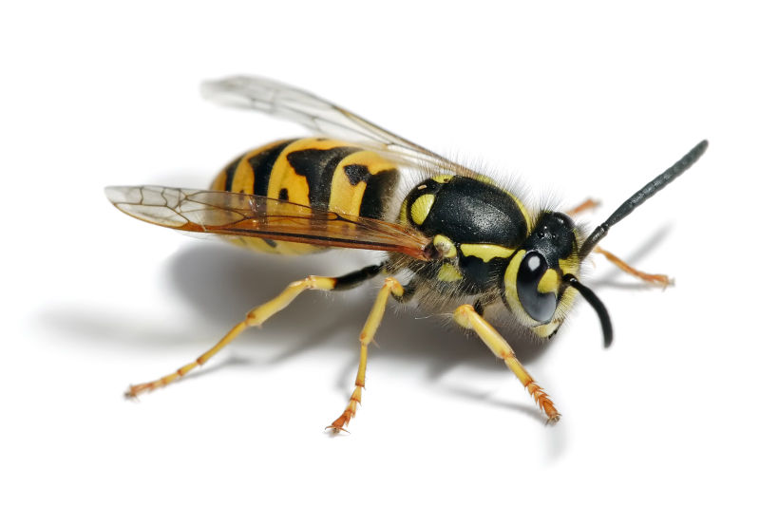
Africanized Honey Bees
Yellow Jackets:
  0.5 inches long.
  Social wasps.
  Aggressive.
  Adults feed on carbohydrates.
  Larvae feed on proteins.

Slide 10
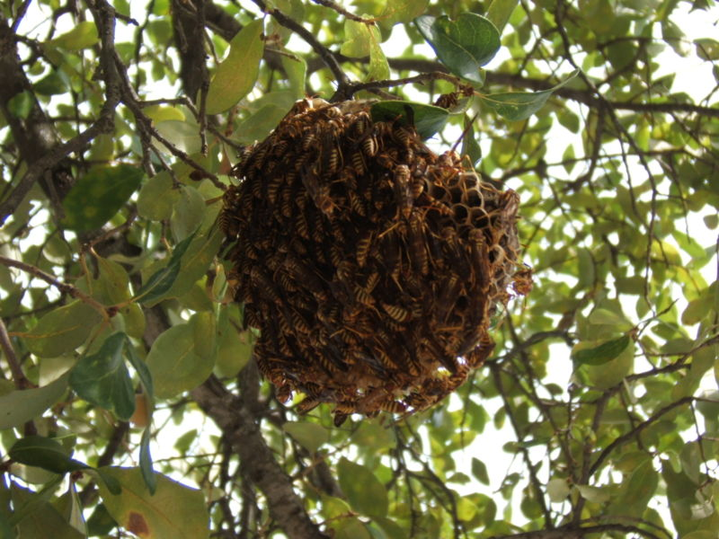
Africanized Honey Bees
Yellow Jacket Nest

Slide 11
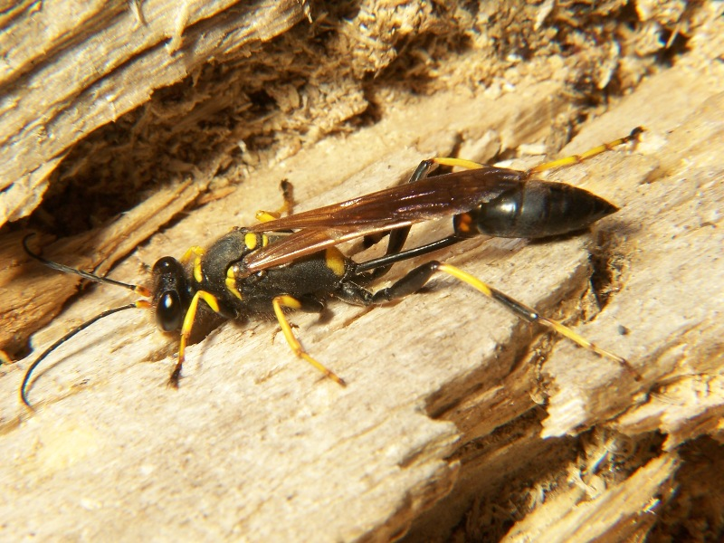
Africanized Honey Bees
Mud Daubers:
  Long, slender wasps.
  Nonaggressive unless threatened.
  Common.
  Nest type variable.

Slide 12
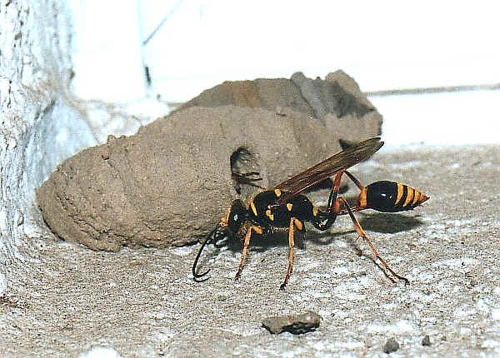
Africanized Honey Bees
Mud Dauber Nest

Slide 13
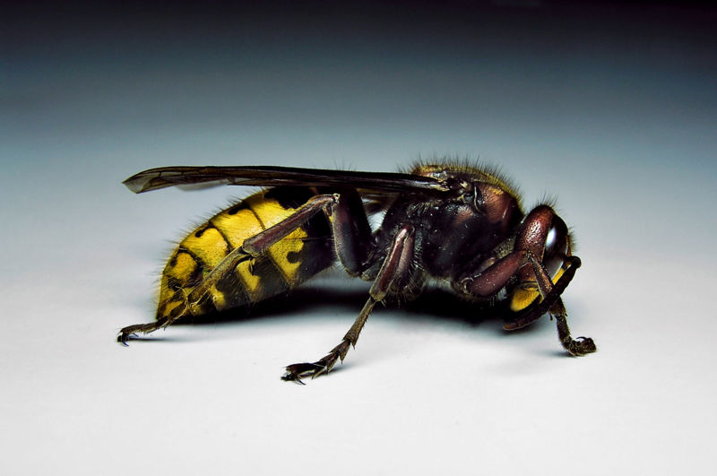
Africanized Honey Bees
Hornets:
  Largest of the social wasps.
  Can be aggressive.
  Multiple types.

Slide 14
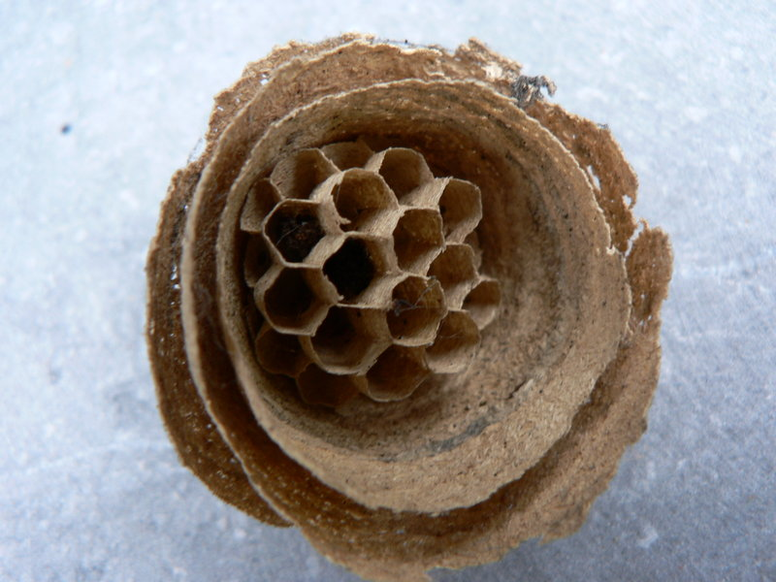
Africanized Honey Bees
Hornet Nest

Slide 15
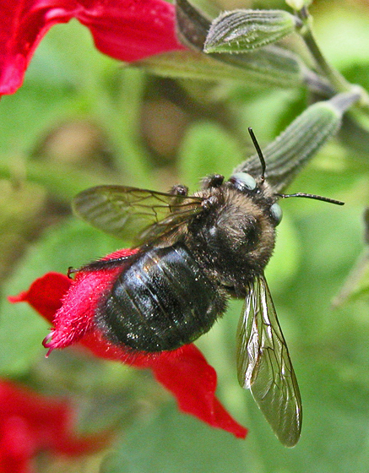
Africanized Honey Bees
Carpenter Bees:
  Live in tunnels.
  Generally solitary.
  Nonaggressive and will not sting unless provoked.

Slide 16
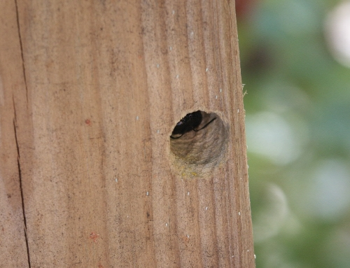
Africanized Honey Bees
Carpenter Bee Tunnel

Slide 17
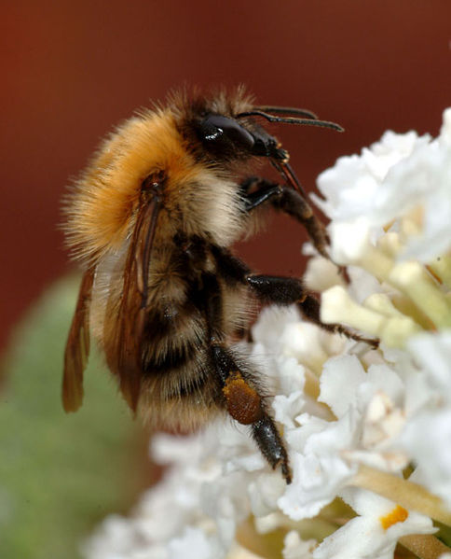
Africanized Honey Bees
Bumblebees:
  Social insects.
  Nonaggressive, but will sting if provoked.
  Feed on nectar.
  Prefer higher latitudes.

Slide 18
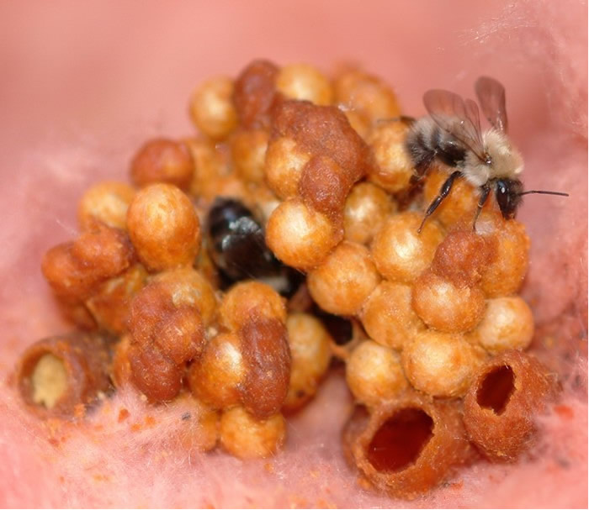
Africanized Honey Bees
Bumblebee Nest

Slide 19
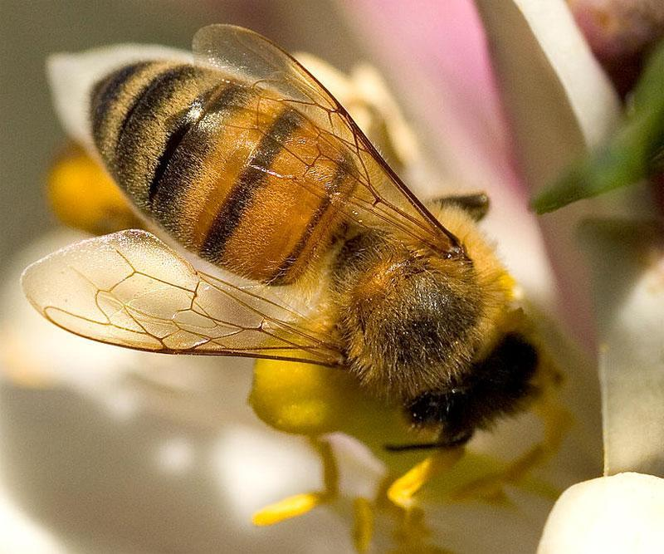
Africanized Honey Bees
Western Honey Bee:
  Also known as the European honey bee.
  Highly social insects.
  Major pollinators in many ecosystems.
  Fairly docile.

Slide 20
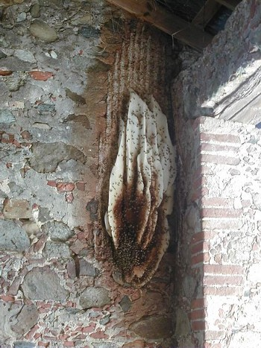
Africanized Honey Bees
Western Honey Bee Nest

Slide 21
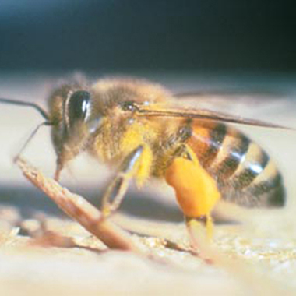
Africanized Honey Bees
Africanized Honey Bees:
  Virtually identical to Western honey bee to untrained eye.
  Highly aggressive.
  Various levels of hybridization.

Slide 22
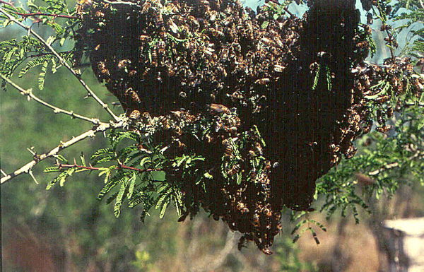
Africanized Honey Bees
AHB Nest

Slide 23



Africanized Honey Bees

Slide 24
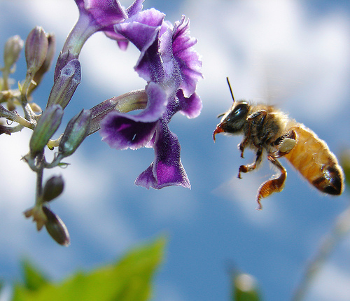
Africanized Honey Bees
Bees have evolved and adapted to feeding on nectar and pollen from flowering plants.
Bees are major pollinators in most ecosystems.

Slide 25
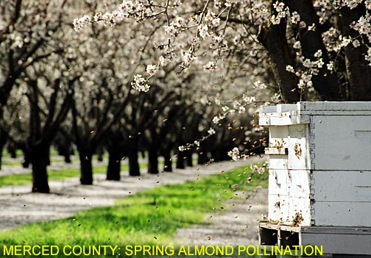
Africanized Honey Bees
Bees are important in crop management and kept by many farmers for pollination of crops.

Slide 26
Africanized Honey Bees
Bees are generally solitary or social.
Social bee communities highly organized.
Social communities have single fertile queen.

Slide 27
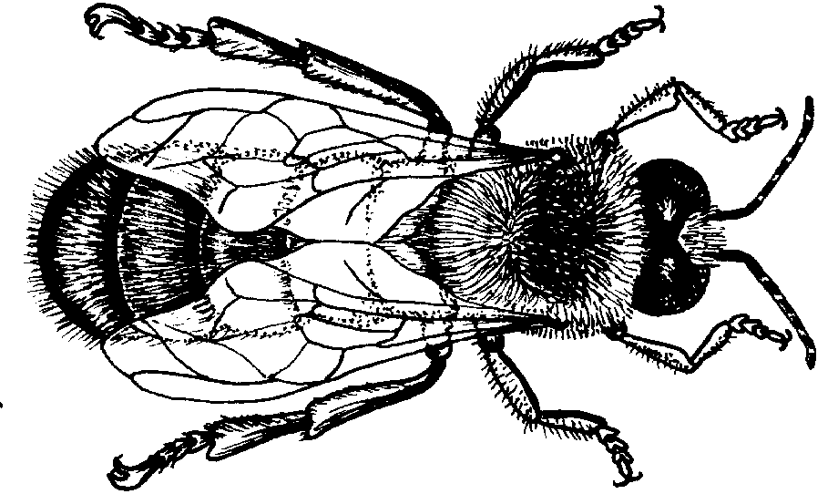
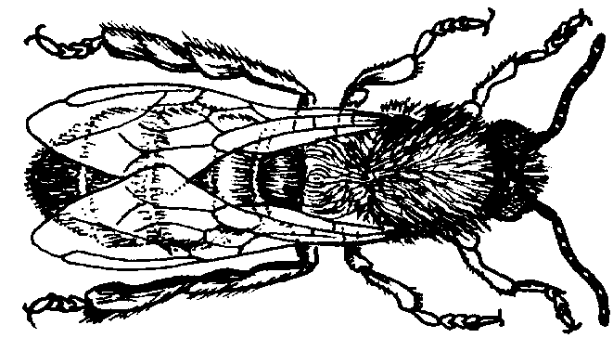
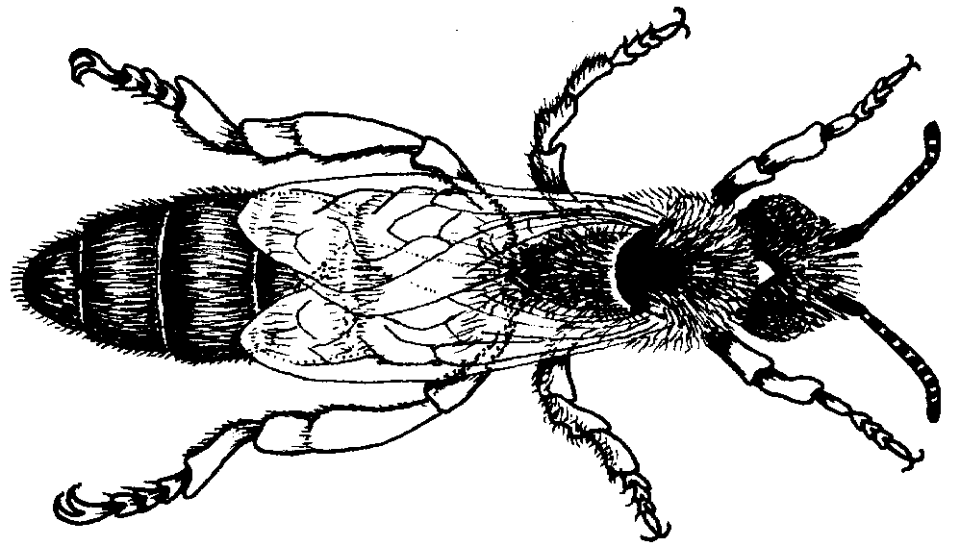
Africanized Honey Bees
Queen:
  Only fertile female in most nests.
  Fed royal jelly.
Workers:
  Non-fertile females.
  Do all of the work of the nest.
Drones:
  Sole task to mate with queen.
  Do not work or sting.

Slide 28
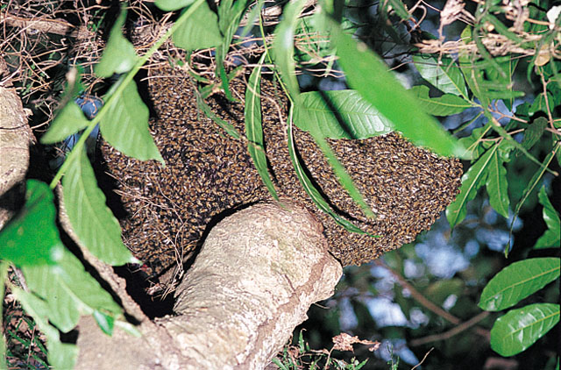
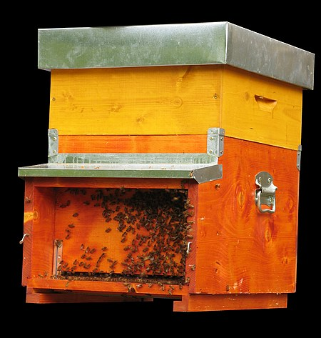
Africanized Honey Bees
Social bees will generally live in a nest.
This is referred to as a hive if the bees are domestic.

Slide 29
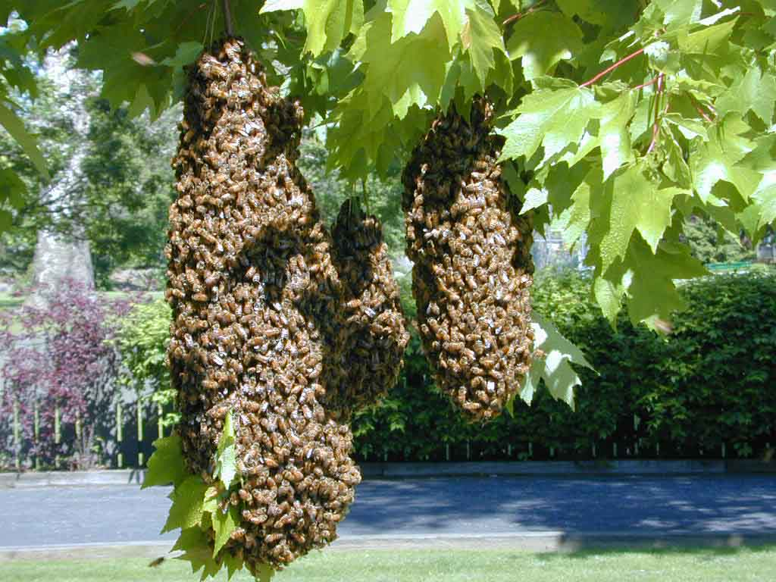
Africanized Honey Bees
Bees will periodically swarm to form a new nest.
New nests can develop if queen bee is present or virgin queen develops.

Slide 30
Africanized Honey Bees
Bees have exoskeleton.
  Made of chitin.
Open circulatory system.
  Hemolymph.
Open respiratory system.
  System of tubes (tracheae).
  Connect to the outside via spiracles.

Slide 31
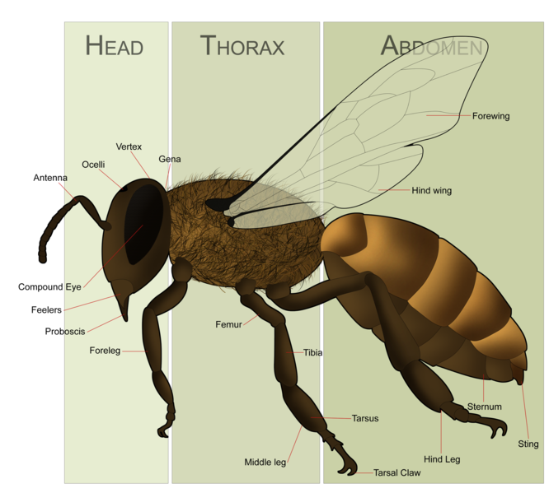
Africanized Honey Bees

Slide 32
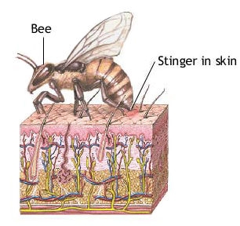
Africanized Honey Bees
Bee venom:
  Histamine
  Pheromones
  Enzymes
  Peptides
  Acids
  Amino Acids

Slide 33
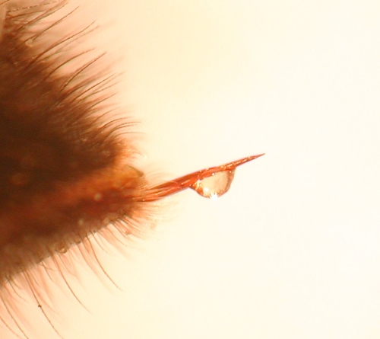
Africanized Honey Bees
Venom is cytotoxic.
LD50:
  19 stings/kg
  8.6 stings/pound
  Highly variable

Slide 34
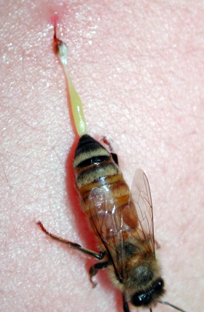
Africanized Honey Bees
Bee dies during sting.
Stinger and venom sac (and attached muscles) remain.
Envenomation continues.

Slide 35
Africanized Honey Bees
Multiple bee stings
may result in an
allergic reaction and envenomation.

Slide 36
Africanized Honey Bees
European honey bees brought to the Americas in 1622 by European colonists.
Experimental cross-breeding of African honey bees and European honey bees was attempted in Sao Paulo in 1956 in an attempt to increase honey production.

Slide 37
Africanized Honey Bees
In 1957, 26 African queen bees and swarms of European honey bees escaped from research facility in Sao Paulo.
Bees subsequently interbred inter-bred forming Africanized honey bee hybrids.

Slide 38
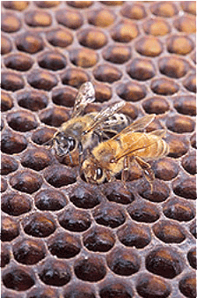
Africanized Honey Bees
Africanized and European honey bees differ.
Hard to distinguish from a distance.
EHB
AHB

Slide 39
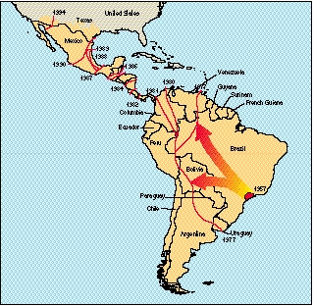
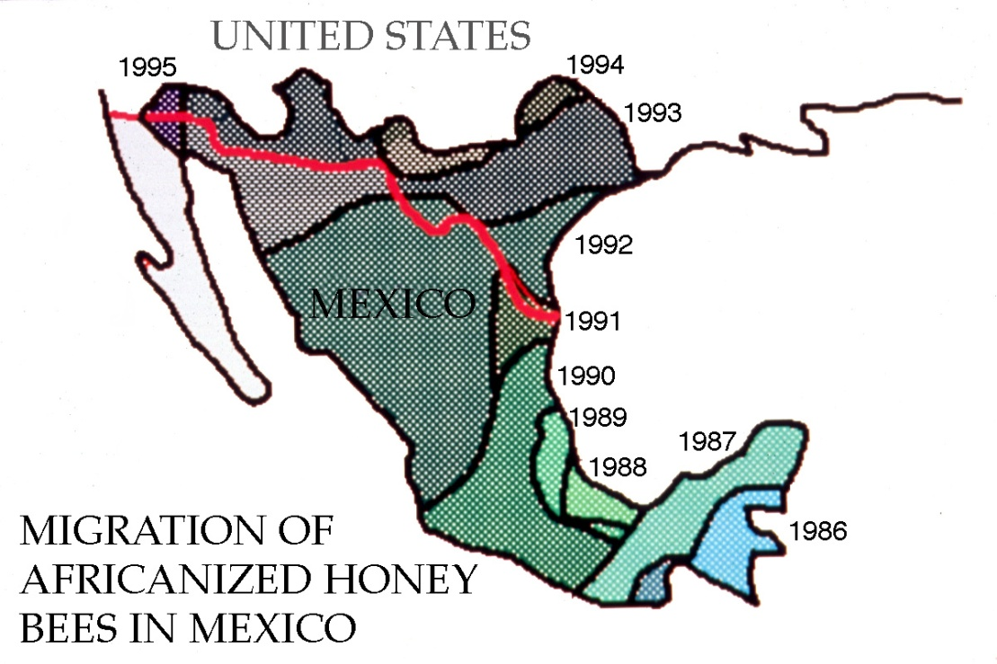
Africanized Honey Bees

Slide 40
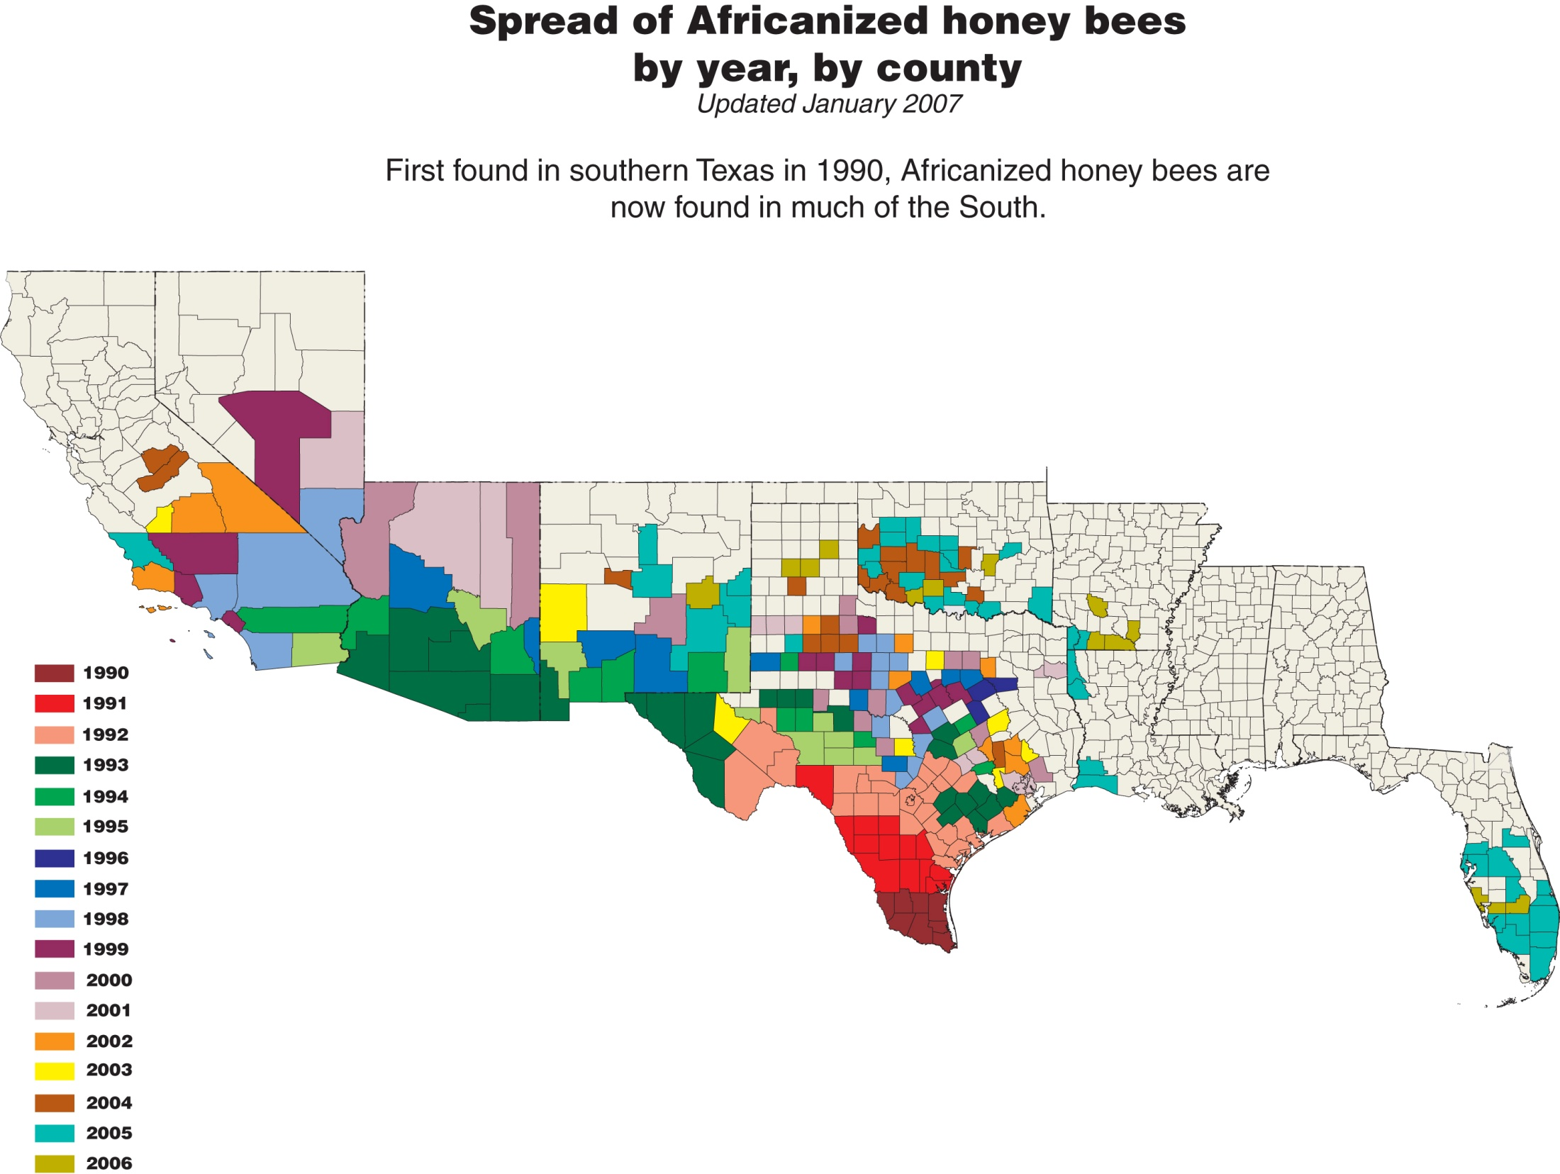

Slide 41
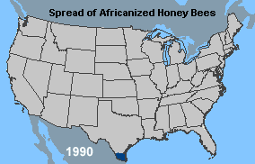
Africanized Honey Bees
AHBs migrating at 100-200 miles per year.
Survived desert conditions.
Now on the Florida peninsula.

Slide 42
Africanized Honey Bees
AHB Characteristics:
  Swarm more frequently.
  Greater defensiveness when in a resting swarm.
  Is more likely to migrate (as food supplies fall).
  Is more likely to leave a hive and relocate.
  Lives more often in ground cavities compared to Western honey bees.

Slide 43
Africanized Honey Bees
AHB Characteristics:
  Guards the hive aggressively.
  Larger defense zone around the hive.
  Higher proportion of “guard bees” within the hive.
  Deploys in greater numbers for defense.
  Will pursue for greater distances.
  Cannot survive extended periods of forage deprivation.

Slide 44
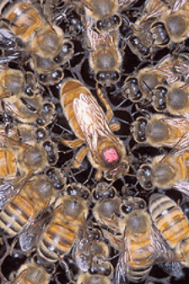
Africanized Honey Bees
AHB venom no more potent that WHB venom.
AHBs sting in much greater numbers and with less provocation.

Slide 45
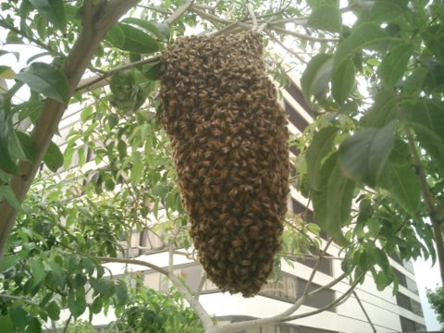
Africanized Honey Bees
AHB Nests:
  Poles
  Holes in trees.
  Shrubs.
  Bird houses.
  Abandoned vehicles.
  Sheds

Slide 46

Africanized Honey Bees
AHB Provocation:
  Engine vibrations
  Exhaust gasses
  Intrusion into defended space
  Direct threat to the nest
  Loud noises

Slide 47

Africanized Honey Bees
AHBs don’t’ like:
  Dark clothing
  Black wooly objects
  Panty hose
  Aromatic substances:
    Cologne
    Perfume
    Hairspray

Slide 48
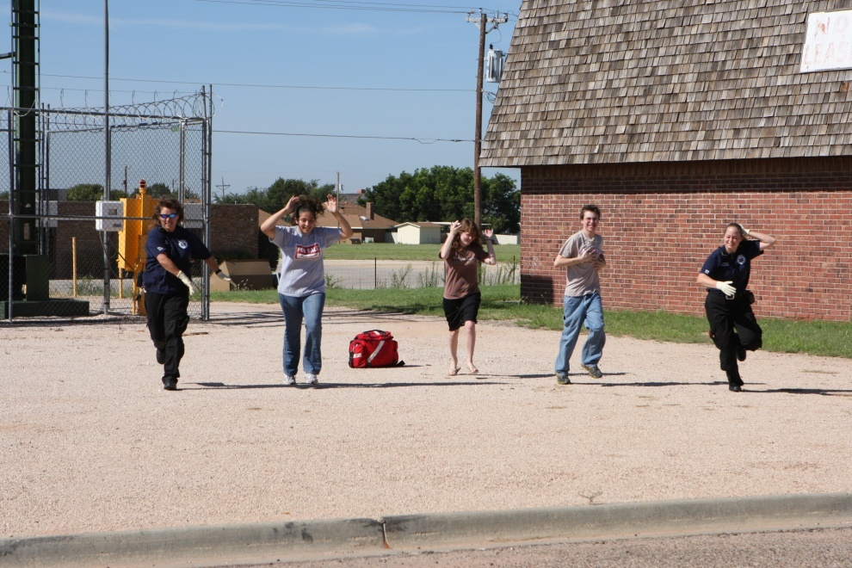
Africanized Honey Bees
AHB Response:
  High-risk situation.
  Bees do not discriminate in who they will attack.
  May follow victim for ¼ mile.

Slide 49
Africanized Honey Bees
Pre-Response Planning:
  Each agency must have an AHB response plan!
  Identify local beekeepers, entomologists, and exterminators familiar with AHBs.
  Develop a “DO NO DEPLOY” list of personnel with bee or insect allergies who should NOT respond to a bee attack even if on duty.

Slide 50
Africanized Honey Bees
DO NOT DEPLOY
Name | Address | Work Number | Cell Phone | Home Phone | Pager

Slide 51
Africanized Honey Bees
LOCAL EXTERMINATORS & BEEKEEPERS
Name | Address | Work Number | Cell Phone | Home Phone | Pager

Slide 52
Africanized Honey Bees
Dispatch Information:
  Caller Name
  Call Back Number
  Location and Cross Street
  Number of People Stung
  Victim Location
  Bee Source
  High Risk Area (e.g., school, day care, nursing home, shopping center, etc).

Slide 54
Africanized Honey Bees
Pre-determine apparatus response:
  Apparatus type
  Capabilities
  Personnel
Areas where AHBs are endemic should consider developing an AHB response cache.

Slide 55
Africanized Honey Bees
AHB Response Cache:
  Sting Shield Insect Veils or beekeepers veils.
  Duct tape (to close openings in bunker gear).
  Medication supplies:
    EpiPens or epinephrine 1:1,000 vials
    Diphenhydramine (oral and parenteral)
    Steroids
    Nebulizer medications

Slide 56
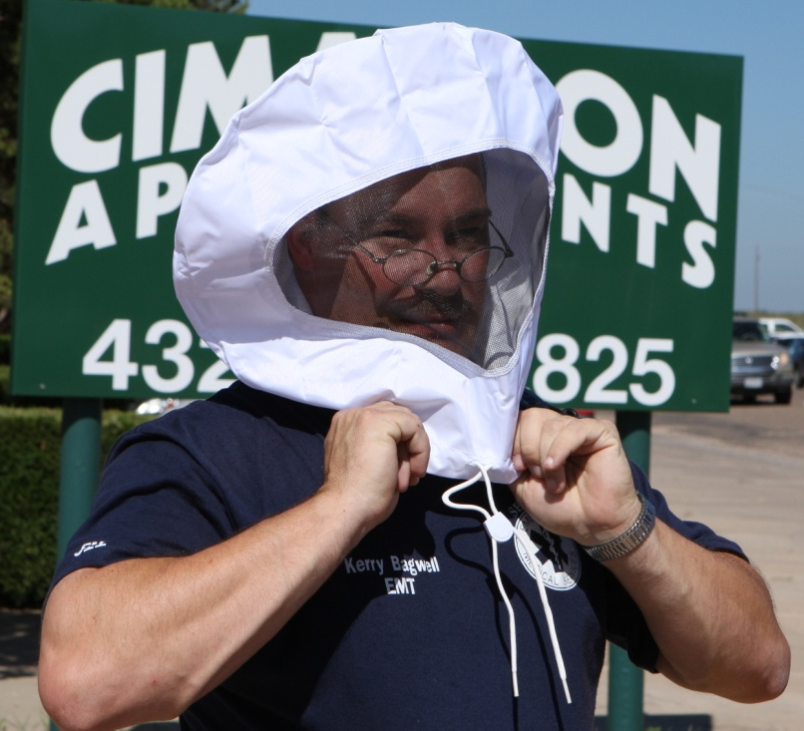
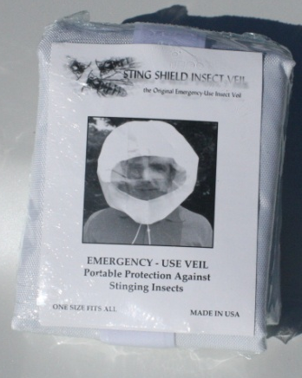
Africanized Honey Bees
  Sting Shield Insect Veils or beekeepers veils.
Firefighting helmets do not provide protection against AHBs and should not be used.

Slide 57
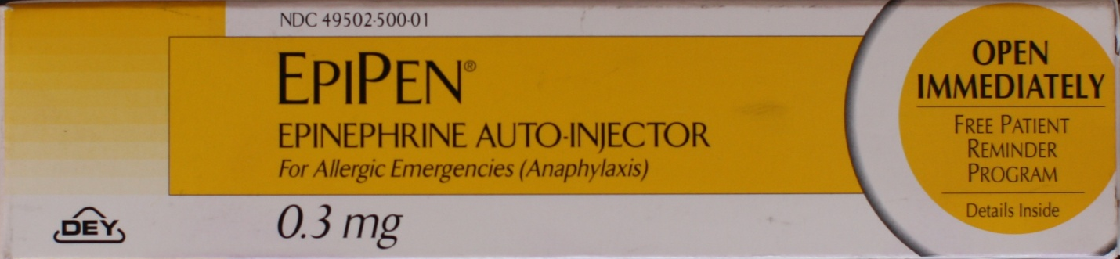
Africanized Honey Bees
EpiPens should be readily available.

Slide 58
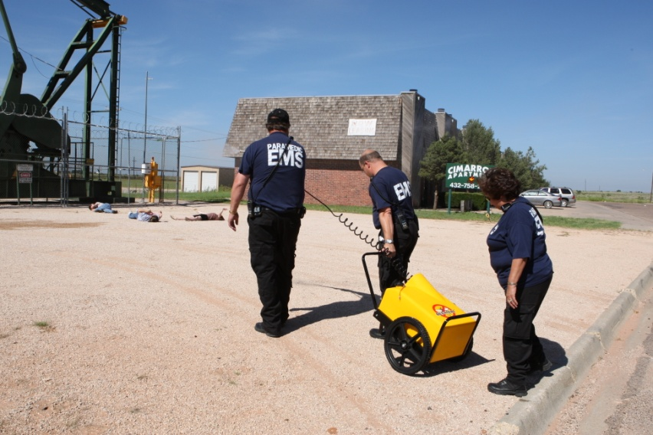
Africanized Honey Bees
The BeeAlert™ provides adequate protection from AHBs without protective equipment.
Always follow local protocols in regard to protective equipment.

Slide 59
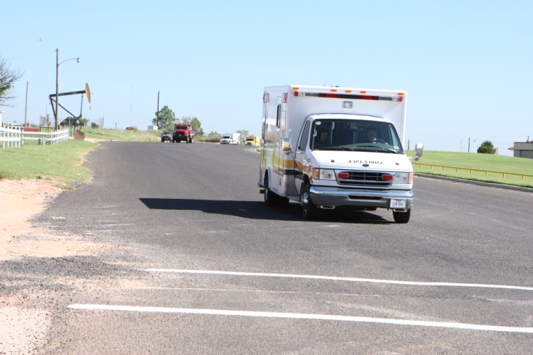
Africanized Honey Bees
Emergency Response:
  Note wind speed and direction.
  Evaluate scene from a safe distance.
  Stage at least 200 yards from the nest.

Slide 60

Africanized Honey Bees
Try and determine the number of victims and assure scene safety before the final approach.

Slide 61
Africanized Honey Bees
Determine whether the response is a rescue situation or simply the presence of an AHB hive.
Rescue situation:
  Stage appropriately
  Summon needed resources
Non-Rescue situation:
  Follow department policy on eradication.

Slide 62
Africanized Honey Bees
Do not attempt a rescue or get within 200 yards of the bees without protective gear or the BeeAlert System.

Slide 63
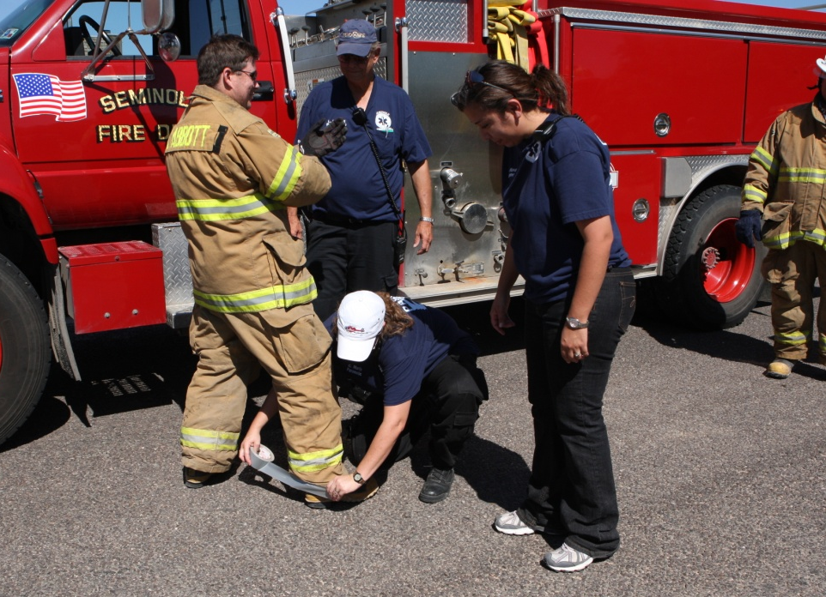
Africanized Honey Bees
Use proper protective equipment.
Be sure to secure all openings to bunker gear with duct tape.
SCBAs not required.

Slide 64
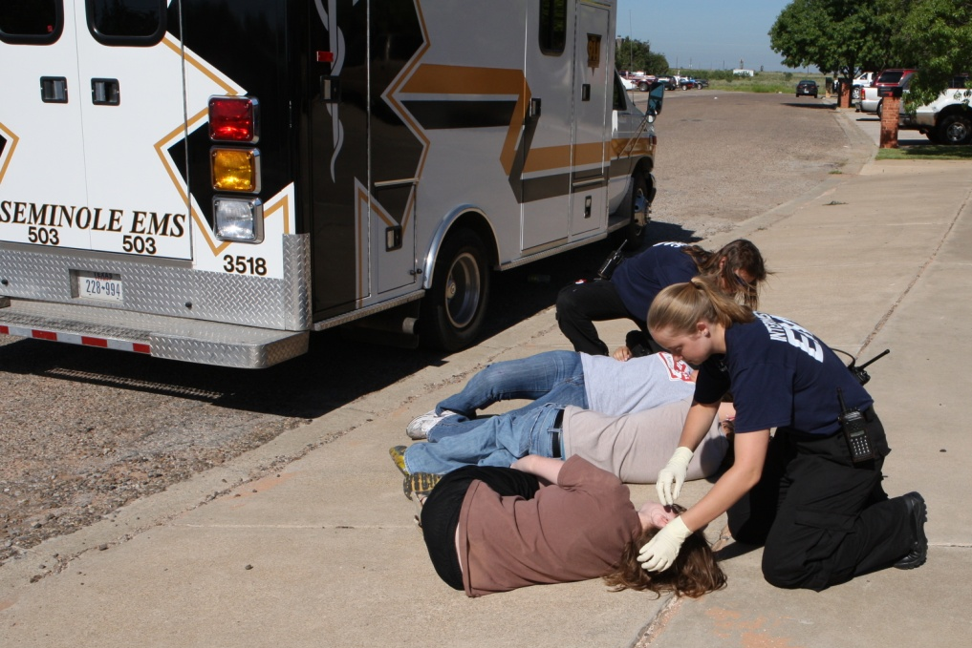
Africanized Honey Bees
If several patients are present, designate a staging area a safe distance from the nest.

Slide 65
Africanized Honey Bees
Response Options for Rescue:
  Fire department present:
    Water
    Foam
    BeeAlert
  Fire department not present:
    BeeAlert
    Full beekeeper’s protective gear
    Approach in closed vehicle and call the victim toward the vehicle.

Slide 66
Africanized Honey Bees
Water:
  Water fog can be used to knock down bees temporarily to effect a rescue.
  Least effective form of protection.
  Rescuers and firefighters must wear full protection as previously detailed.
  Quick attack 1 ½” or 1 ¾” hose line set to widest fog pattern.
  Approach using the classic “O” pattern.

Slide 67
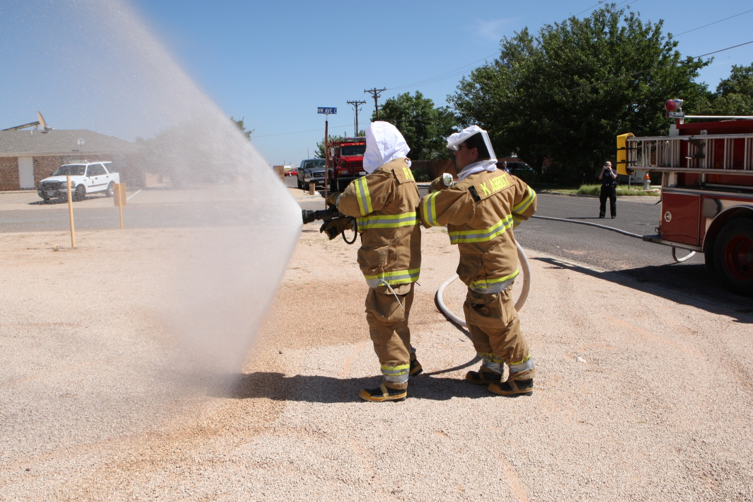
Africanized Honey Bees

Slide 68
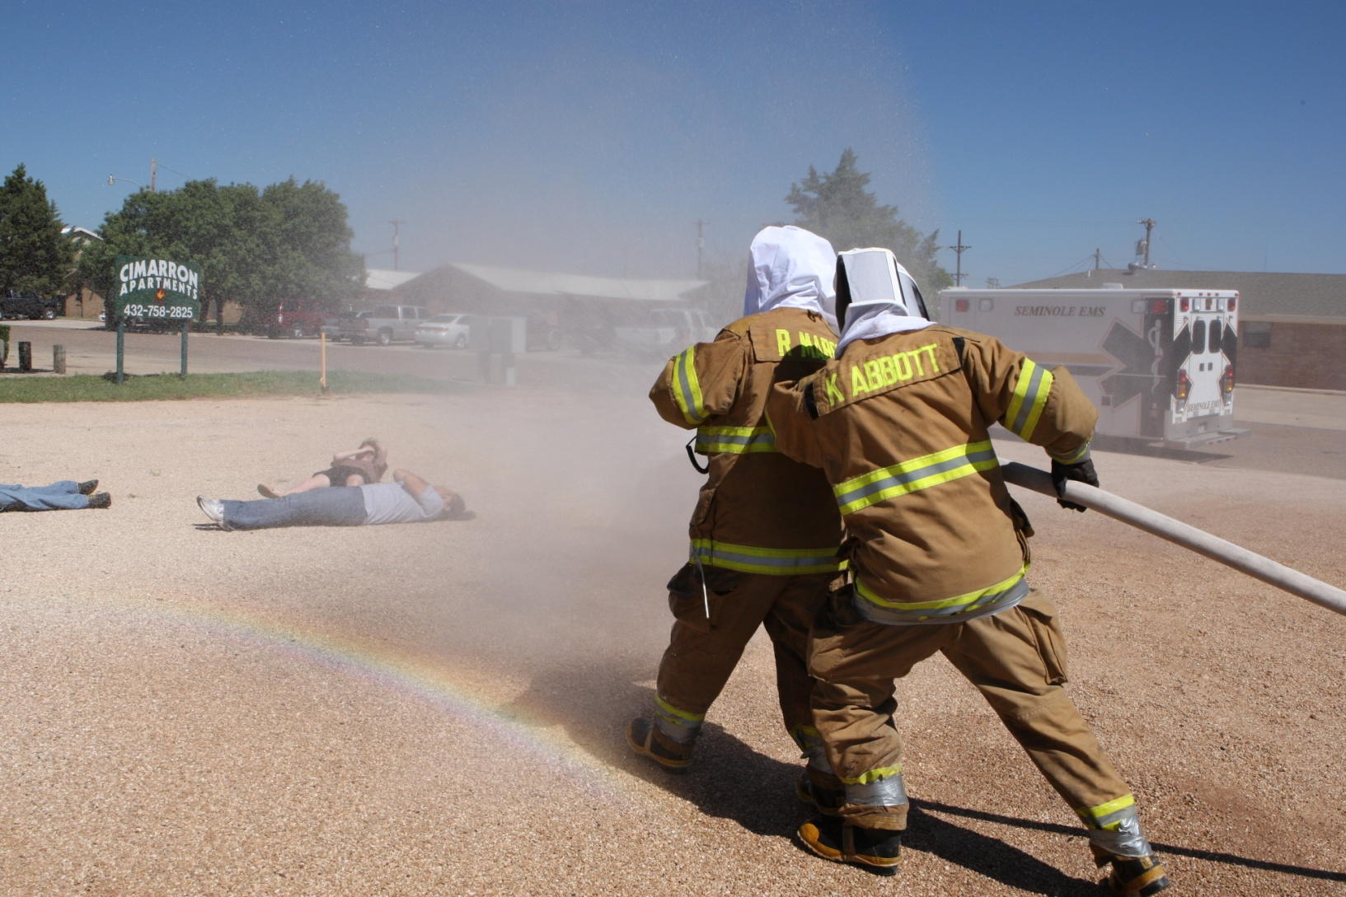
Africanized Honey Bees

Slide 69
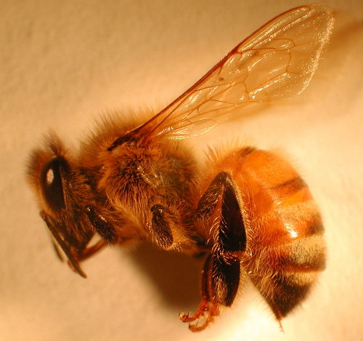
Africanized Honey Bees
Problems with water:
  Surface tension of water prevents water from penetrating hairs on bees which protect the spiracles on the bee.

Slide 70
Africanized Honey Bees
Foam:
  Firefighting foam can be used.
  Foam and soap are wetting agents which decrease water surface tension allowing water to penetrate spiracles.
  Aqueous film-forming foam (AFFF) or compressed air foam systems (CAFS) can be used.
  Foam obscures scene.

Slide 71
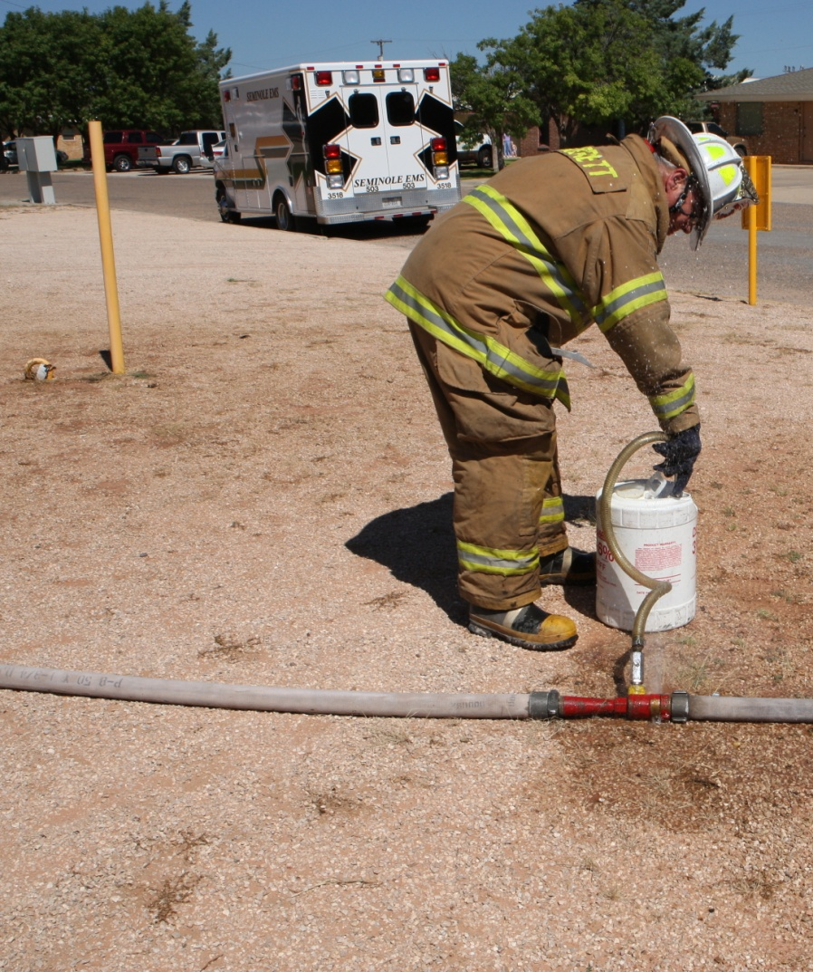
Africanized Honey Bees
Prepare AFFF.

Slide 72

Africanized Honey Bees

Slide 73

Africanized Honey Bees

Slide 74

Africanized Honey Bees

Slide 75
Africanized Honey Bees
Other wetting agents can be used:
  Dishwashing liquid.
  Baby shampoo.

Slide 76

Africanized Honey Bees
Rescue Tactics without Fire Department:
  BeeAlert system
  Full beekeepers protection.

Slide 77
Africanized Honey Bees
If nothing available:
  Call victim over PA and tell them to run toward your voice.
  Close windows and approach patient. Verbally direct them to enter vehicle.

Slide 78

Africanized Honey Bees
Full beekeepers garb can be effective if properly worn,

Slide 79

Africanized Honey Bees
BeeAlert™ system.
Provides protective fog to approach and rescue victims.
Found to be highly effective in tests by entomologists at Texas A&M University.

Slide 80

Africanized Honey Bees
BeeAlert uses proprietary surfactant to knock down and suffocate bees.
Found to work faster than typical surfactants (soaps).
Chemical-free and environmentally-safe.

Slide 81



Africanized Honey Bees
Provided as:
  Tractor-based system.
  Portable system.
  Spray cans.

Slide 82

Africanized Honey Bees
System provides a protective fog for ingress, rescue and egress.

Slide 83

Africanized Honey Bees
Texas A&M Field Tests:
  Nest strength of AHBs estimated at 20,000-30,000.
  Unprotected drive approached hive on tractor and remained in danger zone for 4 minutes, 21 seconds.
  Only 4 stings.

Slide 84

Africanized Honey Bees
BeeAlert can be sprayed directly on victims to remove and kill bees.

Slide 85
Africanized Honey Bees
BeeAlert response:
  Activate fog 50 feet or more from nest.
  Sweep nozzle to provide protective for all rescuers.
  Expand fog to cover victims.
  Remove victims using fog to protect rescuers and victims.

Slide 86

Africanized Honey Bees

Slide 87

Africanized Honey Bees

Slide 88

Africanized Honey Bees

Slide 89

Africanized Honey Bees

Slide 90

Africanized Honey Bees
Nest Extermination:
  Local entomologist.
  Flood with water or foam.
  BeeAlert.

Slide 91
Africanized Honey Bees
Bee Stings:
  Limited number of stings and no evidence of systemic reaction.
  Large number of stings and no evidence of systemic reaction.
  Limited number of stings with mild systemic symptoms.
  Evidence of bee stings with severe symptoms (anaphylaxis).

Slide 92
Africanized Honey Bees
  Limited number of stings and no evidence of systemic reaction:
    Note number of stings.
    Remove any stingers/venom sacs.
    Always assess ABCs.
    Monitor for systemic reaction.
    Analgesics (acetaminophen, ibuprofen).
    Drying solutions:
      Calamine
      Ban-Aid Anti-Itch Gel

Slide 93
Africanized Honey Bees
  Large number of stings and no evidence of systemic reaction:
  Note number of stings.
    Remove any stingers/venom sacs.
    Always assess ABCs.
    Monitor for systemic reaction.
    Expose patient.
    Consider prophylactic diphenhydramine (Benadryl) 25-50 mg IM or 50-100 mg PO.
    Transport

Slide 94
Africanized Honey Bees
  Limited number of stings with mild systemic symptoms:
    Remove any stingers/venom sacs.
    Always assess ABCs.
    Monitor for systemic reaction.
    Expose patient.
    Epinephrine 1:1,000 0.3-0.5 mg IM or SQ.
    Diphenhydramine (Benadryl) 25-50 mg IM.
    Consider corticosteroids.
    Transport.

Slide 95
Africanized Honey Bees
  Evidence of bee stings with severe symptoms (anaphylaxis):
    ABCs
    100% oxygen.
    Remove stingers/venom sacs.
    Obtain IV/IO access.
    For true anaphylaxis:
      Epinephrine 1:10,000 0.1 mg IV/IO.
      Consider epinephrine drip (1-4 mcg/minute)
      1-2 liters N or LR.
      Diphenhydramine 25-50 mg IV/IO/IM.

Slide 98
Africanized Homey Bees
Summary:
  AHBs are a major biological risk for EMS and fire personnel.
  Each system should have an AHB response plan.
  Personnel with bee allergies should not deploy.
  Complications from bee stings, especially anaphylaxis, must be treated aggressively.

Slide 99
Africanized Homey Bees
Sting Shield Insect Veils for photo shoot provided by Sting Shield, Inc.
http://www.stingshield.com/
Thanks to the men and women of
Seminole (TX) EMS and Seminole (TX) Fire Department
for restaging the AHB attack of June 2007.

Slide 100
Credits
This is a product of Cielo Azul Publishing.

