Slide 1
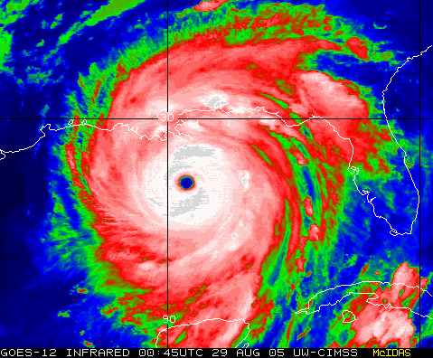
Austere EMS Standards of Care:
Principles and Practice
tactical
disaster
wilderness
Keith Conover, M.D., FACEP
conovers.org/ftp

Slide 2
Bike Accident

Slide 3
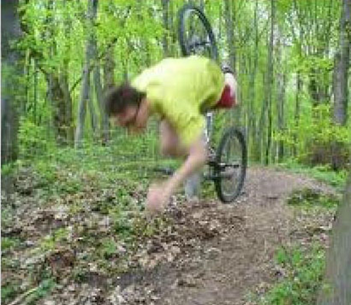
Notes:
You get a call for a 20 year old man involved in an accident while on his mountain bike. He has multiple abrasions and contusions, but his main complaints are of pain in the neck and upper abdomen.

Slide 4
“Street” Standard of Care?

Slide 5
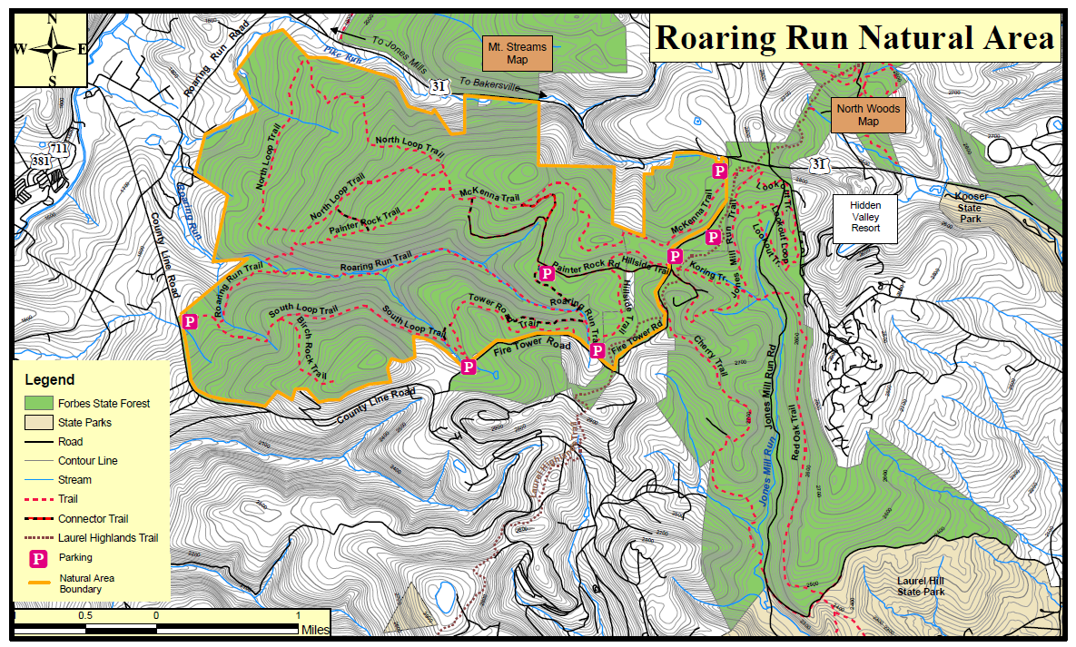
Notes:
His friend, who was riding with him, called for 911 for help using his cellphone. “We were riding across the road from Seven Springs. He flipped his bike and now his neck and belly hurt.”

Slide 6
Notes:
He says it’s just a short way off the road, about a two-mile bike/walk.

Slide 7
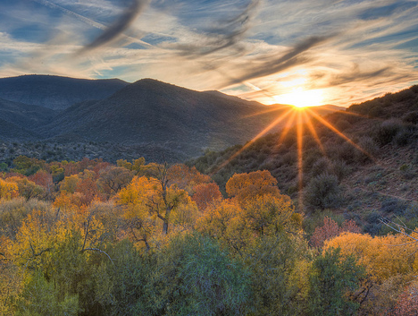
Notes:
It is early spring (or late fall depending on when I give the talk!) The days short. By the time your unit gets to the trailhead, the sun is starting to set.

Slide 8
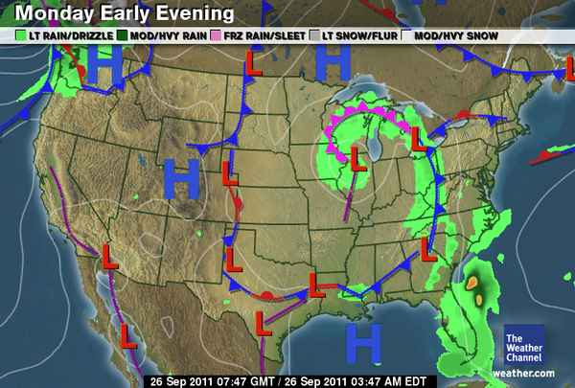

Notes:
The temperature has been in the 60’s during the day, but this is the weather map. A cold front is coming through.

Slide 9
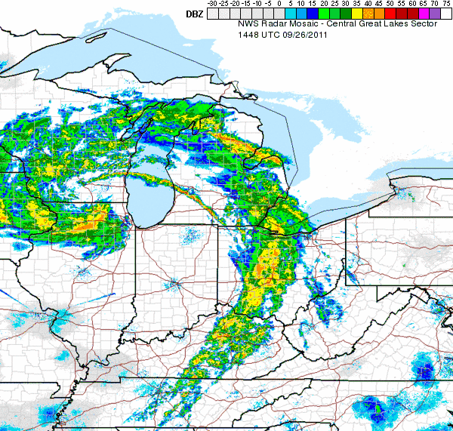
Notes:
Red stars indication the location

Slide 10
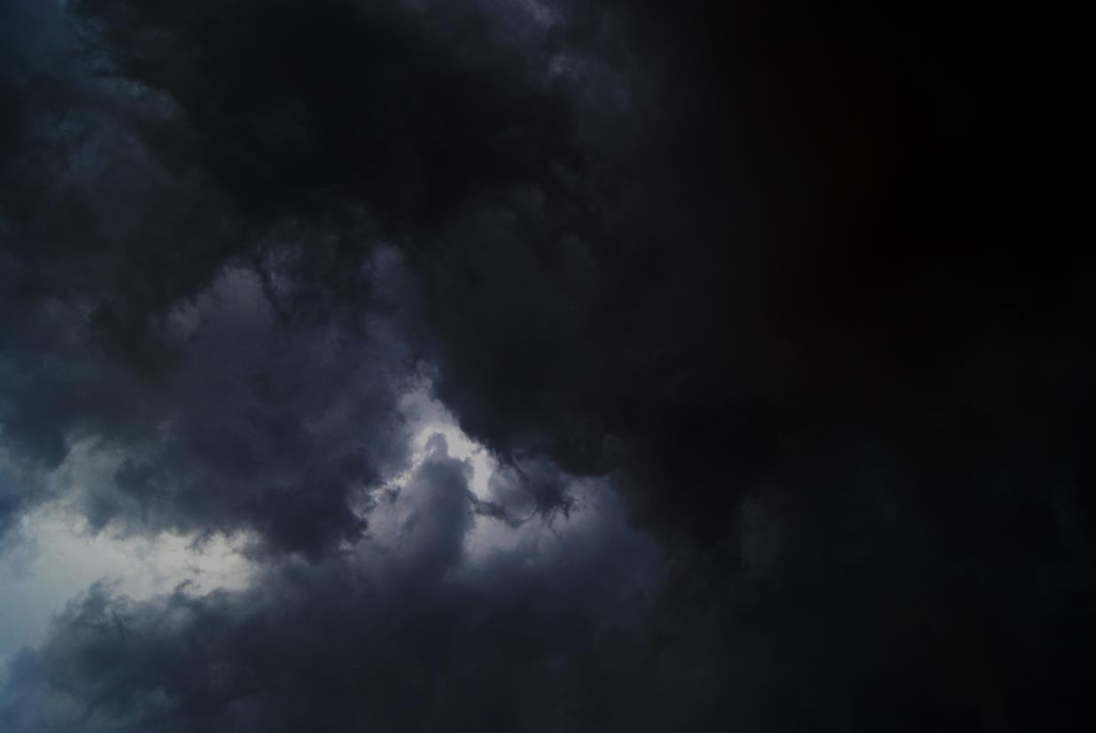
Notes:
Black clouds are moving in from the west, and the wind is picking up.

Slide 11
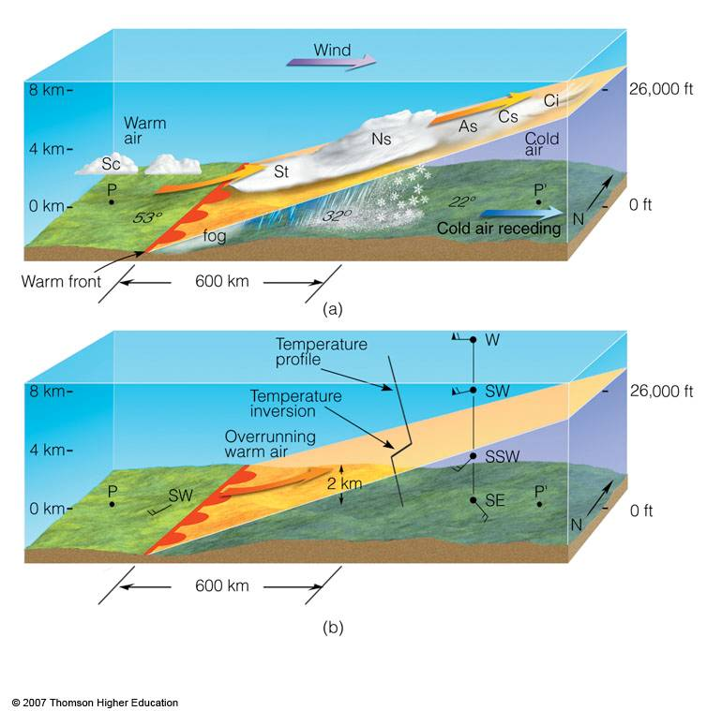
Notes:
What’s the difference between a warm front and a cold front? Warm air rises, overrides the colder air. Gradually lowering clouds, drizzle, rain, not much wind.

Slide 12
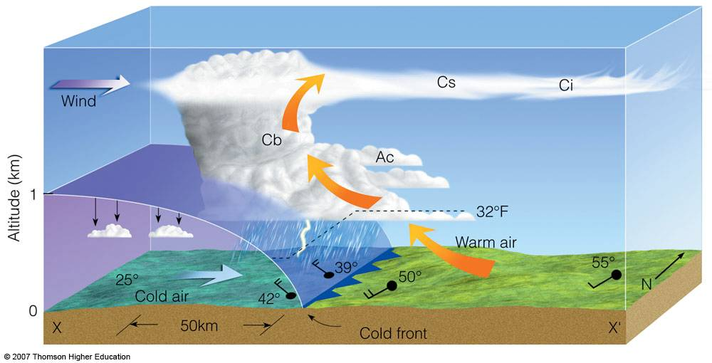
Notes:
Cold front: cold air pushes warm air up, which causes clouds and precipitation. Compared to a warm front, cold fronts hit suddenly with high winds, falling temperatures, and heavy precipitation. There’s more to weather than this; you need to know about low-pressure and high-pressure areas, but that’s left as an exercise to the reader.

Slide 13
Notes:
So what’s you’re weather prediction for tonight?

Slide 14
Notes:
So now, given the weather and the terrain, do we need to modify “street” care?

Slide 15
Austere EMS Standards of Care:
Principles and Practice
tactical
disaster
wilderness
Keith Conover, M.D., FACEP
Notes:
Disaster, Wilderness and Tactical share a number of commonalities:

Slide 16
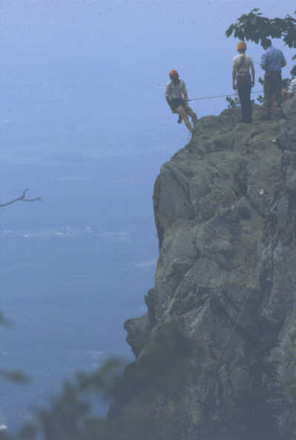
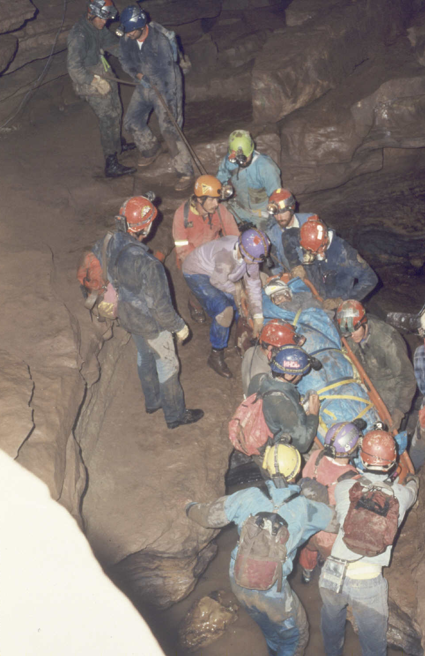
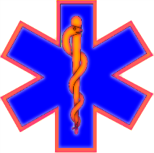
Time
Distance
Equipment
Terrain
Weather
Notes:
Similarities between disaster and wilderness EMS:

Slide 17
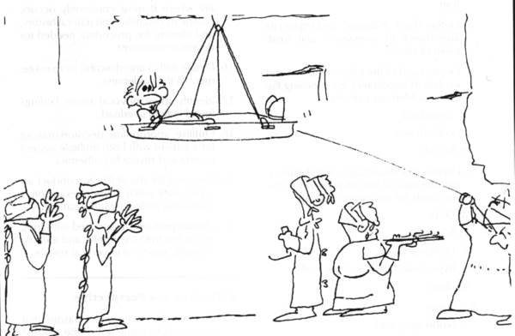
Notes:
EMS: taking the hospital to the patient. Austere EMS: taking the hospital ALL THE WAY to the patient.

Slide 18
Objectives - conovers.org/ftp
Discuss how the following austere contexts affect the standard of care: time, distance, equipment, terrain, and weather.
Discuss how to make the decision whether to follow a “street” or an “austere” standard of care, including consideration of: the specific medical or surgical condition, the natural history of the condition, and the context .
Discuss the regulatory, legal, ethical and moral aspects of deviating from “street” standards of care.
Address the “doctrine of necessity” and the potential conflict between context-dependent standards of care and “street” EMS protocols.

Slide 19
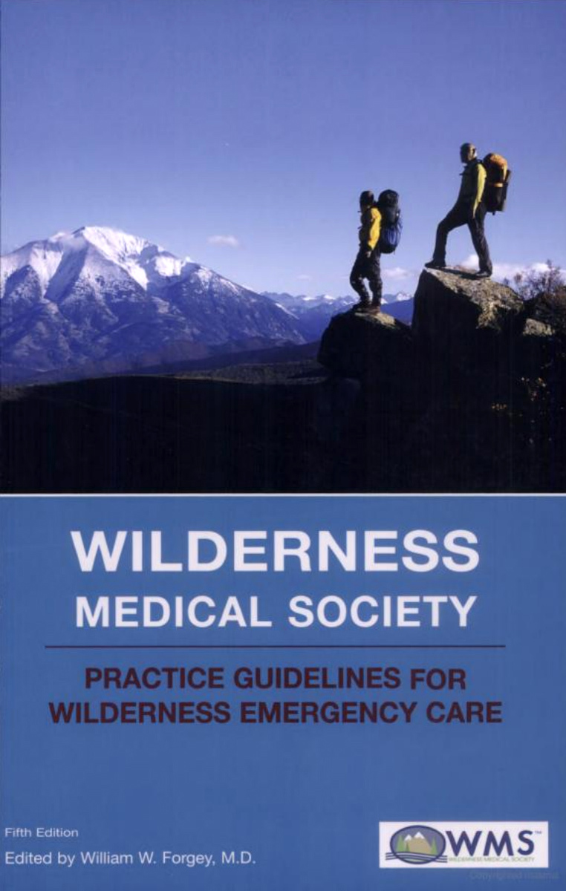
Different Standards of Care
Wilderness Medical Society
Practice Guidelines
for Wilderness Emergency Care
also applies to disasters, tactical

Slide 20
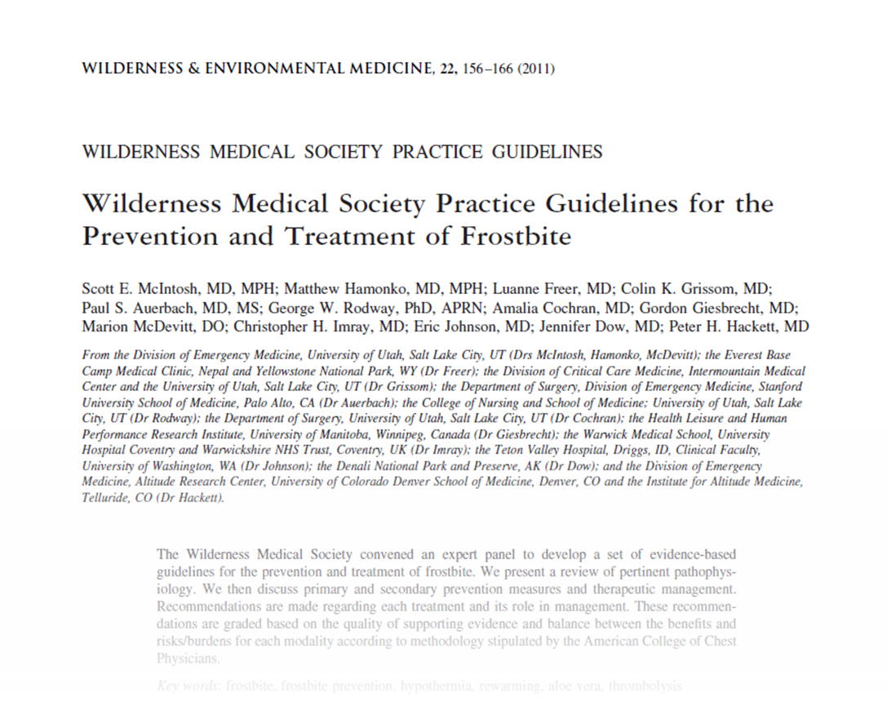
Notes:
Standard of care also updated by consensus documents published in Wilderness & Environmental Medicine, such as this one.

Slide 22
ED-ED Interhospital Transfer

Slide 23
Stable Cervical Spine Fx

Slide 24
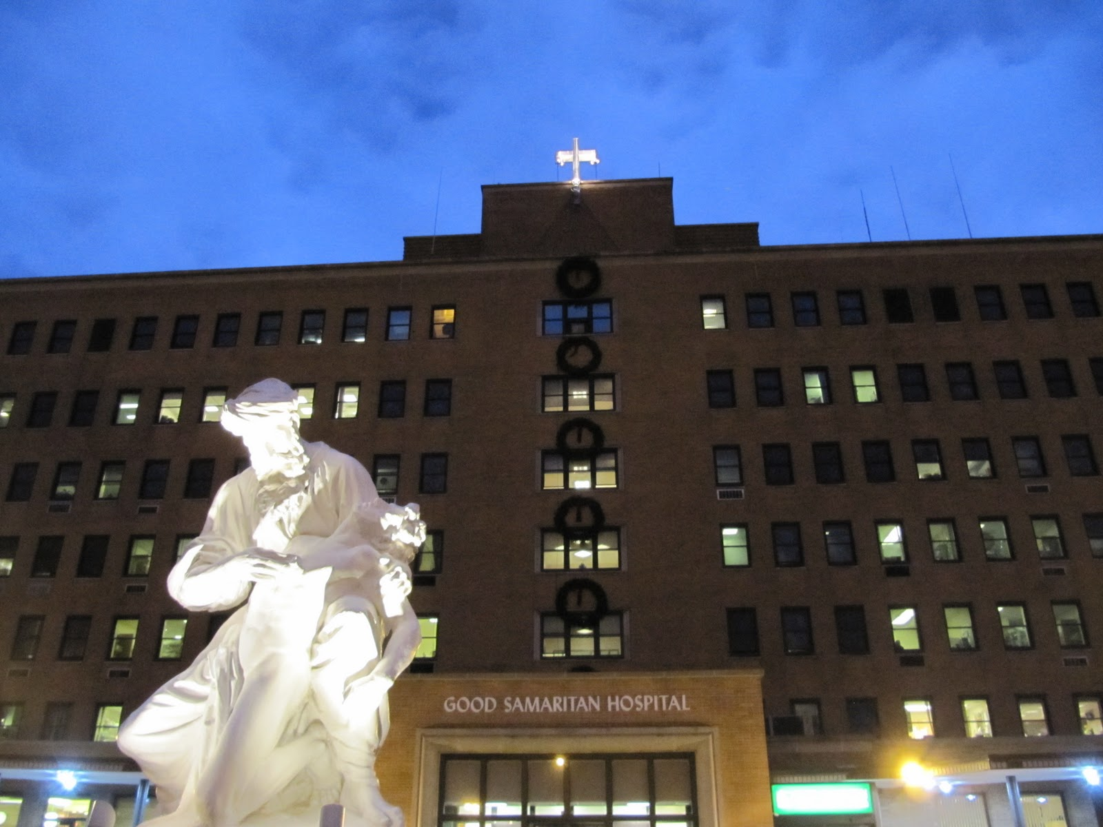
Notes:
Transfer from Good Sam Hospital on Lon-gIsland to Yale New Haven Medical Center

Slide 25
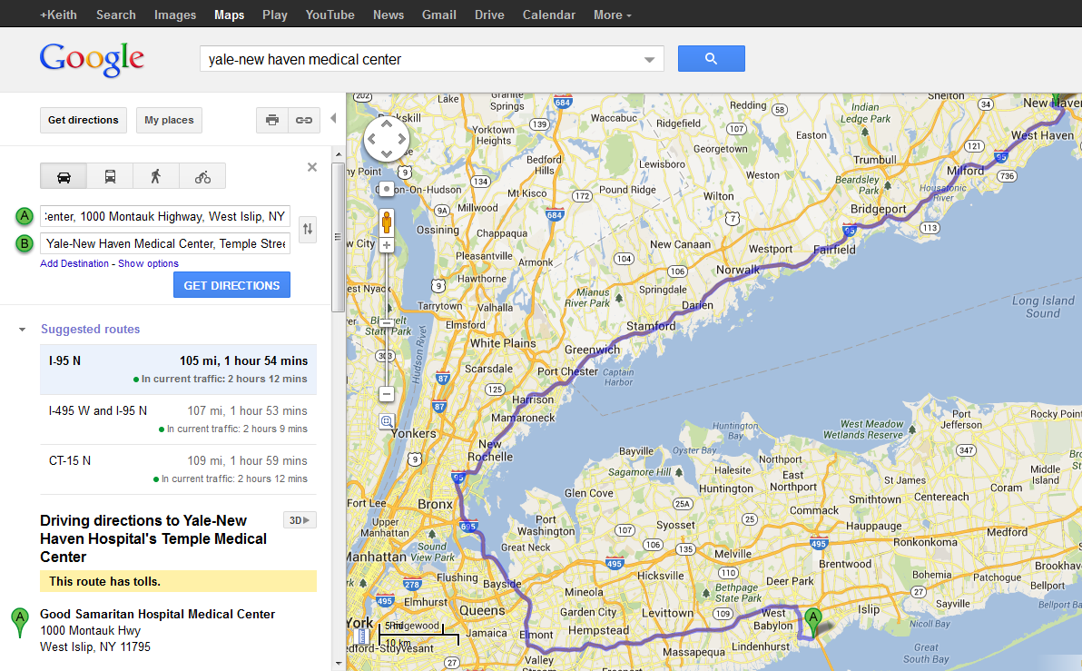
Notes:
2-hour drive. Any thoughts about need to deviate from “street” protocols? 2 hours on a backboard?

Slide 26
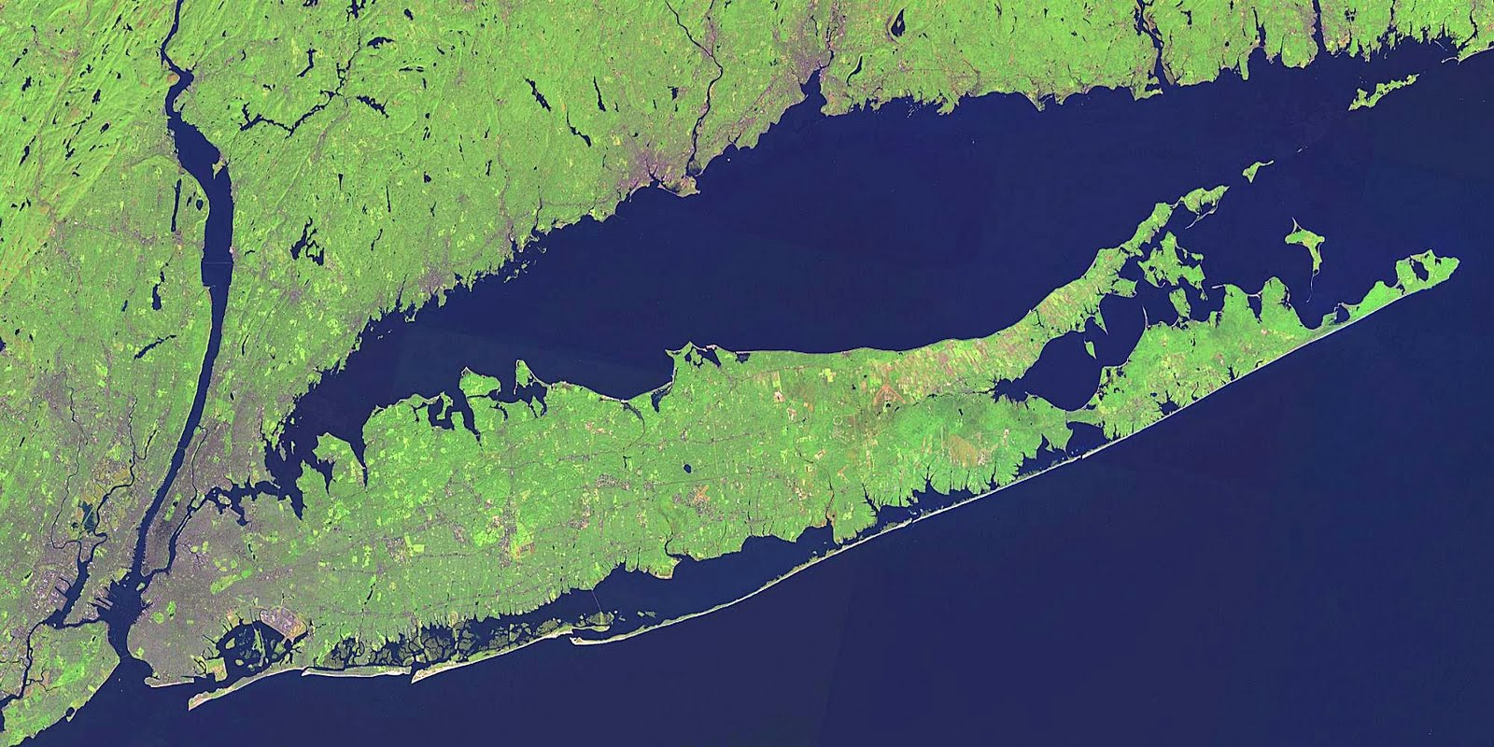
Notes:
Sept 22, 2015
Last night, a Cat 5 hurricane hit Long Island.

Slide 27
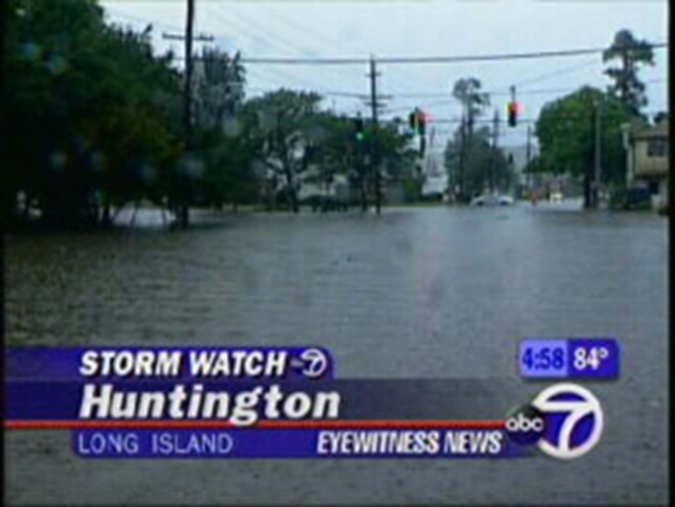
Notes:
Long Island is cut off from the mainland. All bridges are out. All airports are damaged and closed. It is too windy for helicopters but it may clear soon. Landline telephones are all cut off. Cellphone coverage is very spotty, mostly not available.

Slide 28
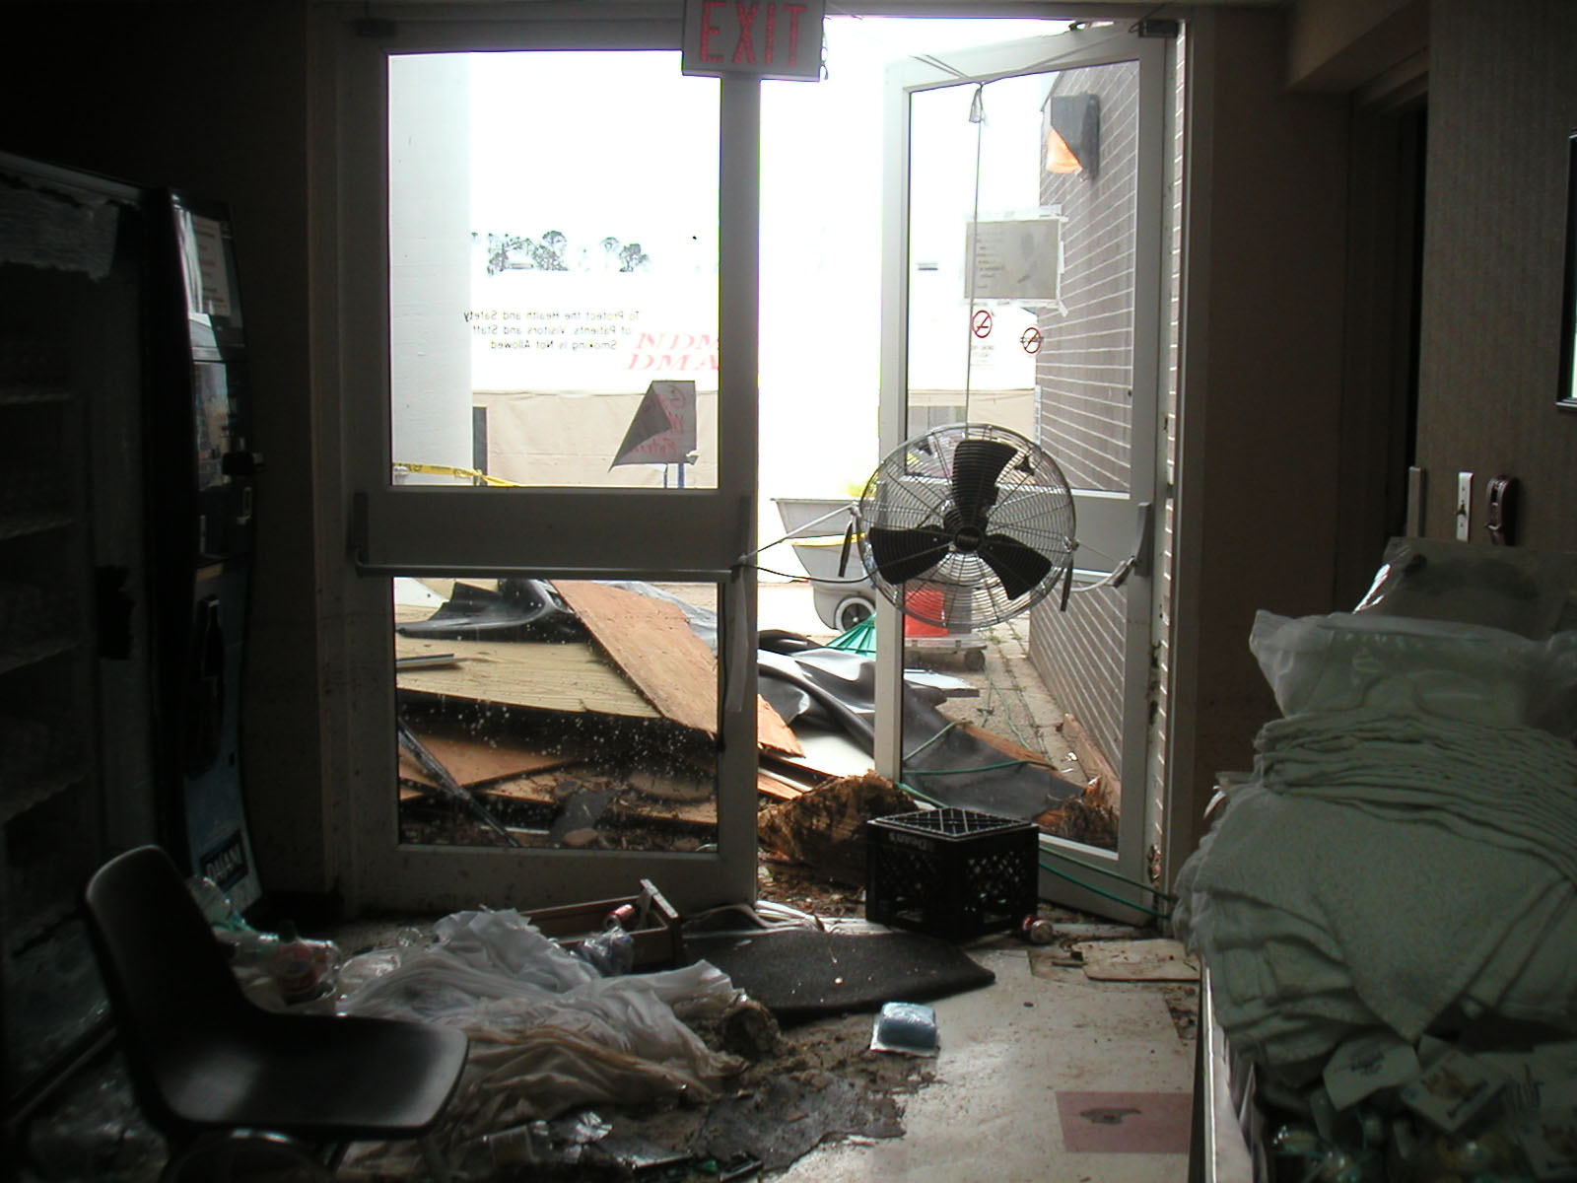
Notes:
This is the employee entrance to the ED.

Slide 29
Notes:
This is a house across the street

Slide 30
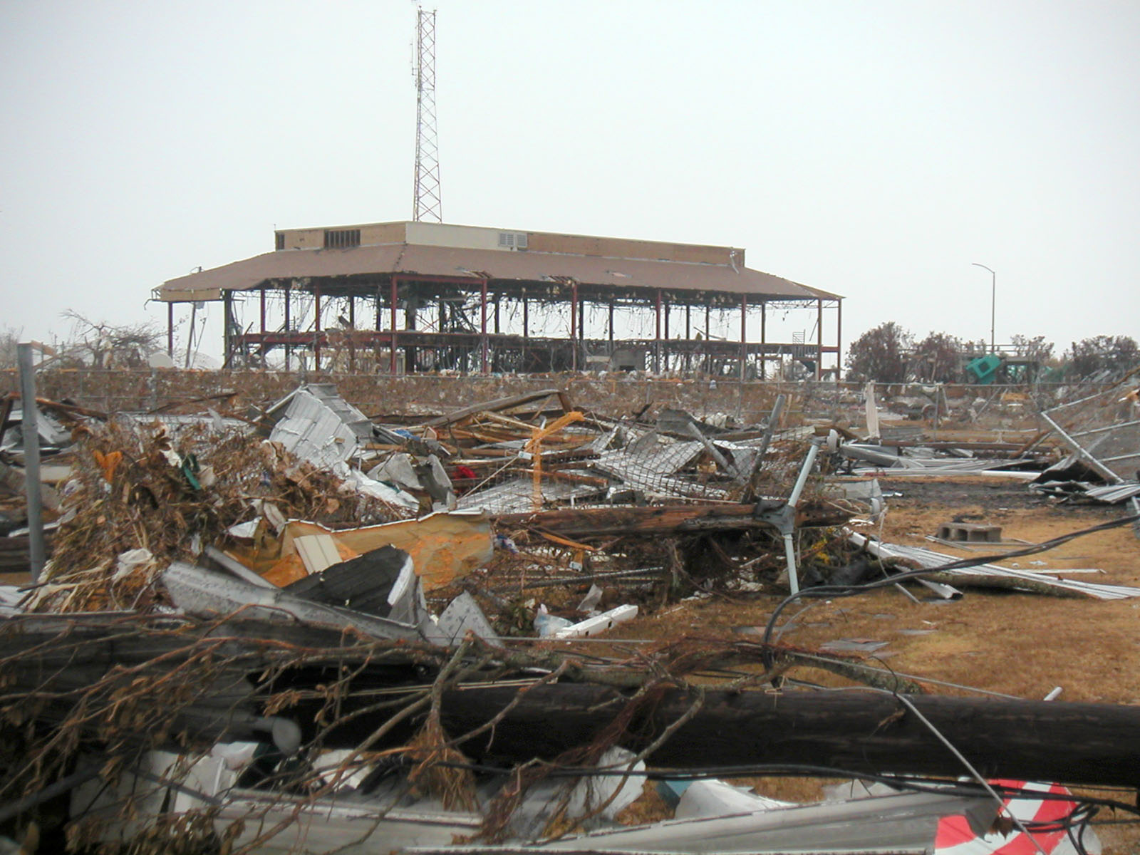
Notes:
This is a structure near the hospital where some employees are sleeping to stay dry from the rain.

Slide 31
Notes:
There is only one bridge open to the mainland. Only one lane is open. Estimates are that it will take 6-8 hours just to get to the bridge. What about backboards now? What about food and water? Are you going to starve and dehydrate your patient? Why do we not give food and water to “street” patients?

Slide 32
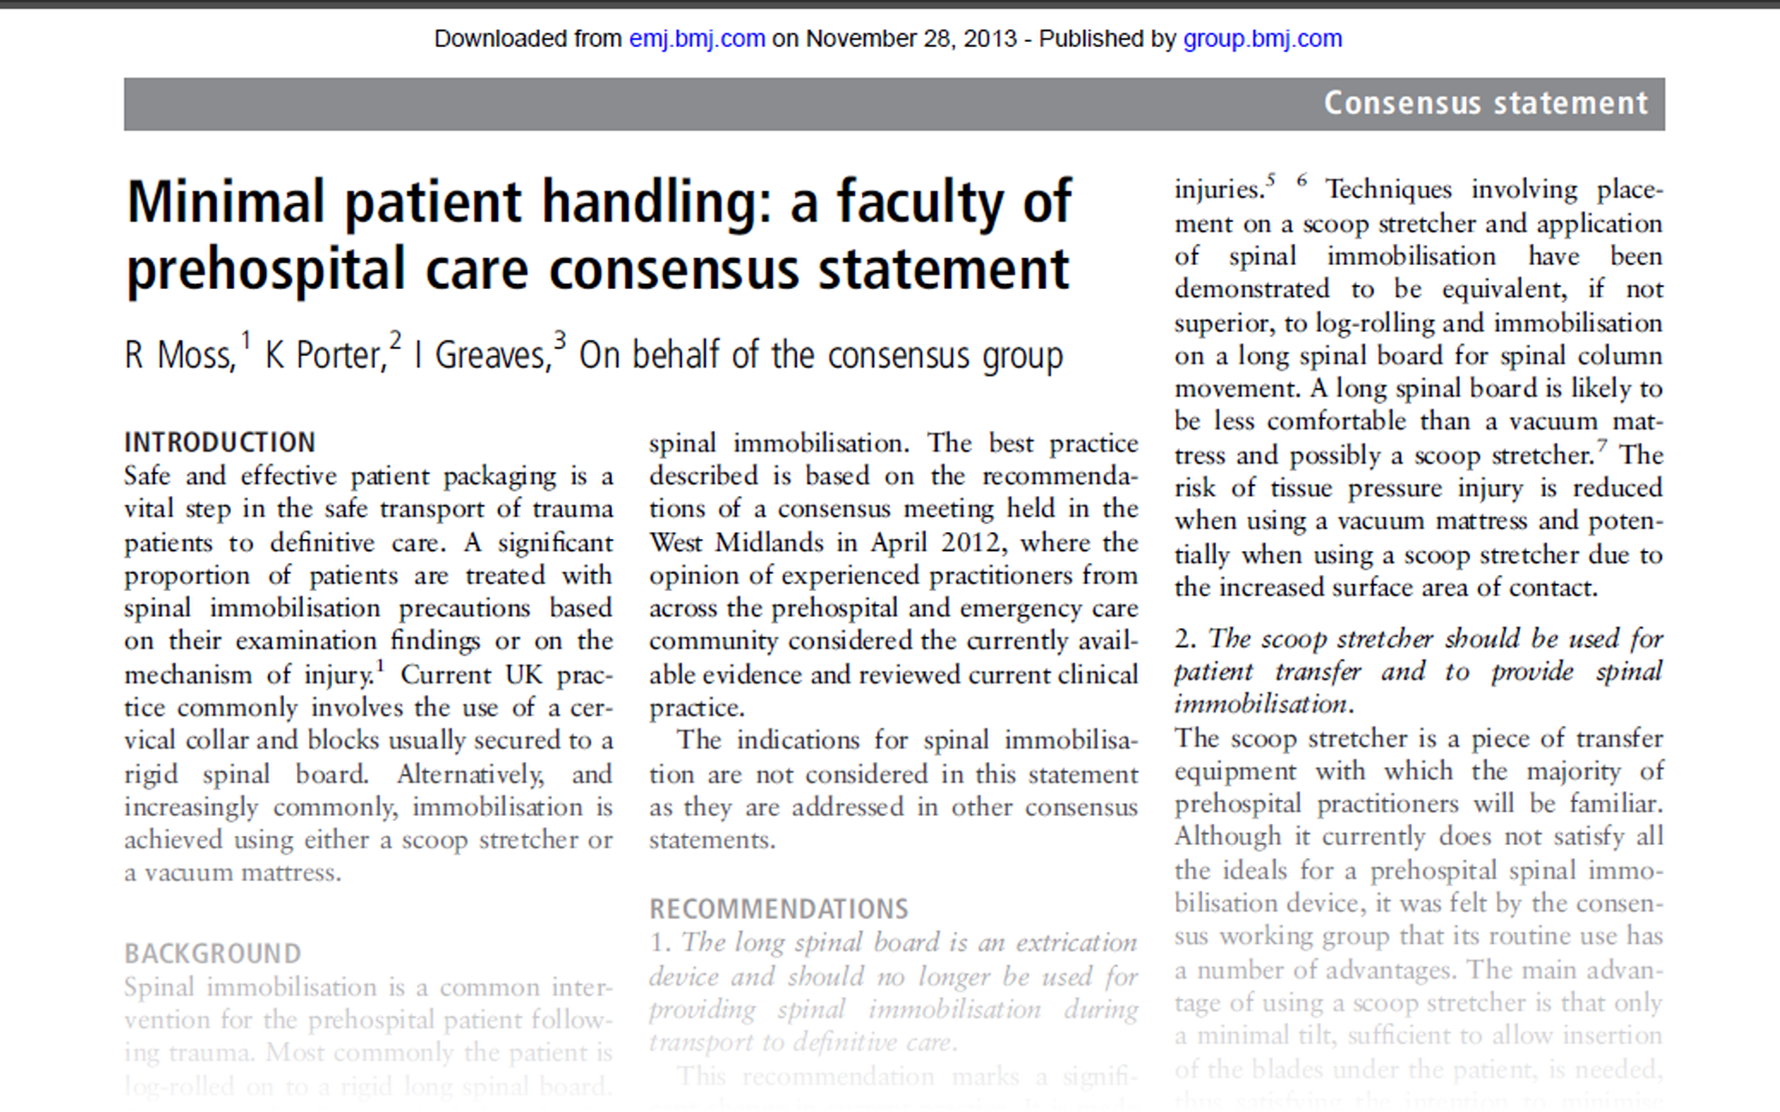
Notes:
A consensus statement in the BMJ’s “Emergency Medicine Journal” says backboards should only be used for extrication from vehicles and not for transport. Scoop stretchers should be used for any transport less than 45 minutes. Log rolls are bad if there is spinal injury. Something similar is coming from the National Association of EMS Physicians.

Slide 34
Open
Ankle Fracture

Slide 35
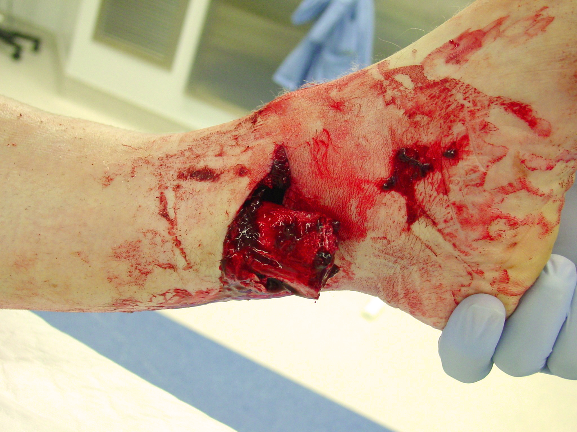
Notes:
Street care?

Slide 36
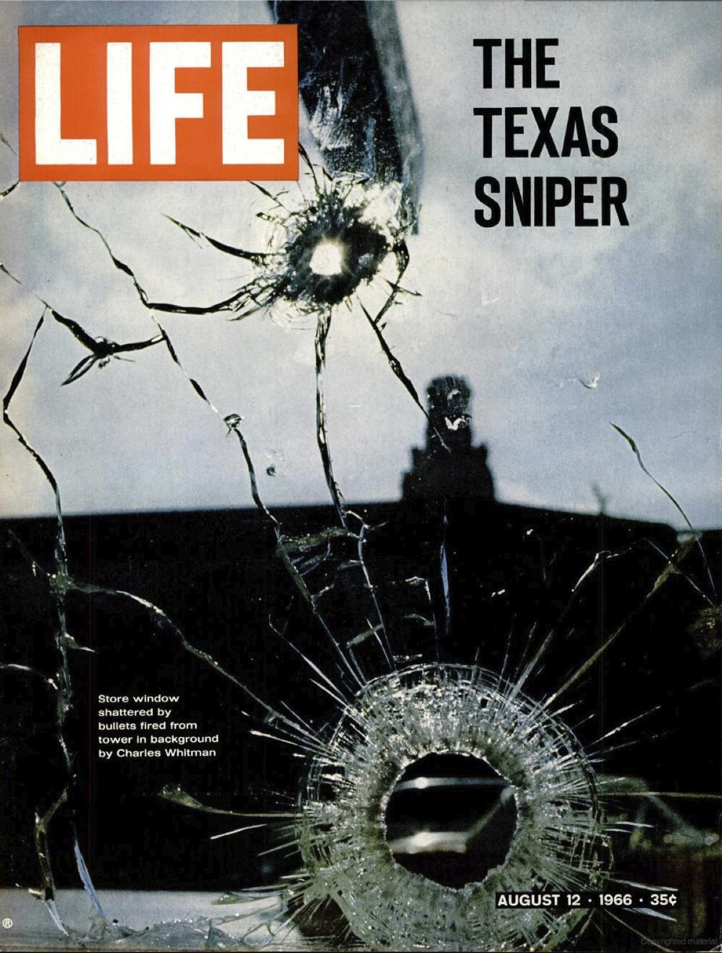
Notes:
Charles Joseph Whitman (June 24, 1941 – August 1, 1966) was an engineering student and former United States Marine, who killed seventeen people and wounded thirty-two others in a mass shooting rampage located in and around the Tower of the University of Texas in Austin on the afternoon of August 1, 1966.

Slide 37
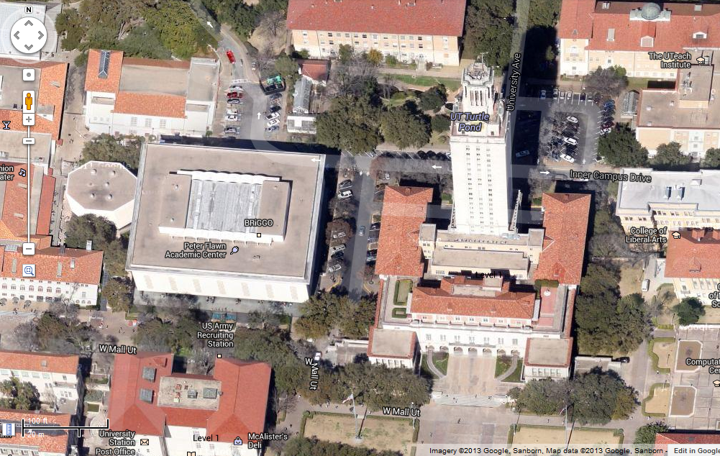
Notes:
The Tower, UT Austin: you are doing some volunteer time in the Student Health Service clinic in this building. There is a copycat with an AK-47 on top of the tower, who has mined all of the approaches to the tower. You are in contact with the campus police who say they can’t get you out of the building right now; they suspect it will be many hours until they can get you and your patient out safely. What do you do now? Irrigate? IM or PO antibiotics? Reduce and splint?

Slide 39
More Examples:

Slide 40
Different Care: Examples
CPR
Wounds
Dislocations
Impaled Objects

Slide 41
Different Care: Examples
CPR
Wounds
Dislocations

Slide 42
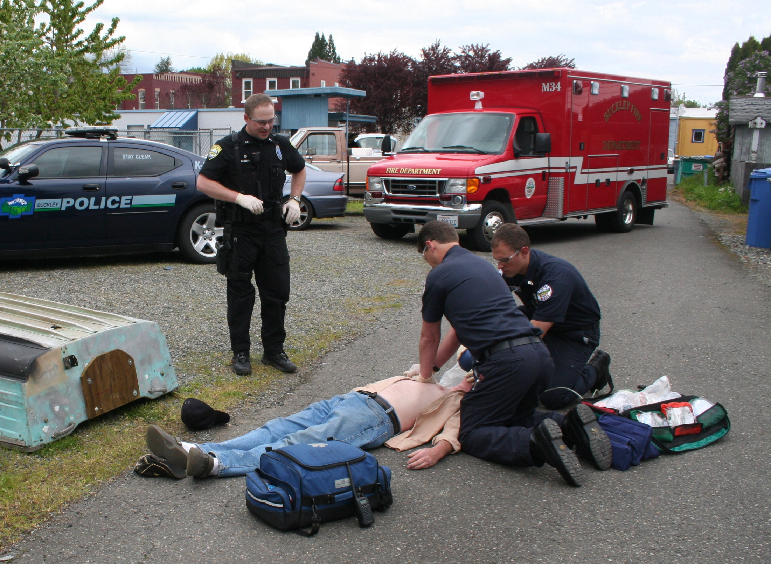
Notes:
Street care?

Slide 43
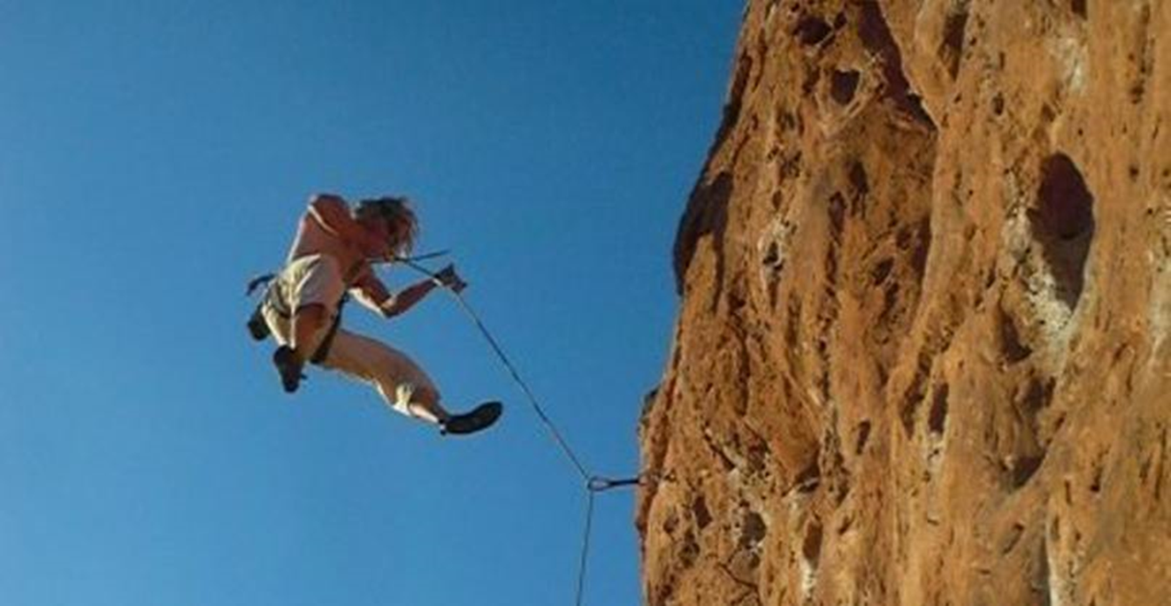
Austere EMS: CPR
Long-term survival from CPR on the street?
  3-10% (15% in City of Pittsburgh)
  Traumatic Arrest (urban): <5%
  (17% if include arrest in ED)
  most survivors had tension PTX
Notes:
Woman fell 120’ onto her chest. When you arrive there, her climbing partners have been doing CPR for an hour and a half. What do you do?
Even on the street, with a medical cardiac arrest, not much survival. For traumatic arrest on the street, even less, and mostly if someone needles the chest.

Slide 44
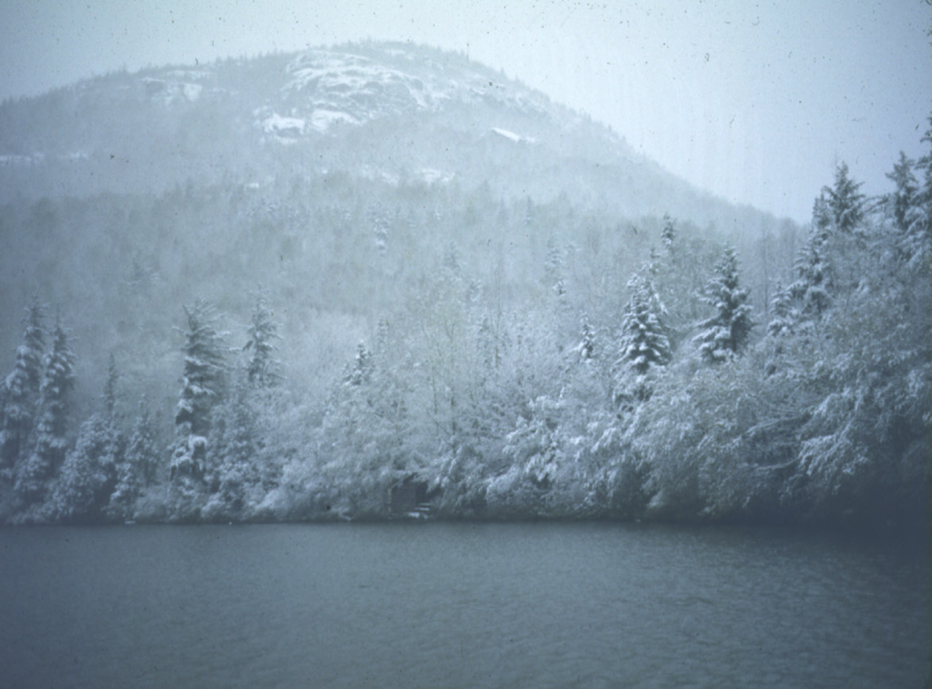
Austere EMS: CPR
Special Situations:
  Hypothermia/Coldwater Submersion/Avalanche Burial
  Lightning Strike
Notes:
There are a few situations where prolonged backcountry CPR might be effective.

Slide 45
Austere EMS: CPR
CPR for 30’ (if safe), then give up
OK to keep going if:
  hypothermic arrest
  (esp. cold-water submersion)
  avalanche burial
  lightning strike
No CPR if traumatic arrest
(consider chest decompression)

Slide 47
Different Care: Examples
CPR
Wounds
Dislocations
Impaled Objects

Slide 48
Different Care: Examples
CPR
Wounds
Dislocations

Slide 49
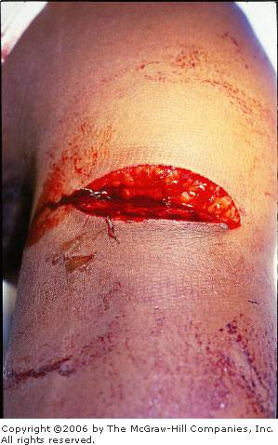
Notes:
Could you fix this? If so, need to follow the rules:

Slide 50
Golden 8 Hours?
Piss-Poor-Protoplasm?
  smoking
  diabetes mellitus
  steroids
  chronic illness, malnutrition, injury
  age
Notes:
If you have diabetes, it’s a golden 0 hours and the patient should probably get antibiotics. If you don’t have diabetes mellitus, it’s probably a “golden many, many hours.”

Slide 51
Golden 8 Hours?
Bad Wound?
  Crush
  Bite contamination
  Other contamination: wood, clay
  Poor blood supply (shin, fingertip)

Slide 52
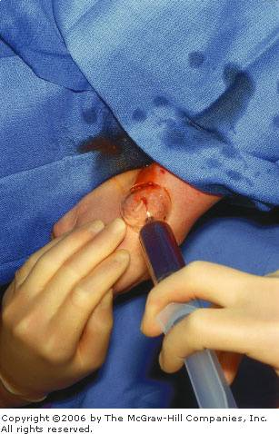
Notes:
Irrigate contaminated wounds with high-pressure clean (not necessarily sterile) water. Right pressure from a 35 mL syringe, 18 ga angiocath, and an average 2nd-year surgical resident (per Edlich’s original study): decreases wound infections. But for non-contaminated wounds (elbow vs. chin, for example), swelling from the irrigation will actually increase wound infections, so just slosh some water through it.

Slide 53
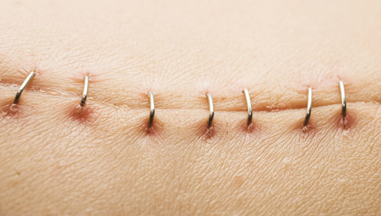
Notes:
You could use a stapler for this, right?

Slide 54
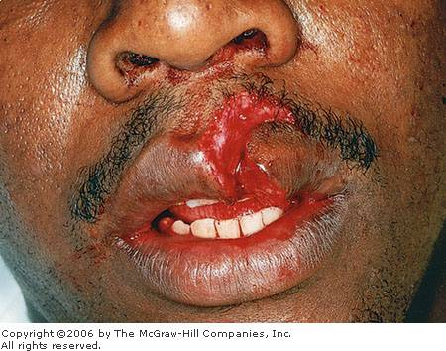
Notes:
What about this? Maybe not.

Slide 55
Delayed Primary Closure?
Keep wound open (may close slightly)
Twice a day:
  clean with soap and water
  apply Bacitracin (not Neosporin) ointment around edges
  sterile dressing
If not visibly infected in 4 days from injury, close like new wound.

Slide 56
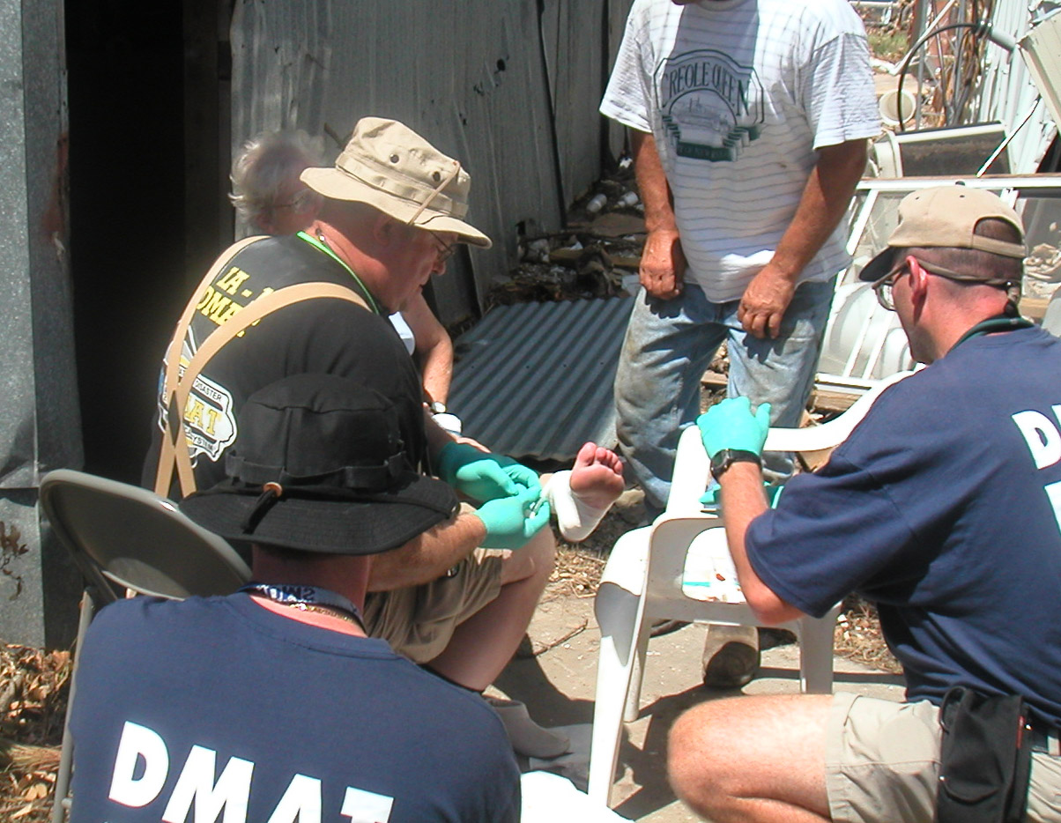
Notes:
a DMAT Operating Theatre.

Slide 58
Different Care: Examples
CPR
Wounds
Dislocations
Impaled Objects

Slide 59
Different Care: Examples
CPR
Wounds
Dislocations

Slide 60
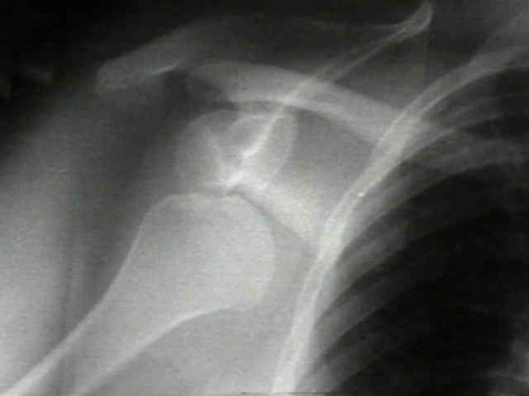
Notes:
Classic anterior dislocation. Street treatment? Immobilize and transport. Austere EMS treatment? Attempt reduction (take WEMT to learn how).

Slide 61
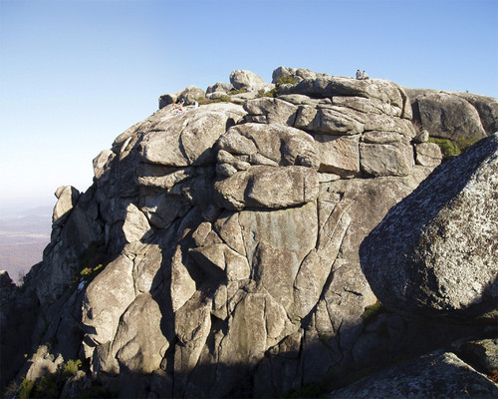
Notes:
This is the summit of Old Rag Mountain in Shenandoah National Park. A real case I was involved in some years ago: You have a patient who has had a 250-foot tumbling fall, and has been on a ledge halfway down a 500-foot cliff, near the top of a small mountain, all night and all day, it’s getting dark, the rain is starting to freeze... Sometimes it’s clear when you need to invoke the wilderness context.

Slide 62
Notes:
Patient had a mountain-biking accident a half-mile from the road and has a single injury, a dislocation. What should you do?
Should you use street or Austere protocols? What if it’s a patella dislocation? Austere. What if it’s a hip dislocation? Street. I would rather have the patient in the ED if I need to do moderate sedation.

Slide 64
Different Care: Examples
CPR
Wounds
Dislocations
Impaled Objects
Notes:
Street: stabilize and transport. Austere: take it out, as a general principle.

Slide 65
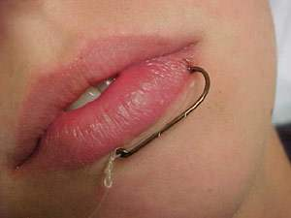

Slide 66
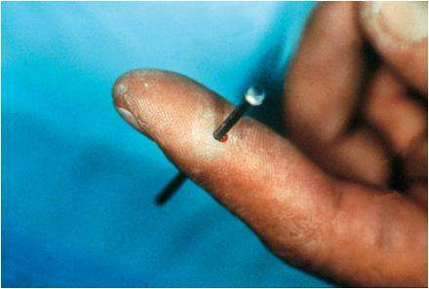
Notes:
A Leatherman and a boot would make short work of this.

Slide 67
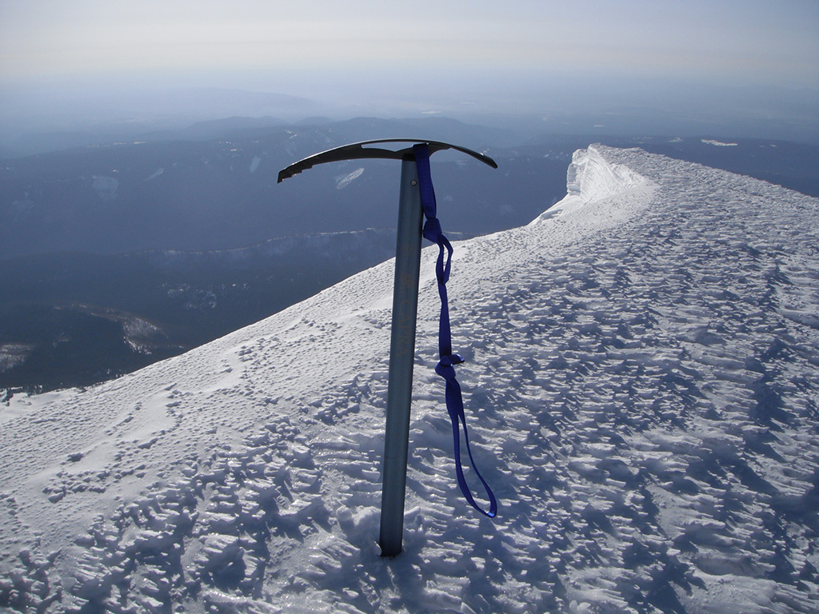
Notes:
Even impaled iceaxes should probably come out.

Slide 69
Force Protection
Notes:
Force protection is taking care of your teammate’s minor medical problems. This may return them to their job, or at least prevent future problems.

Slide 70
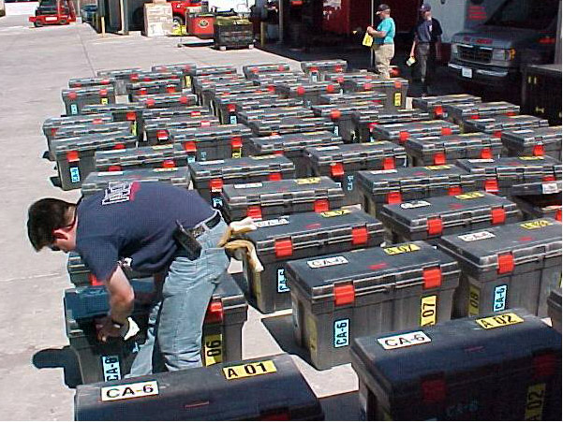
Notes:
NDMS Disaster Medical Assistance Team cache.

Slide 71
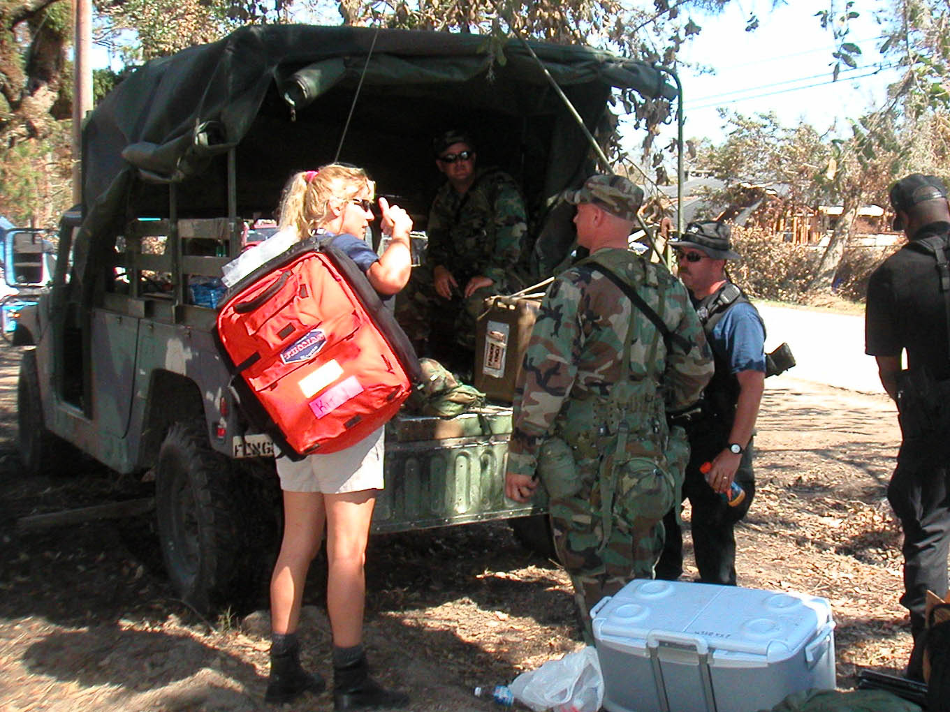
Notes:
DMATs used to have these Thomas packs for strike team deployment. Basically an ALS bag, it was of limited usefulness.

Slide 72
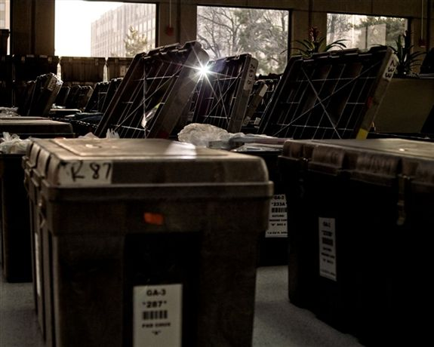
Notes:
But then the DMAT cache added a Mobile Medical Kit. It fills three of these boxes.

Slide 73
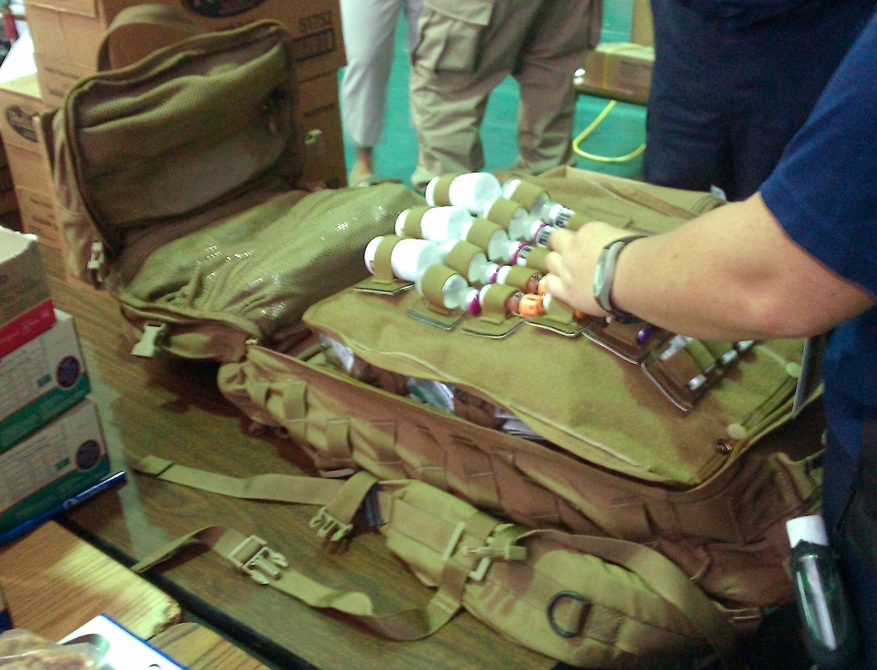
Notes:
It has some ALS stuff, but it has packs full of eyedrops, eardrops, pills, creams and the like. Perfect for Force Protection. Unfortunately the NDMS got rid of these.

Slide 74
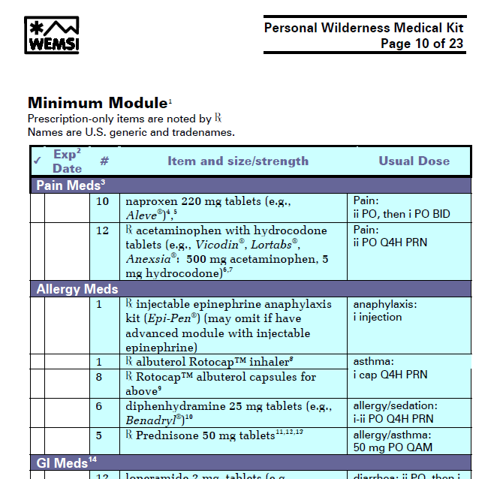
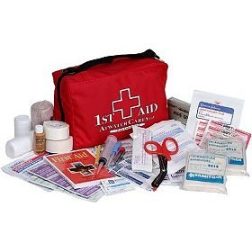
Medical – Personal Wilderness Medkit
Notes:
Personal first aid/medical kits may (and should) contain over-the-counter and prescription medications for common problems during an austere deployment/mission.

Slide 75
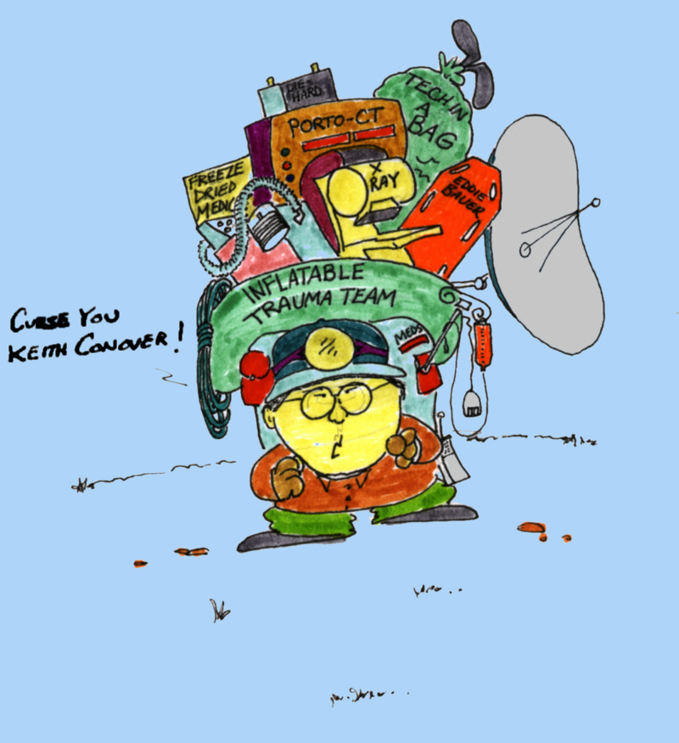
Notes:
Mike Yee, a member of my Allegheny Mountain Rescue Group, complained that sometimes I made him carry too much gear...

Slide 76
Force Protection
Diarrhea
UTIs
Ankle sprains/ Ottawa rules
Notes:
A few examples of force protection.

Slide 77
Force Protection
UTIs
Ankle sprains/ Ottawa rules
Notes:
A few examples of force protection.

Slide 78
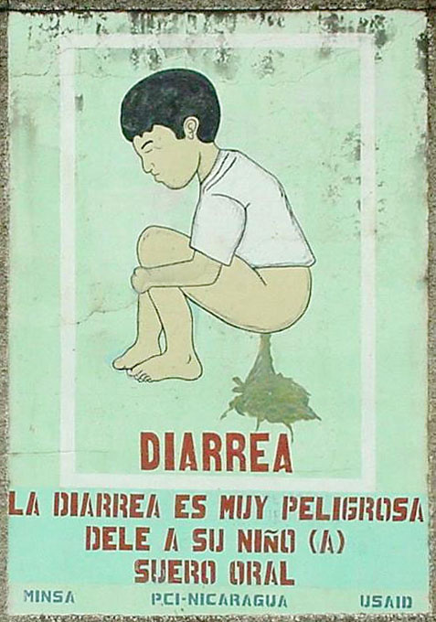
Notes:
Diarrhea is a pain in the ass, and can decimate your team.

Slide 79
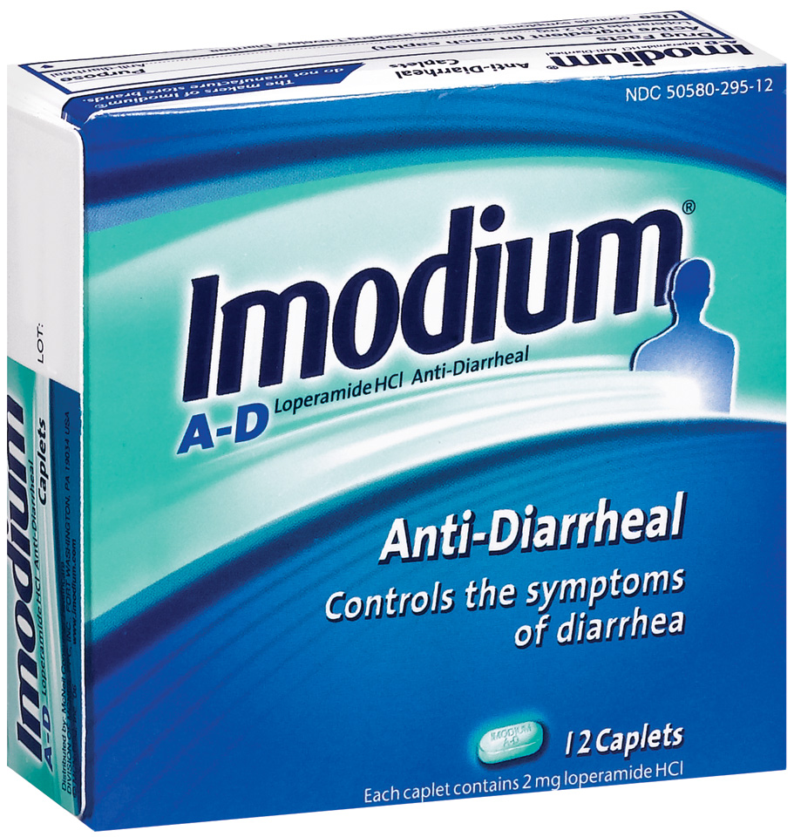
Notes:
Simply carrying some over-the-counter Imodium can make markedly decrease the toll on your team from Montezuma’s Revenge.

Slide 81
Force Protection
Diarrhea
UTIs
Ankle sprains/ Ottawa rules

Slide 82
Force Protection
UTIs
Ankle sprains/ Ottawa rules

Slide 83

Notes:
Normal flora: you skin is coated with bacteria.

Slide 84
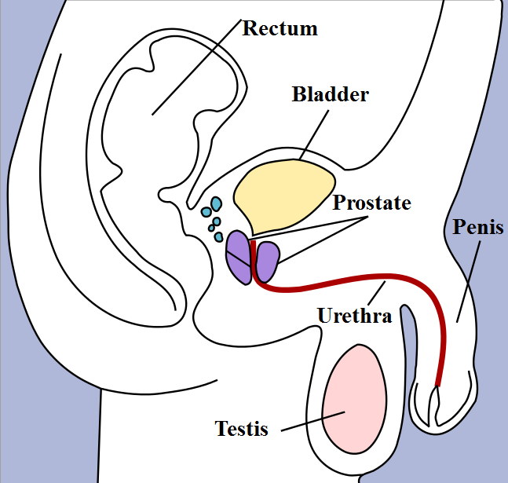
Notes:
The bacteria are always crawling up your urethra. Every time you pee you wash them out. It’s a constant battle. If you get dehydrated (a problem in summer, but also in winter due to “cold diuresis” and fluid loss from the lungs, and you don’t pee enough, they can crawl up into your bladder and set up housekeeping. It’s more common in women due to the shorter urethra, but still happens in men.

Slide 85
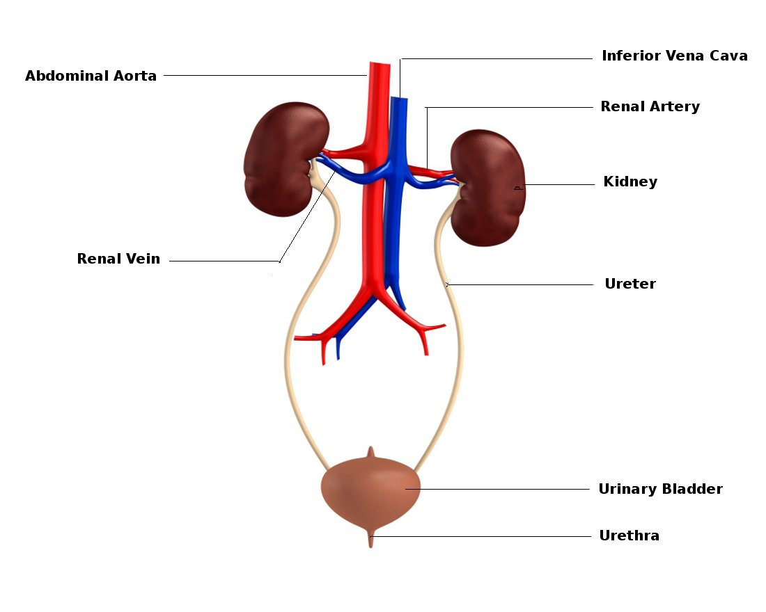
Notes:
Once the bacteria are in the bladder, the inquisitive ones head up the ureter to the kidneys; a kidney infection known as pyelonephritis (“pyelo”) may cause high fever, vomiting, and debilitation. Treating early with an antibiotic as part of force protection may prevent this.

Slide 87
Force Protection
Diarrhea
UTIs
Ankle sprains/ Ottawa rules
Notes:
Ankle injuries are the commonest traumatic injury to teammates. Is it a fracture that needs a carry-out? Is it just a sprain that you can tape up and say “now pick up your pack and keep going”?

Slide 88
Force Protection
UTIs
Ankle sprains/ Ottawa rules
Notes:
Ankle injuries are the commonest traumatic injury to teammates. Is it a fracture that needs a carry-out? Is it just a sprain that you can tape up and say “now pick up your pack and keep going”?

Slide 89
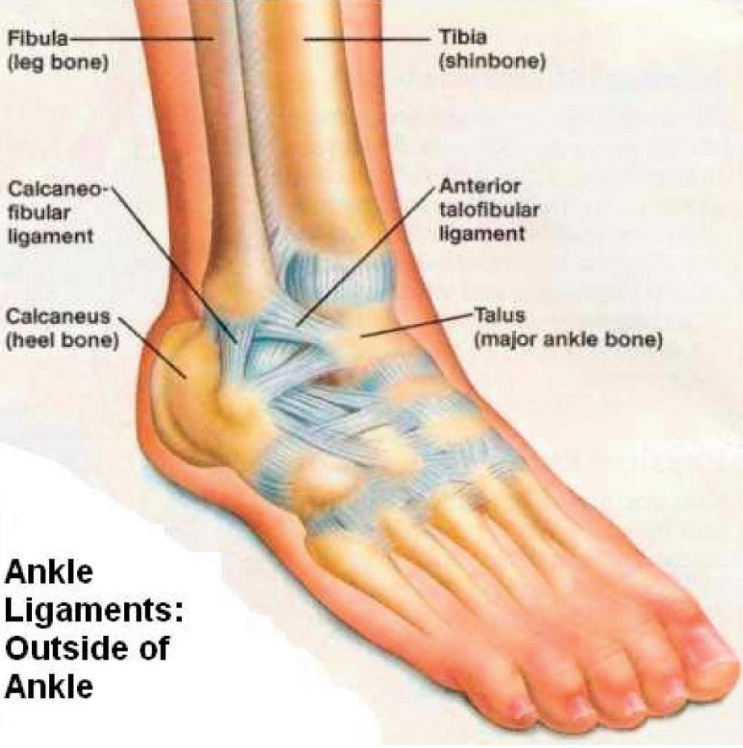

Slide 90
Ankle Sprains
Ottawa Rules for ankle injury:
  if could walk 4 steps then, or now, might not need x-rays
  if could walk, and no tenderness of the inferior-posterior 6 cm of lateral or medial malleolus, no need for ankle X-rays
  if could walk, and if no tenderness over navicular, or base 5th metatarsal, no need for foot xrays
Notes:
The Ottawa rules tell you when you don’t need to get X-rays of the foot or ankle. If someone doesn’t need X-rays, you can treat as a sprain and no need to go to the ED.

Slide 91

Notes:
This diagram I found with a Google image search looked great until I noticed and corrected a couple of errors; beware the original!

Slide 92

Notes:
These are my own drawings, also found in the handout.

Slide 93


Slide 94

Notes:
An Aircast Airstirrup is the best treatment for a sprained ankle; larger Force Protection kits might have them.

Slide 95

Notes:
But almost any team will have duct tape. You DO have duct tape wrapped around your water bottle, right? When taping an ankle sprain, do so as shown. If you don’t have much tape, omit the first two circles of tape, and tape only on the side that hurts. Flex a bit so as to protect the sprained ligament (to shorten it) as taping.

Slide 97
Legal Stuff

Slide 98
What is a Medical Practice Act and why should I care?
Notes:
(see handout: free discussion with audience)

Slide 99
What is Delegated Practice and how does it apply to Austere/Wilderness EMTs?

Slide 100
How do nurses fit into Delegated Practice, then?

Slide 101
I have just taken a [wilderness first aid][Wilderness First Responder][Wilderness Emergency Medical Technician] [Tactical EMT] course, and they taught me to [use an Epi-Pen][reduce shoulder dislocations][give IM antibiotics][perform field appendectomies]. Is it legal for me to now do these things?

Slide 102
If I’m in an Austere EMS setting, and someone is having chest pain, is it legal give him one of my aspirin tablets?

Slide 103
What happens when a paramedic or an EMT goes across state lines? WHAT? But what about aeromedical transports across state lines? We all know that the sending facility’s physician provides medical direction until the craft lands, and that the paramedics and nurses continue to follow the standing orders from their original medical director until they land.

Slide 104
So if I’m an First Responder, EMT or paramedic, what is my legal status in the backcountry in another state, both for unexpected emergencies and if I respond to the other state regularly as part of a search and rescue team?

Slide 105
If I am faced with a patient in the backcountry, and I don’t know what it’s legal for me to do, what should I do?

Slide 107

Wilderness EMT Class
Notes:
Wilderness EMT classes: a great place to learn some of this stuff. (This is a Wilderness EMT field exercise on the side of Cairn Gorm in Scotland.)

Slide 108

Wilderness EMT Class
Notes:
The WEMT’s version of a field hospital.

Slide 109

Medical – CDS Outdoor School cdsoutdoor.com
Notes:
cdsoutdoor.com is the local provider of Wilderness EMT classes.

Slide 110

The END
conovers.org/ftp

