Slide 1
Carbon Monoxide Poisoning
Bryan Bledsoe, DO, FACEP, FAAEM
Professor, Emergency Medicine
University of Nevada School of Medicine

Slide 2
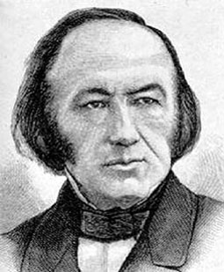
Carbon Monoxide
Significantly more is known about CO poisoning since Claude Bernard described it in 1857.
    Bernard C. Lecons sur les Effets des Substaces Toxiques et Medicamenteuses. Paris: J-B Bailliere et Fils, 1857

Slide 3
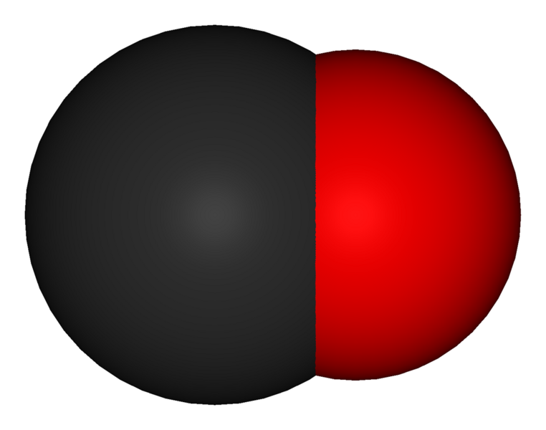
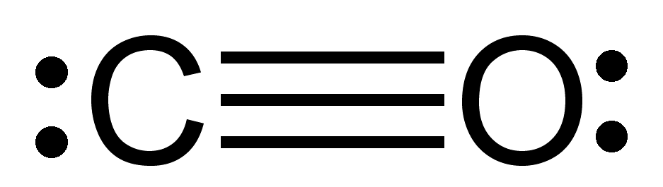
Chemistry
Gas
Odorless
Colorless
Tasteless
Relative vapor density = 0.97
Extremely stable
Extremely flammable

Slide 4
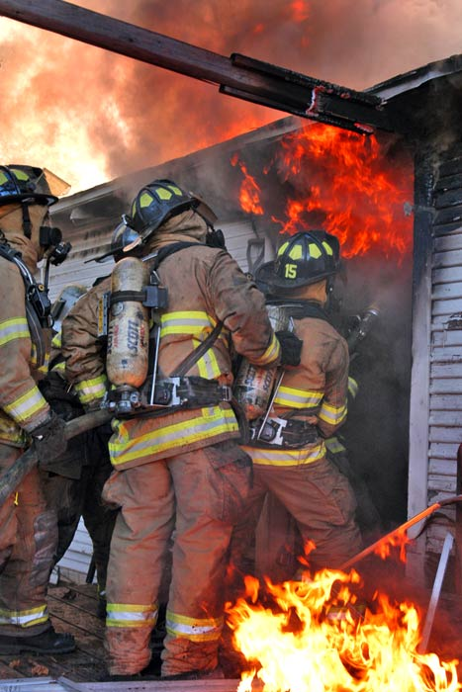
Sources of Carbon Monoxide
Endogenous
Exogenous
Methylene chloride

Slide 5
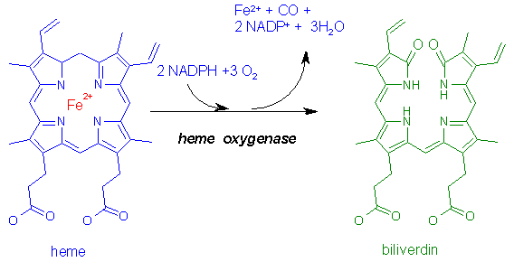
Sources of Carbon Monoxide
Endogenous:
  Normal heme catabolism:
    Only biochemical reaction in the body known to produce CO.
  Levels increased in:
    Hemolytic anemia.
    Sepsis

Slide 6
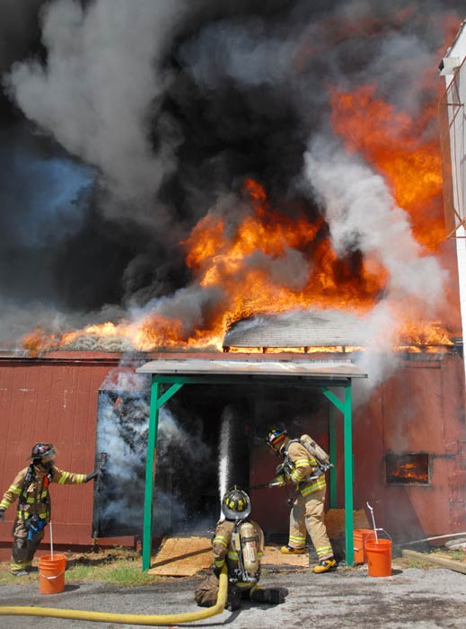
Sources of Carbon Monoxide
Exogenous:
  House fires.
  Gas–powered electrical generators.
  Automobile exhaust.
  Propane-powered vehicles.
  Heaters.
  Camp stoves.
  Boat exhaust.
  Cigarette smoke.

Slide 7

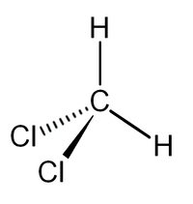
Sources of Carbon Monoxide
Methylene chloride:
  Paint and adhesive remover.
  Converted to CO in the liver after inhalation.

Slide 8
Incidence
CO is leading cause of poisoning deaths in industrialized countries.
CO may be responsible for half of all poisonings worldwide.
~5,000–6,000 people die annually in the United States as a result of CO poisoning.
~40,000–50,000 emergency department visits annually result from CO poisoning.
Source: Hampson NB. Trends in the incidence of carbon monoxide poisoning in the United States. Am J Emerg Med. 2005;23:838-841

Slide 9
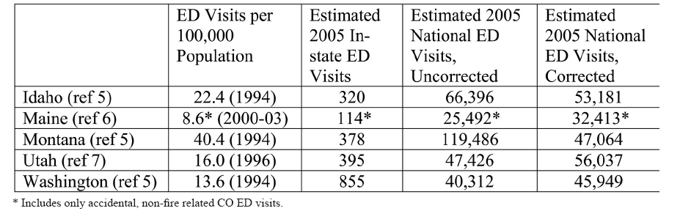
Incidence
Source: Hampson NB, Weaver LK. Carbon Monoxide Poisoning: A New Incidence of an Old Disease. Undersea Hyperb Med. 2007;34:163-168

Slide 10
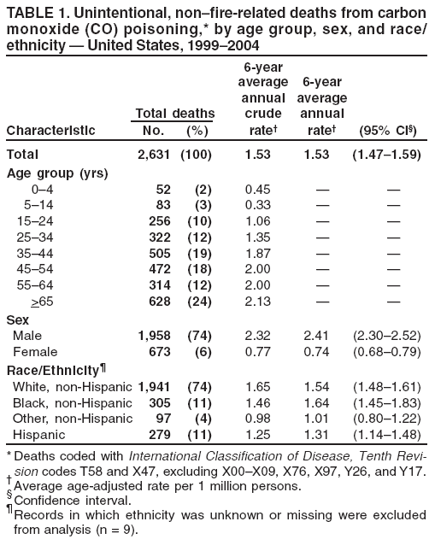
Incidence
COHb not routinely measured in autopsy specimens.
Post-mortem measurements often unreliable
CDC. MMWR. 56;50: December 21, 2007

Slide 11
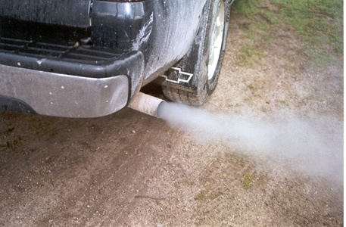
Incidence
Accidental CO poisoning deaths declining:
  Improved motor vehicle emission policies.
  Use of catalytic converters.
  Home CO detectors.

Slide 12
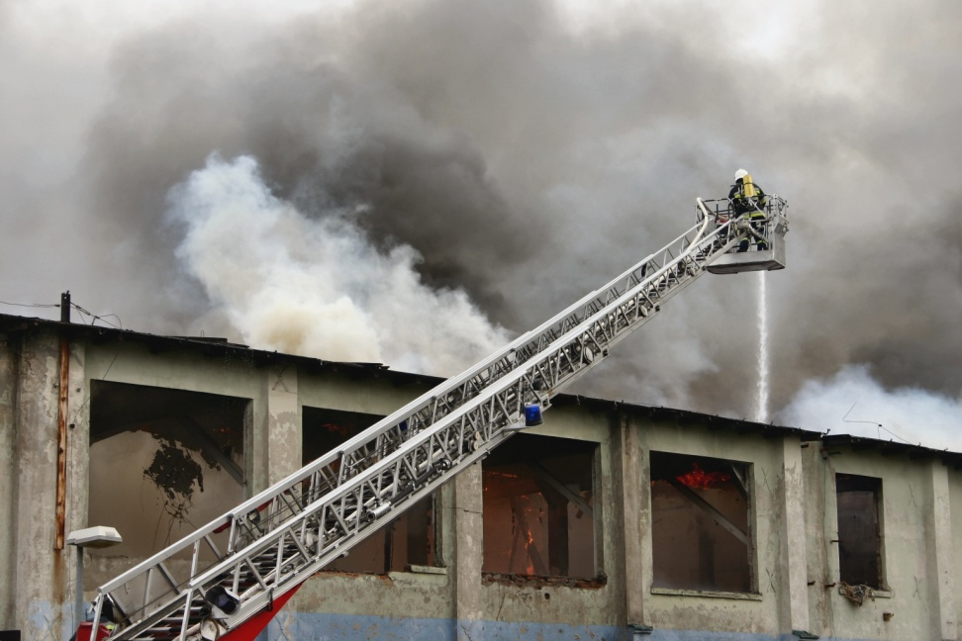
Incidence
Most accidental deaths are due to:
  House fires.
  Automobile exhaust.
  Indoor-heating systems.
  Stoves and other appliances.
  Gas-powered electrical generators
  Charcoal grills.
  Camp stoves.
  Water heaters.
  Boat exhausts.

Slide 13

Incidence
Increased accidental CO deaths:
  Patient > 65 years of age.
  Male
  Ethanol intoxication.
Accidental deaths peak in winter:
  Use of heating systems.
  Closed windows.

Slide 14
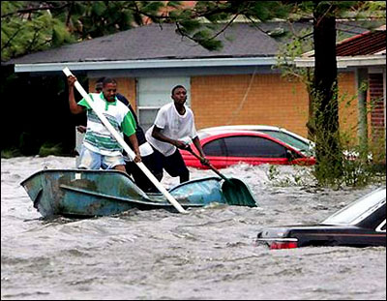
Incidence
Significant increase in CO poisoning seen following disasters.
Primarily relates to loss of utilities and reliance on gasoline-powered generators and use of fuel-powered heaters.

Slide 15
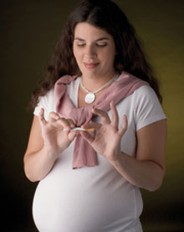
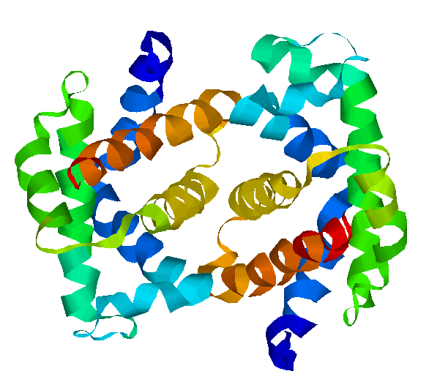
Incidence
Fetal hemoglobin has a much greater affinity for CO than adult hemoglobin.
Pregnant mothers may exhibit mild to moderate symptoms, yet the fetus may have devastating outcomes.

Slide 16
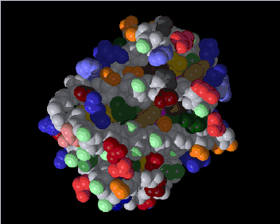
Pathophysiology
CO poisoning actually very complex.
CO binds to hemoglobin with an affinity ~ 250 times that of oxygen.

Slide 17
Pathophysiology
CO also binds to other iron-containing proteins:
  Myoglobin
  Cytochrome
  Neuroglobin
Binding to myoglobin reduces O₂ available in the heart:
  Ischemia
  Dysrhythmias
  Cardiac dysfunction

Slide 18
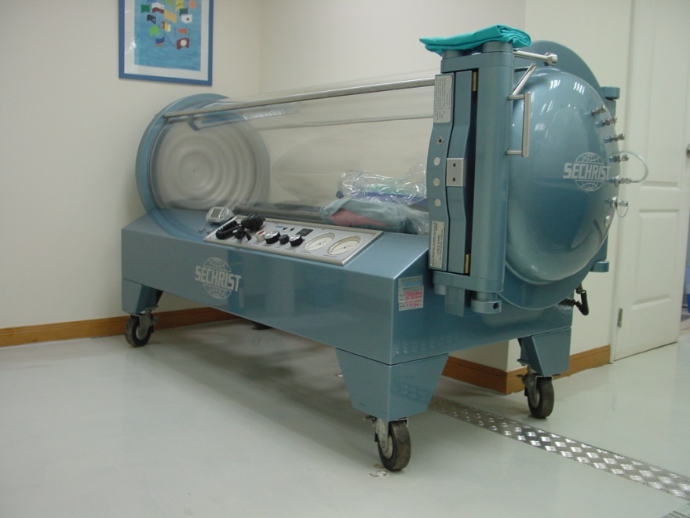
Pathophysiology
COHb ultimately removed from the circulation and destroyed.
Half-life:
  Room air: 240-360 minutes
  O₂ (100%): 80 minutes
  Hyperbaric O₂: 22 minutes

Slide 19
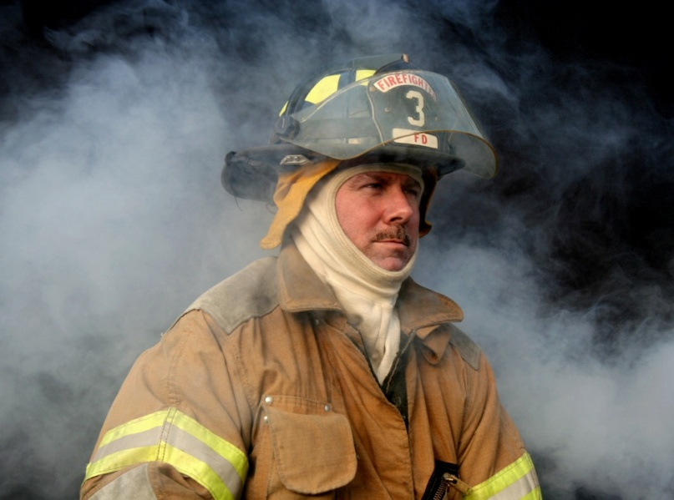
Pathophysiology
Signs and symptoms of CO poisoning do NOT correlate with COHb levels.
Other pathophysiologic processes must be involved.

Slide 20
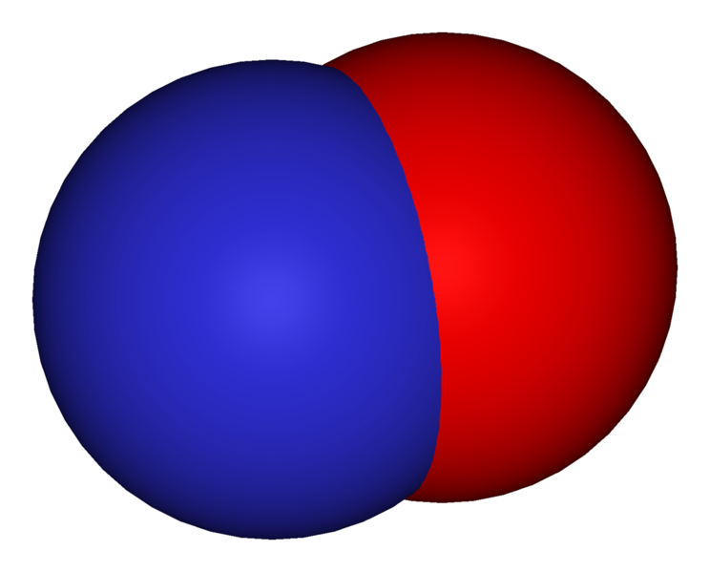
Pathophysiology
Nitric oxide (NO):
  Highly-reactive gas that participates in numerous biochemical reactions.
  Oxygen free-radical
  Levels increased with CO exposure.

Slide 21
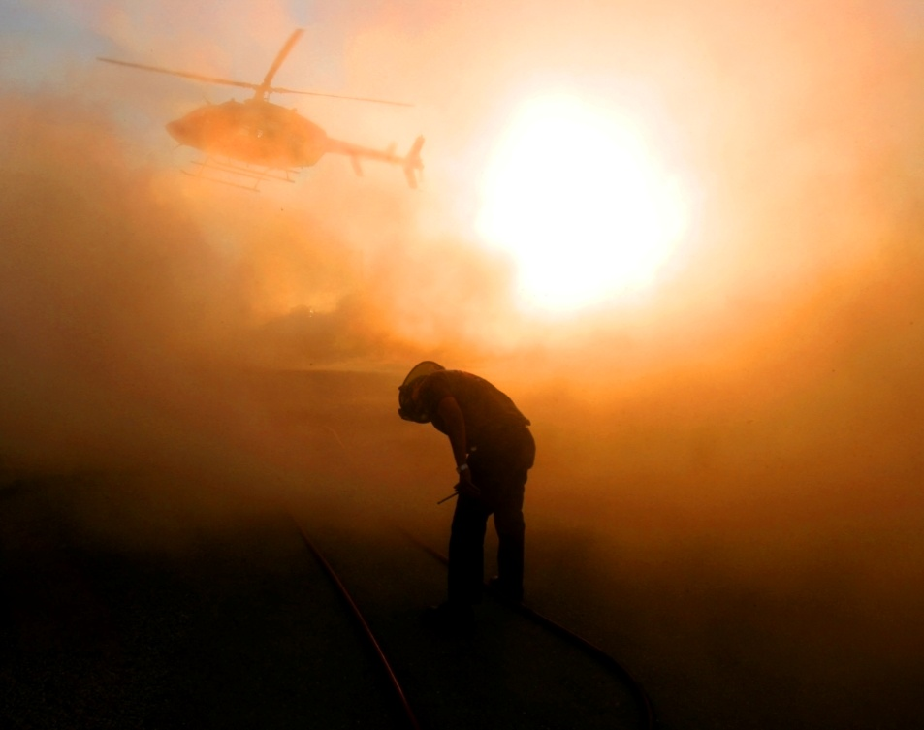
Pathophysiology
Nitric Oxide (NO):
  Causes cerebral vasodilation:
    Syncope
    Headache
  May lead to oxidative damage to the brain:
    Probable cause of syndrome of delayed neurologic sequelae (DNS).
    Associated with reperfusion injury.

Slide 22
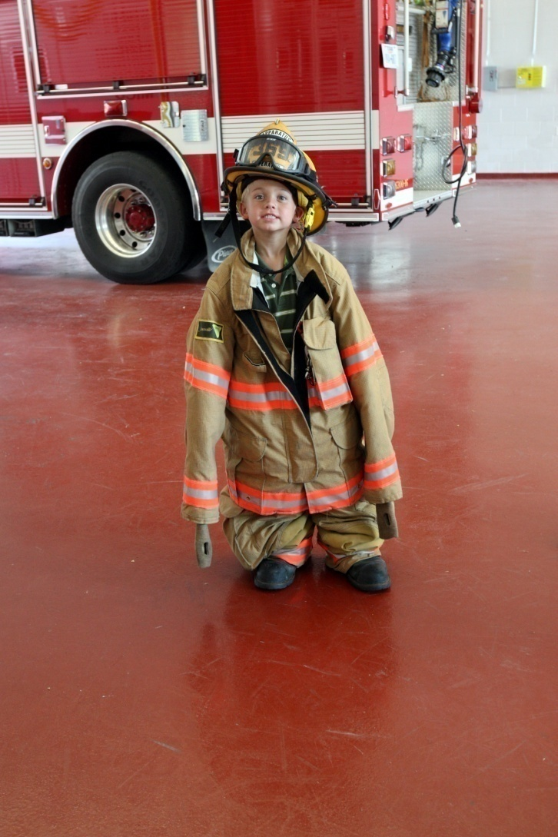
CO Exposure

Slide 23

CO Exposure
15 year (1980-1994) comparison of atmospheric CO levels and mortality in Toronto.
Adjusted for day-of-the week effects, nonparametric smoothed functions of the day of the study, and weather variables.

Slide 24
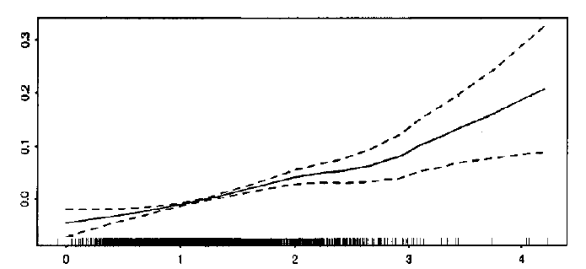
CO Exposure
Carbon Monoxide (ppm)—2 day Average

Slide 25
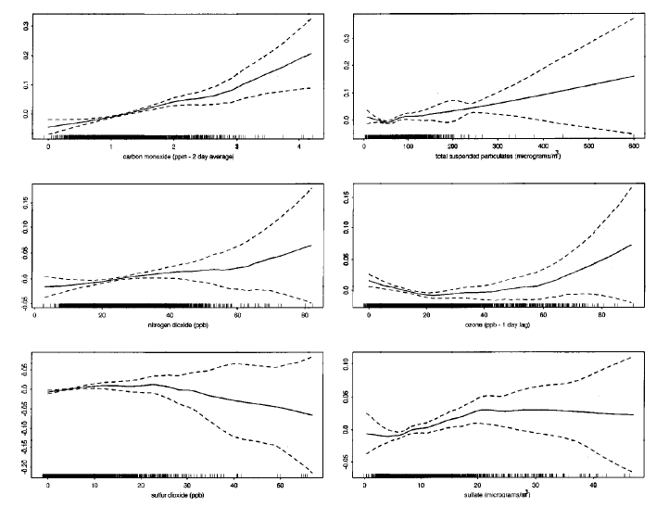
CO Exposure
Total Suspended Particulates
CO
NO₂
O₃
SO₂
SO₄

Slide 26
CO Exposure
“Epidemiological data indicate a potent and pervasive effect of even low ambient CO levels.”
Source: Burkett RT, Cakmak S, Raizenne ME, et al. The Association between Ambient Carbon Monoxide Levels and Daily Mortality in Toronto, Canada. J Air Waste Mgmt. 1998;48:689-700

Slide 27
CO Exposure
Swedish study.
Population-based cohort study of 22,444 men between 1974-1984.
COHb% was measured from 6/77 to 1/81 in 8,413 men (ages 34-49 years).
Men with history of MI, cancer and/or stroke were excluded.

Slide 28
CO Exposure
Cohort analysis:
  Never smokers: 2,893
    Divided into 4 quartiles based upon COHb%:
      COHb% = 0.43 (0.13-0.49) [N= 743 men]
      COHb% = 0.54 (0.50-0.57) [N= 781 men]
      COHb% = 0.62 (0.58-0.66) [N= 653 men]
      COHb% = 0.91 (0.67-5.47) [N= 716 men]

Slide 29
CO Exposure
 | Cardiac Event |  | CVD Deaths |  | All Deaths
Variable | RR | 95% CI | RR | 95% CI | RR | 95% CI
First Quartile | Reference |  | Reference |  | Reference
Second Quartile | 1.20 | 0.59-2.46 | 0.80 | 0.30-2.16 | 1.01 | 0.60-1.72
Third Quartile | 1.73 | 0.87-3.46 | 1.11 | 0.43-2.88 | 1.09 | 0.63-1.87
Fourth Quartile | 3.37 | 1.84-6.18 | 3.50 | 1.62-7.27 | 2.50 | 1.61-3.90
RR = Relative Risk is the risk of an event (or of developing a disease) relative to exposure. Relative risk is a ratio of the probability of the event occurring in the exposed group versus the control (non-exposed) group.

Slide 30
CO Exposure
“Incidence of CV disease and death in non-smokers was related to COHb%. It is suggested that measurements of COHb% could be a part of risk assessment in the non-smoking patients considered at risk of cardiac disease.”
Source: Hedblad B, Engström, Janzon E, Berglunf G, Janzon L. COHb% as a marker of cardiovascular risk in never smokers: Results from a population-based cohort study. Scand J Pub Health. 2006;34:609-615

Slide 31
Pathophysiology
Inhaled CO may interrupt myocardial oxidative phosphorylation by decreasing the activity of myocardial cytochrome oxidase (CcOX), the terminal oxidase in the electron transport chain.
Animal study (mice) exposed to 1,000 ppm CO over 3 hours.

Slide 32
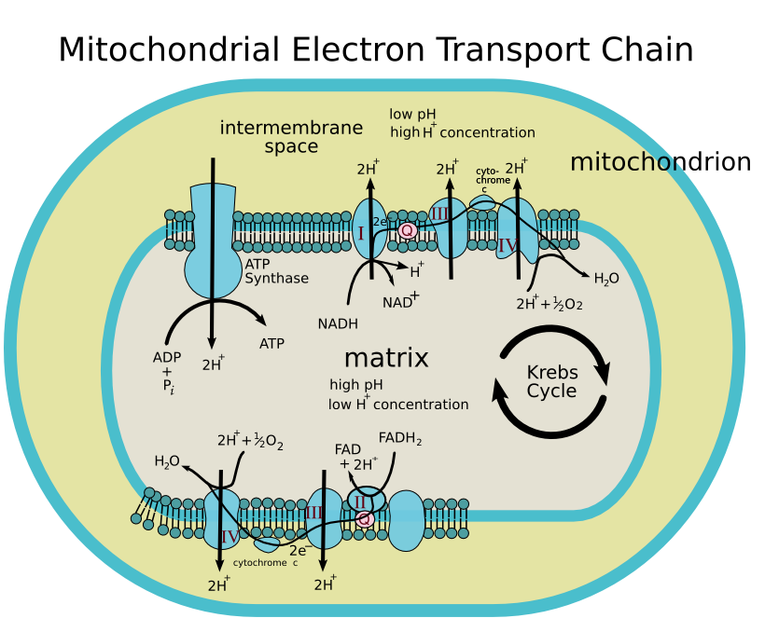
Pathophysiology

Slide 33
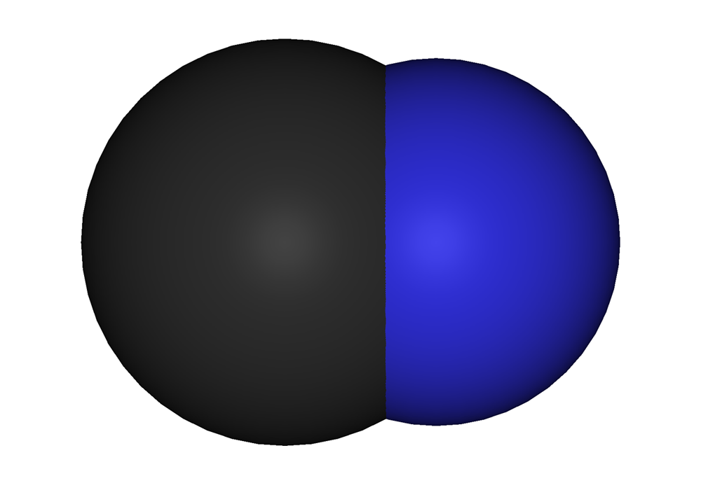
Pathophysiology
Virtually identical to the effect of cyanide.

Slide 34
Pathophysiology
CO decreased myocardial CcOX activity.
CO exposure decreases heme aa₃ content.
CO decreases steady-state levels of CcOX subunit I protein without affecting steady state mRNA levels (increased enzyme destruction).
CO exposure (1,000 ppm) increases COHb levels without causing tissue hypoxia.

Slide 35
Pathophysiology
Cause:
  Increased enzyme destruction due to binding of CO to heme groups.
  Production of reactive oxygen species production, oxidative stress, and subsequent protein destruction.
Source: Iheagwara KN, Thom SR, Deutschman CS, Levy RJ. Myocardial cytochrome oxidase activity is decreased following carbon monoxide exposure. Biochem Biophys Acta. 2007;1772:1112-1116

Slide 36
Pathophysiology
Ex Vivo murine model.
Grouping:
  100% O2 + KHH (Control Group)
  70% O2 + 30% N2 + KHH (N2 Control Group)
  70% O2 + 30% CO + KHH (CO Group)
Parameters:
  LVEsP
  LVEdP
  Coronary Perfusion Pressure
  * - KHH is a buffer solution used as a perfusate.

Slide 37
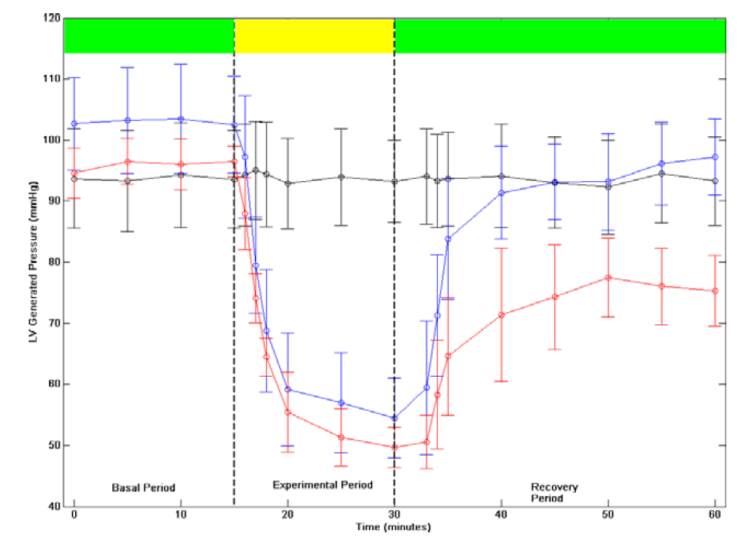
Pathophysiology

Slide 38
Pathophysiology
Conclusions:
  COHb not a factor (not in perfusate).
  Binding of CO to myoglobin, cytochrome oxidase, and other intracellular enzyme systems is the most likely explanation.
Source: Suner S, Jay S. Carbon monoxide has direct toxicity on the myocardium distinct from effects of hypoxia in an ex vivo rat heart model. Acad Emerg Med. 2008;15:59-65

Slide 39
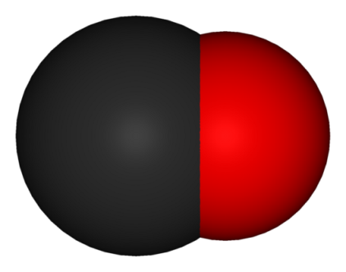
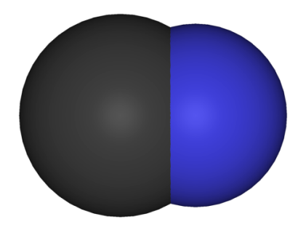
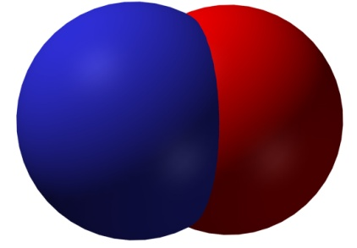
Pathophysiology
Chemical | Molar Mass (g/mol) | Water Solubility (mL/100 mL)
CO | 28.01 | 2.3
NO | 30.01 | 7.4
HCN | 27.03 | Completely Miscible
CO and NO are known second messengers
CO, NO and CN⁻ bind to heme and competitively inhibit CcOX.
NO targets intracellular heme.
NO impairs heme synthesis and enhances heme destruction by increasing heme oxygenase activity.

Slide 40
Basic Science
Free radical (reactive oxygen species):
  Highly-reactive atom, molecule or molecular fragment with a free or unpaired electron.
  Produced in various ways such as normal metabolic processes, ultraviolet radiation from the sun, and nuclear radiation.
  Free radicals have been implicated in aging, cancer, cardiovascular disease and other kinds of damage to the body.
  Every cell in the body suffers approximately 10,000 free radical hits a day.

Slide 41
Basic Science
Free radicals:
  Most clinically-significant free radicals in medicine are:
    Superoxide free radical (•O₂⁻)
    Hydrogen peroxide (H₂O₂)
    Hydroxyl free radical (•OH)
    Nitric oxide (•NO)
    Singlet oxygen (¹O₂)
    Ozone (O₃)

Slide 42
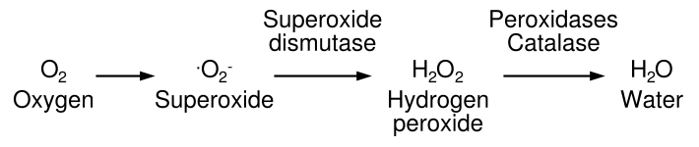
Basic Science
Various enzyme systems are available to remove free radicals:
  Superoxide dismutase

Slide 43
Basic Science
Nitric oxide:
  Originally called endothelium-derived relaxing factor.
  Biological messenger
    Vasodilation
    Neurotransmission
    Penile erections
  Free radical:
    Not overly reactive

Slide 44
Basic Science
Reactions of NO:
NO• + •O₂⁻ ONOO⁻
NO• + •OH NHO₂
NO• + HbO₂ MetHb + O₂
Nitric Oxide
Superoxide ion
Peroxynitrite
Nitric Oxide
Hydroxyl radical
Nitrous Acid
Nitric Oxide
Oxyhemoglobin
Methemoglobin

Slide 45
Basic Science
NO
DNA deamination
Nitration
(Tyr-NO₂)
Nitrosylation
(Cys-NO)
Soluble guanylyl cyclase
LOW NO CONCENTRATION
HIGH NO CONCENTRATION
Transcription Factors
Heme-containing enzymes

Slide 46
Pathophysiology
Oxidative stress
  Damage from free radicals results from oxidation and free radical attack on living tissues.
  Associated with aging:
    Cardiovascular disease (atherogenesis)
    Alzheimer’s disease
    Parkinson’s disease
    Diabetes
    Motor neuron disease

Slide 47
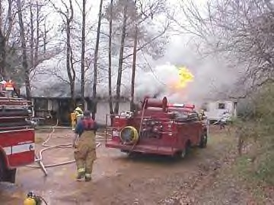
Pathophysiology
CO is actually a two-edged sword.
It possesses some protective effects in some situations.
It possesses some harmful effects in other situations.
Source: Mannaioni PF, Vannacci A, Masini E. “Carbon monoxide: the bad and the good side of the coin, from neuronal death to anti-inflammatory activity.” Inflamm Res. 2005;55:261-273

Slide 48
Pathophysiology
CO exposure can cause:
  Increased NO levels
  Increased superoxide levels
  These can combine to form the highly toxic peroxynitrite.
  Effect of free radicals is primarily on the vasculature.
  May cause hemorrhagic necrosis.
Source: Ischiropoulos H, et al. “Nitric oxide production and perivascular tyrosine nitration in brain after carbon monoxide poisoning in the rat.” J Clin Invest. 1996;97:2260-2267

Slide 49
Pathophysiology
CO exposure can cause:
  Increased hydroxyl radicals noted during both the hypoxic and reoxygenation stage.
Source: Zang J, Piantadosi CA. “Mitochondrial oxidative stress after carbon monoxide hypoxia in the rat brain.” J Clin Invest. 1992;90:1193-1199

Slide 50
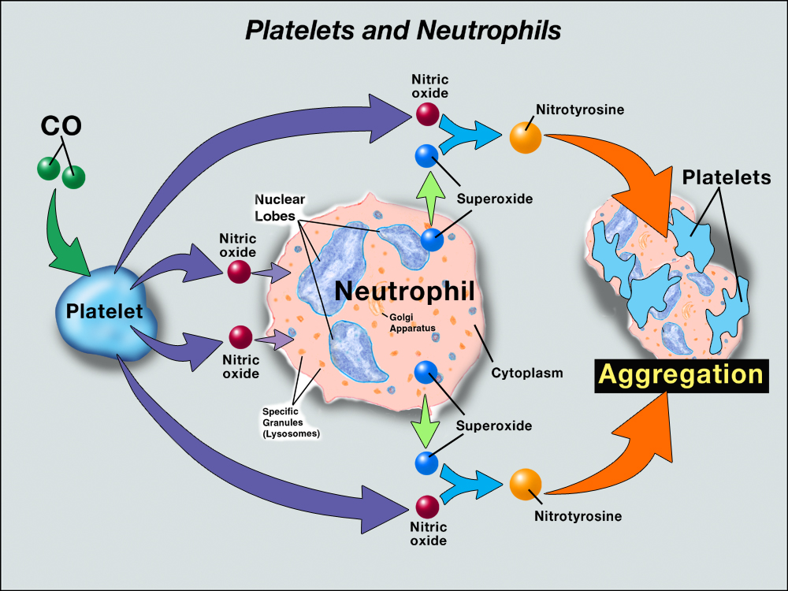
Pathophysiology

Slide 51
Pathophysiology
Ill Effects:
  CO causes hypoxia due to:
    The direct effect on hemoglobin
    Impaired perfusion from cardiac dysfunction.
  CO impairs mitochondrial electron transport because CO binds to CcOX (at higher COHb levels).
  Impairs brain ATP synthesis.
Source: Thom SR, Bhopale VM, Han S-T, Clark JM, Hardy KR. “Intravascular Neutrophil Activation Due to Carbon Monoxide Poisoning.” Am J Respir Crit Care Med. 2006;174:1239-1248

Slide 52
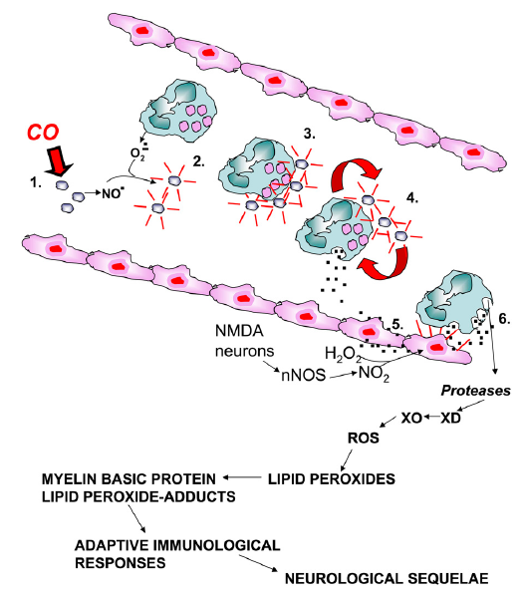
CO binds to platelet hemoproteins and increases NO efflux.
Platelet-derived NO reacts with neutrophil-derived superoxide which activates platelets and causes platelet-neutrophil aggregates.
Reactive products and adhesion molecules promote firm aggregation and stimulate degranulation of neutrophils.
Endothelial cells acitaved by myeloperoxidase facilitating firm neutrophil adhesion and further degranulation.
Reactive oxygen species (ROS) initiate lipid peroxidation and adducts interact with brain myelin basic protein. The altered myelin basic protein triggers an adaptive immunologic response that causes neurologic dysfunction.
Source: Thom SR, Bhopale VM, Han S-T, Clark JM, Hardy KR. “Intravascular Neutrophil Activation Due to Carbon Monoxide Poisoning.” Am J Respir Crit Care Med. 2006;174:1239-1248

Slide 53
Pathophysiology
Ill Effects:
  Increased mitochondrial production of free radicals.
  Although energy production and mitochondrial function may be restored after COHb levels fall, neuronal cell death (apoptosis) can still occur.
Source: Thom SR, Bhopale VM, Han S-T, Clark JM, Hardy KR. “Intravascular Neutrophil Activation Due to Carbon Monoxide Poisoning.” Am J Respir Crit Care Med. 2006;174:1239-1248

Slide 54
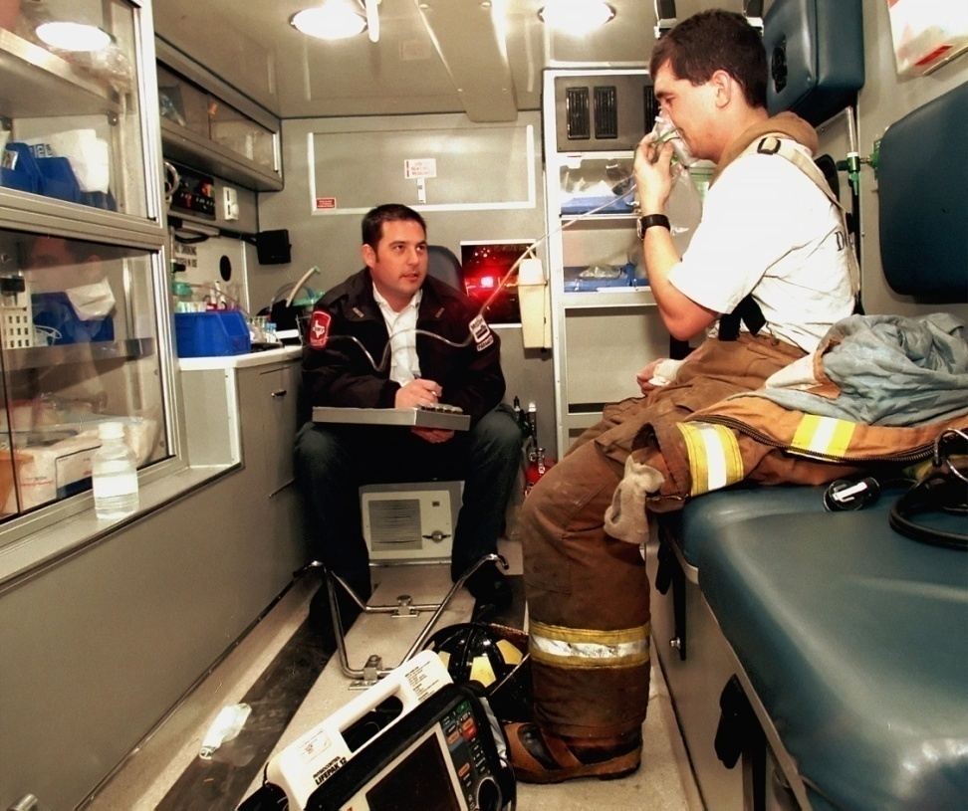
Pathophysiology
COHb levels do not always correspond with symptoms.
Indicates that other factors are involved.

Slide 55
Pathophysiology
Impact of CO on major body systems:
  Cardiac:
    Decreased myocardial function:
      Hypotension with tachycardia.
      Chest pain.
      Dysrhythmias.
      Myocardial ischemia.
      Most CO deaths are from ventricular fibrillation.
    Long-term effects:
      Increased risk of premature cardiac death.

Slide 56
Pathophysiology
Impact of CO on major body systems:
  Metabolic:
    Respiratory alkalosis (from hyperventilation).
    Metabolic acidosis with severe exposures.
  Respiratory:
    Pulmonary edema (10-30%)
      Direct effect on alveolar membrane.
      Left-ventricular failure.
      Aspiration.
      Neurogenic pulmonary edema.

Slide 57
Pathophysiology
Impact of CO on major body systems:
  Multiple Organ Dysfunction Syndrome (MODS):
    Occurs at high-levels of exposure.
    Associated with a high mortality rate.

Slide 58
Pathophysiology
Delayed Neurologic Syndrome (DNS):
  Recovery seemingly apparent.
  Behavioral and neurological deterioration 2-40 days later.
  True prevalence uncertain (estimate range from 1-47% after CO poisoning).
  Patients more symptomatic initially appear more apt to develop DNS.
  More common when there is a loss of consciousness in the acute poisoning.

Slide 59
Delayed Neurologic Syndrome
Signs and Symptoms:
  Memory loss
  Confusion
  Ataxia
  Seizures
  Urinary incontinence
  Fecal incontinence
  Emotional lability
Signs and Symptoms:
  Disorientation
  Hallucinations
  Parkinsonism
  Mutism
  Cortical blindness
  Psychosis
  Gait disturbances
  Other motor disturbances

Slide 60
Pathophysiology Summary
Limits O₂ transport:
  CO more readily binds to Hb forming COHb.
Inhibits O₂ transfer:
  CO changes structure of Hb causing premature release of O₂ into the tissues.
Tissue inflammation:
  Poor perfusion initiates an inflammatory response.

Slide 61
Pathophysiology Summary
Poor cardiac function:
  ↓ O₂ delivery can cause dysrhythmias and myocardial dysfunction.
  Long-term cardiac damage reported after single CO exposure.
Increased activation of nitric oxide (NO):
  Peripheral vasodilation.
  Inflammatory response.

Slide 62
Pathophysiology Summary
Vasodilation:
  Results from NO increase.
  Cerebral vasodilation and systemic hypotension causes reduced cerebral blood flow.
  NO is largely converted to methemoglobin.
Free radical formation:
  NO accelerates free radical formation.
  Endothelial and oxidative brain damage.

Slide 63
Patient Groups at Risk
Children.
Elderly.
Persons with heart disease.
Pregnant women.
Patients with increased oxygen demand.
Patients with decreased oxygen-carrying capacity (i.e., anemias, blood cancers).
Patients with chronic respiratory insufficiency.

Slide 64
Clinical
11-year chart review of 1,533 patients admitted to a burn unit.
18 patients with COHb levels ≥ 10%.
“These data suggest that myocardial damage can result from acute carbon monoxide poisoning, and appropriate screening is indicated for the detection of such injuries.”
Source: Williams J, Lewis II RW, Kealey GP. ,“Carbon Monoxide Poisoning and Myocardial Ischemia in Patients with Burns.” J Burn Care Rehabil. 1999;12:210-213

Slide 65
Clinical
12-year boy who suffered occult damage despite mild symptoms and low COHb levels.
COHb at admission was 24.5%.
ECG showed sinus tachycardia with diffuse ST segment elevation.
Heart and valvular abnormalities noted.
No long-term complications
Source: Gandini C, et al. “Cardiac Damage in Pediatric Carbon Monoxide Poisoning.” Clin Tox. 2001;39:45-510-213

Slide 66
Clinical
Smoking, CO, and Heart Disease:
  “Patients under age 65 without symptoms of ischemic heart disease who smoked shortly before surgery had more episodes of rate pressure product-related ST segment depression than nonsmokers, prior smokers, or chronic smokers who did not smoke before surgery.”
Source: Woehlck HJ, Connolly LA, Cinquegrani MP, Dunning MB, Hoffman RG. “Acute Smoking Increases ST Depression in Humans During General Anesthesia.” Anesth Analg. 1999;89:856-860

Slide 67
Clinical
Neurological Complications:
  Prospective evaluation of 127 CO-poisoned patients.
  Depression and anxiety measured at 6-weeks, 6-months, and 12-months.
Source: Jasper BW, Hopkins RO, Van Duker H, Weaver LK. “Affective Outcome Following Carbon Monoxide Poisoning: A Prospective Longitudinal Study.” Cog Behav Neurol. 2005;18:127-134

Slide 68
Clinical
Neurological Complications:
  Outcomes (anxiety and depression):
    6-weeks: 45%
    6-months: 44%
    12-months: 43%
  At 6-weeks people who attempted suicide had a higher prevalence of anxiety and depression.
  No differences between groups at 12-months.
Source: Jasper BW, Hopkins RO, Van Duker H, Weaver LK. “Affective Outcome Following Carbon Monoxide Poisoning: A Prospective Longitudinal Study.” Cog Behav Neurol. 2005;18:127-134

Slide 69
Clinical
Neurological Complications:
  Biosphere 2 participant developed atypical Parkinsonism and a gait disturbance after living 2 years in the project.
  Findings postulated to be do to chronic hypoxia and CO exposure.
Source: Lassinger BK, et al. “Atypical Parkinsonism and Motor Neuron Syndrome in a Biosphere 2 Participant: A Possible Complication of Chronic Hypoxia and Carbon Monoxide Toxicity?” Mov Disord. 2004;19:465-469

Slide 70
Clinical
Neurological Complications:
  5-year-old with CO poisoning (COHb = 20.2%) recovered following HBOT.
  Developed visual and gait disturbances 2 days later (delayed neurologic syndrome).
  MRI findings found in brain.
Source: Kondo A, et al. “Delayed neuropsychiatric syndrome in a child following carbon monoxide poisoning” Brain Develop. 2007;29:174-177

Slide 71
Clinical
230 consecutive patients treated for moderate to severe CO poisoning in the HBO chamber at Hennepin County Medical Center.
Mean age: 47.2 years (72% males)
56% active tobacco smokers.
Other cardiac risk factors uncommon.
Source: Satran D, Henry CR, Adkinson C, Nicholson CI, Bracha Y, Henry TD. “Cardiovascular manifestations of moderate to severe CO poisoning.” J Am Coll Cardiol. 2005;45:1513-1516

Slide 72
Patient Characteristics
Parameter | Number | Percentage
Age (yrs) | 47.2 | 19-91 (average/range)
Men | 166 | 72%
Diabetes | 15 | 7%
Hypertension | 52 | 23%
Active smoker | 129 | 56%
Previous MI | 15 | 7%
Previous revascularization | 6 | 3%
Accidental poisoning | 159 | 59%
Intentional poisoning | 91 | 40%
COHb (%) | 33.1 | 2-65 (average range)
Intubated | 116 | 50%
Pressors required | 14 | 6%

Slide 73
Predictors of Myocardial Injury
Finding | No Injury | Injury | RR | 95% CI
Men | 64.8 | 84.7 | 3.01 | 1.52-5.94
GCS ≤ 14 | 41.7 | 61.5 | 2.23 | 1.27-3.94
Hypertension | 18.3 | 31.3 | 2.04 | 1.09-3.82
Previous revascularization | 0.7 | 1.2 | 1.74 | 0.11-28.16
Diabetes | 5.6 | 8.4 | 1.55 | 0.54-4.45
Previous MI | 6.3 | 7.2 | 1.16 | 0.403.38
Age (5 yrs) | 44.8* | 51.2* | 1.12 | 1.03-1.22
COHb level (10%) | 32.7† | 33.9† | 1.03 | 0.93-1.14
Current smoker | 64 | 48.2 | 0.52 | 0.30-0.91
^{* = Average}
^{† = Measured percent}

Slide 74
Clinical
Ischemic ECG changes present in 30% of patients.
Cardiac biomarkers (CK-MB, troponin-I) were elevated in 35%.
In-hospital mortality: 5%
Conclusions: “Cardiovascular sequelae of CO poisoning are frequent.”
Source: Satran D, Henry CR, Adkinson C, Nicholson CI, Bracha Y, Henry TD. “Cardiovascular manifestations of moderate to severe CO poisoning.” J Am Coll Cardiol. 2005;45:1513-1516

Slide 75
Clinical
  Sartran et al.:
    “Myocardial injury from CO poisoning results from tissue hypoxia as well as damage at the cellular level.”
    “In vitro, CO binds to cytochrome-c oxidase of the electron transport chain resulting in asphyxiation at the cellular level.”
    “Oxygen radical formation and subsequent lipid peroxidation has been implicated as a mechanism for cell death.”
    “High concentrations of CO have been to induce cellular apoptosis mediated by nitric oxide.”

Slide 76
Clinical
230 consecutive patients treated for moderate to severe CO poisoning in the HBO chamber at Hennepin County Medical Center (1/1/94-1/1/02).
Patients followed through 11/11/05.
Source: Henry CR, Satran D, Lindgren B, Adkinson C, Nicholson CI, Henry TD. “Myocardial Injury and Long-Term Mortality Following Moderate to Severe Carbon Monoxide Poisoning.” JAMA. 2006;295:398-402

Slide 77
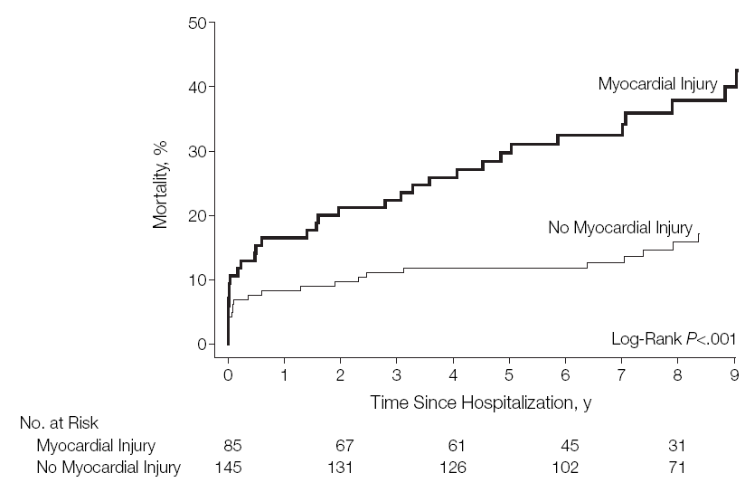
Clinical
Source: Henry CR, Satran D, Lindgren B, Adkinson C, Nicholson CI, Henry TD. “Myocardial Injury and Long-Term Mortality Following Moderate to Severe Carbon Monoxide Poisoning.” JAMA. 2006;295:398-402

Slide 78
Clinical
At median follow-up of 7.6 years:
  54 (24%) deaths [12 (5%) in-hospital]
  85 patients sustained myocardial injury from CO poisoning:
    32 (38%) eventually died
  22 patients did not sustain myocardial injury:
    22 (15%) eventually died
Source: Henry CR, Satran D, Lindgren B, Adkinson C, Nicholson CI, Henry TD. “Myocardial Injury and Long-Term Mortality Following Moderate to Severe Carbon Monoxide Poisoning.” JAMA. 2006;295:398-402

Slide 79
Clinical
“Myocardial injury occurs frequently in patients hospitalized for moderate to severe CO poisoning and is a significant predictor of mortality.”
Source: Henry CR, Satran D, Lindgren B, Adkinson C, Nicholson CI, Henry TD. “Myocardial Injury and Long-Term Mortality Following Moderate to Severe Carbon Monoxide Poisoning.” JAMA. 2006;295:398-402

Slide 80

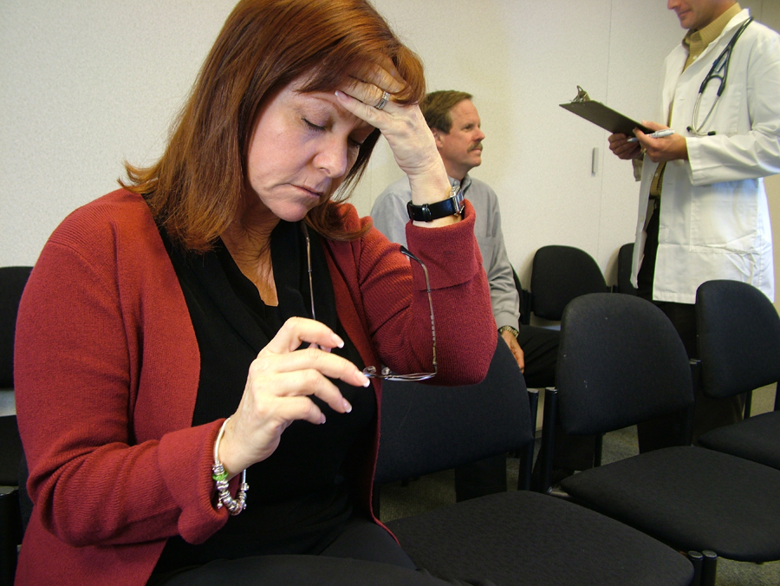
CO Poisoning
Signs and symptoms usually vague and non-specific.
You must ALWAYS maintain a high index of suspicion for CO poisoning!

Slide 81
CO Poisoning
Signs and symptoms closely resemble those of other diseases.
Often misdiagnosed as:
  Viral illness (e.g., the “flu”)
  Acute coronary syndrome
  Migraine
Estimated that misdiagnosis may occur in up to 30-50% of CO-exposed patients presenting to the ED.
Source: Raub JA, Mathieu-Holt M, Hampson NB, Thom SR. Carbon Monoxide Poisoning: A Public Health Perspective. Toxicology 200;145:1-14

Slide 82
Signs and Symptoms (Acute)
Malaise
Flu-like symptoms
Fatigue
Dyspnea on exertion
Chest pain
Palpitations
Lethargy
Confusion
Depression
Impulsiveness
Distractibility
Hallucination
Confabulation
Agitation
Nausea
Vomiting
Diarrhea
Abdominal pain

Slide 83
Signs and Symptoms (Acute)
Headache
Drowsiness
Dizziness
Weakness
Confusion
Visual disturbances
Syncope
Seizures
Fecal incontinence
Urinary incontinence
Memory disturbances
Gait disturbances
Bizarre neurologic symptoms
Coma
Death

Slide 84

Signs and Symptoms
Cherry red skin color is not always present and, when present, is often a late finding.
Severity | CO-Hb Level | Signs & Symptoms
Mild | < 15 - 20% | Headache, nausea, vomiting, dizziness, blurred vision.
Moderate | 21 - 40% | Confusion, syncope, chest pain, dyspnea, weakness, tachycardia, tachypnea, rhabdomyolysis.
Severe | 41 - 59% | Palpitations, dysrhythmias, hypotension, myocardial ischemia, cardiac arrest, respiratory arrest, pulmonary edema, seizures, coma.
Fatal | > 60% | Death
COHb levels do not always correlate with symptoms nor predict sequelae.

Slide 85
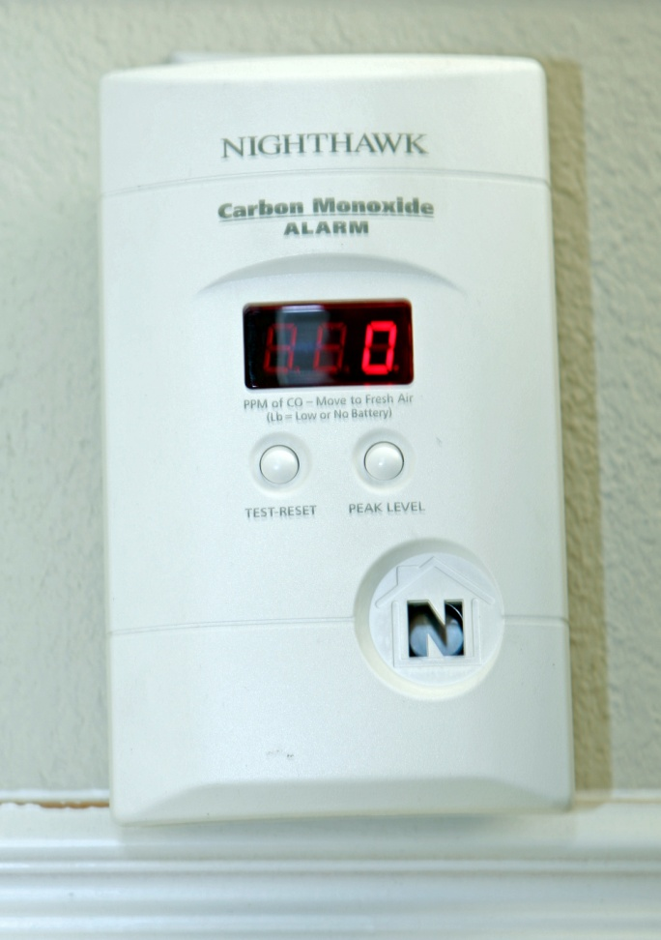
Carbon Monoxide Detection
CO detectors have been widely-available for over a decade.
Still vastly underutilized.
Underwriters Laboratories (UL) revised guidelines for CO detectors in 1998.
Units manufactured before 1998 should be replaced.

Slide 86
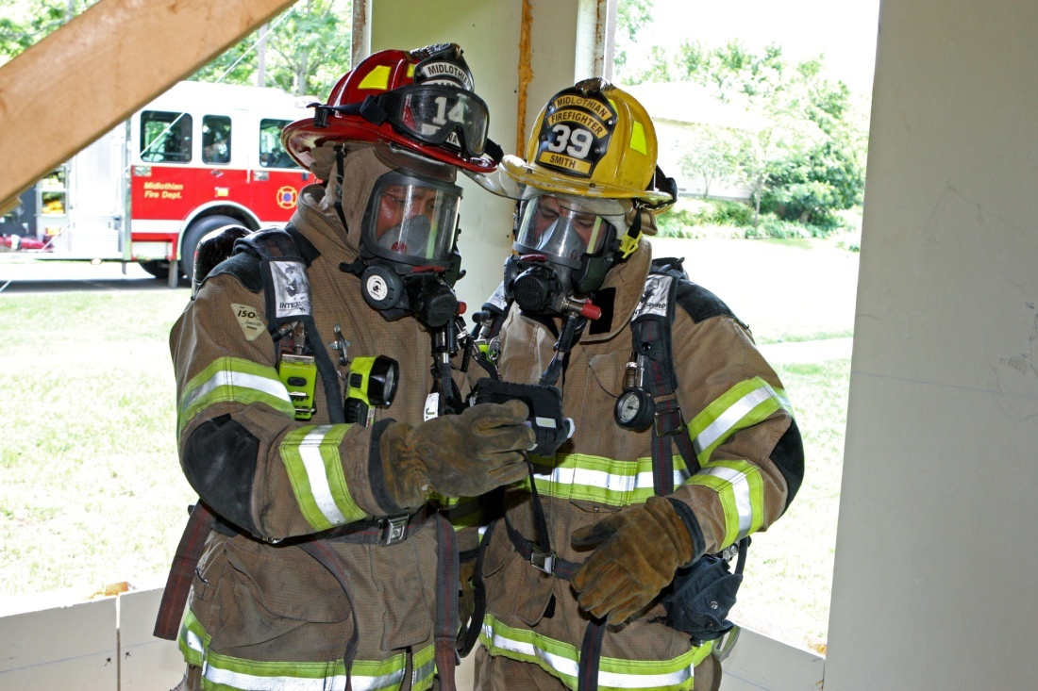
Carbon Monoxide Detection
Hand-held devices now available to assess atmospheric levels of CO.
Multi-gas detectors common in the fire service:
  Combustible gasses
  CO
  O₂
  H₂S

Slide 87
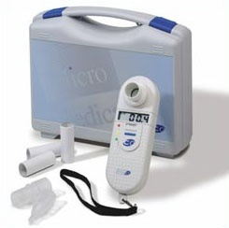
Carbon Monoxide Detection
Biological detection of CO limited:
  Exhaled CO measurement.
  Hospital-based carboxyhemoglobin levels (arterial or venous).

Slide 88
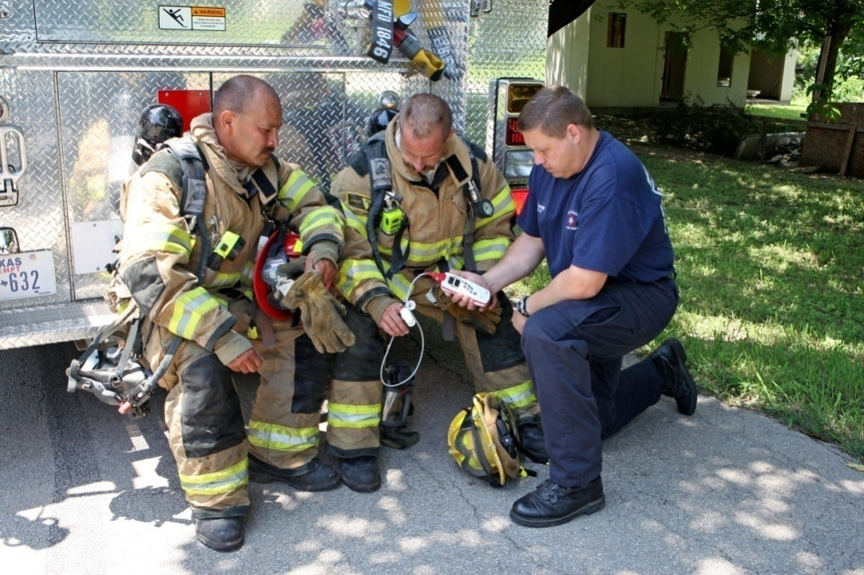
Carbon Monoxide Detection
Technology now available to detect biological COHb levels in the prehospital and ED setting.
Referred to as CO-oximetry

Slide 89
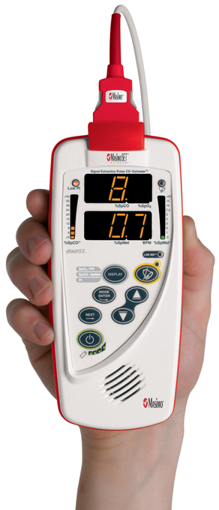
Carbon Monoxide Detection
New generation oximeter/CO-oximeter can detect 4 different hemoglobin forms.
  Deoxyhemoglobin (Hb)
  Oxyhemoglobin (O₂Hb)
  Carboxyhemoglobin (COHb)
  Methemoglobin (METHb)
Provides:
  SpO₂
  SpCO
  SpMET
  Pulse rate

Slide 90
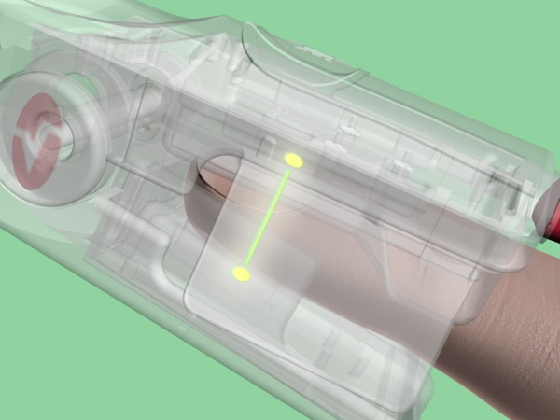
CO-Oximetry
Uses finger probe similar to that used in pulse oximetry.
Uses 8 different wavelengths of light (instead of 2 for pulse oximetry).
Readings very closely correlate with COHb levels measured in-hospital.

Slide 91
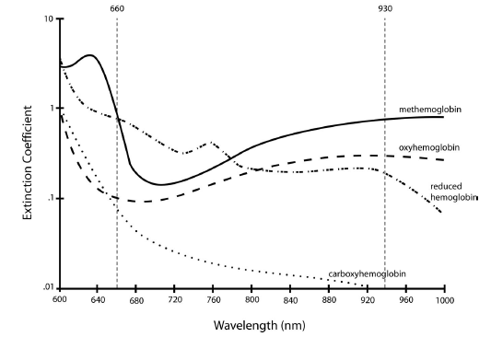
CO-Oximetry

Slide 92
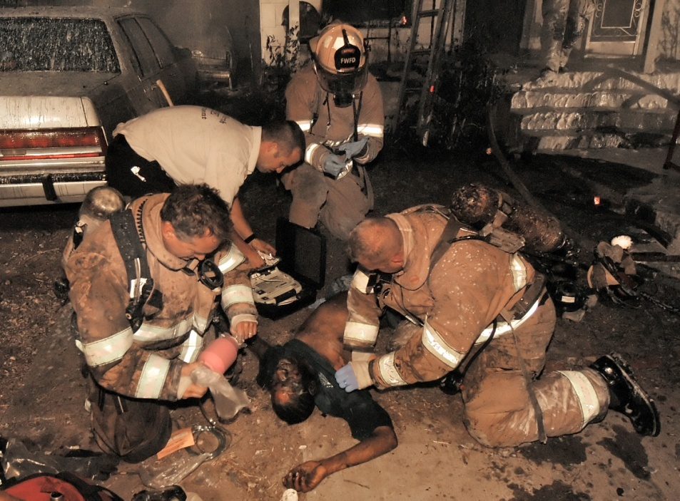
CO-Oximetry
What is the accuracy?

Slide 93
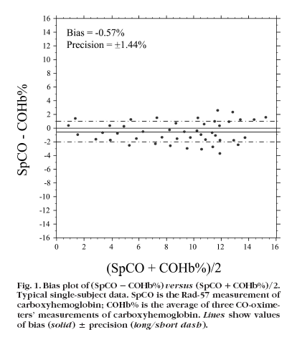
CO-Oximetry

Slide 94
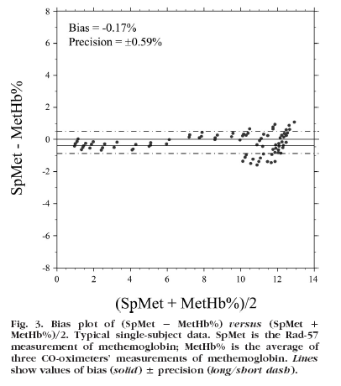
CO-Oximetry

Slide 95
CO-Oximetry
Carboxyhemoglobin (Range of 0-15%): Accuracy ± 2%
Methemoglobin (Range of 0-12%) Accuracy ± 0.5%
Source: Barker SJ, Curry J, Redford D, Morgan S. Measurement of carboxyhemoglobin and methemoglobin levels by pulse oximetry: A human volunteer study. Anesthesiology 2006;105:892-7

Slide 96
CO-Oximetry
Parameter | SaO₂ (ABL) | SpO₂ (RAD 57) | SaCO (ABL) | SpCO (RAD 57)
Mean | 90.8 ± 5.4 (σ) | 93.8 ± 4.2 (σ) | 2.0 ± 1.8 (σ) | 2.5 ± 2.0 (σ)
Maximum | 97.5 | 99 | 9.3 | 11
Minimum | 74.6 | 80 | 0.8 | 1
P Value |  | 0.001 |  | <0.015
Source: Mottram CD, Hanson LJ, Scanlon PD. Comparison of the Masimo RAD57 Pulse Oximeter with SPCO Technology against a Laboratory CO-oximeter Using Arterial Blood. Resp Care. 2005;50:11

Slide 97
Diagnostic Criteria
Biologic:
  COHb > 5% in nonsmokers.
  COHb > 10% in smokers.
Environmental:
  No confirmatory test.

Slide 98
Diagnostic Criteria
Suspected:
  Potentially-exposed person, but no credible threat exists.
Probable:
  Clinically-compatible case where credible threat exists.
Confirmed:
  Clinically-compatible case where biological tests have confirmed exposure.

Slide 99
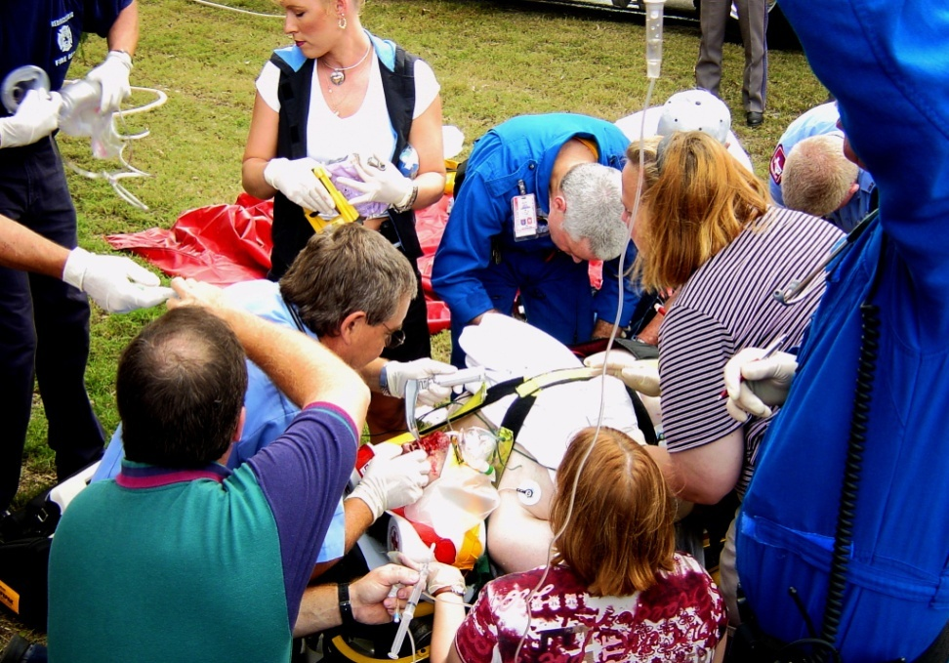
Treatment
Treatment is based on the severity of symptoms.
Treatment generally indicated with SpCO > 10-12%.
Be prepared to treat complications (i.e., seizures, dysrhythmias, cardiac ischemia).

Slide 100

Treatment
Administer high-concentration oxygen.
Maximizes hemoglobin oxygen saturation.
Can displace some CO from hemoglobin.
Associated with improvements in neurological and cardiac complications.
The importance of early administration of high-concentration oxygen CANNOT be overemphasized!

Slide 101
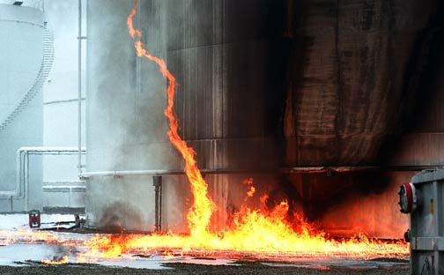
Treatment
Which is better?
  Oxygenation
  Ventilation

Slide 102
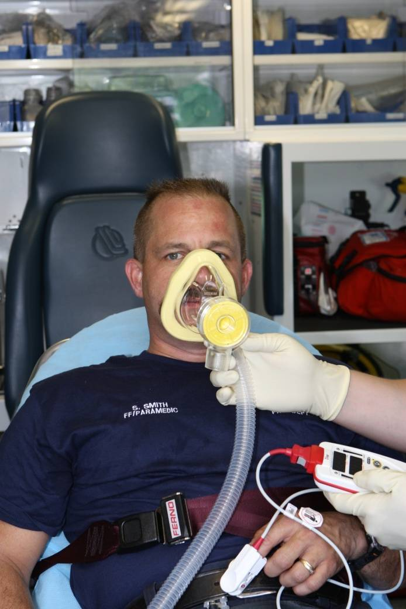
Treatment
Prehospital CPAP can maximally saturate hemoglobin and increase oxygen solubility.
Strongly suggested for moderate to severe poisonings.
Source: Jones A, Recent Advances in the Management of Poisoning. Ther Drug Monit 2002;24:150-155

Slide 103
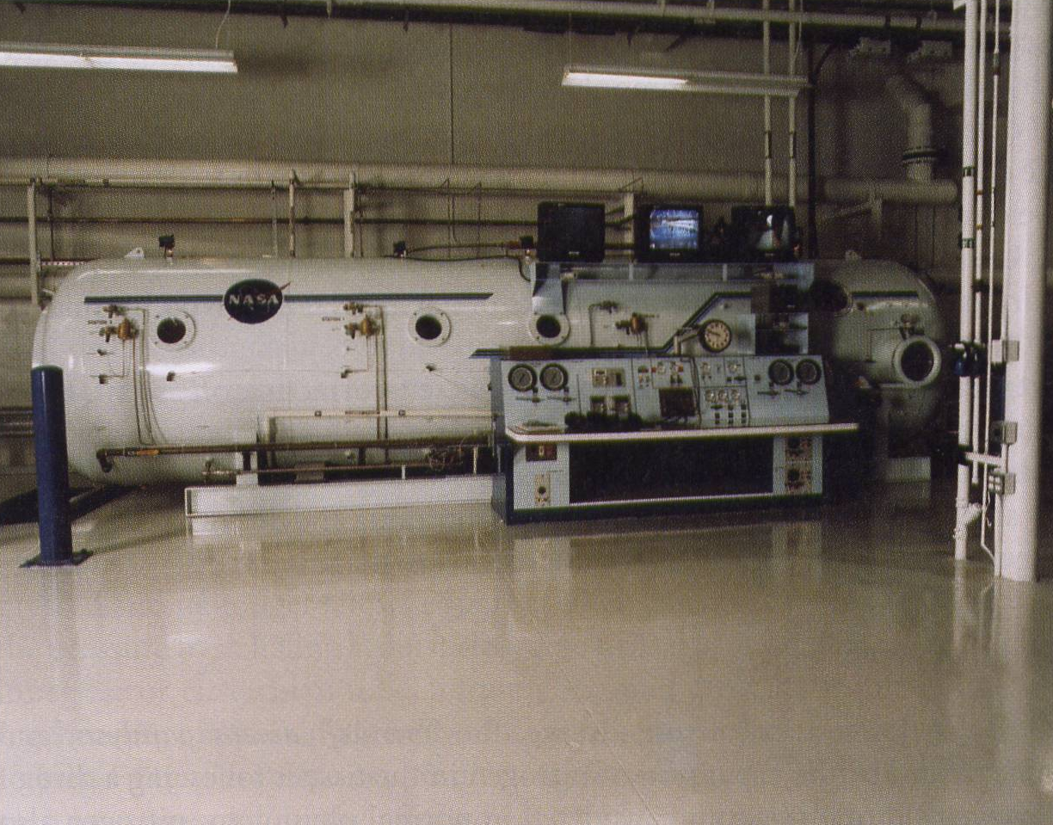
Treatment
Efficacy of hyperbaric oxygen therapy (HBO) is a matter of conjecture although still commonly practiced.
Generally reserved for severe poisonings.
May aid in alleviating tissue hypoxia.
Significantly decreases half-life of COHb.

Slide 104
Indications for HBO Therapy
Strongly consider for:
  Altered mental status.
  Coma.
  Focal neurological deficits.
  Seizures.
  Pregnancy with COHb>15%.
  History of LOC.

Slide 105
Indications for HBO Therapy
Possibly consider for:
  Cardiovascular compromise (e.g., ischemia, dysrhythmias).
  Metabolic acidosis.
  Extremes of age.

Slide 106

Remember
Don’t forget about the possibility of cyanide poisoning—alone or with CO!

Slide 107
Summary
CO still common and under diagnosed.
There appears to be a link between acute and chronic CO exposure and long term morbidity and mortality.
Effects of CO on hemeproteins and free-radical induction and oxidative stress probable mechanism.
EPs should have a low threshold for screening for CO.

