Slide 1


CAT
Joshua Bucher, M.D.
PGY 3 – RWJMS
Co-Chief, Department of EM

Slide 2

Disclosures

Slide 3
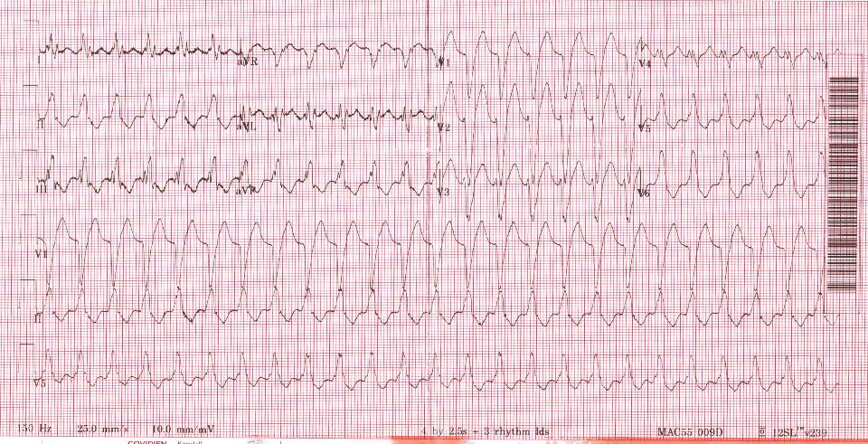
Medic phone rings…
Dr Resus, this is Ed. I have a cardiac patient for you…
Notes:
Patient has been having palpitations and had 1 shock this morning and now still has palpitations. She feels a little dizzy. Hx cad, htn, dm, CHF, ppm
HR 150 BP 110/70 RR 22 Sp02 98% on 4L

Slide 4
Question 1 = how can you identify vt?

Slide 5

Can we differentiate VT from SVT?

Slide 6

Is this VT?
Atrioventricular (AV) dissociation
Presence of fusion or captured complexes.
Subtle variability in QRS complex morphology due to slight variability in the direction of impulse conduction and myocardial activation
Variability of ST and T waves from superimposed P waves or from changes in repolarization.
A period of irregularity prior to the initiation of arrhythmia ("warm up phenomenon")
Concordance of QRS complexes in the precordial leads
QRS axis shift from baseline ECG axis.
http://www.uptodate.com/contents/sustained-monomorphic-ventricular-tachycardia-diagnosis-and-evaluation#H10017891

Slide 7
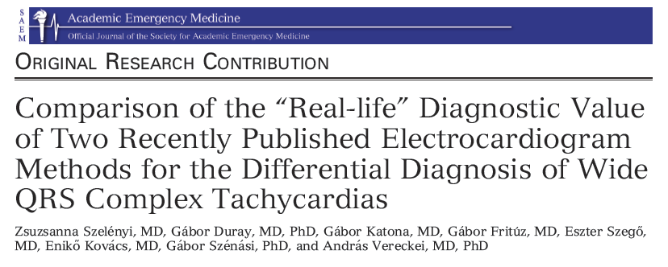
What do we do in real time?
Notes:
7 examiners sitting in a room (NOT IN “Real Life”) got the ECGs.
Read the articles.
Given 30 ekgs to interpret
7 people = 2 board certified cards, 2 board certified ed docs, 1 em resident, 1 internal medicine resident, 1 new cardiology fellow
Compared to electrophysiologically proven VT (presumably they could induce the arrhythmia in the EP lab)

Slide 8
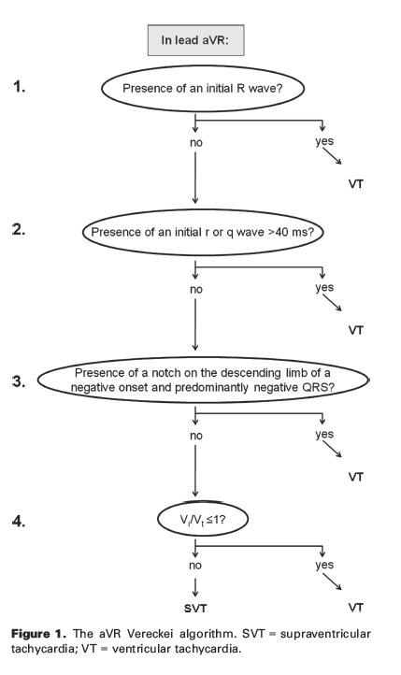

Slide 9


Lead II R-wave peak time (RWPT) criterion
The principle on which the lead II RWPT criterion is based is that most VTs (myocardial VTs) are associated with slow initial ventricular activation close to the site of origin due to slow muscle-to-muscle conduction, resulting in a more significantly prolonged QRS duration or time to the intrinsicoid deflection when the mechanism of WCT is VT versus SVT.
< 50 ms

Slide 10
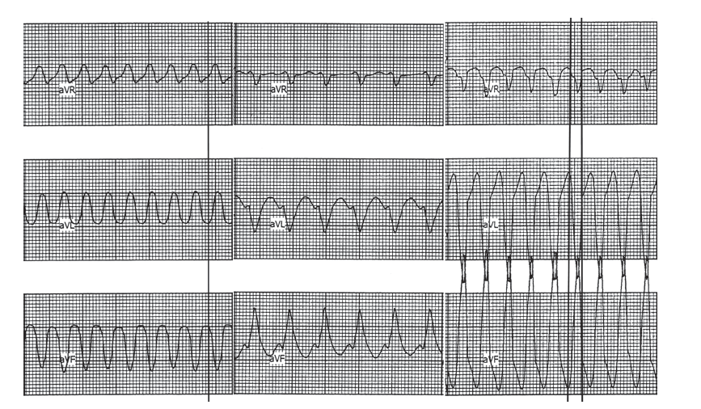
Notes:
Examples for the positivity of the first three steps of the new aVR algorithm. The figure demonstrates three different wide
QRS tachycardia WCT ECGs where one of the first three steps of the new aVR algorithm was positive (i.e., suggested a diagnosis of
VT). Only the simultaneously recorded leads aVR, aVL, and aVF are shown from each 12-lead ECG. In the left panel an initial R-wave is
present in lead aVR; thus the first step suggests VT. The crossing point of the vertical line with the contour of the last QRS denotes the
onset of the QRS. In the middle panel an rS complex is seen in lead aVR, with an R-wave width of 70 milliseconds; therefore, the second
step of the algorithm suggests VT. The right panel displays a notch on the downstroke of a negative onset and predominantly negative
QRS; thus VT is diagnosed in the third step. The crossing points of the two vertical lines with the contour of the sixth QRS complex
mark the onset and end of the QRS. Reproduced, with permission, from Vereckei A, Duray G, Szenasi G, Altemose GT, Miller JM. A
new algorithm using only lead aVR for the differential diagnosis of wide QRS complex tachycardia. Heart Rhythm 2008;5:89–98.15
ECG = electrocardiogram; SVT = supraventricular tachycardia; VT = ventricular tachycardia; WCT = wide QRS complex tachycardia.

Slide 11
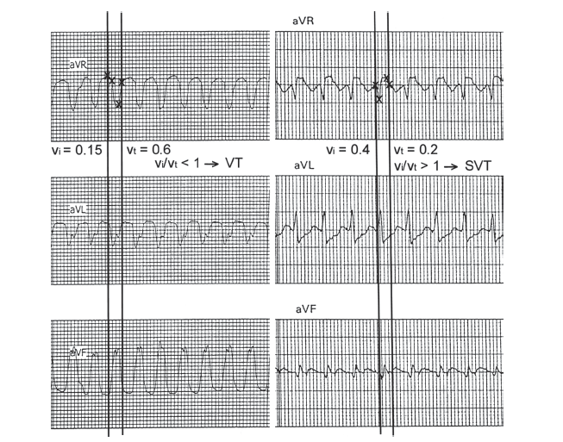
Notes:
The use of vi/vt criterion in the fourth step of the new aVR algorithm. In both panels the crossing points of the vertical
lines with the QRS contour in lead aVR show the onset and end of the QRS complex in lead aVR. The crossing points and initial
and terminal 40 milliseconds of the chosen QRS complex are marked by small crosses. In the left panel, during the initial 40 milliseconds
of the QRS the impulse traveled vertically 0.15 mV; therefore, the vi = 0.15 and during the terminal 40 milliseconds of the
QRS the impulse traveled vertically 0.6 mV; therefore, the vt = 0.6, and thus the vi/vt < 1 yields a diagnosis of VT. In the right panel
the vi = 0.4 and vt = 0.2 determined the same way as in the left panel, and thus vi/vt > 1 suggests a diagnosis of SVT. Reproduced,
with permission, from Vereckei A, Duray G, Szenasi G, Altemose GT, Miller JM. A new algorithm using only lead aVR for the differential
diagnosis of wide QRS complex tachycardia. Heart Rhythm 2008;5:89–98.15 VT = ventricular tachycardia; SVT = supraventricular
tachycardia; WCT = wide QRS complex tachycardia.

Slide 12
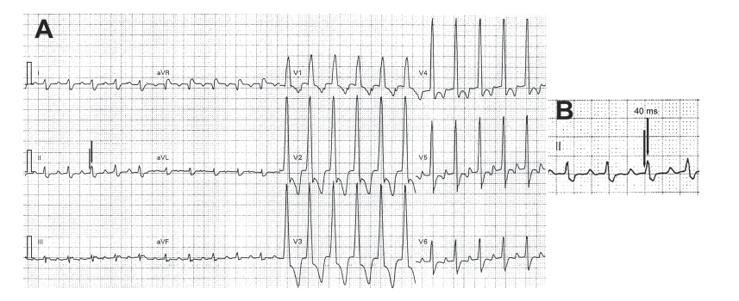
Notes:
The use of the lead II RWPT criterion. (A) Twelve-lead WCT tracing recorded from a patient with SVT and a right bundle
branch block pattern. (B) Magnified view of lead II from A. The RWPT, which is the interval between the two vertical arrows, was
<50 milliseconds; thus SVT diagnosis was made with the lead II RWPT criterion. RWPT = R-wave peak time; SVT = supraventricular
tachycardia; WCT = wide QRS complex tachycardia.

Slide 13
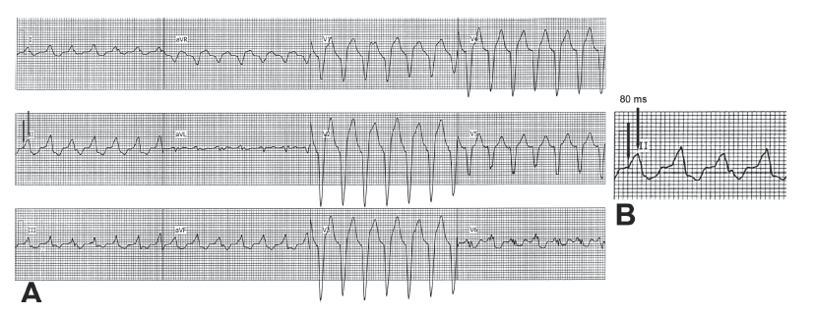
Notes:
The use of the lead II RWPT criterion. (A) Twelve-lead WCT tracing recorded from a patient with VT and left bundle
branch block pattern. (B) Magnified view of lead II from A. The RWPT, which is the interval between the two vertical arrows, was
≥50 milliseconds; thus VT diagnosis was made with the lead II RWPT criterion. RWPT = R-wave peak time; VT = ventricular tachycardia;
WCT = wide QRS complex tachycardia.

Slide 14
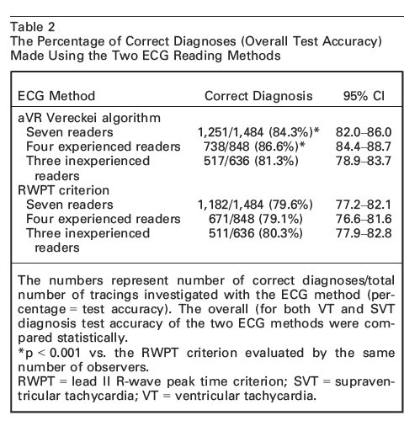
Notes:
Here is the % correct. This is terrible!!!!!!!!!

Slide 15
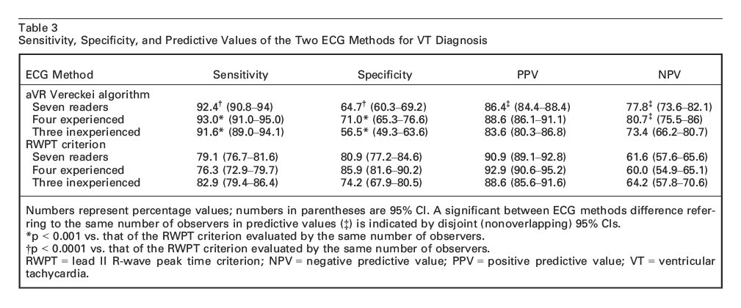
Notes:
These sensitivities and NPV are terrible because VT is a life threatening diagnosis that kills people if you miss it.

Slide 16
Conclusions?
The aVR lead Vereckei algorithm had a superior overall
test accuracy, sensitivity, and negative predictive value
for ventricular tachycardia diagnosis and inferior
specificity and positive predictive value for ventricular
tachycardia diagnosis compared to those of the lead II
R-wave peak time criterion. The incorrect diagnoses
made by the aVR Vereckei algorithm were mainly due to
misdiagnosis of supraventricular tachycardia as ventricular
tachycardia, while the majority of incorrect diagnoses
made by the lead II R-wave peak time criterion were
mostly due to misdiagnosis of ventricular tachycardia as
supraventricular tachycardia, which is the more dangerous
error. We failed to reproduce the excellent overall
test accuracy, sensitivity, specificity, and predictive values
reported originally for both electrocardiographic
methods. A post hoc analysis suggests that the two electrocardiographic
methods have similar diagnostic value
when applied by inexperienced physicians, and the diagnostic
value of the aVR Vereckei algorithm is superior in
the hands of experienced physicians.
Notes:
YOU CANNOT RULE OUT VT WITH THESE ALGORITHIMS

Slide 17
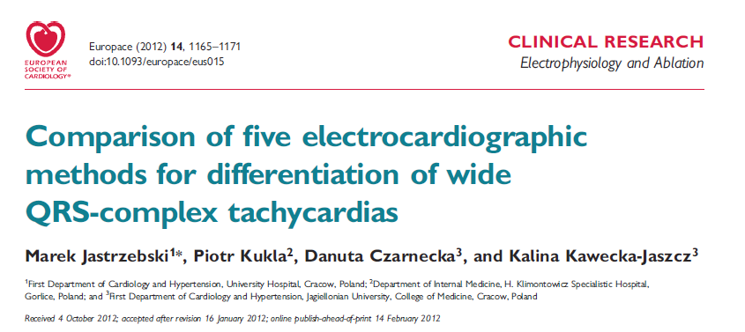
Notes:
Taken 260 ekgs
1 cards, 1 EP
VT confirmed by EP study, intracardiac EKG, more EP lab stuff
5 different methods – lead II RWPT
aVR, Brugada, Bayesian, Griffith,

Slide 18
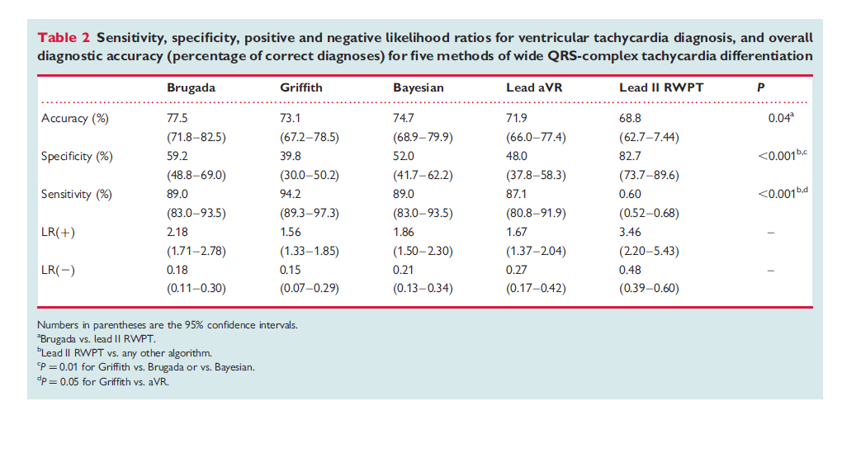
Notes:
Look at these numbers! Terrible! We CANNOT RULE OUT VT based on algorithims.

Slide 19


Conclusion
None of them are good enough to reliably rule out VT

Slide 20
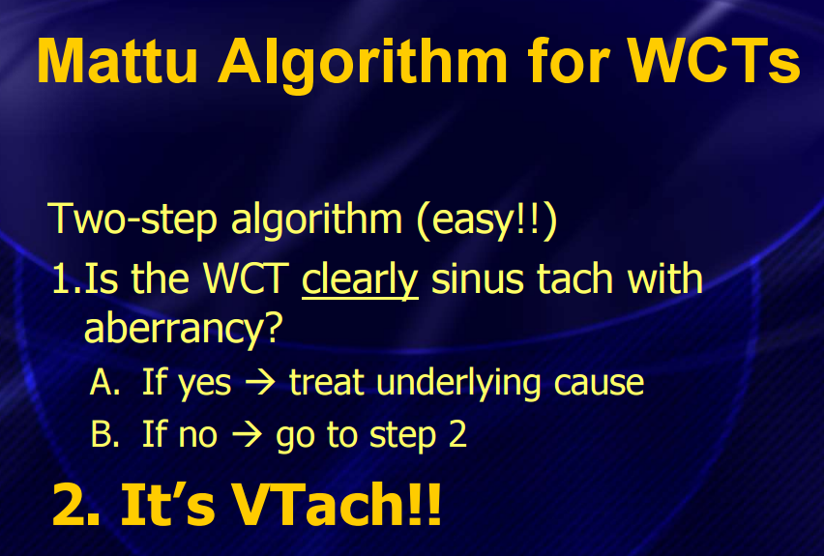
Course: From Paper to Patient: Recent Advances in Emergency Electrocardiography That Will Save a Life. ACEP SA 2014. Chicago, IL.

Slide 21
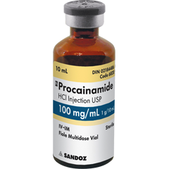
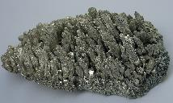
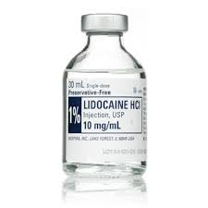
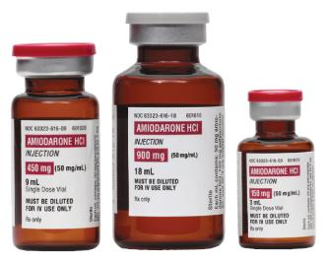
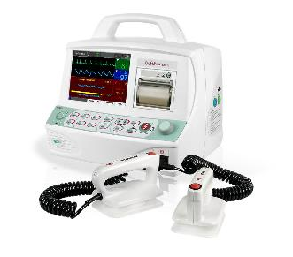
Question 2 = What is the safest way to treat VT?

Slide 22
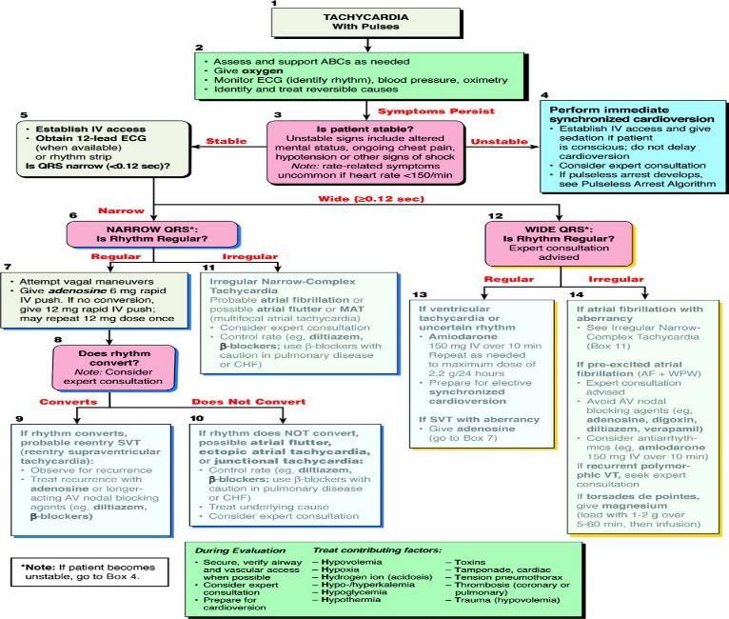
Notes:
Take a look here? Is it wide?
Amiodarone?
Magnesium?
SVT with aberrance?
Adenosine?
Seek Expert Consultation?

Slide 23
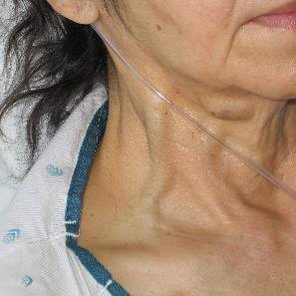


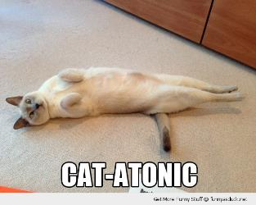
Stable vs Unstable
Notes:
Unstable – bad vitals, diaphoretic, ams, jvd, heart failure, rales, bad circulation
Stable - ?

Slide 24

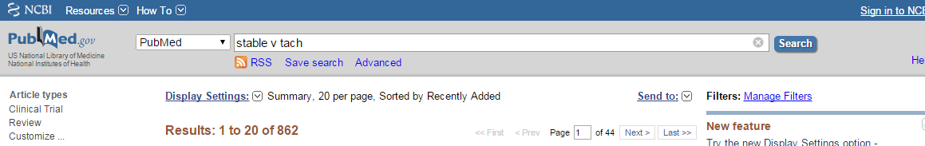

Stable VT?
Notes:
Most of these articles are not even about cardiology.

Slide 25
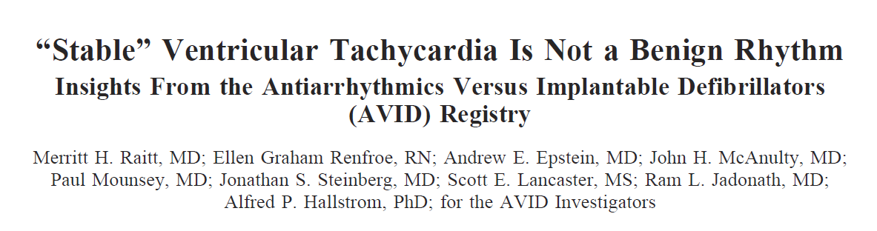
Notes:
AVID – antiarrythmic versus implantable defibrillator for vt patients – this is a subgroup analysis
Stable VT was defined as electrocardiographically documented
sustained VT not associated with significant hemodynamic compromise
or angina.
1500 patients or so

Slide 26
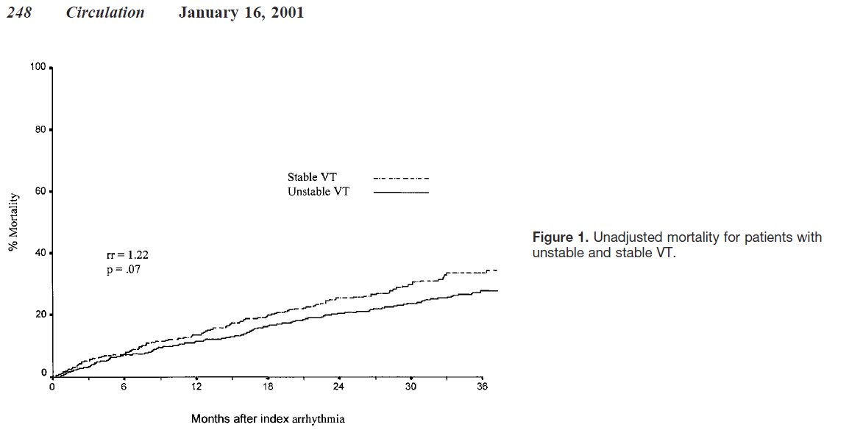
Notes:
Unadjusted mortality higher in the group with “stable VT” episodes

Slide 27
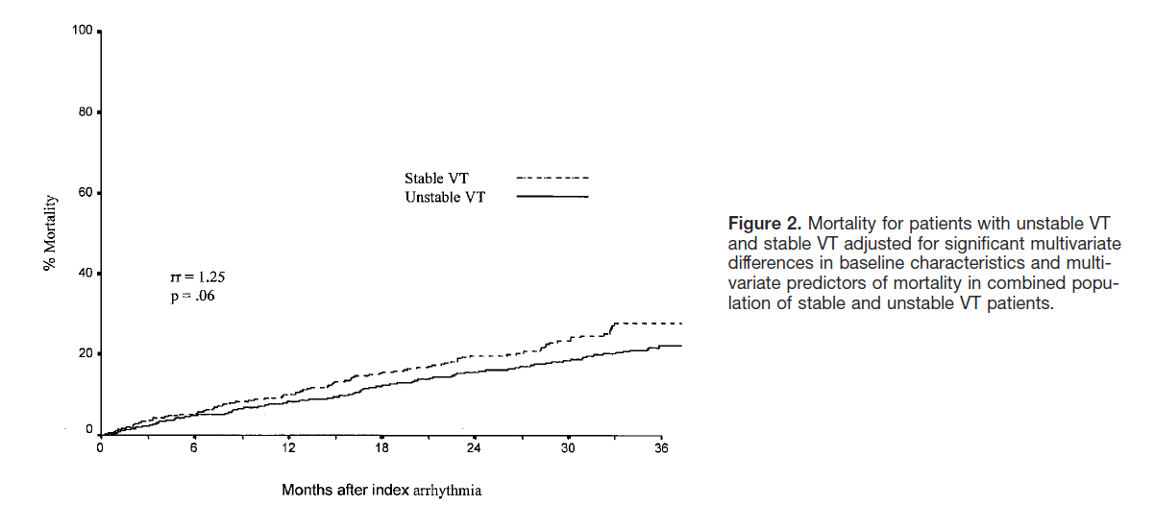
Notes:
Adjusted mortality. “stable vt” patients still died more

Slide 28
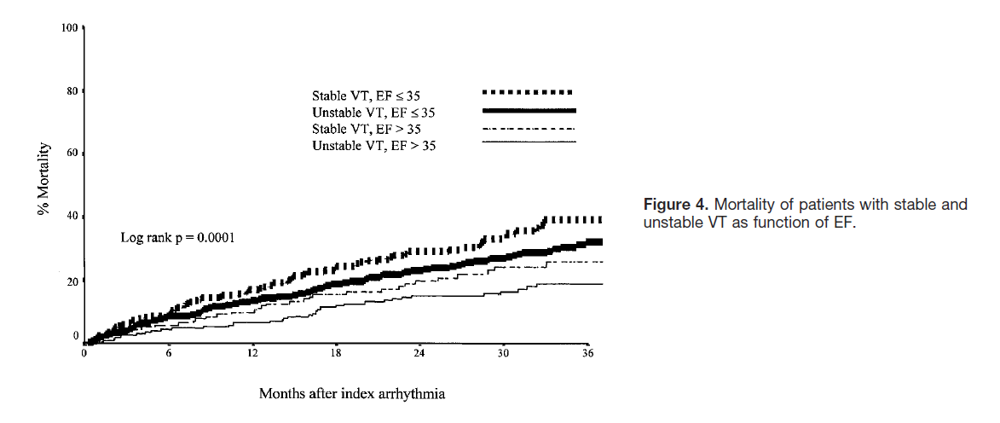

Slide 29


Conclusion
The stable VT patients tended to have a higher mortality (33.6% versus 27.6%) at 3 years, with a
relative risk (RR) of death of 1.22 (P50.07). After adjustment for predictors of mortality (Figure 2), the trend toward increased mortality in stable VT persisted (RR51.25; 95% CI, 0.99 to 1.59; P50.06).
Notes:
This retrospective, nonrandomized, observational analysis suggests that patients presenting with stable, hemodynamically well-tolerated VT and underlying heart disease have at least as high a total mortality rate as patients presenting with
VT and more severe symptoms. Stable VT may be a marker for a cardiac electrophysiological substrate capable of pro-ducing arrhythmias that are more malignant. ICD therapy has been shown to decrease mortality in patients with unstable
VT, and given these results, ICD therapy may decrease mortality in patients presenting with stable VT. Studies of ICD therapy in patients with stable VT are warranted
IS THIS APPLICABLE TO US? NO BECAUSE LONG TERM MORTALITY OUTCOME, BUT WE NEED TO BE AWARE THAT THERE IS NO SUCH THING AS STABLE VT

Slide 30

Now what do we do?
Stable
Unstable

Slide 31
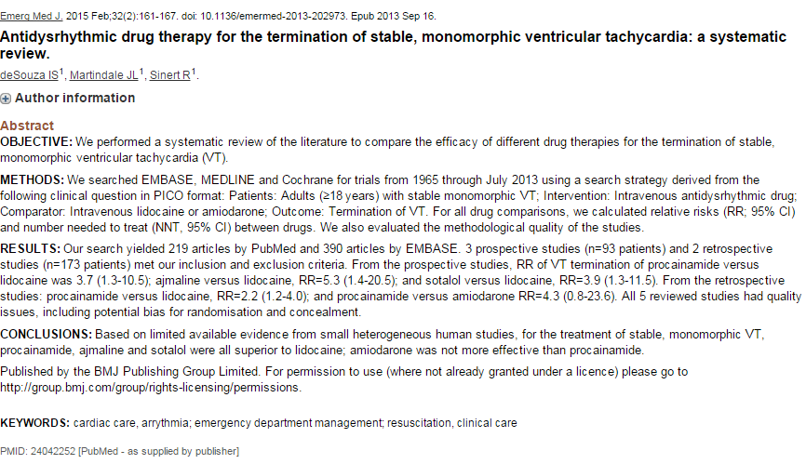
Notes:
Procainamide, amiodarone, sotalol all great choices.
Lidocaine slightly less effective.

Slide 32
Amiodarone
ALERT: U.S. Boxed WarningLife-threatening arrhythmias:Amiodarone is intended for use only in patients with indicated life-threatening arrhythmias because its use is accompanied by substantial toxicity.
Potentially fatal toxicities:Amiodarone has several potentially fatal toxicities, the most important of which is pulmonary toxicity (hypersensitivity pneumonitis or interstitial/alveolar pneumonitis) that has resulted in clinically manifest disease at rates as high as 10% to 17% in some series of patients with ventricular arrhythmias given doses of approximately 400 mg/day, and as abnormal diffusion capacity without symptoms in a much higher percentage of patients. Pulmonary toxicity has been fatal approximately 10% of the time. Liver injury is common with amiodarone, but is usually mild and evidenced only by abnormal liver enzymes. However, overt liver disease can occur and has been fatal in a few cases. Like other antiarrhythmics, amiodarone can exacerbate the arrhythmia (eg, by making the arrhythmia less well tolerated or more difficult to reverse). This has occurred in 2% to 5% of patients in various series, and significant heart block or sinus bradycardia has been seen in 2% to 5%. In most cases, all of these events should be manageable in the proper clinical setting. Although the frequency of such proarrhythmic events does not appear greater with amiodarone than with many other agents used in this population, the effects are prolonged when they occur.
High-risk patients:Even in patients at high risk of arrhythmic death in whom the toxicity of amiodarone is an acceptable risk, amiodarone poses major management problems that could be life-threatening in a population at risk of sudden death; therefore, make every effort to utilize alternative agents first.
The difficulty of using amiodarone effectively and safely poses a significant risk to patients. Patients with the indicated arrhythmias must be hospitalized while the loading dose of amiodarone is given, and a response generally requires at least 1 week, usually 2 weeks or more. Because absorption and elimination are variable, maintenance dose selection is difficult, and it is not unusual to require dosage decrease or discontinuation of treatment. In a retrospective survey of 192 patients with ventricular tachyarrhythmias, 84 patients required dose reduction and 18 required at least temporary discontinuation because of adverse reactions, and several series have reported 15% to 20% overall frequencies of discontinuation because of adverse reactions. The time at which a previously controlled life-threatening arrhythmia will recur after discontinuation or dose adjustment is unpredictable, ranging from weeks to months. The patient is obviously at great risk during this time and may need prolonged hospitalization. Attempts to substitute other antiarrhythmic agents when amiodarone must be stopped will be made difficult by the gradually, but unpredictably, changing amiodarone body burden. A similar problem exists when amiodarone is not effective; it still poses the risk of an interaction with whatever subsequent treatment is tried.
http://www.uptodate.com/contents/amiodarone-drug-information?source=search_result&search=amiodarone&selectedTitle=1~150
Notes:
Pulmonary toxicity. Ventricular arrhythmia. Abnormalk DLCO. Liver toxicity. Thyroid dysfunction. Pro arrythmogenic

Slide 33
There’s more…
Adverse Reactions Significant In a recent meta-analysis, adult patients taking lower doses of amiodarone (152 to 330 mg daily for at least 12 months) were more likely to develop thyroid, neurologic, skin, ocular, and bradycardic abnormalities than those taking placebo (Vorperian, 1997). Pulmonary toxicity was similar in both the low-dose amiodarone group and in the placebo group, but there was a trend towards increased toxicity in the amiodarone group. Gastrointestinal and hepatic events were seen to a similar extent in both the low-dose amiodarone group and placebo group. As the frequency of adverse events varies considerably across studies as a function of route and dose, a consolidation of adverse event rates is provided by Goldschlager, 2000.
>10%:
Cardiovascular: Hypotension (IV 16%, refractory in rare cases)
Central nervous system (3% to 40%): Abnormal gait, ataxia, dizziness, fatigue, malaise, memory impairment, involuntary body movements, peripheral neuropathy
Gastrointestinal: Nausea (oral: 10% to 33%; IV: 4%), vomiting (10% to 33%), anorexia (≤25%) constipation (≤25%)
Hepatic: Increased transaminases (oral: 3% to 9%; IV: <2%)
Neuromuscular & skeletal: Tremor (3% to 40%)
Ophthalmic: Corneal deposits (>90%; causes visual disturbance in <10%), photophobia
1% to 10%:
Cardiovascular: Atrioventricular block (5%), bradycardia (3% to 5%), CHF (3%), sinus node dysfunction (1% to 3%), cardiac arrhythmia, cardiac conduction disturbance, cardiac failure, flushing, edema, phlebitis (IV, with concentrations >3 mg/mL). Additional effects associated with IV administration include torsades de pointes (rare) (<2%), ventricular fibrillation (<2%), asystole, atrial fibrillation, cardiac arrest, atrioventricular dissociation, pulseless electrical activity (PEA), ventricular tachycardia, and cardiogenic shock.
Central nervous system: Altered sense of smell (1% to 3%), headache (1% to 3%), insomnia (1% to 3%), sleep disorder (1% to 3%)
Dermatologic: Blue-gray skin pigmentation (oral: ≤15% with prolonged exposure to amiodarone)
Endocrine & metabolic: Hyperthyroidism (3% to 10%; more common in iodine-deficient regions of the world), hypothyroidism (1% to 10%), decreased libido (1% to 3%)
Gastrointestinal: Altered salivation (1% to 3%), dysgeusia (1% to 3%), diarrhea(<2%), abdominal pain
Hematologic & oncologic: Blood coagulation disorder (1% to 3%)
Ophthalmic: Visual halos (≤10%), visual disturbance (2% to 9%), optic neuritis (1%)
Respiratory: Pulmonary toxicity has been estimated to occur at a frequency between 2% and 7% of patients (some reports indicate a frequency as high as 17%). Toxicity may present as hypersensitivity pneumonitis; pulmonary fibrosis (cough, fever, malaise); pulmonary edema (IV: <2%), pneumonitis; interstitial pneumonitis; or alveolar pneumonitis.
<1% (Limited to important or life-threatening): Acute renal failure, agranulocytosis, alopecia, anaphylactic shock, angioedema, aplastic anemia, brain disease, bronchiolitis obliterans organizing pneumonia, bronchospasm, cholestatic hepatitis, confusion, delirium, demyelinating polyneuropathy, disorientation, DRESS syndrome, drug-induced Parkinson’s disease, dyskinesia, dyspnea, eosinophilic pneumonia, epididymitis (noninfectious), erythema multiforme, exfoliative dermatitis, fever, gynecomastia, hallucination, hemolytic anemia, hemoptysis, hepatic cirrhosis, hepatitis, hypotension, hypoxia, impotence, injection site reaction, intracranial hypertension (IV), leukocytoclastic vasculitis, malignant neoplasm of skin, mass (pulmonary), muscle weakness, myopathy, optic neuropathy, pancreatitis, pancytopenia, pleural effusion, pleurisy, pseudotumor cerebri, pulmonary alveolar hemorrhage, pulmonary infiltrates, prolonged Q-T interval on ECG (associated with worsening of arrhythmia), renal insufficiency, respiratory failure, rhabdomyolysis, SIADH, sinoatrial arrest, skin granuloma, skin rash, spontaneous ecchymosis, Stevens-Johnson syndrome, thrombocytopenia, thyroid cancer, thyroid nodule, thyrotoxicosis, toxic epidermal necrolysis, vasculitis, wheezing
Contraindications Hypersensitivity to amiodarone, iodine, or any component of the formulation; severe sinus-node dysfunction causing marked sinus bradycardia; second- and third-degree heart block (except in patients with a functioning artificial pacemaker); bradycardia causing syncope (except in patients with a functioning artificial pacemaker); cardiogenic shock
http://www.uptodate.com/contents/amiodarone-drug-information?source=search_result&search=amiodarone&selectedTitle=1~150

Slide 34
And more
Warnings/PrecautionsConcerns related to adverse effects:
• Bradycardia/hypotension: May cause hypotension and bradycardia (infusion-rate related). Hypotension with rapid administration has been attributed to the emulsifier polysorbate 80. Commercially-prepared premixed solutions do not contain polysorbate 80 and may have a lower incidence of hypotension.
• Dermatologic toxicity: May cause life-threatening or fatal cutaneous reactions, including Stevens-Johnson syndrome and toxic epidermal necrolysis (TEN). If symptoms or signs (eg, progressive skin rash often with blisters or mucosal lesions) occur, immediately discontinue.
• Hepatotoxicity: [U.S. Boxed Warning]: Liver toxicity is common, but usually mild with evidence of only increased liver enzymes; severe liver toxicity can occur and has been fatal in a few cases. Hepatic enzyme levels are frequently elevated in patients exposed to amiodarone; most cases are asymptomatic. If increases >3x ULN (or ≥2x baseline in patients with preexisting elevations), consider dose reduction or discontinuation. Monitor hepatic enzymes regularly in patients on relatively high maintenance doses.
• Neurotoxicity: Peripheral neuropathy has been reported rarely with chronic administration; may resolve when amiodarone is discontinued, but resolution may be slow and incomplete.
• Ocular effects: Regular ophthalmic examination (including slit lamp and fundoscopy) is recommended. May cause optic neuropathy and/or optic neuritis resulting in visual impairment (peripheral vision loss, changes in acuity) at any time during therapy; permanent blindness has occurred. If symptoms of optic neuropathy and/or optic neuritis occur, prompt ophthalmic evaluation is recommended. If diagnosis of optic neuropathy and/or optic neuritis is confirmed, reevaluate amiodarone therapy. Corneal microdeposits occur in a majority of adults and may cause visual disturbances in up to 10% of patients (blurred vision, halos); asymptomatic microdeposits may be reversible and are not generally considered a reason to discontinue treatment. Corneal refractive laser surgery is generally contraindicated in amiodarone users (from manufacturers of surgical devices).
• Photosensitivity: Avoid excessive exposure to sunlight; may cause photosensitivity. During long-term treatment, a blue-gray discoloration of exposed skin may occur; risk increased in patients with fair complexion or excessive sun exposure; may be related to cumulative dose and duration of therapy.
• Proarrhythmic effects: [U.S. Boxed Warning]: Amiodarone can exacerbate arrhythmias, by making them more difficult to tolerate or reverse; other types of arrhythmias have occurred, including significant heart block, sinus bradycardia, new ventricular fibrillation, incessant ventricular tachycardia, increased resistance to cardioversion, and polymorphic ventricular tachycardia associated with QTc prolongation (torsades de pointes [TdP]). Risk may be increased with concomitant use of other antiarrhythmic agents or drugs that prolong the QTc interval. Proarrhythmic effects may be prolonged.
• Pulmonary toxicity: [U.S. Boxed Warning]: Pulmonary toxicity (hypersensitivity pneumonitis or interstitial/alveolar pneumonitis and abnormal diffusion capacity without symptoms) may occur. Reports of acute-onset pulmonary injury (pulmonary infiltrates and/or mass on X-ray, pulmonary alveolar hemorrhage, pleural effusion, bronchospasm, wheezing, fever, dyspnea, cough, hemoptysis, hypoxia) have occurred; some cases have progressed to respiratory failure and/or death. Fatalities due to pulmonary toxicity occur in ~10% of cases; most fatalities due to sudden cardiac death occurred when amiodarone was discontinued; rule out other causes of respiratory impairment before discontinuing amiodarone in patients with life-threatening arrhythmias; use extreme caution if dose is decreased or discontinued. If hypersensitivity pneumonitis occurs, discontinue amiodarone and institute steroid therapy; if interstitial/alveolar pneumonitis occurs, institute steroid therapy and reduce amiodarone dose or preferably, discontinue. Some cases of interstitial/alveolar pneumonitis may resolve following dosage reduction and steroid therapy; rechallenge at a lower dose has not resulted in return of interstitial/alveolar pneumonitis in some patients; however, in some patients the pulmonary lesions have not been reversible. Educate patients about monitoring for symptoms (eg, nonproductive cough, dyspnea, pleuritic pain, hemoptysis, wheezing, weight loss, fever, malaise). Evaluate new respiratory symptoms; preexisting pulmonary disease does not increase risk of developing pulmonary toxicity, but if pulmonary toxicity develops then the prognosis is worse. Use of lower doses may be associated with a decreased incidence, but pulmonary toxicity has been reported in patients treated with low doses. The lowest effective dose should be used as appropriate for the acuity/severity of the arrhythmia being treated.
• Thyroid effects: May cause hyper- or hypothyroidism; hyperthyroidism may result in thyrotoxicosis (including fatalities) and/or the possibility of arrhythmia breakthrough or aggravation. If any new signs of arrhythmia appear, consider the possibility of hyperthyroidism. If hyper- or hypothyroidism occurs, reduce dose or discontinue amiodarone. Thyroid nodules and/or thyroid cancer have also been reported. Use caution in patients with thyroid disease; thyroid function should be monitored prior to treatment and periodically thereafter, particularly in the elderly and in patients with underlying thyroid dysfunction.
Disease-related concerns:
• Arrhythmias: Appropriate use: [U.S. Boxed Warnings]: Only indicated for patients with life-threatening arrhythmias because of risk of substantial toxicity. Alternative therapies should be tried first before using amiodarone. Patients should be hospitalized when amiodarone is initiated. Currently, the 2010 ACLS guidelines recommend IV amiodarone as the preferred antiarrhythmic for the treatment of pulseless VT/VF. In patients with non-life-threatening arrhythmias (eg, atrial fibrillation), amiodarone should be used only if the use of other antiarrhythmics has proven ineffective or are contraindicated.
• Cardiac devices (eg, implanted defibrillators, pacemakers): Chronic administration of antiarrhythmic drugs may affect defibrillation or pacing thresholds. Assess when initiating amiodarone and during therapy.
• Electrolyte imbalance: Correct electrolyte disturbances, especially hypokalemia or hypomagnesemia, prior to use and throughout therapy.
• Myocardial infarction: In the setting of acute myocardial infarction, beta-blocker therapy should still be initiated even though concomitant amiodarone therapy provides beta-blockade.
• Wolff-Parkinson-White (WPW) syndrome: Amiodarone should not be used in patients with WPW syndrome and preexcited atrial fibrillation/flutter since ventricular fibrillation may result (AHA/ACC/HRS [January, 2014]).
Concurrent drug therapy issues:
• Drug-drug interactions: Potentially significant interactions may exist, requiring dose or frequency adjustment, additional monitoring, and/or selection of alternative therapy. Consult drug interactions database for more detailed information.
• Drugs metabolized by CYP enzymes: Amiodarone is a potent inhibitor of CYP enzymes and transport proteins (including p-glycoprotein), which may lead to increased serum concentrations/toxicity of a number of medications.
• Drugs with QT prolongation potential: Particular caution must be used when a drug with QTc-prolonging potential relies on metabolism via enzymes amiodarone inhibits, since the effect of elevated concentrations may be additive with the effect of amiodarone. Carefully assess risk:benefit of coadministration of other drugs which may prolong QTc interval.
• Warfarin: Use caution when initiating amiodarone in patients on warfarin. Cases of increased INR with or without bleeding have occurred in patients treated with warfarin; monitor INR closely after initiating amiodarone in these patients.
Special populations:
• Elderly: Use is associated with thyroid disease, pulmonary abnormalities, and QT-interval prolongation. In the treatment of atrial fibrillation, avoid antiarrhythmics as first-line treatment. In older adults, data suggests rate control may provide more benefits than risks compared to rhythm control for most patients (Beers Criteria).
• Surgical patients: Use caution and close perioperative monitoring in surgical patients; may enhance myocardial depressant and conduction effects of halogenated inhalational anesthetics; adult respiratory distress syndrome (ARDS) has been reported postoperatively (fatal in rare cases). Hypotension upon discontinuation of cardiopulmonary bypass during open-heart surgery have been reported (rare); relationship to amiodarone is unknown.
Dosage form specific issues:
• Commercially-prepared premixed infusion: Contains the excipient cyclodextrin (sulfobutyl ether beta-cyclodextrin), which may accumulate in patients with renal insufficiency.
• Long-term use: There has been limited experience in patients receiving IV amiodarone for >3 weeks.
Other warnings/precautions:
• CAST trial: In the Cardiac Arrhythmia Suppression Trial (CAST), recent (>6 days but <2 years ago) myocardial infarction patients with asymptomatic, nonlife-threatening ventricular arrhythmias did not benefit and may have been harmed by attempts to suppress the arrhythmia with flecainide or encainide. An increased mortality or nonfatal cardiac arrest rate (7.7%) was seen in the active treatment group compared with patients in the placebo group (3%). The applicability of the CAST results to other populations is unknown. Use of amiodarone post-MI was not associated with an increase in mortality in two post-MI trials. Antiarrhythmic agents should be reserved for patients with life-threatening ventricular arrhythmias.
• Discontinuation of therapy: Patients may still be at risk for amiodarone–related drug interactions after the drug has been discontinued. The pharmacokinetics are complex (due to prolonged duration of action and half-life) and difficult to predict.
http://www.uptodate.com/contents/amiodarone-drug-information?source=search_result&search=amiodarone&selectedTitle=1~150

Slide 35
Lastly …
Drug Interactions
(For additional information: Launch Lexi-Interact™ Drug Interactions Program)
Afatinib: P-glycoprotein/ABCB1 Inhibitors may increase the serum concentration of Afatinib. Management: Per US labeling: reduce afatinib by 10mg if not tolerated. Per Canadian labeling: avoid combination if possible; if used, administer the P-gp inhibitor simultaneously with or after the dose of afatinib. Risk D: Consider therapy modification
Agalsidase Alfa: Amiodarone may diminish the therapeutic effect of Agalsidase Alfa. Risk X: Avoid combination
Agalsidase Beta: Amiodarone may diminish the therapeutic effect of Agalsidase Beta. Risk X: Avoid combination
Antiarrhythmic Agents (Class Ia): Amiodarone may enhance the QTc-prolonging effect of Antiarrhythmic Agents (Class Ia). Amiodarone may increase the serum concentration of Antiarrhythmic Agents (Class Ia). Management: Avoid whenever possible. While considered contraindicated in some places, amiodarone U.S. prescribing information suggests that use could be considered under some circumstances, with careful monitoring. Reduce quinidine or procainamide dose by one third. Risk X: Avoid combination
Aprepitant: May increase the serum concentration of CYP3A4 Substrates. Risk C: Monitor therapy
Azithromycin (Systemic): May enhance the QTc-prolonging effect of Amiodarone. Management: The concomitant use of amiodarone, which has a high risk for QTc prolongation, with azithromycin, which may also prolong the QT interval, should be avoided. Risk X: Avoid combination
Beta-Blockers: Amiodarone may enhance the bradycardic effect of Beta-Blockers. Possibly to the point of cardiac arrest. Amiodarone may increase the serum concentration of Beta-Blockers. Exceptions: Levobunolol; Metipranolol. Risk C: Monitor therapy
Bile Acid Sequestrants: May decrease the bioavailability of Amiodarone. Risk D: Consider therapy modification
Boceprevir: May increase the serum concentration of Amiodarone. Risk C: Monitor therapy
Bosentan: May decrease the serum concentration of CYP3A4 Substrates. Risk C: Monitor therapy
Bosentan: CYP2C9 Inhibitors (Moderate) may increase the serum concentration of Bosentan. Management: Concomitant use of both a CYP2C9 inhibitor and a CYP3A inhibitor or a single agent that inhibits both enzymes with bosentan is likely to cause a large increase in serum concentrations of bosentan and is not recommended. See monograph for details. Risk C: Monitor therapy
Bosutinib: P-glycoprotein/ABCB1 Inhibitors may increase the serum concentration of Bosutinib. Risk X: Avoid combination
Bradycardia-Causing Agents: May enhance the bradycardic effect of other Bradycardia-Causing Agents. Risk C: Monitor therapy
Brentuximab Vedotin: P-glycoprotein/ABCB1 Inhibitors may increase the serum concentration of Brentuximab Vedotin. Specifically, concentrations of the active monomethyl auristatin E (MMAE) component may be increased. Risk C: Monitor therapy
Bretylium: May enhance the bradycardic effect of Bradycardia-Causing Agents. Bretylium may also enhance atrioventricular (AV) blockade in patients receiving AV blocking agents. Risk C: Monitor therapy
Calcium Channel Blockers (Nondihydropyridine): May enhance the bradycardic effect of Amiodarone. Sinus arrest has been reported. Risk D: Consider therapy modification
Cannabis: CYP2C9 Inhibitors (Moderate) may increase the serum concentration of Cannabis. More specifically, tetrahydrocannabinol serum concentrations may be increased. Risk C: Monitor therapy
Cardiac Glycosides: Amiodarone may increase the serum concentration of Cardiac Glycosides. Management: Reduce the dose of cardiac glycosides by 30% to 50% or reduce the frequency of administration when initiating concomitant amiodarone therapy. Monitor for increased serum concentrations and toxic effects of cardiac glycosides. Risk D: Consider therapy modification
Carvedilol: CYP2C9 Inhibitors (Moderate) may increase the serum concentration of Carvedilol. Specifically, concentrations of the S-carvedilol enantiomer may be increased. Risk C: Monitor therapy
Ceritinib: Bradycardia-Causing Agents may enhance the bradycardic effect of Ceritinib. Management: If this combination cannot be avoided, monitor patients for evidence of symptomatic bradycardia, and closely monitor blood pressure and heart rate during therapy.Risk X: Avoid combination
Cimetidine: May increase the serum concentration of Amiodarone. Management: Consider alternatives to cimetidine. If this combination cannot be avoided, monitor for increased amiodarone concentrations/effects with cimetidine initiation/dose increase or decreased concentrations/effects with cimetidine discontinuation/dose decrease. Risk D: Consider therapy modification
Clopidogrel: Amiodarone may decrease serum concentrations of the active metabolite(s) of Clopidogrel. Risk C: Monitor therapy
Codeine: CYP2D6 Inhibitors (Moderate) may diminish the therapeutic effect of Codeine. These CYP2D6 inhibitors may prevent the metabolic conversion of codeine to its active metabolite morphine. Risk C: Monitor therapy
Colchicine: P-glycoprotein/ABCB1 Inhibitors may increase the serum concentration of Colchicine. Colchicine distribution into certain tissues (e.g., brain) may also be increased. Management: Colchicine is contraindicated in patients with impaired renal or hepatic function who are also receiving a p-glycoprotein inhibitor. In those with normal renal and hepatic function, reduce colchicine dose as directed. Risk D: Consider therapy modification
Conivaptan: May increase the serum concentration of CYP3A4 Substrates. Risk X: Avoid combination
Cyclophosphamide: May enhance the adverse/toxic effect of Amiodarone. Specifically, the risk of pulmonary toxicity may be enhanced. Risk C: Monitor therapy
CycloSPORINE (Systemic): Amiodarone may decrease the metabolism of CycloSPORINE (Systemic). Risk D: Consider therapy modification
CYP2A6 Substrates: CYP2A6 Inhibitors (Moderate) may decrease the metabolism of CYP2A6 Substrates. Risk C: Monitor therapy
CYP2C8 Inducers (Strong): May increase the metabolism of CYP2C8 Substrates. Management: Consider an alternative for one of the interacting drugs. Some combinations may be specifically contraindicated. Consult appropriate manufacturer labeling. Risk D: Consider therapy modification
CYP2C8 Inhibitors (Moderate): May decrease the metabolism of CYP2C8 Substrates. Risk C: Monitor therapy
CYP2C8 Inhibitors (Strong): May decrease the metabolism of CYP2C8 Substrates. Risk D: Consider therapy modification
CYP2C9 Substrates: CYP2C9 Inhibitors (Moderate) may decrease the metabolism of CYP2C9 Substrates. Risk C: Monitor therapy
CYP2D6 Substrates: CYP2D6 Inhibitors (Moderate) may decrease the metabolism of CYP2D6 Substrates. Exceptions: Tamoxifen. Risk C: Monitor therapy
CYP3A4 Inducers (Moderate): May decrease the serum concentration of CYP3A4 Substrates. Risk C: Monitor therapy
CYP3A4 Inducers (Strong): May increase the metabolism of CYP3A4 Substrates. Management: Consider an alternative for one of the interacting drugs. Some combinations may be specifically contraindicated. Consult appropriate manufacturer labeling. Risk D: Consider therapy modification
CYP3A4 Inhibitors (Moderate): May decrease the metabolism of CYP3A4 Substrates. Risk C: Monitor therapy
CYP3A4 Inhibitors (Strong): May decrease the metabolism of CYP3A4 Substrates. Risk D: Consider therapy modification
Dabigatran Etexilate: Amiodarone may increase the serum concentration of Dabigatran Etexilate. Management: Dose reductions and/or avoidance of this combination may be necessary. Specific recommendations vary by U.S. vs. Canadian labeling, renal function, and indication for dabigatran. Refer to full monograph or dabigatran labeling. Risk D: Consider therapy modification
Dabrafenib: May decrease the serum concentration of CYP3A4 Substrates. Management: Seek alternatives to the CYP3A4 substrate when possible. If concomitant therapy cannot be avoided, monitor clinical effects of the substrate closely (particularly therapeutic effects). Risk D: Consider therapy modification
Dabrafenib: May decrease the serum concentration of CYP2C8 Substrates. Management: Seek alternatives to the CYP2C8 substrate when possible. If concomitant therapy cannot be avoided, monitor clinical effects of the substrate closely (particularly therapeutic effects). Risk D: Consider therapy modification
Deferasirox: May decrease the serum concentration of CYP3A4 Substrates. Risk C: Monitor therapy
Deferasirox: May increase the serum concentration of CYP2C8 Substrates. Risk C: Monitor therapy
DOXOrubicin (Conventional): CYP2D6 Inhibitors (Moderate) may increase the serum concentration of DOXOrubicin (Conventional). Management: Seek alternatives to moderate CYP2D6 inhibitors in patients treated with doxorubicin whenever possible. One U.S. manufacturer (Pfizer Inc.) recommends that these combinations be avoided. Risk D: Consider therapy modification
DOXOrubicin (Conventional): P-glycoprotein/ABCB1 Inhibitors may increase the serum concentration of DOXOrubicin (Conventional). Management: Seek alternatives to P-glycoprotein inhibitors in patients treated with doxorubicin whenever possible. One U.S. manufacturer (Pfizer Inc.) recommends that these combinations be avoided. Risk D: Consider therapy modification
Dronabinol: CYP2C9 Inhibitors (Moderate) may increase the serum concentration of Dronabinol. Risk C: Monitor therapy
Edoxaban: P-glycoprotein/ABCB1 Inhibitors may increase the serum concentration of Edoxaban. Management: See full monograph for details. Reduced doses are recommended for patients receiving edoxaban for venous thromboembolism in combination with certain P-glycoprotein inhibitors. Similar dose adjustment is not recommended edoxaban use in atrial fibrillation. Risk D: Consider therapy modification
Etravirine: May decrease the serum concentration of Amiodarone. Risk C: Monitor therapy
Everolimus: P-glycoprotein/ABCB1 Inhibitors may increase the serum concentration of Everolimus. Management: Everolimus dose reductions are required for patients being treated for subependymal giant cell astrocytoma or renal cell carcinoma. See prescribing information for specific dose adjustment and monitoring recommendations. Risk D: Consider therapy modification
Fesoterodine: CYP2D6 Inhibitors may increase serum concentrations of the active metabolite(s) of Fesoterodine. Risk C: Monitor therapy
Fingolimod: May enhance the arrhythmogenic effect of Antiarrhythmic Agents (Class III). Risk X: Avoid combination
Flecainide: Amiodarone may enhance the QTc-prolonging effect of Flecainide. Amiodarone may increase the serum concentration of Flecainide. Management: Decrease flecainide dose by 50% in the presence of amiodarone. Monitor for adverse effects of flecainide and consider monitoring for elevated serum concentrations during concomitant therapy. Risk D: Consider therapy modification
Fosaprepitant: May increase the serum concentration of CYP3A4 Substrates. Risk C: Monitor therapy
Fosphenytoin: May enhance the QTc-prolonging effect of Amiodarone. Fosphenytoin may decrease the serum concentration of Amiodarone. Amiodarone may increase the serum concentration of Fosphenytoin. Management: Seek alternatives when possible. Monitor patients receiving this combination for QT interval prolongation or changes in cardiac rhythm, and for decreased serum concentrations/effects of amiodarone and increased concentrations/effects of phenytoin. Risk D: Consider therapy modification
Fusidic Acid (Systemic): May increase the serum concentration of CYP3A4 Substrates. Risk X: Avoid combination
Grapefruit Juice: May decrease serum concentrations of the active metabolite(s) of Amiodarone. Grapefruit Juice may increase the serum concentration of Amiodarone. Risk X: Avoid combination
Highest Risk QTc-Prolonging Agents: May enhance the QTc-prolonging effect of other Highest Risk QTc-Prolonging Agents. Risk X: Avoid combination
HMG-CoA Reductase Inhibitors: Amiodarone may decrease the metabolism of HMG-CoA Reductase Inhibitors. Management: Dose of HMG-CoA reductase inhibitor may need to be reduced (limit simvastatin adult maximum dose to 20 mg/day, limit lovastatin adult maximum dose to 40 mg/day). Exceptions: Pitavastatin; Pravastatin. Risk D: Consider therapy modification
Hydrocodone: CYP3A4 Inhibitors (Weak) may increase the serum concentration of Hydrocodone. Risk C: Monitor therapy
Idelalisib: May increase the serum concentration of CYP3A4 Substrates. Risk X: Avoid combination
Ivabradine: May enhance the QTc-prolonging effect of Highest Risk QTc-Prolonging Agents. Risk X: Avoid combination
Ivacaftor: May increase the serum concentration of CYP3A4 Substrates. Risk C: Monitor therapy
Lacosamide: Bradycardia-Causing Agents may enhance the AV-blocking effect of Lacosamide. Risk C: Monitor therapy
Ledipasvir: P-glycoprotein/ABCB1 Inhibitors may increase the serum concentration of Ledipasvir. Risk C: Monitor therapy
Lidocaine (Systemic): Amiodarone may increase the serum concentration of Lidocaine (Systemic). Risk C: Monitor therapy
Lidocaine (Topical): May enhance the arrhythmogenic effect of Antiarrhythmic Agents (Class III). Antiarrhythmic Agents (Class III) may increase the serum concentration of Lidocaine (Topical). This mechanism specifically applies to amiodarone and dronedarone.Risk C: Monitor therapy
Lomitapide: CYP3A4 Inhibitors (Weak) may increase the serum concentration of Lomitapide. Management: Limit the maximum adult dose of lomitapide to 30 mg daily when used in combination with any weak CYP3A4 inhibitor. Risk D: Consider therapy modification
Loratadine: Amiodarone may increase the serum concentration of Loratadine. Management: Due to reported QT interval prolongation and Torsades de Pointes with this combination, consider an alternative to loratadine when possible. Risk D: Consider therapy modification
Luliconazole: May increase the serum concentration of CYP3A4 Substrates. Risk C: Monitor therapy
Metoprolol: CYP2D6 Inhibitors may increase the serum concentration of Metoprolol. Management: Consider an alternative for one of the interacting drugs in order to avoid metoprolol toxicity. If the combination must be used, monitor response to metoprolol closely. Metoprolol dose reductions may be necessary. Risk D: Consider therapy modification
Mifepristone: May enhance the QTc-prolonging effect of Highest Risk QTc-Prolonging Agents. Risk X: Avoid combination
Mipomersen: Amiodarone may enhance the hepatotoxic effect of Mipomersen. Risk C: Monitor therapy
Mitotane: May decrease the serum concentration of CYP3A4 Substrates. Management: Doses of CYP3A4 substrates may need to be adjusted substantially when used in patients being treated with mitotane. Risk D: Consider therapy modification
Moderate Risk QTc-Prolonging Agents: May enhance the QTc-prolonging effect of Highest Risk QTc-Prolonging Agents. Risk X: Avoid combination
Naloxegol: P-glycoprotein/ABCB1 Inhibitors may increase the serum concentration of Naloxegol. Risk C: Monitor therapy
Nebivolol: CYP2D6 Inhibitors (Moderate) may increase the serum concentration of Nebivolol. Risk C: Monitor therapy
Netupitant: May increase the serum concentration of CYP3A4 Substrates. Risk C: Monitor therapy
Orlistat: May decrease the absorption of Amiodarone. Risk C: Monitor therapy
PAZOPanib: P-glycoprotein/ABCB1 Inhibitors may increase the serum concentration of PAZOPanib. Risk X: Avoid combination
P-glycoprotein/ABCB1 Inducers: May decrease the serum concentration of P-glycoprotein/ABCB1 Substrates. P-glycoprotein inducers may also further limit the distribution of p-glycoprotein substrates to specific cells/tissues/organs where p-glycoprotein is present in large amounts (e.g., brain, T-lymphocytes, testes, etc.). Risk C: Monitor therapy
P-glycoprotein/ABCB1 Inhibitors: May increase the serum concentration of P-glycoprotein/ABCB1 Substrates. P-glycoprotein inhibitors may also enhance the distribution of p-glycoprotein substrates to specific cells/tissues/organs where p-glycoprotein is present in large amounts (e.g., brain, T-lymphocytes, testes, etc.). Risk C: Monitor therapy
P-glycoprotein/ABCB1 Substrates: P-glycoprotein/ABCB1 Inhibitors may increase the serum concentration of P-glycoprotein/ABCB1 Substrates. P-glycoprotein inhibitors may also enhance the distribution of p-glycoprotein substrates to specific cells/tissues/organs where p-glycoprotein is present in large amounts (e.g., brain, T-lymphocytes, testes, etc.). Risk C: Monitor therapy
Phenytoin: May decrease the serum concentration of Amiodarone. Amiodarone may increase the serum concentration of Phenytoin. Risk C: Monitor therapy
Pimozide: CYP3A4 Inhibitors (Weak) may increase the serum concentration of Pimozide. Risk X: Avoid combination
Porfimer: Photosensitizing Agents may enhance the photosensitizing effect of Porfimer. Risk C: Monitor therapy
Propafenone: Amiodarone may enhance the adverse/toxic effect of Propafenone. Specifically, the combination may result in altered cardiac conduction and repolarization. Amiodarone may increase the serum concentration of Propafenone. Risk X: Avoid combination
Protease Inhibitors: May decrease the metabolism of Amiodarone. Risk X: Avoid combination
Prucalopride: P-glycoprotein/ABCB1 Inhibitors may increase the serum concentration of Prucalopride. Risk C: Monitor therapy
QTc-Prolonging Agents (Indeterminate Risk and Risk Modifying): May enhance the QTc-prolonging effect of Highest Risk QTc-Prolonging Agents. Management: Avoid such combinations when possible. Use should be accompanied by close monitoring for evidence of QT prolongation or other alterations of cardiac rhythm. Risk D: Consider therapy modification
Rifampin: May decrease serum concentrations of the active metabolite(s) of Amiodarone. Specifically, desethylamiodarone concentrations may decrease. Rifampin may decrease the serum concentration of Amiodarone. Management: Seek alternatives. When used together, monitor closely for decreased amiodarone concentrations/effects. Dose adjustment may be needed. Risk D: Consider therapy modification
Rifaximin: P-glycoprotein/ABCB1 Inhibitors may increase the serum concentration of Rifaximin. Risk C: Monitor therapy
Rivaroxaban: P-glycoprotein/ABCB1 Inhibitors may increase the serum concentration of Rivaroxaban. Management: P-gp inhibitors that are also strong CYP3A4 inhibitors should be avoided. P-gp inhibitors that are also moderate CYP3A4 inhibitors should only be used with caution, particularly in patients with any renal dysfunction. Risk D: Consider therapy modification
Silodosin: P-glycoprotein/ABCB1 Inhibitors may increase the serum concentration of Silodosin. Risk X: Avoid combination
Siltuximab: May decrease the serum concentration of CYP3A4 Substrates. Risk C: Monitor therapy
Simeprevir: May increase the serum concentration of CYP3A4 Substrates. Risk C: Monitor therapy
Sodium Iodide I131: Amiodarone may diminish the therapeutic effect of Sodium Iodide I131. Risk D: Consider therapy modification
St Johns Wort: May decrease the serum concentration of CYP3A4 Substrates. Management: Consider an alternative for one of the interacting drugs. Some combinations may be specifically contraindicated. Consult appropriate manufacturer labeling. Risk D: Consider therapy modification
Stiripentol: May increase the serum concentration of CYP3A4 Substrates. Management: Use of stiripentol with CYP3A4 substrates that are considered to have a narrow therapeutic index should be avoided due to the increased risk for adverse effects and toxicity. Any CYP3A4 substrate used with stiripentol requires closer monitoring. Risk D: Consider therapy modification
Tamoxifen: CYP2D6 Inhibitors (Moderate) may decrease serum concentrations of the active metabolite(s) of Tamoxifen. Specifically, CYP2D6 inhibitors may decrease the metabolic formation of highly potent active metabolites. Management: Consider alternatives with less of an inhibitory effect on CYP2D6 activity when possible. Risk D: Consider therapy modification
Tegafur: CYP2A6 Inhibitors (Moderate) may decrease serum concentrations of the active metabolite(s) of Tegafur. Specifically, CYP2A6 inhibitors may inhibit the conversion of tegafur into its active metabolite, 5-fluorouracil. Risk X: Avoid combination
Telaprevir: May enhance the adverse/toxic effect of Amiodarone. Telaprevir may increase the serum concentration of Amiodarone. Risk C: Monitor therapy
Tetrahydrocannabinol: CYP2C9 Inhibitors (Moderate) may increase the serum concentration of Tetrahydrocannabinol. Risk C: Monitor therapy
Thioridazine: CYP2D6 Inhibitors may increase the serum concentration of Thioridazine. Risk X: Avoid combination
Tocilizumab: May decrease the serum concentration of CYP3A4 Substrates. Risk C: Monitor therapy
Tofacitinib: May enhance the bradycardic effect of Bradycardia-Causing Agents. Risk C: Monitor therapy
Topotecan: P-glycoprotein/ABCB1 Inhibitors may increase the serum concentration of Topotecan. Risk X: Avoid combination
TraMADol: CYP2D6 Inhibitors (Moderate) may diminish the therapeutic effect of TraMADol. These CYP2D6 inhibitors may prevent the metabolic conversion of tramadol to its active metabolite that accounts for much of its opioid-like effects. Risk C: Monitor therapy
Verteporfin: Photosensitizing Agents may enhance the photosensitizing effect of Verteporfin. Risk C: Monitor therapy
VinCRIStine (Liposomal): P-glycoprotein/ABCB1 Inhibitors may increase the serum concentration of VinCRIStine (Liposomal). Risk X: Avoid combination
Vitamin K Antagonists (eg, warfarin): Amiodarone may enhance the anticoagulant effect of Vitamin K Antagonists. Amiodarone may increase the serum concentration of Vitamin K Antagonists. Management: Monitor patients extra closely for evidence of increased anticoagulant effects if amiodarone is started. Consider empiric reduction of 30% to 50% in warfarin dose, though no specific guidelines on dose adjustment have been published. Risk D: Consider therapy modification
http://www.uptodate.com/contents/amiodarone-drug-information?source=search_result&search=amiodarone&selectedTitle=1~150

Slide 36

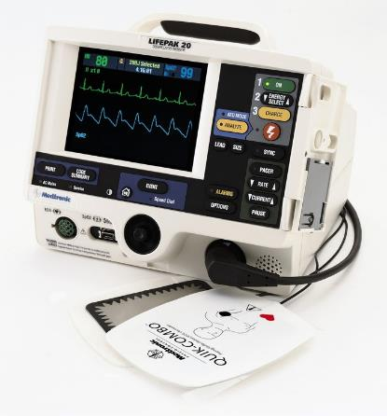
Why not…
Notes:
What are we afraid of?

Slide 37
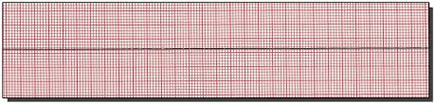
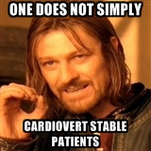
Fears
Notes:
Is this fear even founded?

Slide 38
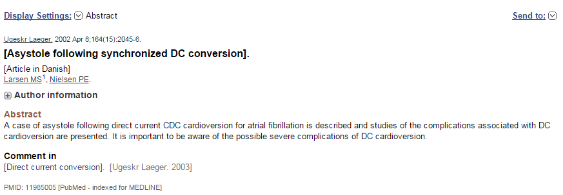

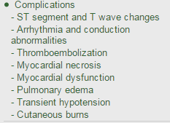
Notes:
We don’t get this journal.
Can we fix those things in up to date?
Most arrhythmia is ST or NSVT which are benign.

Slide 39
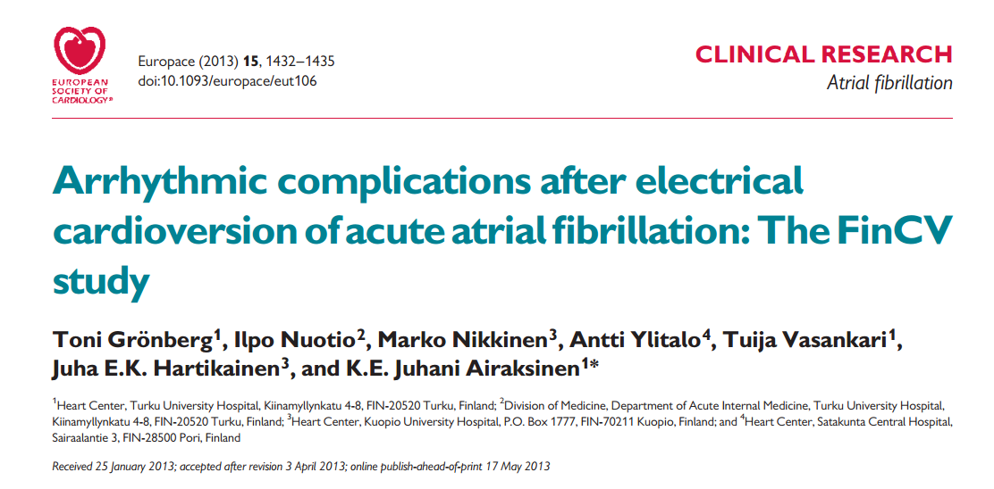
Notes:
Retrospetive
7660 CV if AF < 48 hours

Slide 40
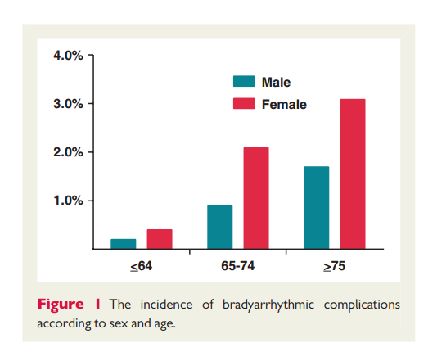
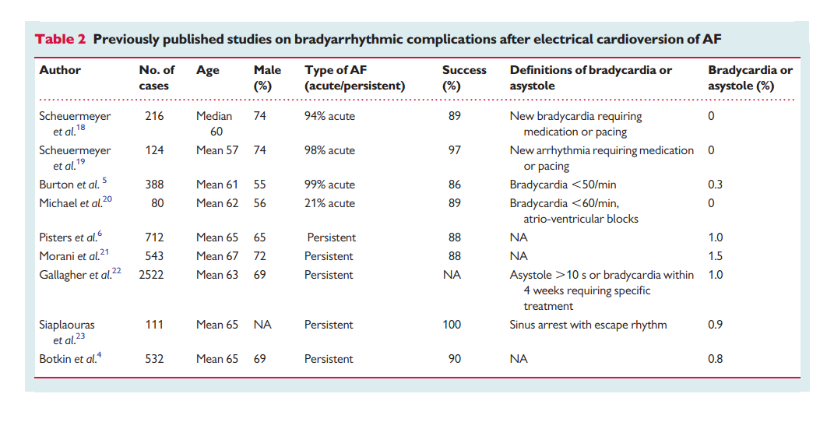
Notes:
Bradycardic complications were rare (0.2%) in younger (,65 years) male patients, but the incidence increased significantly to 3.1% in older female patients (Figure 1)
Bradycardic complications were more common after unsuccessful cardioversion (2.0 vs. 0.8%, P ¼ 0.03), but the pericardioversion use of antiarrythmics no change.
Significant predictor of bradycardia – Old > 65, Female, Unsuccessful cardioversion.
SLOW Ventricular rate, digoxin, BB did not increase.
There were 51 (0.7%) cases of asystole (.5 s) followed by bradycardia in 9 patients. In seven cases, the asystole resulted in short resuscitation and two patients were treated with extrinsic pacing. Significant bradycardia alone (,40 b.p.m.) was registered in 12 patients immediately after cardioversion. There were no cases of ventricular fibrillation or VT. 1 died of dissection (incidental)

Slide 41
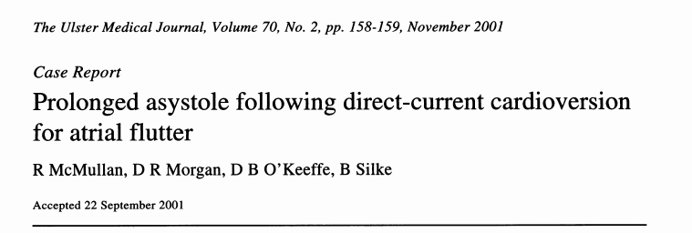
Notes:
Had elective cardioversion. Had a shitload of alfentanil and midazolam. Had percussion pacing. Survived no damage. She was also ON DIGOXIN SERTRALINE SOTALOL AND THIOPANETAL.

Slide 42

Conclusion
If it is not sinus tach
  Then it is Ventricular Tach
Cardioversion is not as scary, nor as risky, as we are taught to think

