Slide 1
CISM: Benefit or Risk?
Bryan E. Bledsoe, DO, FACEP
University of Nevada School of Medicine

Slide 2

Definitions
Stress: a state of physiological or psychological strain caused by adverse stimuli (physical, mental, or emotional, internal or external) that tend to disturb the functioning of an organism and which the organism naturally desires to avoid.

Slide 3

Stress
Stress is a normal evolutionary response and prepares the organism to deal with the environment.

Slide 4
Stress
Eustress (beneficial stress)
Distress (detrimental stress)

Slide 5
Stress
General Adaptation Syndrome:
Alarm
Resistance
Exhaustion

Slide 6
Stress
Alarm Phase:
Increased energy
Tightened muscles
Reduced sensitivity to pain
Increased BP and HR
Increased output of adrenal hormones

Slide 7
Stress
Resistance Phase:
Physiological responses continue.
Body attempts to cope with the stress.
Body more vulnerable to other stressors.

Slide 8
Stress
Exhaustion Phase:
Persistent stress depletes energy stores.
Increased vulnerability to physical problems.

Slide 9
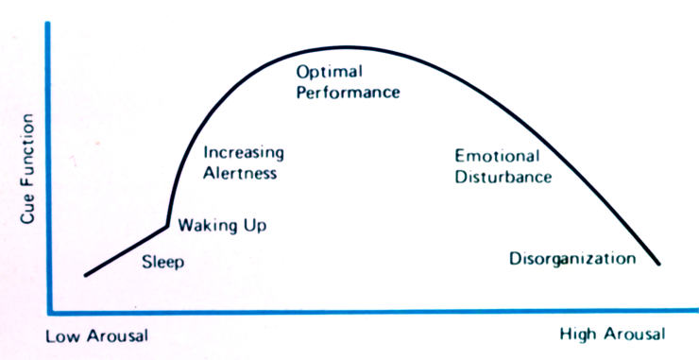
Stress

Slide 10
Stress (Contemporary Views)
No longer seen as uniform or physiologic.
Social construction of stressor.
Loss, threat, or challenge.
Rarely direct effect of major life events.
Effect mediated through impact on “daily hassles” of living.

Slide 11
Stress
Stress versus Strain:
The impact of a stress to a system is determined by the strain present when the stress is applied.
The only truly reliable predictor of what shape you’ll be in two years later has been what shape you were in two days before.

Slide 12
Reactions to Stress
Resilience is by far the most common trajectory.
Recovery appears associated with both personal risk factors and event characteristics.
Chronic reactivity associated with premorbid compromise and co morbidity issues.
Delayed reactivity empirically rare in trauma and questioned in grief reactions.

Slide 13
Coping Styles
Ginzburg et al. (2002) cardiac patients with repressive coping style (RCS) fared better than others after infarct
Frasure-Smith et al. (2002) follow-up nursing care to monitor psychological impact and educate about condition worsened outcome in post-MI patients with RCS
Van Dorp-Brun (2004) found RCS subjects functionally indistinguishable from true low anxiety subjects on a range of dependent variables

Slide 14
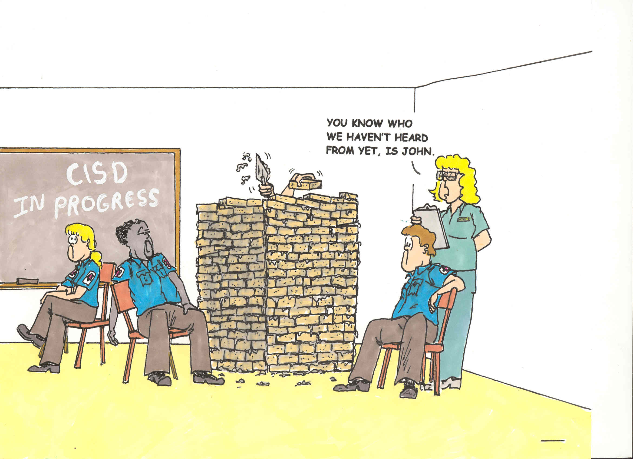

Slide 15
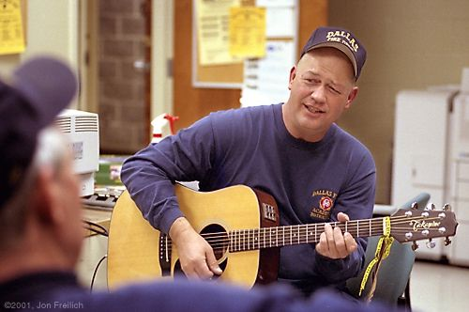
EMS Stress
Is stress in EMS or the fire service higher or different than in other professions?

Slide 16
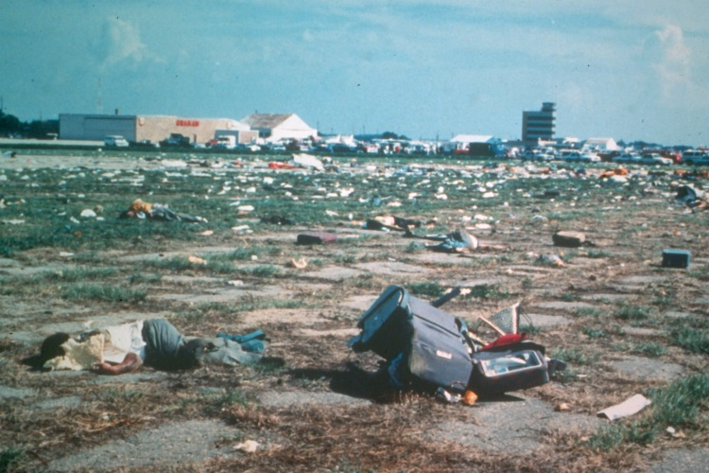
EMS Stress
Sioux City airplane crash 1989.
Good IMS structure.
No difference in those who underwent CISD (40%) and those who declined.
Better outcome associated with non-CISD.
No long-term problems.

Slide 17
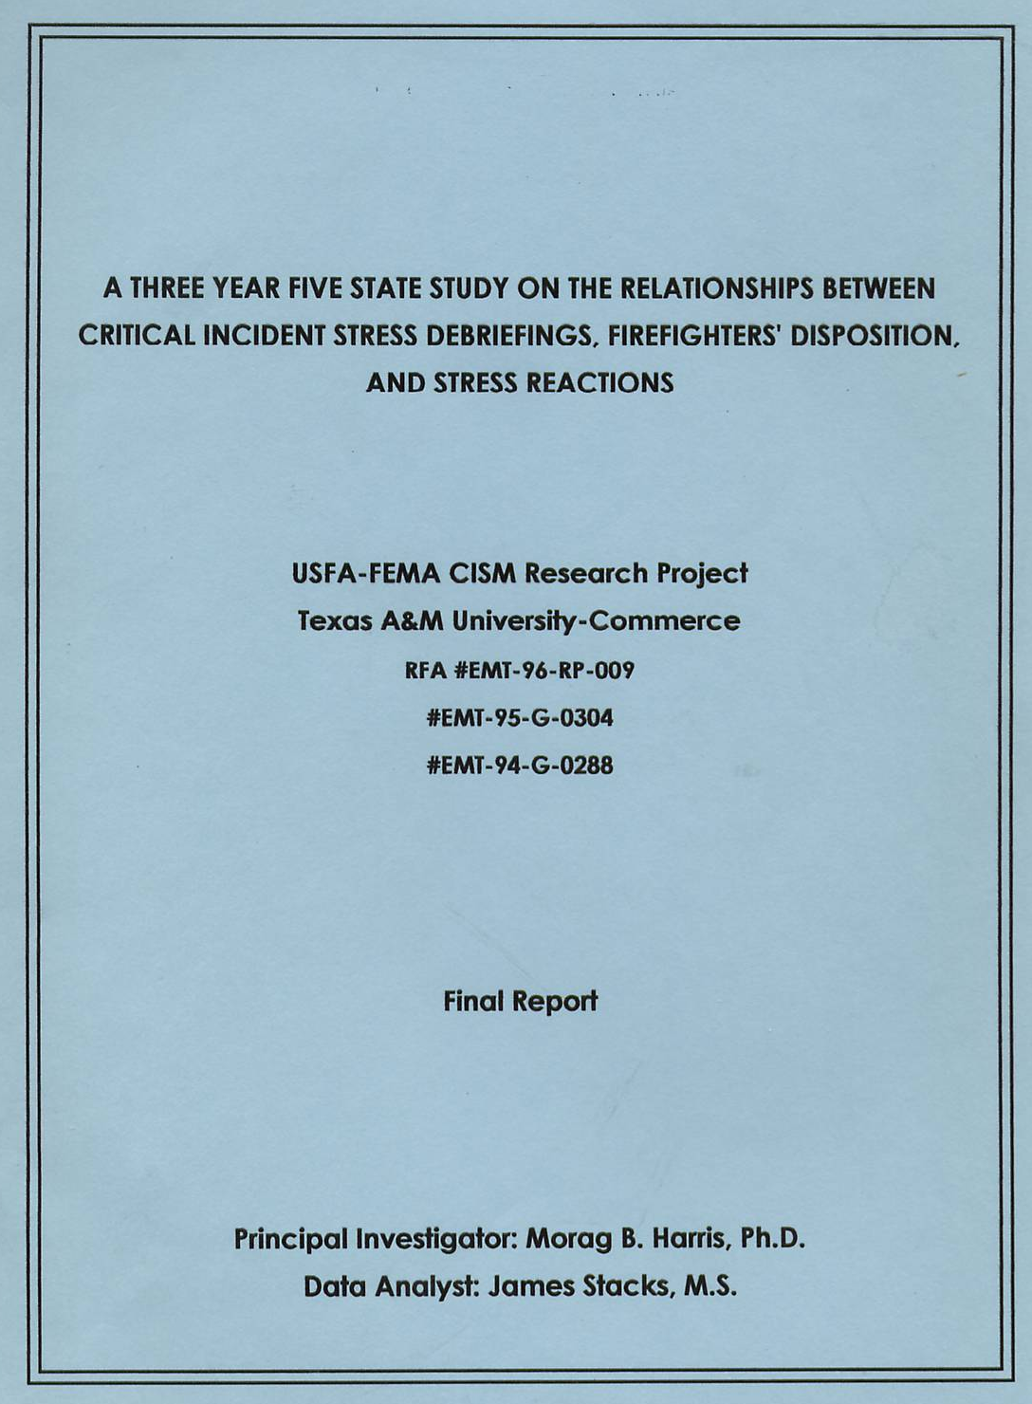
EMS Stress
FEMA funded 3-year, 5-state study of CISD, firefighters’ disposition, and stress reactions.
Included personnel from OKC in Murrah building bombing.

Slide 18
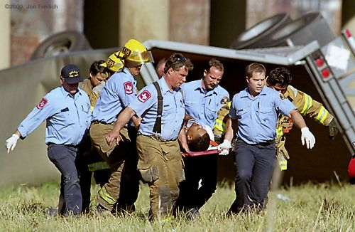
EMS Stress
The social support structure of the fire service is protective.
Firefighters and EMTs are quite resilient.
Social support of EMTs and firefighters comes first from family and then from friends and coworkers.

Slide 19
EMS Stress
The majority of firefighters would seek professional support from clergy (40.9%) over professional counselors (7.4%).
Firefighters and EMTs tend to have positive views about the world despite continued exposure to traumatic events.

Slide 20
EMS Stress
No relationship was found between CISD and stress symptoms or PTSD.
Many firefighters reported that CISD actually brought out memories that were previously suppressed and found the whole process uncomfortable.

Slide 21
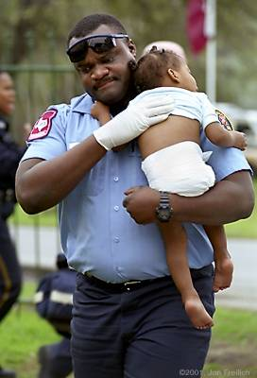
EMS Stress
Well, if stress in EMS and the fire service is not a significant problem, why did we embrace CISM so readily?

Slide 22
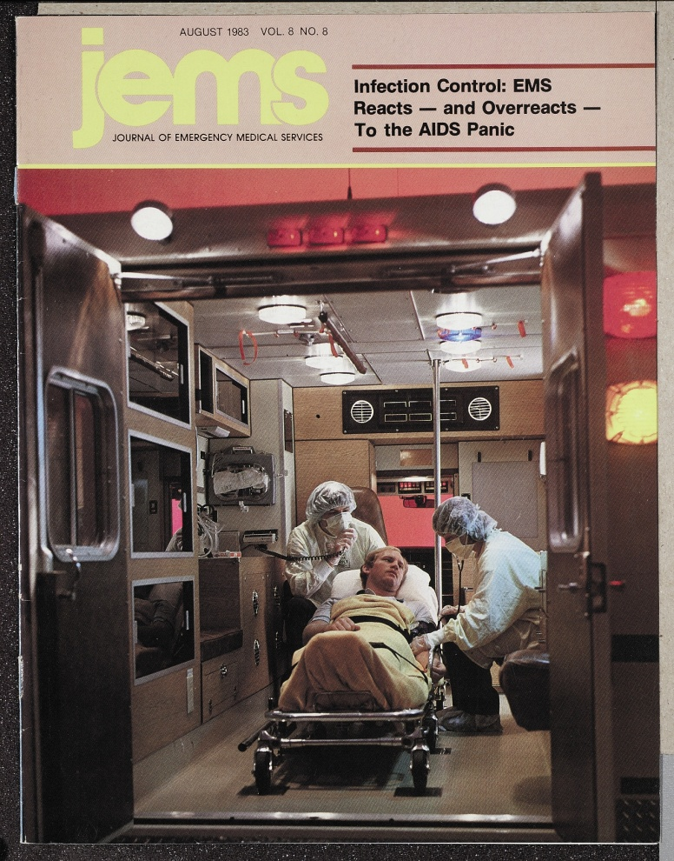
CISM
First described by Jeffrey T. Mitchell, Ph.D., in 1983, in an article in Journal of Emergency Medical Services (JEMS) entitled, “When disaster strikes…the critical incident debriefing process.”

Slide 23

CISM
Also touted in other non-refereed venues of fire and rescue trades.
Significant claims as to scientific basis, empirical study, and extraordinary preventive effects were made.

Slide 24
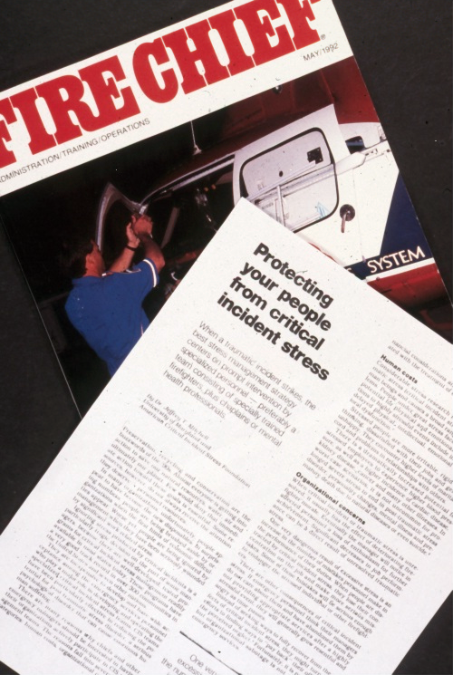
CISM
By 1992, proponents claimed that departments that failed to provide CISD were negligent for not doing so.

Slide 25

CISM
Although there was no scientific evidence whatsoever regarding the effectiveness of CISM, many people adopted the practice.

Slide 26
CISM
Mitchell proposed that firefighters and EMS personnel had a “rescue personality” but never defined what that was or published the results.*
When mainstream researchers asked for the data on the “rescue personality” Mitchell claimed it was lost in an office move.
* Debunked: Wagner SL. The Rescue Personality: Fact or Fiction. Australasian Journal of Trauma and Disaster Studies. 2005;2

Slide 27
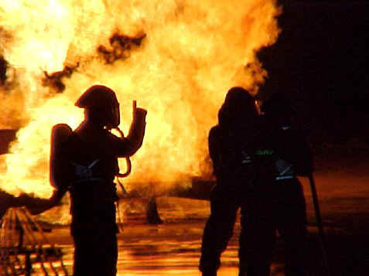
CISM
Though no description or study could be found in the serious psychological literature, it seemed reasonable, sensible, rational, and most of all, doable.

Slide 28

CISM
Mitchell soon formed the International Critical Incident Stress Foundation, Inc. to promote CISM.

Slide 29

CISM
Soon, the CISM movement was widespread in EMS and the fire service—with a nearly evangelical following.

Slide 30
CISM
“Many persons strongly vested in the ‘movement’ aspects of CISD show profound reluctance to consider other viewpoints and surprising hostility toward those perceived as challenging the dominant theme, even when the evidence becomes overwhelming.”
Woodall (1994) NFA -EFO

Slide 31
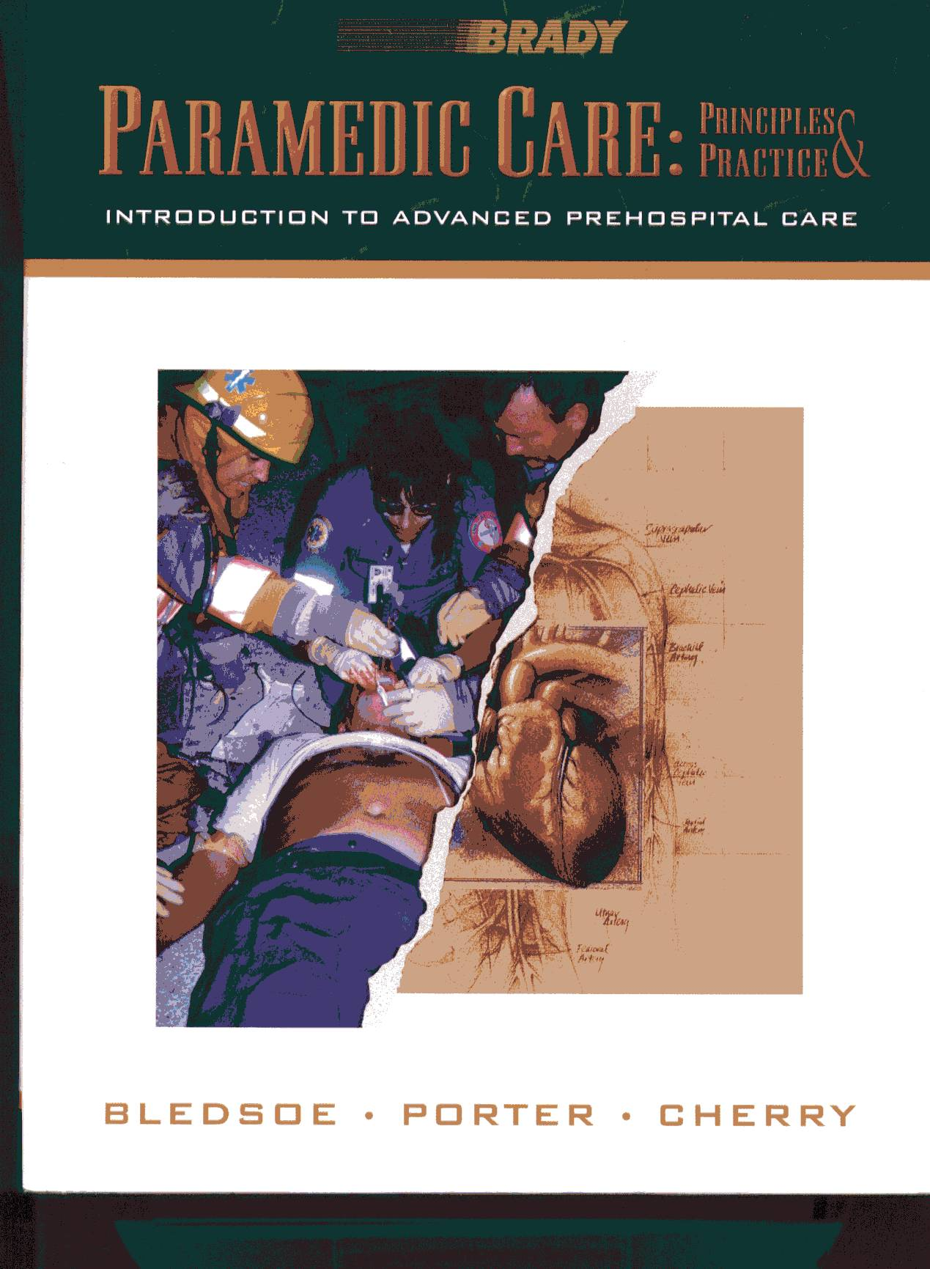
CISM
CISM was included in:
DOT Curricula
Textbooks
Numerous magazine articles.
Protocols
Management plans

Slide 32
CISM
When EMS and mainstream psychology found CISM to be ineffective and iatrogenic, they soon moved to other areas:
Police departments
Schools
Public health
Disasters

Slide 33
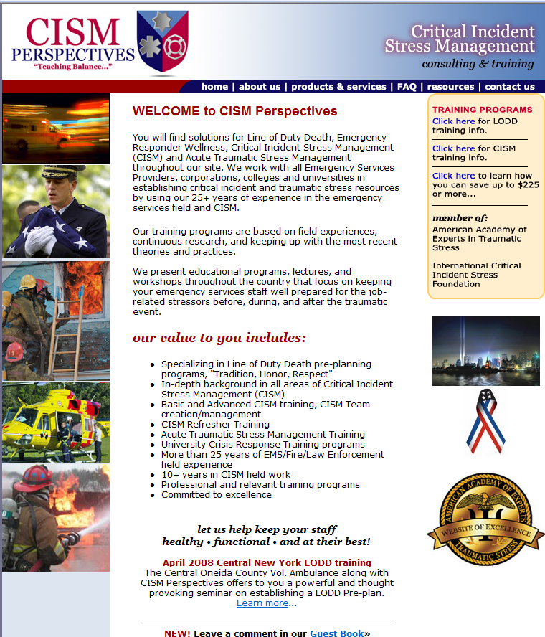
Now a Cottage Industry
CEO holds an AAS in Human Behaviors and Marketing Management from Monroe Community College in Rochester, NY.
Yet “board certified.”

Slide 34

Vanity Certifications
American Association of Experts in Traumatic Stress (AAETS).
New York-based business.
Relatively easy to obtain “board certifications” in virtually anything you want.
Application:

Slide 35
Vanity Certifications
Board Certified Expert in Traumatic Stress
Board Certification in Forensic Traumatology™
Board Certification in Emergency Crisis Response™
Board Certification in Motor Vehicle Trauma™
Board Certification in Disability Trauma™
Board Certification in Pain Management™
Board Certification in Illness Trauma™
Board Certification in Bereavement Trauma™
Board Certification in Domestic Violence™
Board Certification in Sexual Abuse™
Board Certification in Rape Trauma™
Board Certification in Stress Management™
Board Certification in School Crisis Response™
Board Certification in University Crisis Response™

Slide 36
Vanity Certifications
Certificate in Traumatic Stress Management
Fellowship, American Association of Experts in Traumatic Stress (F.A.A.E.T.S.)
Not recognized by any organization or body (except AAETS).
Not recognized by:
AMA
AOA
APA
APA (MD/DO)
NASW

Slide 37
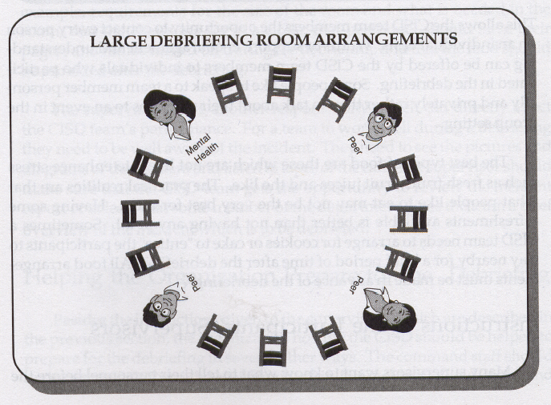
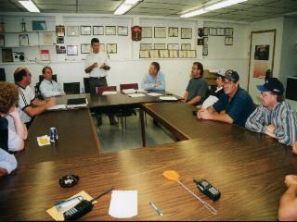
What is CISM?
Critical Incident Stress Debriefing (CISD) was originally developed to allow emergency personnel to openly discuss their feelings with peers and with mental health personnel following exposure to a critical incident.

Slide 38
What is CISM?
Later, the goals of CISD were expanded to include:
Prevention of disorders that may develop as a result of traumatic stress, such as post-traumatic stress disorder (PTSD).
To serve as a screening tool to identify personnel who should be referred for further treatment.
To facilitate verbalization of experiences.

Slide 39
What is CISM?
Later, the goals of CISD were expanded to include:
To normalize reactions to stressful events.
To improve peer group support and cohesion.

Slide 40
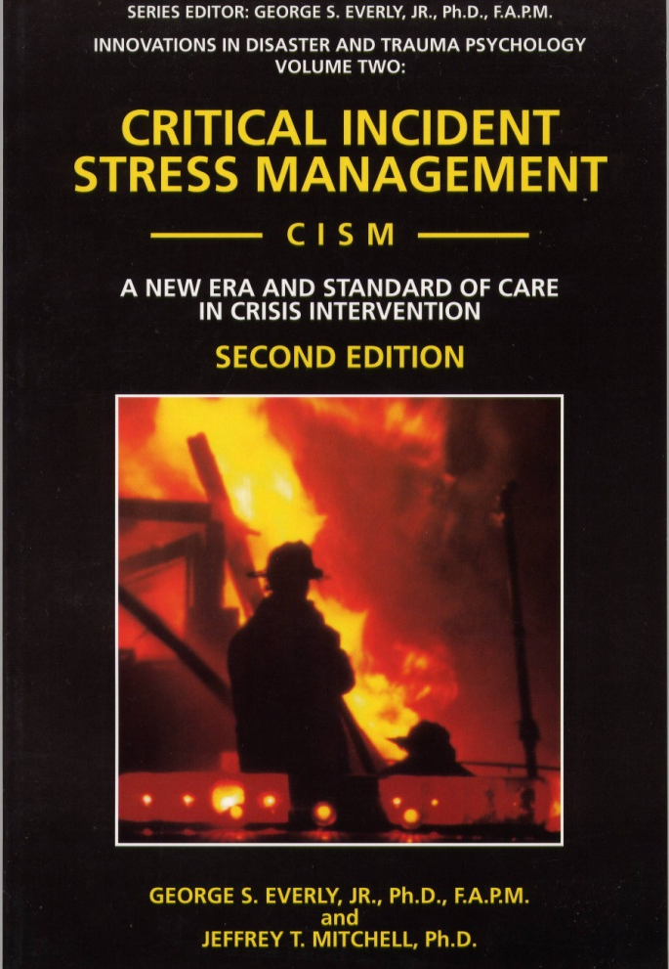
What is CISM?
The name of the process was changed to Critical Incident Stress Management to reflect a more global, multi-component approach.

Slide 41
What is CISM?
The hypothesis behind CISM is that the cognitive structure of the event, such as thoughts, feelings, memories, and behaviors, is modified through retelling the event and experiencing emotional release, and this serves to reduce distress and prevents the emergence of PTSD and other psychiatric sequelae.

Slide 42
What is CISM?
Originally conceived as group sessions that typically take place 24-72 hours after a critical event (sometimes up to 2 weeks later).
In the “Mitchell Model” CISD follows a specific method and structure consisting of 7-phases.

Slide 43
Phases of CISM
Introduction – The CISM intervention team introduces members, explains the process, and sets expectations and ground rules.
Fact – Participants describe the traumatic event from their own perspective.
Thought – Participants describe their thoughts about the event.

Slide 44
Phases of CISM
Reaction – The most traumatic aspect of the crisis is identified for participants who wish to speak. Cathartic ventilation is allowed during this phase.
Symptom – Any symptoms of distress or psychological discord that the group wishes to share are identified.

Slide 45
Phases of CISM
6. Teaching – Facilitates a return to the cognitive domain by normalizing and “demedicalizing” the crisis reactions of the participants. In addition, basic personal stress management techniques are taught.
7. Re-Entry – Provides closure to the CISD process remembering that the goal of CISM is to bring psychological closure to the crisis incident.

Slide 46
What is CISM?
Follow-up sessions may be prescribed as deemed necessary.
Although CISD was originally designed as a group session, proponents advocate using individual sessions or “one-on-one” interventions as elements of their programmed approach.

Slide 47
Pathological Stress
Acute Stress Disorder (ASD):
Symptoms experienced during or immediately after the trauma, last for at least 2 days, and resolve within 4 weeks.
Post-Traumatic Stress Disorder (PTSD):
Symptoms begin within the first 3 months after the event, may last for months to years.
Lifetime incidence: 8%

Slide 48
Pathological Stress
People who develop stress disorders have underlying psychological or similar issues.
ASD and PTSD is NOT a normal response to stress.
Only effective treatment for PTSD is cognitive behavioral therapy (CBT).

Slide 49
Pathological Stress
NYC below 110th street after 9/11:
Overall PTSD at 7.5% four weeks after attack.
Higher (~20%) closest to WTC site.
Resolved to 1.7% by four months following.
Further resolved to 0.6% by six months.
Galea et al. (2002, 2003)

Slide 50
Stress
Not all “help” turns out to be helpful.
Sometimes “help” makes matters worse

Slide 51

Stress
Remember the suicide “hotlines” of the 1970s?
What happened to them?

Slide 52
Stress
Our most fundamental concern:
“Primum non nocere”
“First, do no harm”
Any demonstrated benefit must outweigh reasonably foreseeable risk.

Slide 53

Definitions

Slide 54
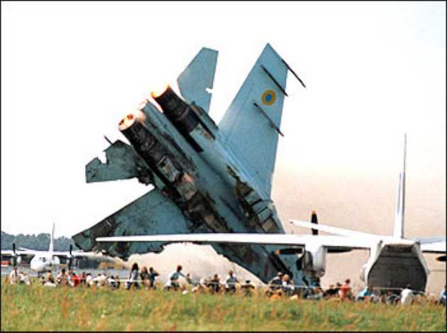
Definitions
Critical Incident: a stressful event that holds the potential to overwhelm one’s usual coping mechanisms, potentially resulting in psychological distress and possible impairment of normal adaptive functioning.

Slide 55
Definitions
Critical Incident Stress Debriefing (CISD): a specific debriefing variant, originally described by Jeffery T. Mitchell, PhD, in 1983 as a 7-phase (originally 6-phase) structured group discussion, usually provided 24-72 hours following a critical incident.

Slide 56
Definitions
Critical Incident Stress Management (CISM): a proprietarily marketed multi-component program for the provision of crisis and disaster mental health services.

Slide 57
CISM Components
Pre-crisis preparation.
Individual crisis intervention (1:1).
Demobilization and staff consult (rescuers).
Defusing (within 12 hours).
Critical Incident Stress Debriefing (CISD).
Systems:
Family CISM.
Organizational consultation.
Follow-up and referral.

Slide 58

The Scientific Evidence

Slide 59
British Psychological Society
“Worst ideas on the mind”
Frontal lobotomy.
Chemical imbalance model of mental illness.
Post-trauma debriefing (CISD/M)
British Psychological Society: "The worst idea on the mind (News section)." The Psychologist. 19(9):518-519, 2006.

Slide 60
Critical Studies

Slide 61
Quality Science
Title: Single-session debriefing after psychological trauma: a meta-analysis
Type: Meta-analysis of RCTs
Journal: Lancet 2002;360:766-771
Authors: van Emmerik, Kapmphuis, Hulsbosch, and Emmelkamp

Slide 62
Quality Science
“CISD and non-CISD interventions were not more effective in reducing PTSD symptomatology than not intervening.”
“While mean weighted effect sizes for the miscellaneous interventions and no intervention indicated improvement in the PTSD domain, this was not the case with CISD.”
“Our findings suggest that CISD and non-CISD interventions do not improve beyond natural recovery from psychotrauma.”

Slide 63
Cohen’s d
Cohen defined effect sizes as:
0.8 = large
0.5 = medium
0.2 = small
d = M1 - M2 / σ
where
σ = √[∑(X - M)² / N]
where X is the raw score, M is the mean, and N is the number of cases.

Slide 65
Quality Science
Title: Psychological debriefing for preventing PTSD (Cochrane Review)
Type: Meta-analysis of RCTs
Journal: Cochrane Review, 2 (2002)
Authors: Rose, Bisson & Wessely

Slide 66
Quality Science
“Single session individual debriefing did not reduce psychological distress nor prevent the onset of PTSD.”
“There is no current evidence that psychological debriefing is a useful treatment for the prevention of PTSD after traumatic incidents. Compulsory debriefings of trauma should cease.”

Slide 67
Quality Science
Title: Effectiveness of
psychological debriefing.
Type: Meta-analysis
Journal: Acta Psych Scan.
2001;104:423-437
Authors: Arndt, Elklit

Slide 68
Quality Science
Meta-analyzed 25 papers pertaining to PD.
Conclusion: “No preventive effect was found from the present use of PD. In contrast, people are generally very satisfied with PD.”
“Results indicate that, in general, debriefing does not prevent psychiatric disorders or mitigate the effects of traumatic stress, even though people generally find the intervention helpful in the process of recovering from traumatic stress.”

Slide 69
Quality Science
Title: Mental health of trauma- exposed firefighters and CISM
Type: Non-Randomized CT
Journal: J Loss Trauma.
2002;7:223-38
Authors: Harris, Baloglu, and Stacks

Slide 70
Quality Science
Of 1,747 firefighters in a FEMA region, 852 met selection criteria for the study.
Of these, 264 had attended CISD sessions following the Mitchell model.
396 non-debriefed firefighters were randomly selected by computer as the comparison group.
Conclusion: “Within this model, we find no evidence of a significant direct contribution of debriefing to coping skills or traumatic stress reactions.”
“No relationship was found between debriefing and PTSD.”

Slide 71
Quality Science
Title: Critical incident stress intervention after loss of an air ambulance: two-year follow-up.
Type: Non-randomized controlled trial
Journal: Prehospital Disaster Medicine
1999;14(1):8-12
Authors: Macnab, Russel, Lowe, Gagnon

Slide 72
Quality Science
Air ambulance accident in British Columbia killed 5.
Directly involved paramedics, physicians, and nurses received CISM. (defusing, debriefing, follow-up).
CISD provided by CISM -trained chaplain assisted by BCAS CISM team.
Control group derived from non-involved peers.
Standard psychological measures used.
Debriefed group had more stress symptoms at 1 week.
CISD did not appear to reduce the severity of stress symptoms.
People with pre-existing stress management routines appeared to have less symptoms at 6 months.

Slide 73
Quality Science
Title: Psychological sequelae following the Gulf War: Factors
associated with subsequent
morbidity and the effectiveness
of PD.
Type: Non-randomized CT
Journal: Brit J Psych, 165 (1994)
Authors: Deahl et al

Slide 74
Quality Science
Evaluated 62 soldiers in the British Army AWGS.
69% received PD.
Conclusion: “These findings show that a psychological debriefing following a series of traumatic events or experiences does not appear to reduce subsequent psychiatric morbidity and highlights the need for further research in military and civilian settings.”

Slide 75
Quality Science
Title: Randomised controlled trial of psychological debriefing for victims of acute burn trauma.
Type: RCT
Journal: Brit J Psych, 171 (1997)
Authors: Bisson, Jenkins, Alexander, Bannister

Slide 76
Quality Science
132 adult burn victims entered into study.
Randomly assigned to a group that received PD or a control group that did not.
They were subsequently evaluated by an assessor blind to PD status at 3 & 13 months.
Conclusion: 26% of the PD group had PTSD at 13 months compared to 9% of the control group.
“This study seriously questions the wisdom of advocating one-off interventions post-trauma and should stimulate research into more effective initiatives.”

Slide 77
Quality Science
“The excess number in the PD group was due to absence of block randomization and termination of recruitment when preliminary analysis of the data revealed possible adverse consequences for the intervention group.”
“The PDs adhered to the structure first described by Mitchell (1983) adapted for use with either an individual or a couple. The facilitator proceeded through a seven-phase semi-structured approach.”

Slide 78
Quality Science
Title: A randomised controlled trial of PD for victims of road traffic accidents.
Type: RCT
Journal: Brit Med J ; 313 (1996)
Authors: Hobbs, Mayou, Harrison, Worlock

Slide 79
Quality Science
106 victims of MVCs were randomly assigned to a PD group or a control group.
PD was completed within 24-48 hours.
Conclusions: “Psychiatric morbidity was substantial 4 months after injury, with no evidence that debriefing had helped—and, indeed, indications that it might have been disadvantageous.”
Notes:
Despite the fact that the PD group had higher mean injury scores and a longer hospital stay, there was in significant difference in baseline PTSD or other psychiatric symptoms.

Slide 80
Quality Science
Proponents of CISM often discount this study because the debriefed group was more severely injured.
But the authors report PTSD was no different between the groups.
CISD is supposed to mitigate PTSD symptoms, not physical injuries.

Slide 81
Quality Science
Proponents state that there is no difference in the pre-intervention and post-intervention scores.
Pre-Intervention (control): 15.30
Post-Intervention (control): 12.87
Pre-Intervention (CISD): 15.13
Post-Intervention (CISD): 15.97
The debriefed group got worse and the control group got better.

Slide 82
Quality Science
Title: PD for road traffic accident victims: Three-year follow- up of a RCT.
Type: RCT
Journal: Brit J Psych ; 176 (2000)
Authors: Mayou, Ehlers, Hobbs

Slide 83
Quality Science
Follow-up of 1996 MVC study.
At 3-years post MVC, subjects were reassessed.
Conclusions: “The intervention group had significantly worse outcomes at 3 years in terms of general psychiatric symptoms, travel anxiety, pain, physical problems, overall level of functioning, and financial problems.”
“Psychological debriefing is ineffective and has adverse long-term effects.”
Notes:
Although there was attrition, the characteristics of the responders and non-responders were similar.

Slide 84
Quality Science
Title: A randomised controlled trial of individual debriefing for victims of violent crime.
Type: RCT
Journal: Psych Med; 29 (1999)
Authors: Rose, Brewin, Andrews, Kirk

Slide 85
Quality Science
2,161 victims of violent crime were contacted, 243 replied, 157 selected for study and randomly assigned to one of three groups:
1. Assessment only,
2. Education,
3. Education & PD (based loosely on Mitchell’s model).
Conclusions: “No evidence was found to support the efficacy of brief one-session interventions for preventing post-traumatic symptoms in individual victims of violent crime.”

Slide 86
Quality Science
Title: The influence of occupational debriefing on post-traumatic stress symptomatology in traumatized police officers.
Type: Non-randomized CT
Journal: Br J Med Psych; 73 (2000)
Authors: Carlier, Voerman, Gersons

Slide 87
Quality Science
A sample of 243 traumatized police officers were divided into three groups:
1. Debriefed officers (86),
2. Non-debriefed-internal (82)
3. Non-debriefed-external (75)
Three group successive debriefing sessions (24 hours, 1 month, and 3 months post-trauma).
Debriefings followed Mitchell’s (1983) model.

Slide 88
Quality Science
Conclusions: “No differences in psychological morbidity were found between the groups at pre-test, 24 hours, and 6 months post-trauma. One week post-trauma, debriefed subjects exhibited more post-traumatic stress disorder symptomatology than non-debriefed subjects.”
“High levels of satisfaction with debriefing were not reflected in positive outcomes.”

Slide 89
Quality Science
Title: Debriefing with brief group psychotherapy in a homogenous group of non- injured victims of a terrorist attack: a prospective study.
Type: Prospective non-controlled
Journal: Acta Psych Scand; 98 (1998)
Authors: Amir, Weil, Kaplan, Tocker, Witztum

Slide 90
Quality Science
15 non-injured women exposed to a terrorist bombing in Israel while on a day care bus trip.
All women participated in a group debriefing 2 days after the attack followed by 6 group psychotherapy sessions.
Conclusion: “The results of the present study show that the psychological intervention did not bring substantial relief of the suffering of terrorist attack victims in this study.”

Slide 91
Quality Science
Title: Fire fighter: A study of stress and coping
Type: Non-randomized, controlled
Journal: Acta Psych Scand; 355 (1989)
Authors: Hytten & Hassle

Slide 92
Quality Science
58 non-professional firefighters participated in a major 12-story hotel fire where 14 guests lost their lives.
39 men participated in PD
Conclusion: “Those who took part in formal debriefing claimed that it had helped them. Nevertheless, there was no significant difference on the IES between those who received formal debriefing versus those who only talked with their colleagues in more informal settings.”

Slide 93
Quality Science
Title: Emotional or Educational Debriefing after Trauma: Randomised Controlled Trial
Type: RCT
Journal: British Journal of Psychiatry; 189 (2006)
Authors: Sibrandji et al.

Slide 94
Quality Science
236 survivors of trauma randomly assigned to:
Emotional debriefing
Educational debriefing
Control group
Followed at 2 weeks, 6 weeks, & 6 months.

Slide 95
Quality Science
Psychiatric symptoms decreased over time in all 3 groups without any difference between.
Participants in emotional debriefing (CISM) with initial hyperarousal scores had significantly more PTSD symptoms at 6 weeks when compared to control group.

Slide 96
Quality Science
Title: Psychological Treatments that Cause Harm
Type: Systematic Review
Journal: Perspectives on Psychological Science; 2 (2007)
Authors: Lillienfield, SO

Slide 97
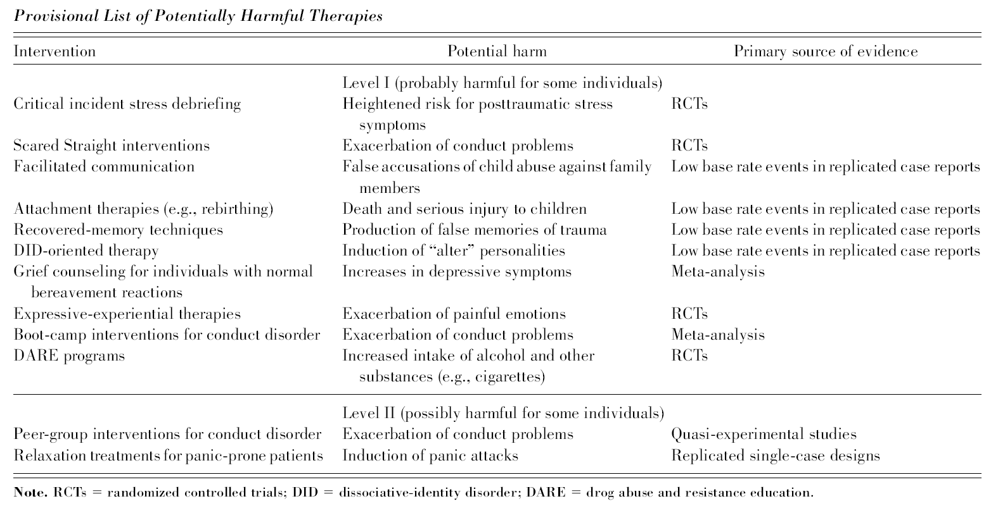
Quality Science

Slide 98
Quality Science
Title: An analogue study of the effects of Psychological Debriefing on eyewitness memory.
Type: Analogue RCT
Journal: Behaviour Research and Therapy; 45 (2007)
Authors: Devilly et al.

Slide 99
Quality Science
61 participants randomized into 3 groups:
Debriefing
Debriefing where confederate provided 3 pieces of misinformation.
Control
Shown stressful video (paramedic at car collision).
Confederate group more likely to remember misinformation.

Slide 100
CISM Studies

Slide 101
CISM’s Science
When asked to produce the “science” behind CISD/CISM in various venues, proponents always point to:
Self-published studies
Studies in non-refereed journals
Articles in trade magazines
Articles in obscure psychology journals

Slide 102
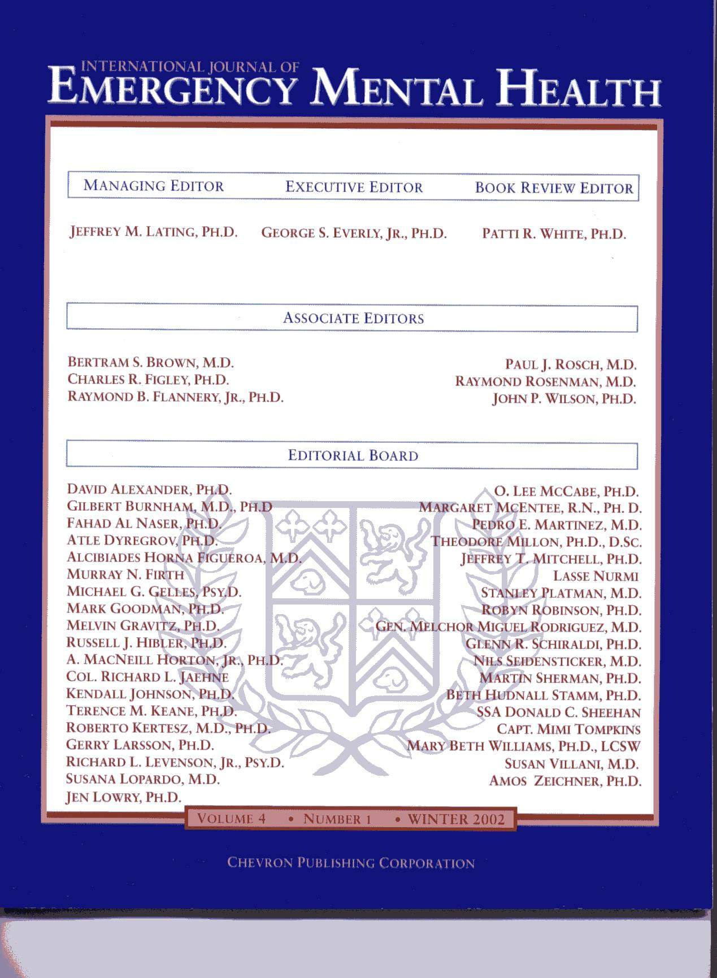
Prestige of Journals
International Journal of Emergency Mental Health.
First published in Winter, 1999 with 4 issues per year advertised.
Published by Chevron Publishing which is affiliated with the ICISF.
Dr. Everly serves as the Executive Editor.

Slide 103
CISM Science
Dr. Mitchell recently prepared a CISM research document showing the status of the literature in regard to CISM:
65 studies were supportive of CISM
26 published in non-peer review journals
8 published in Chevron’s International Journal of Emergency Mental Health.
21 published by people with ties to the ICISF.
2 studies identified as RCTs when both are not.
No RCTs identified in supportive evidence.

Slide 104
CISM’s Science
Title: Critical Incident Stress Management (CISM): A Statistical Review of the Literature
Type: Meta-analysis of quasi- experimental studies
Journal: Psych Quart
2002;73(3):171-182
Authors: Everly, Flannery, Eyler

Slide 105
CISM’s Science
Meta-analysis of 8 quasi-experimental studies that stated, “An extremely large effect size was revealed attesting to the power of CISM to mitigate symptoms of psychological distress.”
Supposedly revealed a Cohen’s d of 3.11(very large effect size).

Slide 106
Cohen’s d
Cohen defined effect sizes as:
0.8 = large
0.5 = medium
0.2 = small
d = M1 - M2 / σ
where
σ = √[∑(X - M)² / N]
where X is the raw score, M is the mean, and N is the number of cases.

Slide 107
CISM’s Science
Let’s look at the studies they meta-analyzed:
Busuttil: Use of PD as a part of the British Royal Air Force treatment program of PTSD. CISD or CISM is not even mentioned in the paper. Multiple debriefings provided in 12-day residential treatment program to 34 individuals, 29 of whom had PTSD for 2-31 years. No control group.
Mitchell (IJEMH): Use of CISD for 18 rescuers with PTSD 42 months after a tornado struck their town. No control group. No pre-intervention assessment.
Richards: Study not published.

Slide 108
CISM’s Science
Let’s look at the studies they meta-analyzed:
Remaining studies were by Flannery and detailed an Assaulted Staff Action Program (ASAP) instituted in Massachusetts State Psychiatric Hospitals.
Only in the most recent paper was CISD mentioned (and then only as a component of the ASAP).
The independent variable was the number of assaults on staff went down once the ASAP was implemented.
Flannery says, “ASAP and CISM are totally different.”
This conclusion is a non-sequitur.

Slide 109
CISM’s Science
Title: CISD: A meta-analysis
Type: Meta-analysis of quasi- experimental studies
Journal: IJEMH 1999 Summer;1(3)
Authors: Everly & Boyle

Slide 110
CISM’s Science
“In this study, 5 previously published investigations were meta-analyzed revealing a large effect size supporting the notion that the CISD model of psychological debriefing is an effective crisis intervention.”

Slide 111
CISM’s Science
Let’s look at the studies he meta-analyzed:
Nurmi (IJEMH): Single-session CISD for rescuers involved with the sinking of the Esotonia.
Jenkins: 29 workers debriefed within 24 hours after mass shooting in Texas (self-reports). No random assignment. No comparison of psychological outcomes between the debriefed and non-debriefed group.
Bohl (doctoral dissertation): Police officer stress.

Slide 112
CISM Science
Chemtob: Using CISD 6 & 9 months after Hurricane Iniki to treat PTSD in survivors. Single-session debriefing. No control group.
Wee (IJEMH): 65 Rescue personnel after LA riots (primary victims). No random assignment or pre-intervention assessment.

Slide 113
CISM’s Science
Title: The effects of timing on critical incident stress debriefing (CISD) on posttraumatic symptoms.
Type: Quasi-experimental
Journal: J Trauma Stress. 2001;14:327-340
Authors: Campfield & Hills

Slide 114
CISM’s Science
Robbery victims in NSW assigned randomly to receive CISD within 10 hours of the crime (n=36), or more than 48 hours after the crime (n=41).
Followed Mitchell’s model.
Single-session debriefings.
Mainly individual debriefings (some small groups)
All subjects primary victims.

Slide 115
CISM Science
The immediate (10 hour) debriefing group reported significantly fewer PTSD symptoms at 2 days, 4 days, and 2 weeks post-intervention.
The delayed group had no decline in symptoms during this period.
Decline of symptoms during this period most likely due to natural recovery.

Slide 116
CISM’s Science
Curious as to why Mitchell says this study supports his practice.
No control group, thus not RCT (although he reports it is in his research treatise).
Group debriefed within 10 hours did much better than group debriefed later.
Primary victim study
Single-sessions
Primarily individual sessions with some small groups.

Slide 117
CISM’s Science
Title: Preventing psychological trauma in soldiers: The role of operational stress training and psychological debriefing.
Type: Non-randomized controlled
Journal: Br J Med Psych. 2000;73:77- 85
Authors: Deahl, et al.

Slide 118
CISM’s Science
106 British soldiers from Bosnia assigned to debriefing (n=54) or to an assessment only control group (n=52).
Soldiers assigned to groups by commanding officers based on availability.
Single-session group debriefing following the Mitchell model.
Assessments performed prior to debriefing, at 3, 6 and 12 months.

Slide 119
CISM’s Science
Control group reported higher stress than the treatment group, but the control group experienced a significant decline in PTSD symptoms, whereas the debriefing group did not.
The levels of psychopathology were low in both groups (2 soldiers in the control group and 1 in the treatment group met PTSD criteria at 6 months).
Fewer anxiety and depressive symptoms in the treatment group based on a questionnaire.

Slide 120
CISM’s Science
CAGE scores for debriefed group significantly improved over the control group.
Participants were primary victims of trauma.
Mitchell reports this as a RCT in his research treatise although the authors state, “…not a true RCT of debriefing because selection of the sample was restricted, the method for randomization was less than ideal and the low level of PTSD symptoms at the outset meant that there was little scope for reduction.”

Slide 121

International Consensus Statements

Slide 122
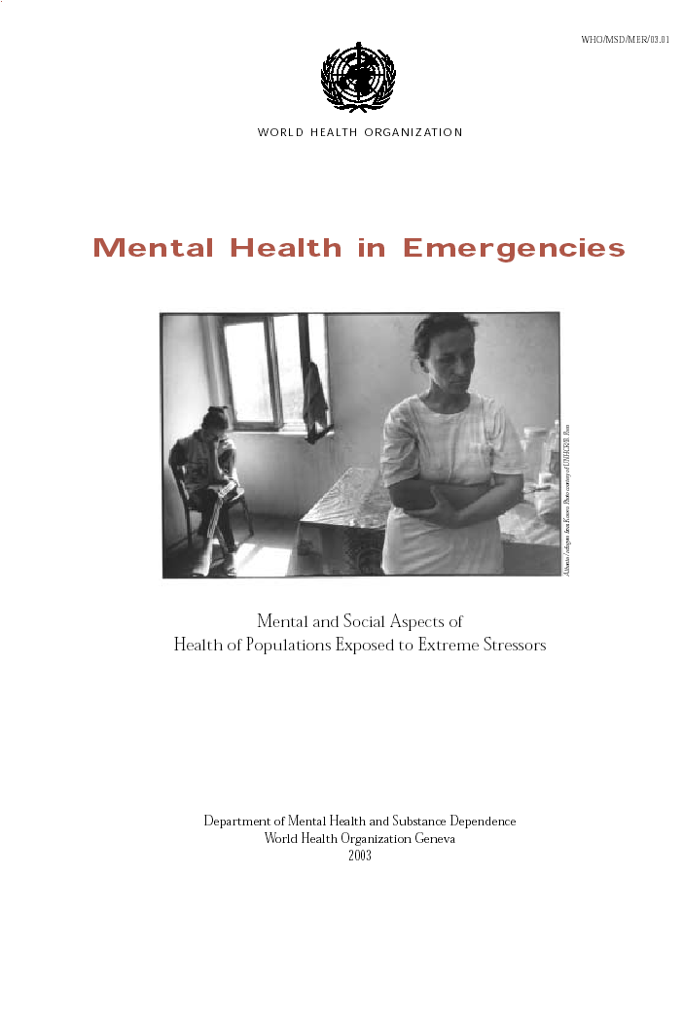
International Consensus Statements
“Because of the possible negative effects, it is not advised to organize forms of single-session debriefing that pushes persons to share their personal experiences beyond what they would normally share.”

Slide 123
International Consensus Statements
“There is still no consensus on the role, if any, of very acute interventions. Classic CISD debriefing can no longer be recommended. The balance between getting people to talk to people, and getting people to talk to professionals, has not been established.”
NATO-Russia Advanced Research Workshop on Social and Psychological Consequences of Chemical, Biological, and Radiological Terrorism

Slide 124
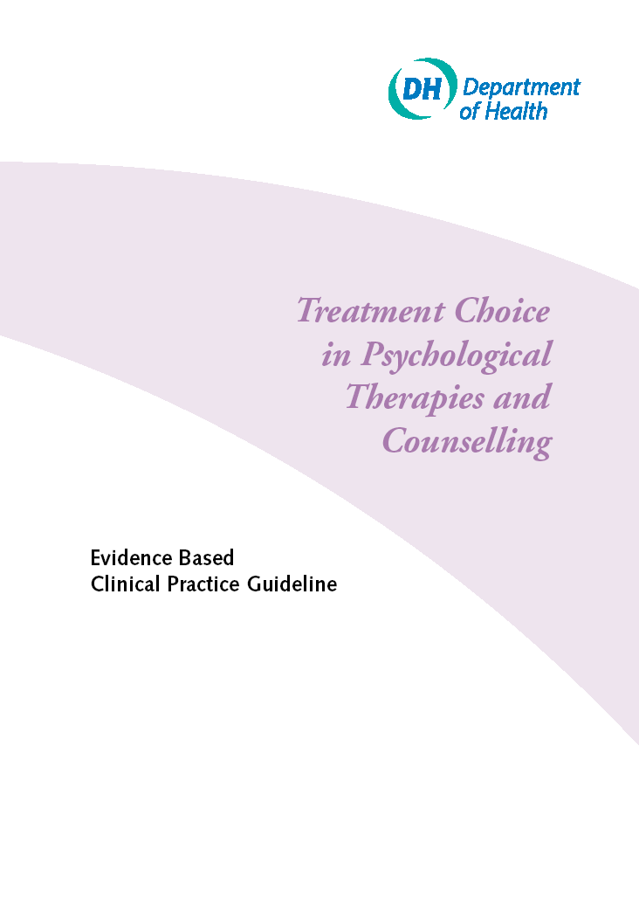
International Consensus Statements
“Routine debriefing after a traumatic event is unlikely to help prevent post-traumatic stress disorder and is not recommended.”
(Directly based on category I evidence)

Slide 125
International Consensus Statements
The 1999 Australasian Critical Incident Stress Association (ACISA)
GLENELG DECLARATION
GUIDELINES FOR GOOD PRACTICE FOR EMERGENCY RESPONDER GROUPS IN RELATION TO EARLY INTERVENTION AFTER TRAUMA AND CRITICAL INCIDENTS

Slide 126
International Consensus Statements
“Calls for evidence based practice recognise the advisability of having agreed and sanctioned guidelines about good practice. This is especially so for early intervention after trauma, since experience and systematic investigations have revealed a marked discrepancy between outcomes once presumed to be achievable (Mitchell, 1983; Mitchell and Everly, 1995) and those that can be reliably delivered. (Rose and Bisson, 1998).”

Slide 127
International Consensus Statements
In their Disaster Mental Health Response Handbook, prepared for the 2000 Olympics, they said there is no evidence CISM prevents PTSD and should not be used.

Slide 128

National Consensus Statements

Slide 129
National Consensus Statements
National Institute of Mental Health (NIMH), in conjunction with:
US Department of Health and Human Services
US Department of Defense
US Department of Veterans Affairs
US Department of Justice
American Red Cross
National Consensus Panel for best practices in evidence-based early psychological interventions for victims/survivors of mass violence.

Slide 130
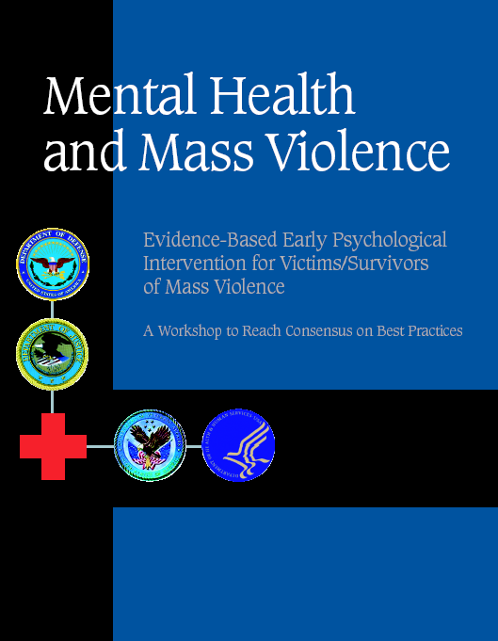
National Consensus Statements
Neither CISM, CISD, or any form of PD was recommended as an early intervention practice.
Only dissention from nearly 100 experts was George Everly, PhD.

Slide 131
So, why does it not work?
May interfere with natural psychological processing (avoidance and intrusion).
May cause personnel to bypass personal support system.
May cause personnel to feel that they were “healed” by the CISD session.
May interfere with natural environment of the organization.
May lead people to expect that they will suffer post-traumatic stress, and that this may be enough to trigger psychological problems after an incident.
Talking through the event might itself add to the trauma for some survivors.

Slide 132
Summary
CISD/CISM/PD is an empirically bad idea.
All quality studies show that, at best, it is ineffective while several suggest it may be iatrogenic.
CISDs, if applied (which they shouldn’t be), should never be mandatory.
All personnel participating in any form of PD should provide informed consent.
EMS & Fire organizations may be exposing themselves to civil liability by providing CISM.

Slide 133

Stress
OK. You made your point. What should we be doing instead?

Slide 134
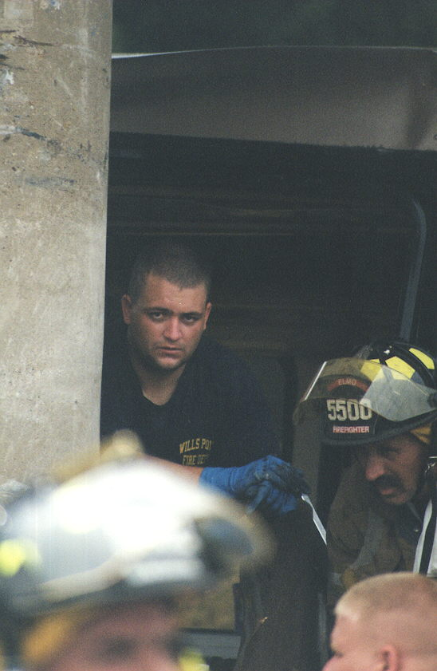
Stress Management
Firefighters and EMTs are resilient.
Use techniques that promote resiliency.
Recognize that people cope differently.
Let them maintain as much “control” over their stress response as possible.

Slide 135
Stress Prevention
Stress can not be treated after exposure.
All personnel must have good stress management techniques.
Most stress in EMS and the fire service is not major events, but the day-to-day hassles of the job.
Pay
Equipment
Dealing with the public
Administrative hassles
Work hours

Slide 136
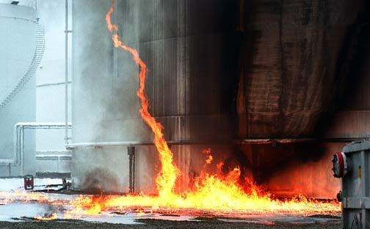
Stress Prevention
If you can handle the daily grind, you can handle the big event.

Slide 137
Stress Prevention
Well run incidents.
Well managed organizations.
Well prepared providers.
Well conditioned personnel.
Well grounded lives.

Slide 138
Stress Management
Critical elements of stress management:
Information
Instrumental aid
Appraisal
Social and emotional support

Slide 139
Information
Information comes FIRST!
People need the facts to know what to feel.
Rumors are a major source of stress.
This gives them some “control”.

Slide 140
Appraisal
Works best through genuine peers.
Upward contact.
Experiential help (“Been there, done that”)
Downward evaluations.

Slide 141
Instrumental Aid
Instrumental aid often means the most.
If there’s help with the “hassles,” folks can grapple with the rest.
“I would be OK if I could just have a cup of coffee!”

Slide 142
Emotional Support
This is not principally an organizational or clinical issue!
Cocoon versus catharsis
I need to be left alone . . .
. . . stay right here and leave me alone!
For you, it’s an occupational issue . . .
. . . for your partner, it’s a relationship issue!

Slide 143
Immediate Assistance
Psychological “First Aid”
Common sense things.
Contact, presence, concern.
Information is first and primary need.
Practical, instrumental assistance.
Palliative steps wherever possible.
Operational debriefing rather than pseudopsychological interventions.
Monitoring and assessment where indicated.
Reserve therapeutic endeavors for those who truly need them.

Slide 144
Psychological First Aid
Listening
Conveying compassion
Assessing needs
Ensuring that basic physical needs are met
Not forcing personnel to talk
Providing or mobilizing company from family or significant others.
Encouraging, but not forcing, social support.
Protection from additional harm.

Slide 145
Post-Event Assessment
Four to six weeks post impact.
Arousal and re-experiencing cardinal indicators.
Any six of ten symptoms endorsed as “twice or more in past week”.
Those showing positively referred for full evaluation.
Positive and negative predictive power >0.90.
Overall efficiency > 0.92.
Brewin, Rose, et al. (2002)

Slide 146
A Rational Approach
Small Incidents:
Small incidents (in size), including those that result in the death of colleagues, should be handled by competent mental health personnel.
Debriefing should not be provided.
Mental health personnel should screen affected personnel for up to 2 months for abnormal responses to stress.
Personnel not adapting should be referred to competent personnel for accepted forms of therapy.

Slide 147
A Rational Approach
Major Incidents/Disasters:
The stress of major events can be mitigated by several strategies:
Proper use of IMS.
Rotating personnel out of the disaster scene.
Constant surveillance of personnel by competent mental health personnel for signs of stress.
Post-incident surveillance of involved personnel by competent mental health personnel.

Slide 148
Summary
No CISM teams.
No defusing or psychological debriefing.
No mandatory psychological interventions.
Appreciate individual coping styles.
Have a competent mental health consultant who knows the culture and the department and who can screen those identified by peers as nonadaptive.

Slide 149
Summary
Do what you used to do!
The EMS and fire department culture is supportive.
Early involvement of family members.
Proper use of IMS.
Provide information and psychological first aid.
Treat only the affected animals—not the entire herd.

Slide 150
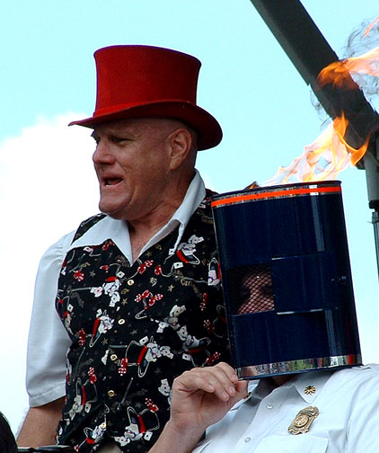
Well, I Still Want CISM!
Well, you may have your studies, but I have seen CISM work and we will keep doing it?

Slide 151
Well, I Still Want CISM!
Researchers will continue to attack the methods of traditional debriefings.
Media will publicize the negative side of controversy.
Employment attorneys will increasingly advise against traditional debriefings.
Plaintiff attorneys will litigate.
Resiliency-based models will replace CISD-models.

Slide 152

Well, I Still Want CISM!
Quality studies have shown that CISM//D has the potential to cause serious harm to a sub-set of people who receive it.
Are you willing to go to court with only your anecdotal evidence?

Slide 153

Well, I Still Want CISM!
“While proponents of CISM say organizations may have liability for NOT offering CISD and CISM, in reality organizations may be increasing their liability by offering a practice that is not supported by the preponderance of the available scientific evidence.”
Richard J. McNally, Richard A. Bryant, and Anke Ehlers. Does Early Psychological Intervention Promote Recovery From Posttraumatic Stress? Psychological Science in the Public Interest. 2003;4(2)

Slide 154
Well, I Still Want CISM!
“Hence, while the buyer should beware (caveat emptor) when buying debriefing services, the evidence of a defective product is mounting to the point where it may be time for the seller to beware (caveat venditor).”
Devilly GJ, Cotton P. The Australian Psychologist. 2004;39(1):35-40

Slide 155
Well, I Still Want CISM!
Minimize your liability (for you may eventually be sued)
Get informed consent before CISD.
Never make CISD mandatory (including use departmental coersion).
Make sure a COMPETENT mental health person attends each session.
Do not let CISM providers try and “treat” those not adapting. They MUST be referred!

Slide 156
Additional Information
Much of this information, including this PowerPoint and many of the studies referenced, are available on-line at:
http://www.bryanbledsoe.com

