Slide 1
Endocrine and Hematologic Emergencies
Patrick Sinclair, D.O., EMT-B

Slide 2
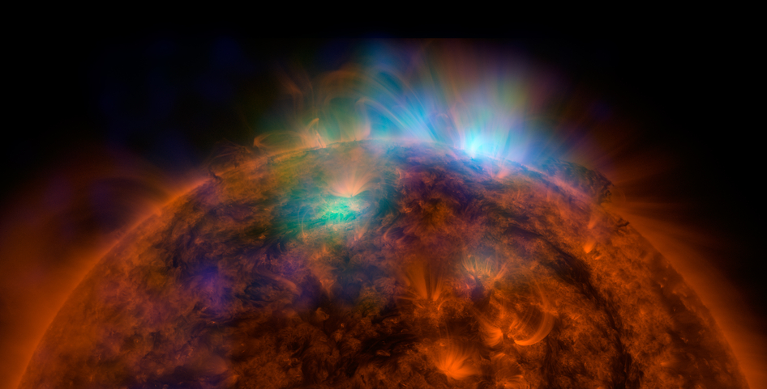
Endocrine
Impaired Glucose
Diabetic Ketoacidosis (DKA)
Hyperosmolar Hyperglycemic Nonketotic Syndrome (HHNS)
Thyroid
Storm
Myxedema Coma
Hematology
Sickle Cell Disease
Bleeding/Clotting Disorders

Slide 3
You Are Dispatched
UOA you see a 19yo pale, ill appearing man lying in bed, moaning, and clutching his abdomen
Mom is present and reports that several days ago he was complaining of “the flu”, which he described as fatigue, nausea, mild abdominal discomfort, and some urinary frequency.
The patient moans and localizes pain, but does not speak coherently. You also notice a funny odor on the patient’s breath

Slide 4

What Do You Do?

Slide 5

What Do You Do?
1) A…B…C…
2) A…B…C…
3) A…B…C…
4) Vital Signs
5) SAMPLE
6) Secondary Assessment

Slide 6
Secondary Assessment
Head and Neck
Lungs
Cardiac
Abdomen
Neuro
Skin
…oh ya, the accucheck reads high…

Slide 7
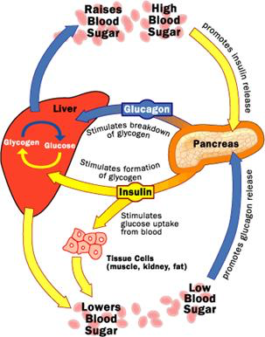
Pathophysiology

Slide 8
Type 1 Diabetes
Type 1 patients do not produce insulin.
Need daily injections of insulin
Typically develops during childhood
Patients more likely to have metabolic problems and organ damage
Considered an autoimmune problem

Slide 9
Type 2 Diabetes
Type 2 patients produce inadequate amounts of insulin, or normal amount that does not function effectively.
Usually appears later in life
Treatment may be diet, exercise, oral medications, or insulin.

Slide 10
The Classic Symptoms of Uncontrolled Diabetes
Polyuria: frequent urination
Polydipsia: thirst
Polyphagia: hunger

Slide 11
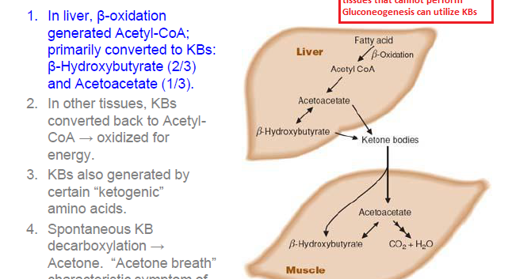
“Fruity Breath”

Slide 12
Hyperosmolar Hyperglycemic Nonketotic State
Most common in Type 2 Diabetics
Usually precipitated by infection
Usually older patients
Characterized by the lack of ketoacidosis
Not really known why
Hypothesized that there is still a minimal amount of insulin that inhibits ketogenesis
Patients are profoundly dehydrated (up to 9L)

Slide 13
Kussmaul Respirations
https://www.youtube.com/watch?v=TG0vpKae3Js

Slide 14
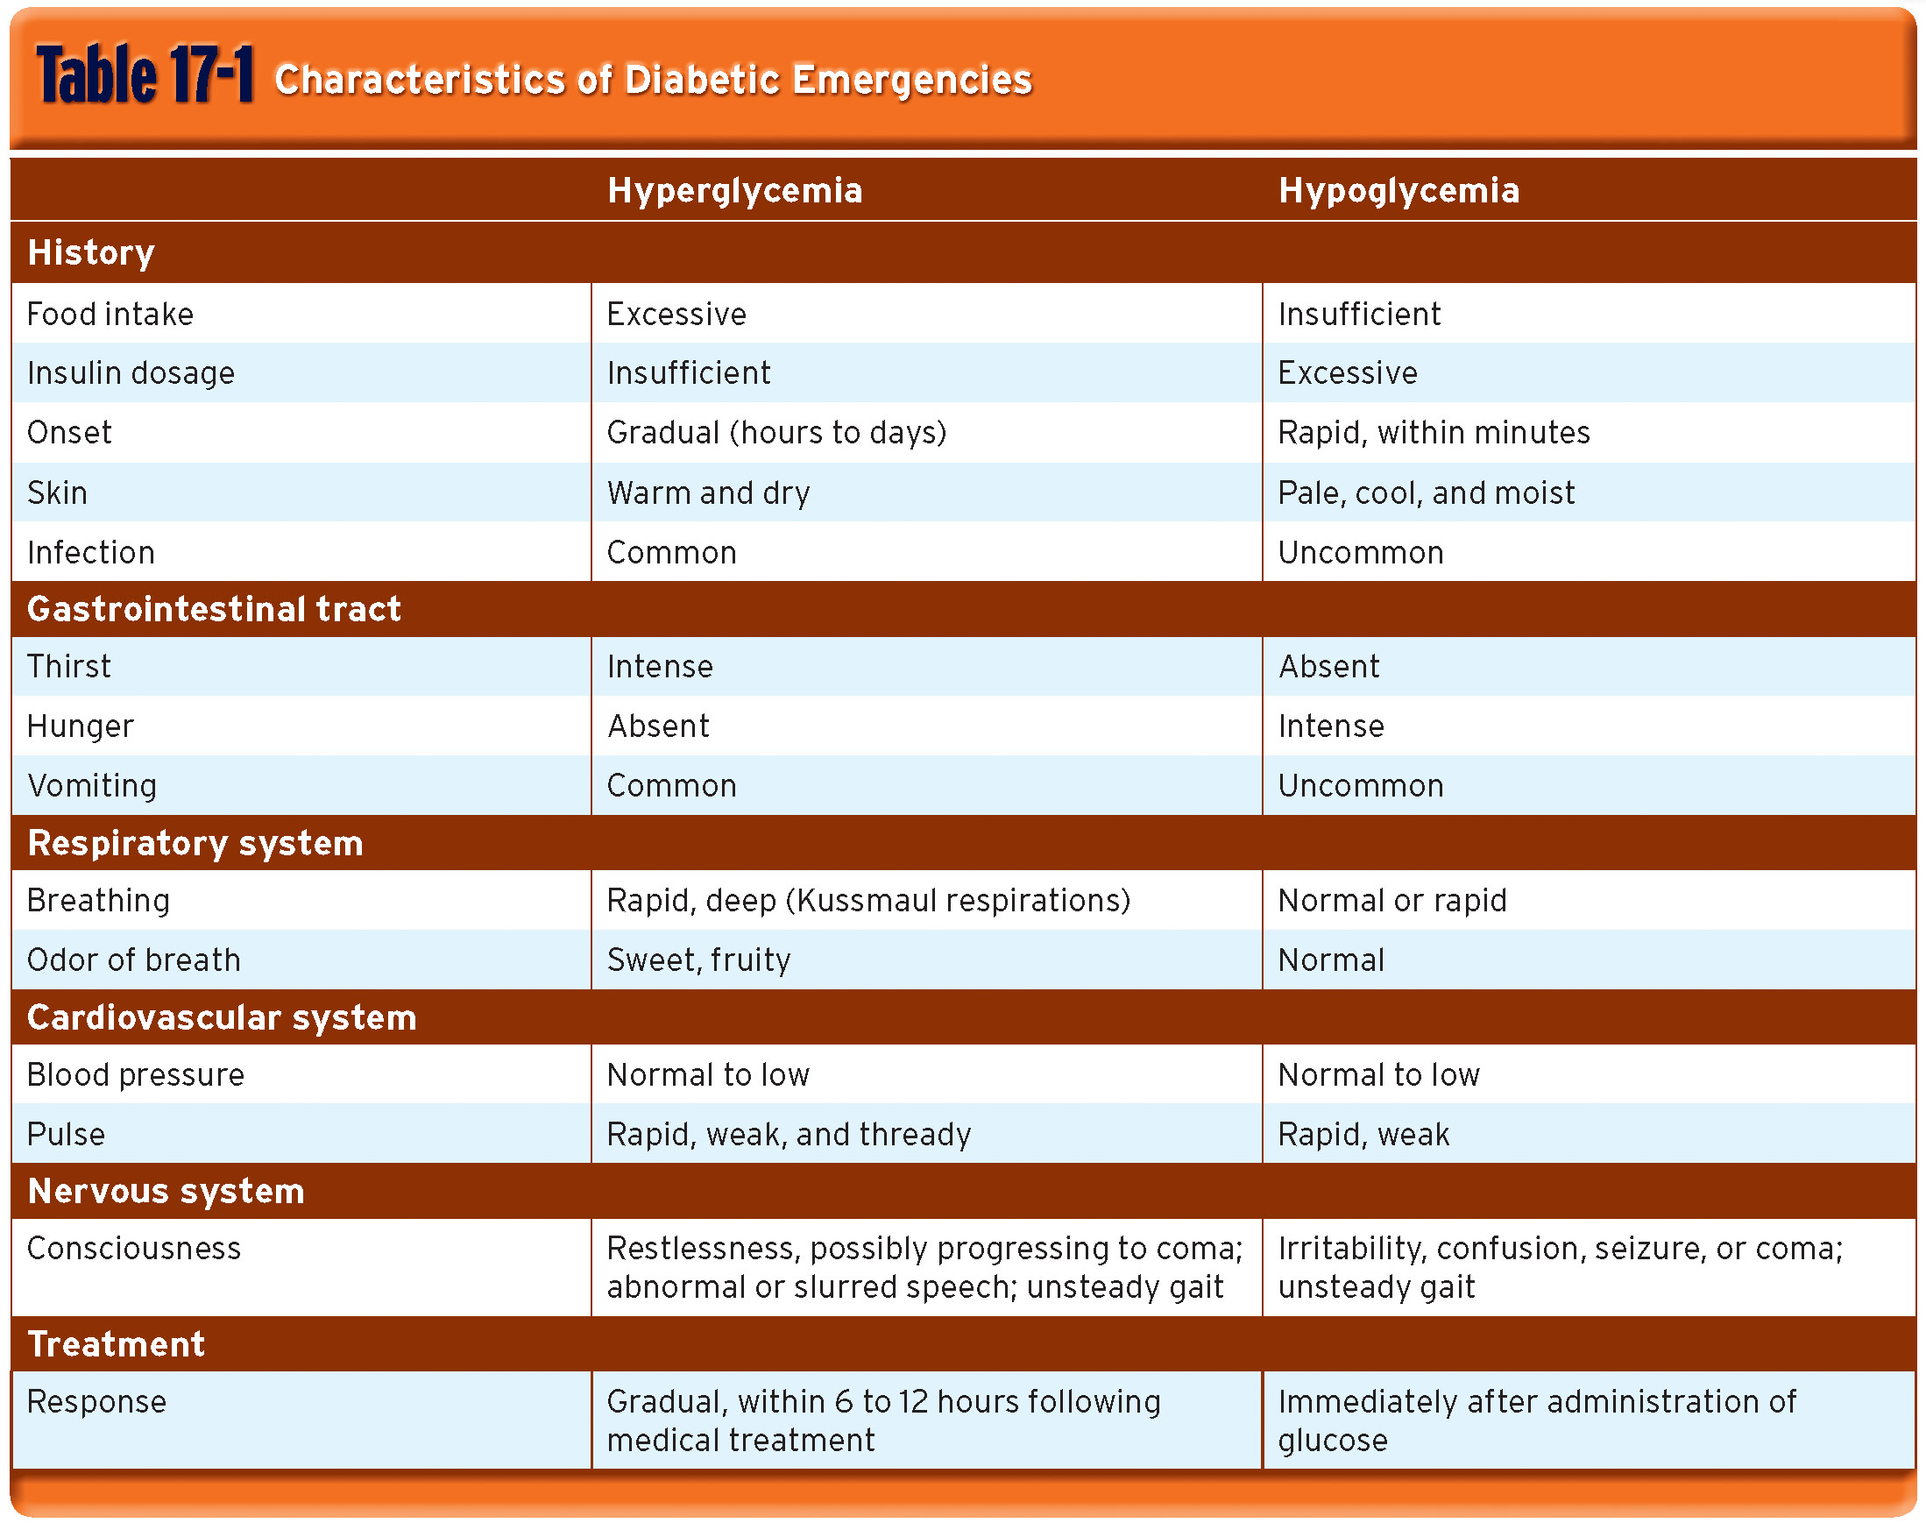
Symptomatology for your Test [In Real Life the Lines are Blurred]

Slide 15
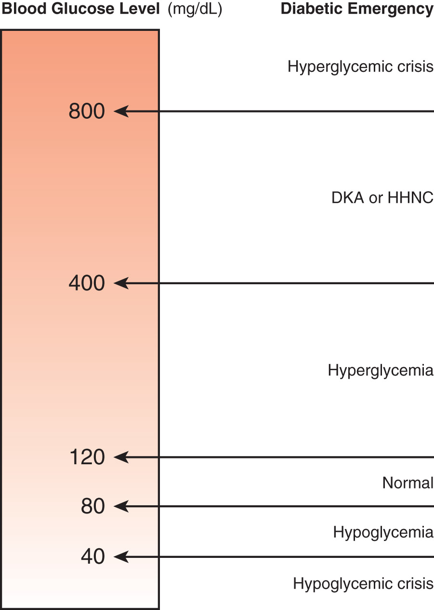
Crisis
Hyperglycemia: takes days of careful fluid and electrolyte repletion
Hypoglycemia: easily corrected with glucose

Slide 16
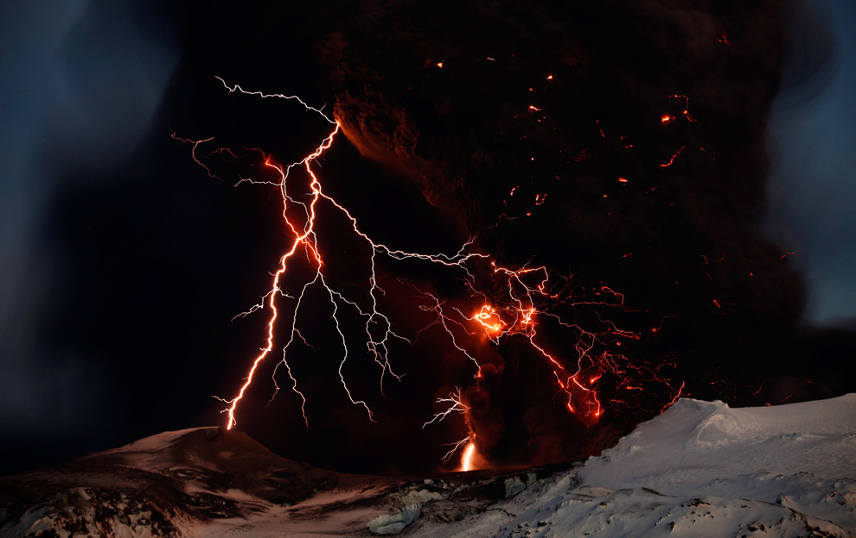
Thyroid Storm
Carries a prognosis of 90% mortality…so ya, you should probably know this…
Definition: a decompensated state of thyroid hormone-induced, severe hypermetabolism involving multiple systems
This leads to: hyperpyrexia, hypertension or hypotension, tachycardia→arrhythmias, agitation/confusion, tremors/seizures
Casuses: Sepsis, DKA, medications, thyroid nodule
Still uncertain of the exact pathophysiology

Slide 17
Myxedema Coma
Commonly occurs in older women with long-standing hypothyroidism who experience an additional significant stress: infxn, systemic dz, medications, cold environment
Hypotension, hypothermia, confusion, stupor, slow respirations, fluid/edema/wet

Slide 18
You Are Dispatched…
30yo female complaining of chest pain for 2 days. She feels feverish, mild shortness of breath, and productive cough.
Chest pain is right sided and worse with inspiration

Slide 19
Acute Chest
Leading cause of death for patients with Sickle Cell Disease
Caused by vaso-oclusion within the pulmonary microvasculature
Look out for infection or asthma as the precipitating factor

Slide 20
Symptoms of Acute Chest
Fever
Pleuritic chest pain
Tachypnea
Wheezing/rales (more often heard in children)
+/- cough
+/- hypoxia

Slide 21
Treatment Options
Oxygen
Nebulized albuterol (no good research on this)
Use if you hear wheezing
Manage the pain (the single biggest challenge with these patients)
IV Fluids

Slide 22
Sickle Cell Disease
Hemoglobin S is a poor O2 carrier and leads to structural compromise of RBC (sickling)
RBCs only live 16 days
Leads to:
Vasooclusive crisis
Aplastic Crisis (failure of bone marrow)
Hemolytic Crisis (massive RBC death)
Splenic Sequestration (autosplenectomy)

Slide 23
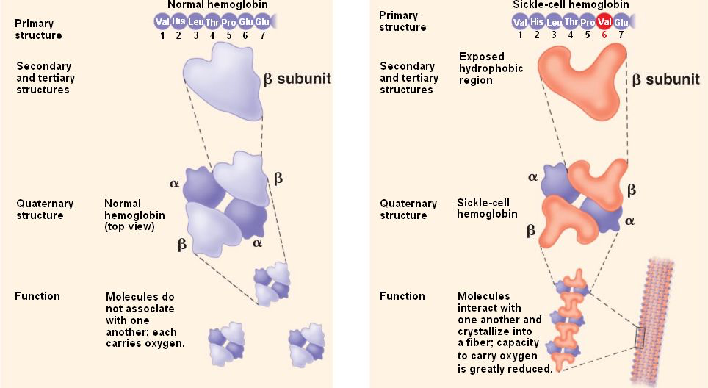
Some Pathophysiology…

Slide 24
Bleeding Disorders
Most common are: Hemophilia A and B, factor deficiencies, and von Willebrand’s disease
Don’t worry about knowing these, worry about achieving hemostasis!
May be the underlying cause of nose bleeds, gum bleeds, hemarthrosis, excessive bruising, abnormal menstrual bleeding, any other abnormal bleeding (usually, platelet dysfunction manifests as petechiae and coag factors manifest as larger bleeds -> hemarthrosis)

Slide 25
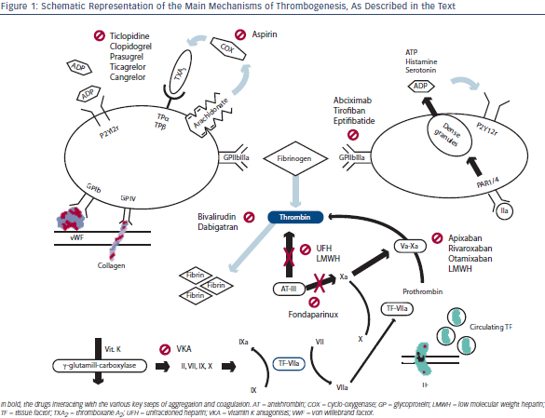
Thrombogenesis

Slide 26
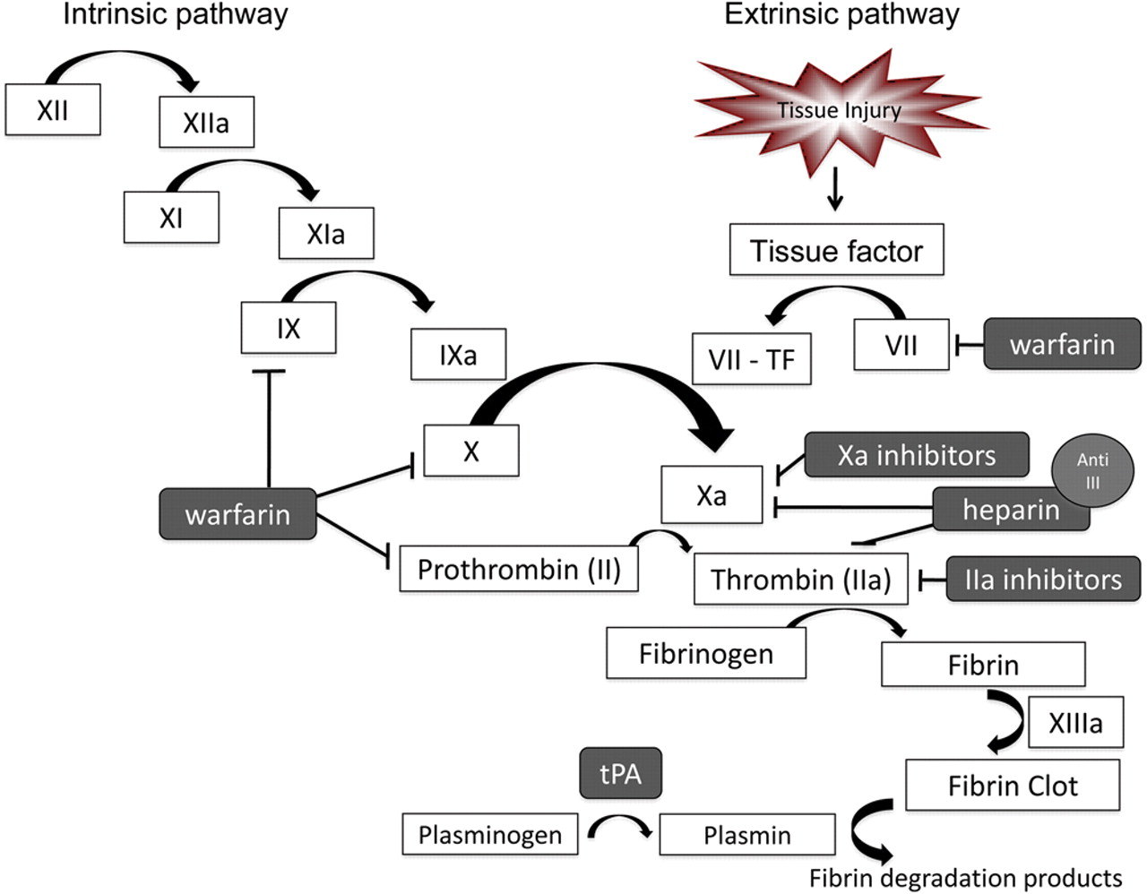
Clotting Disorders

Slide 27
Clotting Disorders
Factor V Leiden, Prothrombin gene mutation, Protein C&S deficiency, Amniotic Fluid Embolus, Disseminated Intravascular Coagulation, Heparin Induced Thrombocytopenia
Underlying causes of DVT, PE, Stroke, Avascular Necrosis

