Slide 1
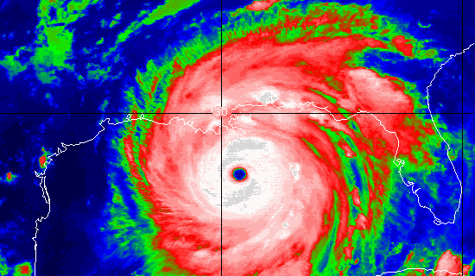
Preparing Yourself for Disaster
Keith Conover, M.D., FACEP

Slide 2
Goals
For those responding individually to disasters:
Explain how to avoid being kicked out as a nuisance.
Identify the major differences in medical needs before and after catastrophic disasters.
Identify your major logistical needs.
Identify your major training needs.

Slide 3
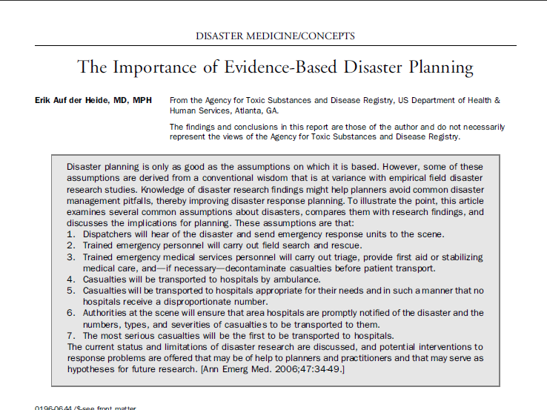
Notes:
Dispatchers will hear of the disaster and send emergency response units to the scene.
Trained emergency personnel will carry out field search and rescue.
Trained emergency medical services personnel will carry out triage, provide first aid or stabilizing medical care, and--if necessary--decontaminate casualties before patient transport.
Casualties will be transported to hospitals by ambulance.
Casualties will be transported to hospitals appropriate for their needs and in such a manner that no hospitals receive a disproportionate number.
Authorities at the scene will ensure that area hospitals are promptly notified of the disaster and the numbers, types, and severities of casualties to be transported to them.
The most serious casualties will be the first to be transported to hospitals.
Auf der Heide, E. (2006). "The importance of evidence-based disaster planning." Ann Emerg Med 47(1): 34-49.

Slide 4
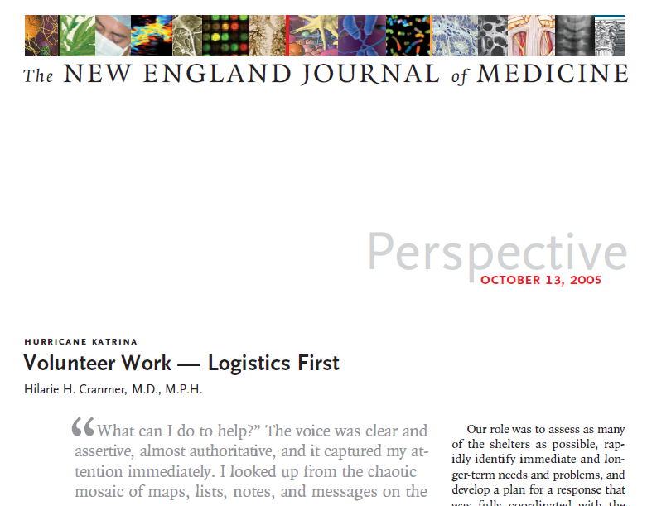
Notes:
many well-intentioned clinicians and health care organizations simply self-deployed and traveled to Louisiana, where their arrival compounded the overall disorganization of the effort to provide health care
Every one of them wanted and expected to save lives and alleviate suffering, but it was still logistically impossible for them to use their skills in the way they expected. Clearly, there was a disconnect between the aspirations of the army of volunteers and the actual needs of the victims of Hurricane Katrina.
In the immediate aftermath of a disaster involving large, displaced populations, doctors, as difficult as it might be to accept, are one of the least useful commodities. The first priorities, standards in the developing world, are security and safety for the population, then water, sanitation, food, and shelter. Once the humanitarian-aid staff is safe from danger, the most effective way to save lives is to ensure the availability of clean water, secure a place for bodily wastes away from the water supply, and then vaccinate every child younger than 15 against measles. Only after these needs have been addressed can curative care become operational.
Cranmer HH. Hurricane Katrina. Volunteer work--logistics first. N Engl J Med 2005;353:1541-4.

Slide 5
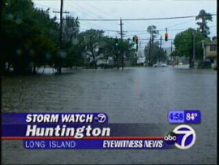
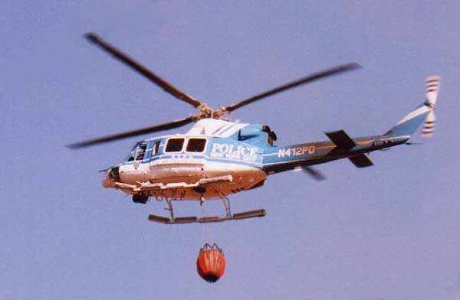
Saturday, Oct 24, 2015
Notes:
Last night, a Cat 5 hurricane hit Long Island.
Thousands are dead or injured.
Within 3 blocks of the beach, it’s just kindling

Slide 6
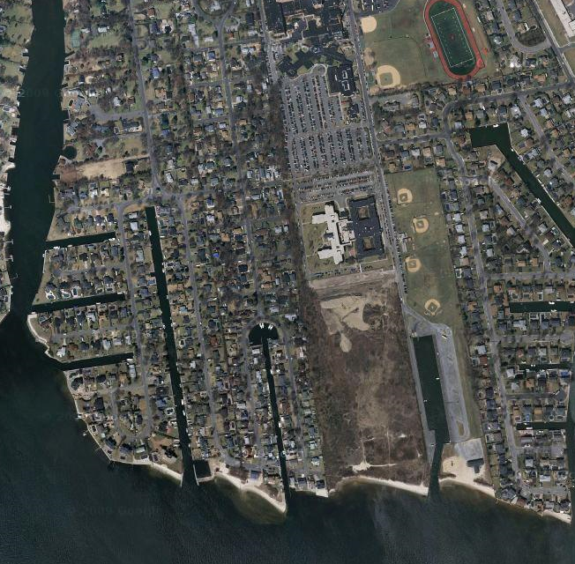
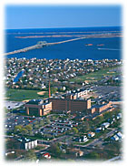
Sunday, Oct 25, 2015
Notes:
Long Island cut off from the mainland.
All bridges out
All airports damaged and closed
Too windy for helicopters but may clear soon.
Landline telephones all cut off.
Cellphone coverage very spotty, mostly not available.

Slide 7
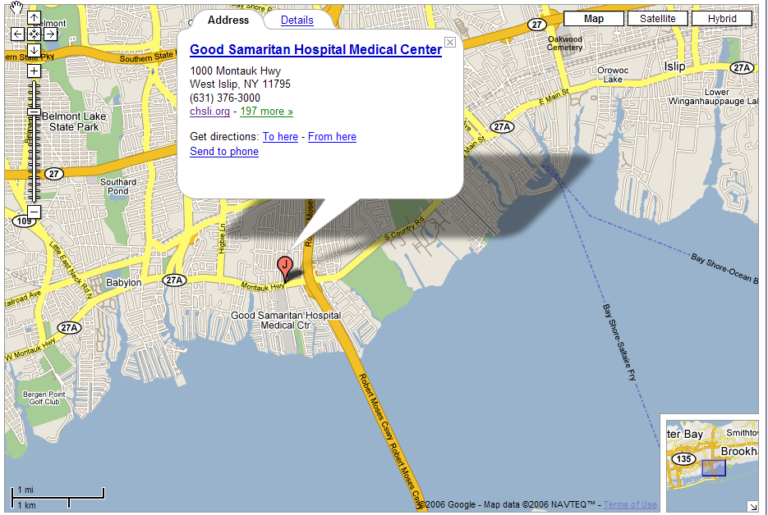
Saturday, Oct 25, 2015
Notes:
Albany Medical Center ED gets a call from Steven Zimmerman, M.D., acting ED chair at Good Samaritan Hospital (431 beds, 48K ED):
badly damaged
hundreds of patients waiting to be seen in ED
no food, no water
sends three pictures from cellphone:
ED staff entrance
best shelter near the hospital
helicopter LZ about 3 miles away with GPS coordinates

Slide 8
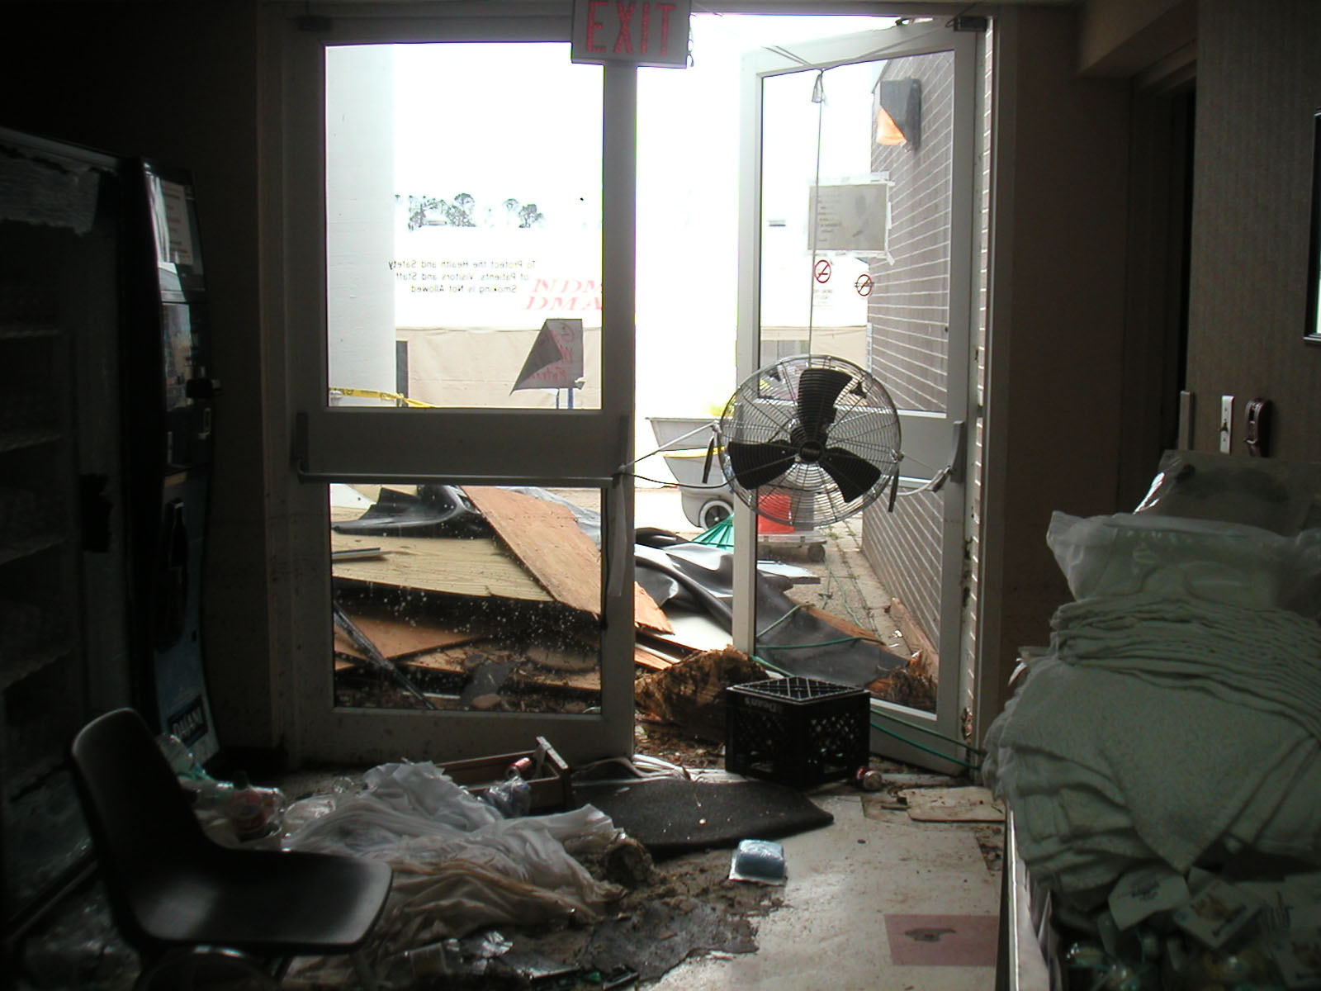

Slide 10
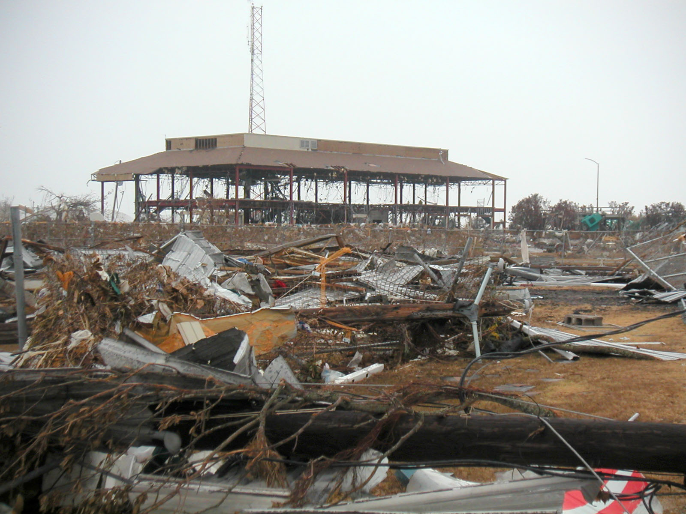

Slide 11
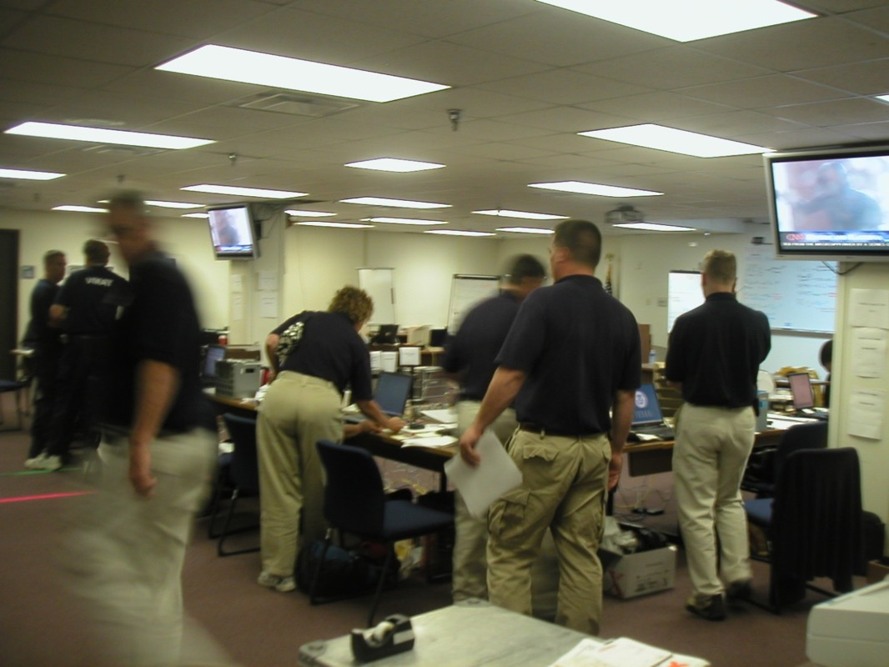
FEMA-NDMS IST
Notes:
Local medical helicopter control contacts FEMA-NDMS IST
Helicopter control authorized to transport team to area; backup Sea King helicopter for final insertion if needed
8 people
each with 70 lbs. of gear, no more
will be dropped at the LZ 3 miles from hospital

Slide 12
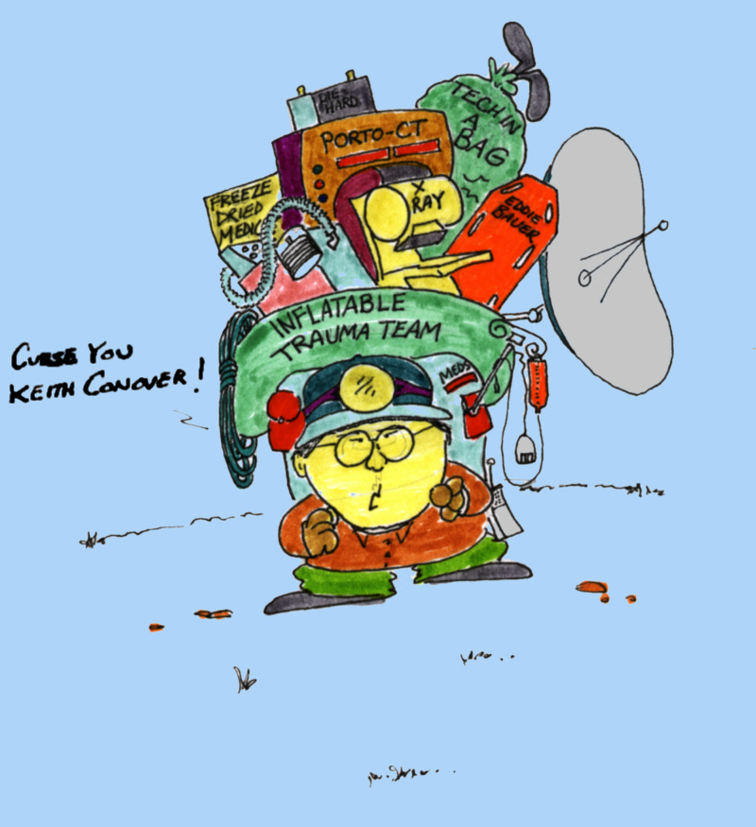
What do you pack?
Notes:
What will happen if you show up and say “I need a place to stay, food, water, and a hot shower?”

Slide 14
Task and Threat Analysis
Security
Shelter
Water
Food
Comms
Navigation
Travel
Medical
Notes:
Who provides these?
Helicopter service?
Your hospital?
Good Samaritan Hospital?
West Islip?
State of New York?
FEMA?
NDMS?
You?

Slide 15
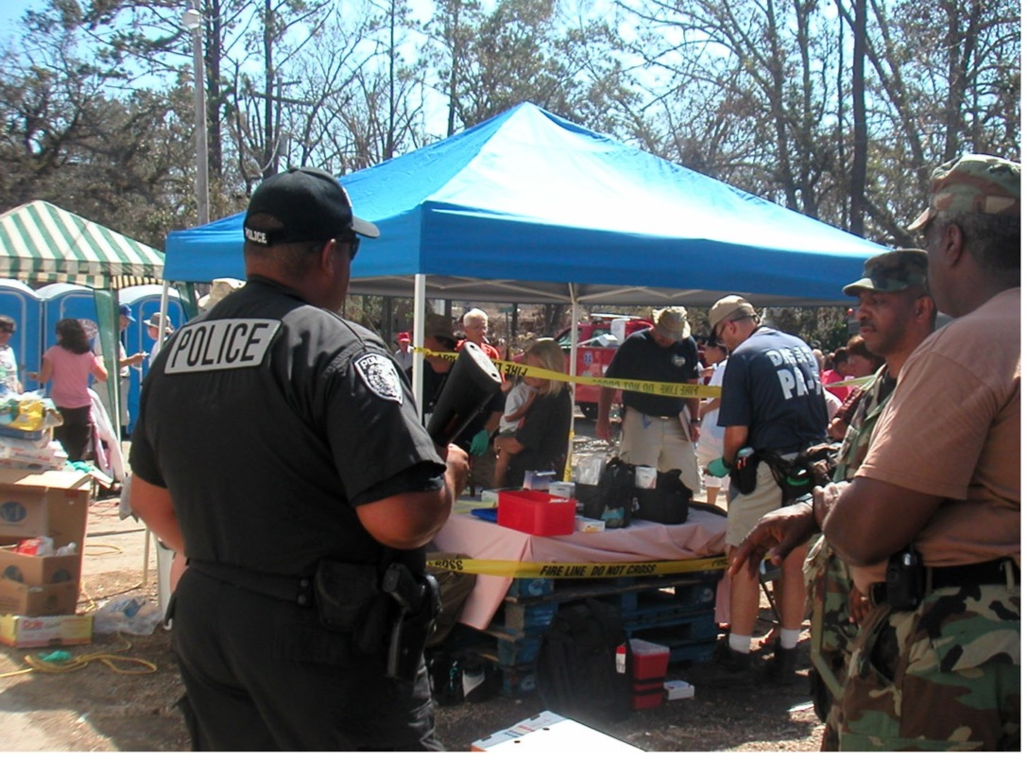
Security
Notes:
You have narcotics. They know this, even if it’s not true. They will come and get them.

Slide 16
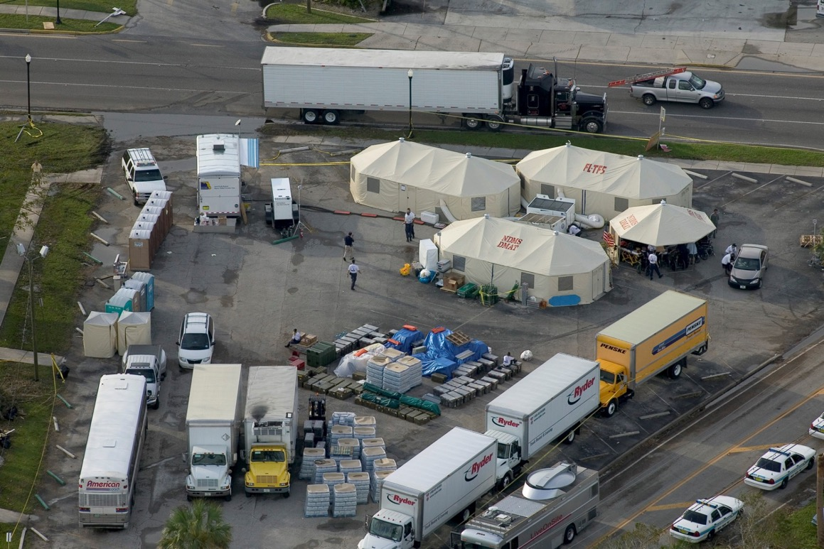
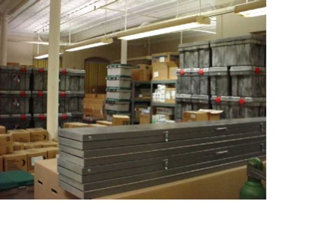
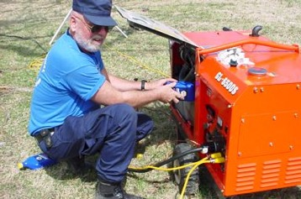
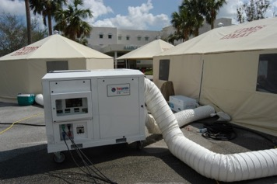
Shelter

Slide 17
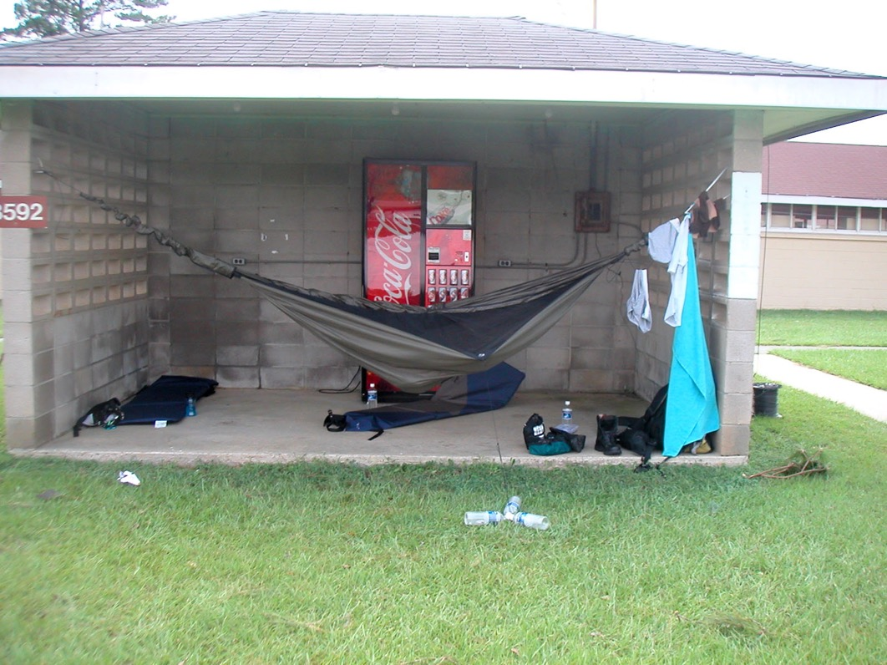
Shelter

Slide 18
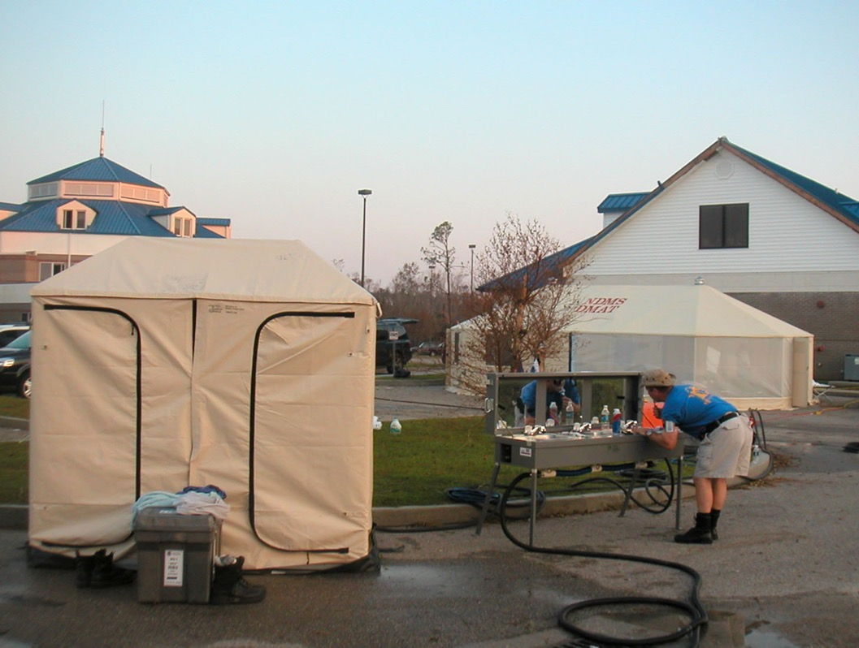
Water

Slide 19
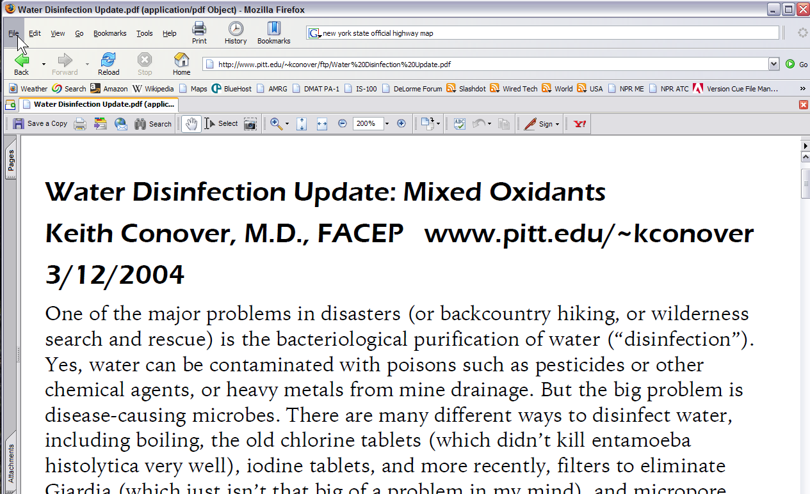
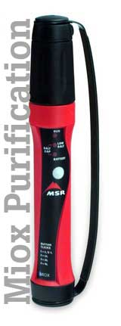
Water
www.conovers.org/ftp

Slide 20
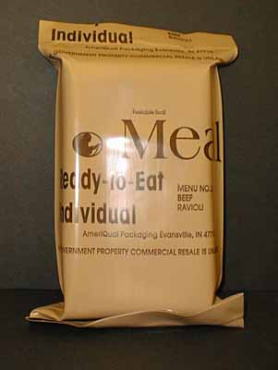
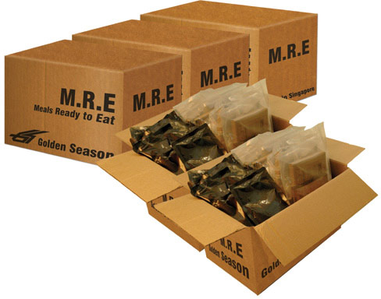
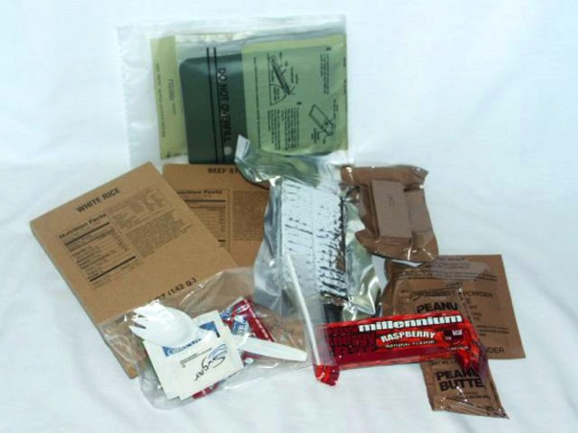
Food

Slide 21

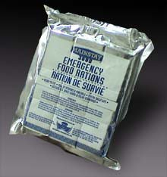
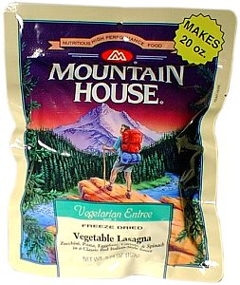



Food

Slide 22
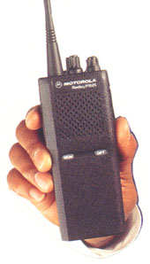
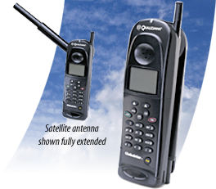
Comms

Slide 23
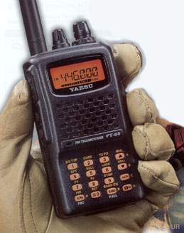
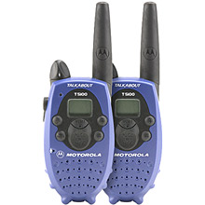
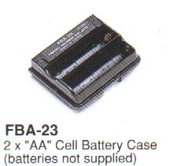
Comms

Slide 24
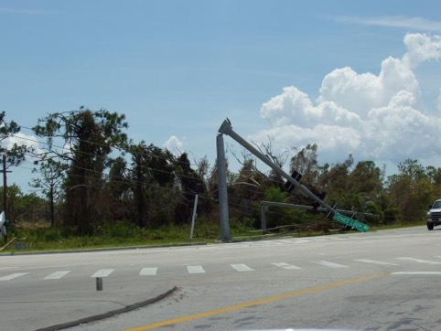
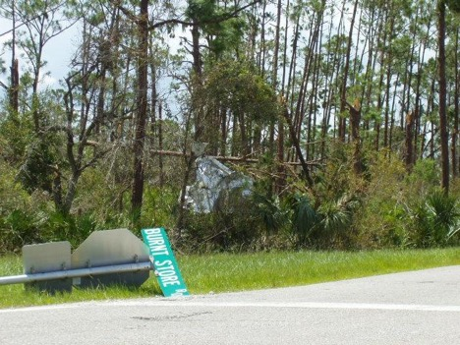
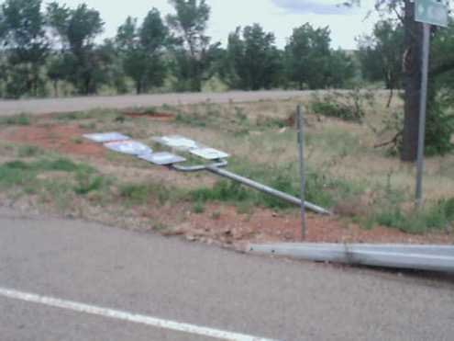
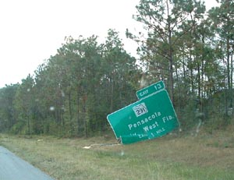
Navigation

Slide 25
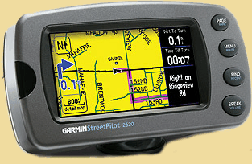
Directions
Notes:
(NOT navigation)
requires 12V car power

Slide 26

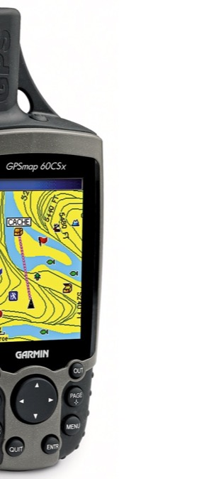
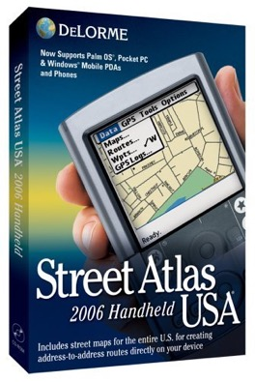

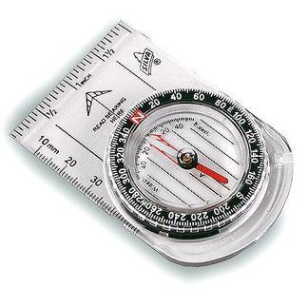
Navigation
Notes:
Map, compass, handheld GPS with spare batteries (again, directions more than navigation), laptop with 12V and 110V power supplies, USB GPS, Street Atlas (aircard and Google Maps, Traffic.com, Texas DOT during Gustav and Ike)

Slide 27
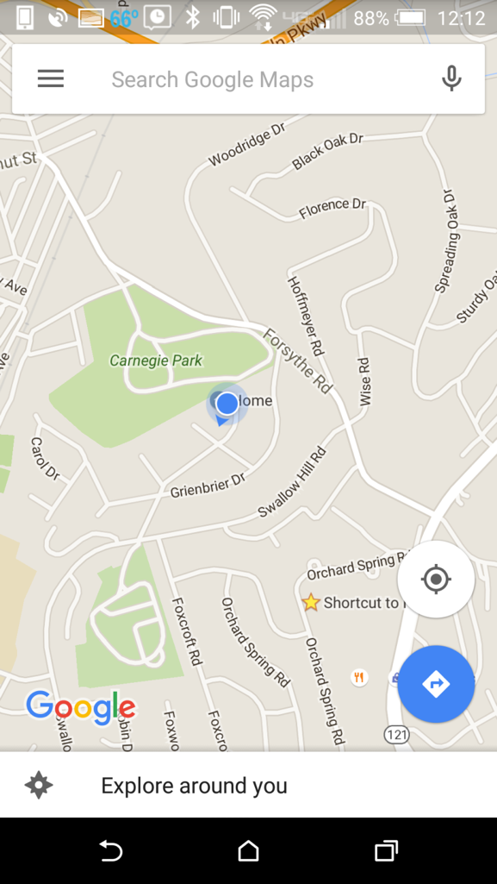
Google Maps: Download Tiles
Notes:
Download Map Tiles

Slide 28
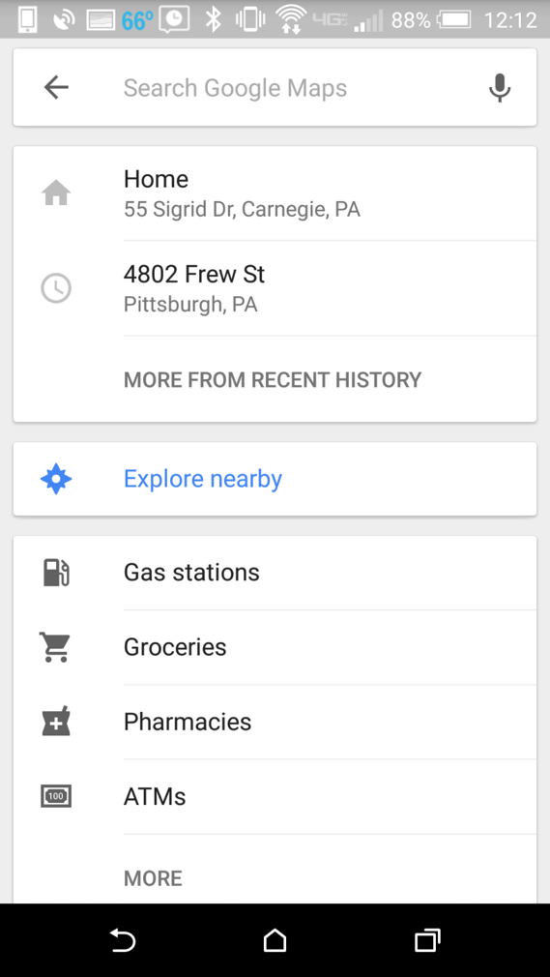
Google Maps: Download Tiles
Notes:
Download Map Tiles

Slide 29
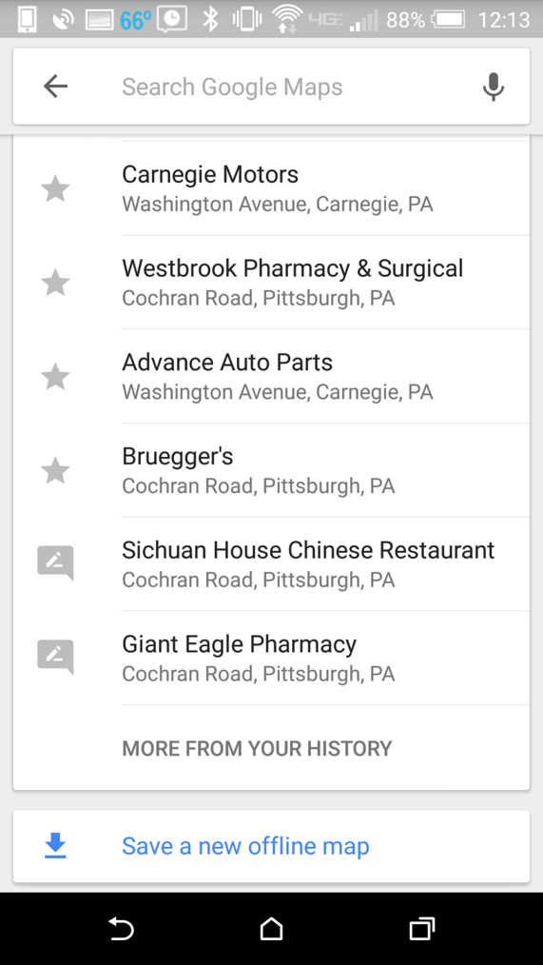
Google Maps: Download Tiles
Notes:
Download Map Tiles

Slide 30
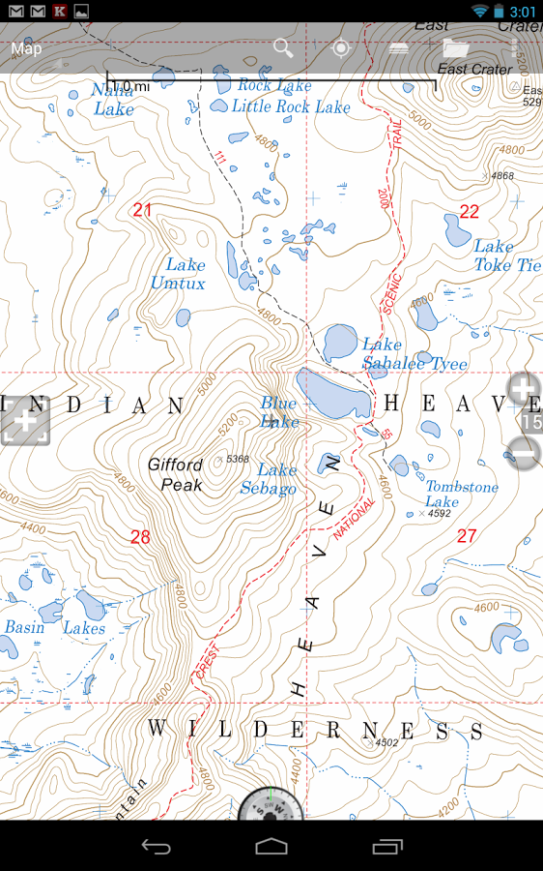
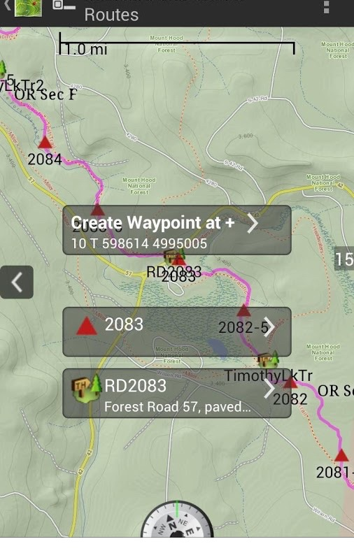
Android Backcountry Navigator: Download Topo Maps
Notes:
Download Map Tiles

Slide 31
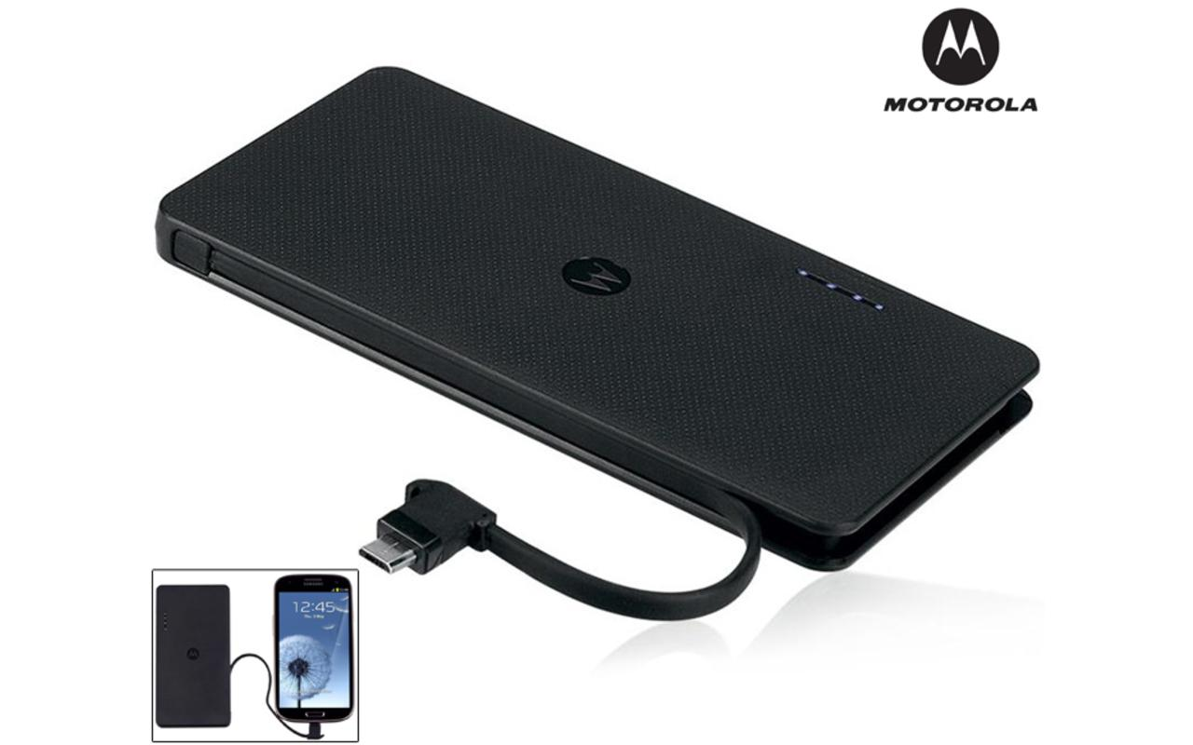
Chargers for cellphone?
Notes:
Motorola P400 cellphone charger

Slide 32
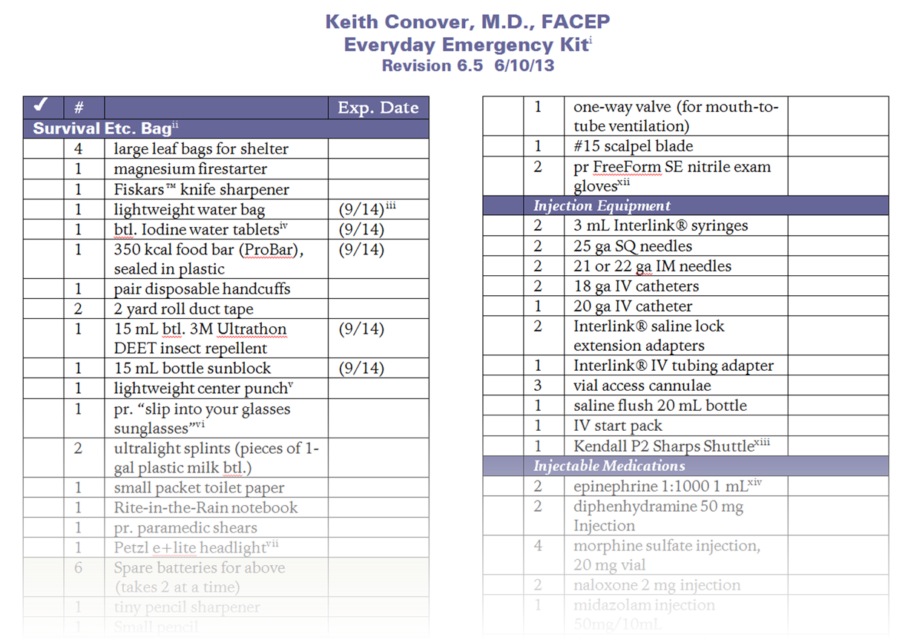
Chargers for cellphone?

Slide 33
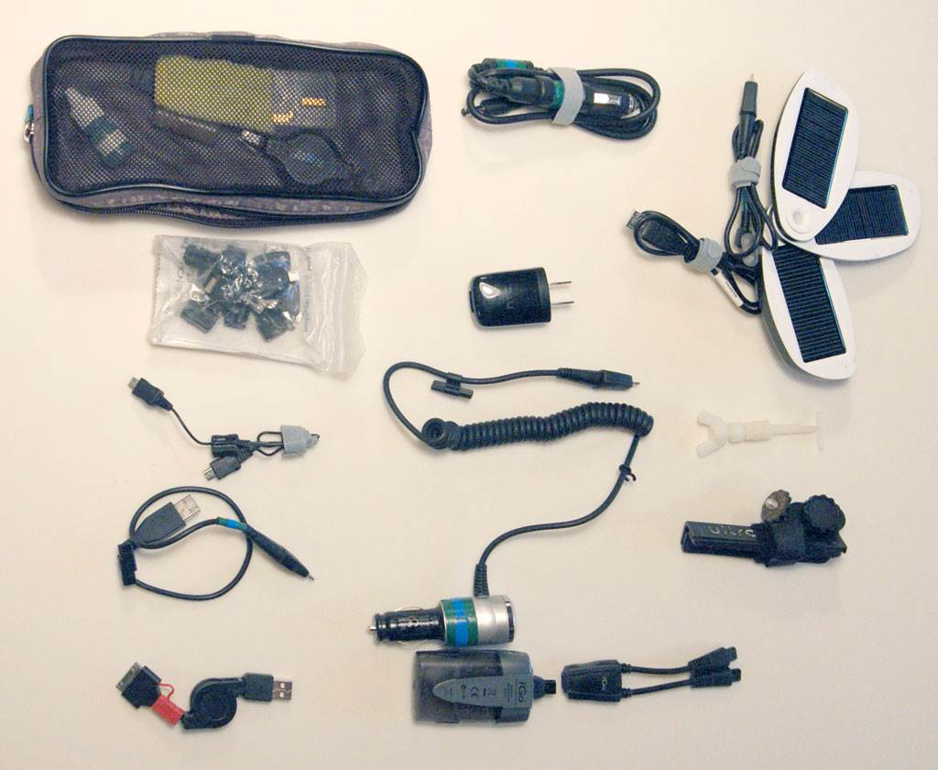
Chargers for cellphone?
Notes:
See my SAR Equipment list

Slide 34
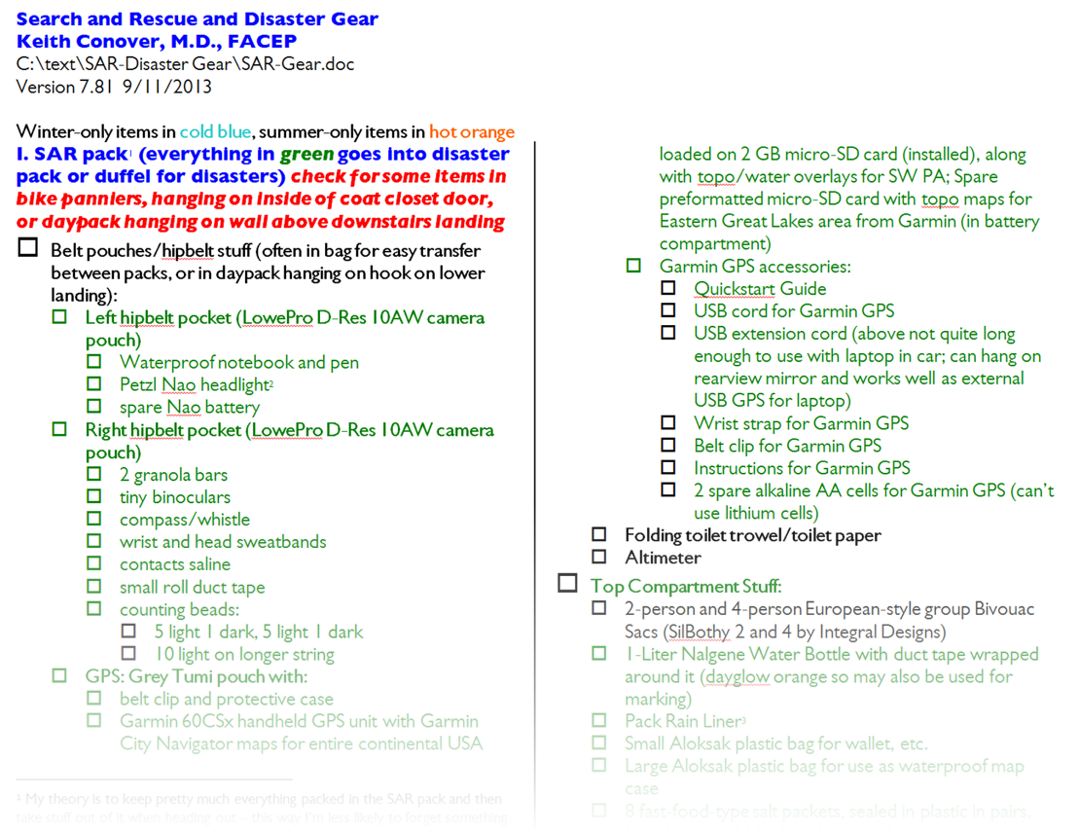
conovers.org/ftp
Notes:
Motorola P400 cellphone charger

Slide 35

Travel
Notes:
Travel can be dangerous

Slide 36
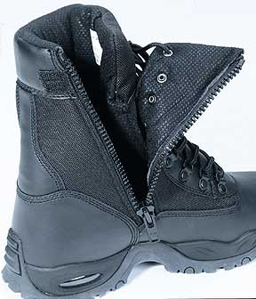
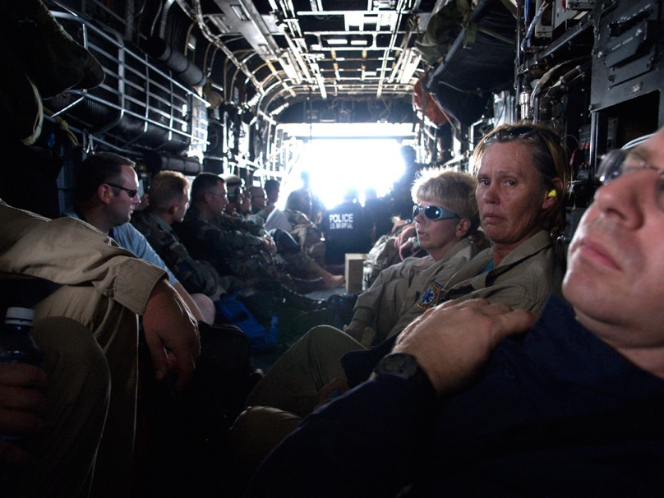
Travel
Notes:
If part of a military or Federal team, can assume (usually) some support. Not so if you’re by yourselves.

Slide 37




Travel
Notes:
Standard lightweight personal backpacking gear is good.

Slide 38


Travel-Medical
conovers.org/ftp
Notes:
handheld flashlights are nearly useless when traveling or doing medical care: recommend Petzl Tikka XP 2 ($40)

Slide 39

Notes:
NDMS Disaster Medical Assistance Team cache.

Slide 40




Medical
Notes:
DMATs are full field ED-in-a-tent; but if responding as a small team, will likely provide care at a field or regular hospital; depend on logistics folks to work on the right supplies and equipment.

Slide 41

Medical – Strike Team

Slide 42

Notes:
But the DMAT cache included a Mobile Medical Kit. It fills three of these boxes.

Slide 43

Notes:
It has some ALS stuff, but it has packs full of eyedrops, eardrops, pills, creams and the like. Perfect for Force Protection. They discontinued it but I hope it re-emerges.

Slide 44


Medical – Force Protection
conovers.org/ftp

Slide 45

bring your own infrastructure…

Slide 47



Time
Distance
Equipment
Terrain
Weather

Slide 48


SAR Boot Camp
Survival
Hypothermia: Killer of the Unprepared

Slide 49


SAR Boot Camp
Survival
Wilderness Travel

Slide 50


SAR Boot Camp
Survival
Wilderness Travel
Land Navigation

Slide 51

SAR Boot Camp
Survival
Wilderness Travel
Land Navigation
Communications

Slide 52

SAR Boot Camp
Survival
Wilderness Travel
Land Navigation
Communications
Improvised Rescue

Slide 53





Wilderness Rescue

Slide 54




Wilderness Rescue: conovers.org/ftp/ SAR-Evacs.pdf

Slide 55

SAR Boot Camp
Survival
Wilderness Travel
Land Navigation
Communications
Improvised Rescue
Wilderness First Aid

Slide 56

SAR Boot Camp
Survival
Wilderness Travel
Land Navigation
Communications
Improvised Rescue
Wilderness First Aid

Slide 57

SAR Boot Camp
Survival
Wilderness Travel
Land Navigation
Communications
Improvised Rescue
Wilderness First Aid

Slide 58


SAR Boot Camp
Survival
Wilderness Travel
Land Navigation
Communications
Improvised Rescue
Wilderness First Aid
www.cdsoutdoor.com

Slide 59
SAR Boot Camp
Survival
Wilderness Travel
Land Navigation
Communications
Improvised Rescue
Wilderness First Aid
Incident Management…

Slide 60

Incident Management
Notes:
NOW,” said the rabbit. “THIS IS A SEARCH AND I’VE ORGANIZED IT…”
“DONE WHAT TO IT?” said Pooh.
“ORGANIZED IT. Which means… well, it’s what you do to a search, when you don’t all look in the same place at once…”
--A.A. Milne, 1928

Slide 61

Incident Management - ICS Training

Slide 62

Notes:
Klein GA. Sources of power : how people make decisions. Cambridge, Mass.: MIT Press; 1998.

Slide 63

Appalachian Search and Rescue PA Search and Rescue Council
www.asrc.net
www.psarc.org

Slide 65
How do I get to go?
DHS/FEMA
DHHS/NDMS
EMAC
JRC?

Slide 66

USAR

Slide 67

VMAT

Slide 68

DMORT

Slide 69

IMSuRT

Slide 70

DMAT

Slide 71


Slide 72


Slide 73


Slide 74


Slide 75


Slide 76


Slide 77


Slide 78


Slide 79


Slide 80

Notes:
More frequency shelter operations now, need IM, FP more than EM, and nursing more than physicians.

Slide 81
Disaster Medical Assistance Teams
www.dmatpa-1.com
www.dmatpa3.com
www.pa4dmat.org

Slide 82

MRC – disaster vaporware?
Notes:
Are there core competencies required to become an MRC volunteer?
The MRC program will soon establish core competencies, possibly using elements of the American Red Cross basic training.

Slide 83

EMAC
Notes:
Article VI – Liability Officers or employees of a party state rendering aid in another state pursuant to this compact shall be considered agents of the requesting state for tort liability and immunity purposes; and no party state or its officers or employees rendering aid in another state pursuant to this compact shall be liable on account of any act or omission in good faith on the part of such forces while so engaged or on account of the maintenance or use of any equipment or supplies in connection therewith. Good faith in this article shall not include willful misconduct, gross negligence, or recklessness.

Slide 84

ESAR-VHP

Slide 85

RJRC

Slide 86

CERT
Notes:
Community Emergency Response Teams
8-16 hours training for lay public
CERT team in every neighborhood
To train 2x/year
Some CERT teams are very active and may respond outside their areas

Slide 87
Will I get in trouble?
Are you licensed where you are going?
Will you have malpractice coverage?
Federal teams: sovereign immunity
EMAC request: licensure waived

Slide 88

UEVHPA

Slide 90
The “What If?” Lifestyle
List, Pack
Notes:
Make up your own list,
keep your disaster gear packed to respond at a moment’s notice, highlight on the list what needs to be added, and where it usually lives
keep 5 gal. of gasoline in your garage, ready to go

Slide 91
conovers.org/ftp
Notes:
Motorola P400 cellphone charger

Slide 92
The “What If?” Lifestyle
Spares
Notes:
get and carry spares:
spare cellphone battery
spare AA cells for FRS radio
spare cells and light bulb for headlamp
personal meds
carry backups for critical gear when possible (spare FRS radio, spare glasses or contacts)
toilet paper, Tampax

Slide 93
The “What If?” Lifestyle
Practice
Notes:
know how to program FRS radio; practice with it
know how to use all your cellphone’s features; practice with it
know how to fix all your gear
carry simple tools (Leatherman? Swiss Army knife? cable ties? self-drilling screws? epoxy putty? Superglue? add to your list!)

Slide 94
The “What If?” Lifestyle
Decisions
Notes:
instead of a fancy cellphone with lots of features that doubles as an iPod, get a ruggedized, water-resistant cellphone
instead of that new BMW, get a used Jeep or Land Rover with a winch—and practice with it

Slide 95
The “What If?” Lifestyle
Worry
Notes:
have a disaster plan for those you leave at home
think about disasters a lot; stop what you’re doing to jot down a note about stuff to add to your gear
instead of watching TV, go through your gear over and over again
worry a lot; have your will made out
when you see a paranoid or OCD patients, ask for their ideas on personal disaster planning

Slide 96
The “What If?” Lifestyle
Shape up
Notes:
don’t smoke
aerobic exercise
work out at the gym

Slide 97
The “What If?” Lifestyle
Shape up your mind
Notes:
“hardening”
experience helps…
emergency medicine training/experience
EMS training/experience
outdoor/backcountry training/experience
wilderness search and rescue training/experience
disaster field training/experience

Slide 98
Goals
For those responding individually to disasters:
Explain how to avoid being kicked out as a nuisance.
Identify the major differences in medical needs before and after catastrophic disasters.
Identify your major logistical needs.
Identify your major training needs.
Notes:
“A good general is a master of tactics. A great general is a master of strategy. But the greatest generals are masters of logistics.”

Slide 99

conovers.org/ftp www.psarc.org www.asrc.net www.cdsoutdoor.com

