Slide 1
Psychiatric & Toxicological Emergencies
Jeremy Lacocque, DO

Slide 2
Lecture outline
Psychiatric emergencies
Behavioral emergencies
All emergencies
Toxicological emergencies

Slide 3
Definitions
Psychiatric emergencies
Behavioral emergencies
All emergencies
Behavior: The way in which one acts or conducts oneself, especially toward others.
Behavioral emergency:
  situation in which a patient exhibits abnormal behavior within a given situation that is unacceptable or intolerable to the patient, family or community.
    Reflection of the patient’s culture

Slide 4
Definitions
Psychiatric emergencies
Behavioral emergencies
All emergencies
Psychiatric emergency:
Precipitated by a psychiatric illness, like depression, mania, schizophrenia, etc
  Life-threatening behavior, presence of delusions, panic attacks, rapid changes in behavior

Slide 5
Definitions
Psychiatric emergencies
Behavioral emergencies
All emergencies
What do they all have in common?
Communication
  Controlling and making sense of chaos
  Assessment of danger to self or others

Slide 6
Bottom line...
Psychiatric emergencies
Behavioral emergencies
All emergencies
What do they all have in common?
Effective de-escalation and making the appropriate treatment and transport decisions
Being a patient advocate

Slide 7
Behavioral Emergencies
Common causes:
Altered mental status: AEIOU-TIPS
Alcohol, epilepsy/environmental, insulin, overdose, underdose, trauma, infection, psychoses, sepsis/stroke/situational
Notes:
Alcohol, epilepsy/environmental (exposure to heat/cold, emotional trauma), insulin (hypoglycemia), overdose (of legal or illegal drugs, poisons, etc), underdose (of medications used to control behavior), trauma (head injury), infection, psychoses, sepsis/stroke/situational

Slide 8
Behavioral Emergencies
Common causes:
Five categories of AMS:
Toxic/metabolic
Structural
Vital sign change
Infectious
Psychogenic
Notes:
Alcohol, epilepsy/environmental (exposure to heat/cold, emotional trauma), insulin (hypoglycemia), overdose (of legal or illegal drugs, poisons, etc), underdose (of medications used to control behavior), trauma (head injury), infection, psychoses, sepsis/stroke/situational

Slide 9
Recognizing a behavioral emergency
Subjective (symptoms)
  Family, friends, nursing staff will know patient best – have they been acting differently?
  Does the person have a significant medical history or social history? Has this happened before?
    Are there any stressors, substance abuse or medical problems present?
    Has the patient been compliant with medications?

Slide 10
Recognizing a behavioral emergency
Objective (signs)
  Evidence of drug abuse
  Unhygienic, neglect of surroundings
  Setting (Nursing home vs bar)

Slide 11
Psychiatric Emergencies
Psychiatric emergencies
Behavioral emergencies
All emergencies
Precipitated by a psychiatric illness, like depression, mania, schizophrenia, etc
  Life-threatening behavior, presence of delusions, panic attacks, rapid changes in behavior
Notes:
Material adapted from First Aid for the USMLE Step 1 2012.

Slide 12
Psychiatric conditions
Cognitive disorders
  Change in cognition (memory, attention, language, judgment)
  Can be from general medical condition, mediations or substance abuse
  Associated with delirium and dementia

Slide 13
Psychiatric conditions
Delirium | Dementia
-Acute -Waxing and waning level of consciousness -Secondary to disease, infection, trauma, substance abuse and/or withdrawal “Little Johnny is delirious!” vs | -Gradual -Steady decline in intellect, without affecting level of consciousness -Memory deficits, loss of abstract thought, personality changes. -A patient with dementia can develop delirium (a patient with Alzheimer's disease gets pneumonia and becomes confused) “Demented old lady”

Slide 14
Psychiatric conditions
Psychosis & psychotic disorders
  Distorted perception of reality
    Delusions, hallucinations, disorganized thinking
Hallucinations
  Visual – usually from a medical illness
  Auditory – usually from a psychiatric illness
  Olfactory – aura before an epilepsy or tumor
  Tactile – Alcohol & cocaine abuse “formication”

Slide 15
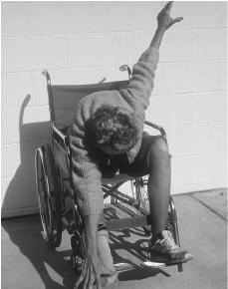
Psychiatric conditions
Schizophrenia
  Chronic mental disorder with periods of psychosis, disturbed behavior and thought and decline in functioning. Patients are usually in 20’s or 30’s.
  “Positive symptoms” – delusions, hallucinations, disorganized speech, catatonic behavior
  “Negative symptoms” – Social withdrawal, lack of speech or thought
  Brief psychotic disorder (<1 month) → Schizophreniform disorder (1-6 months) → Schizoaffective disorder (2 weeks + manic/depressive episode)
  Five subtypes
    Paranoid (delusions)
    Disorganized (speech)
    Catatonic (automatisms)
    Undifferentiated (characteristics of >1)
    Residual
Schizoid
Schizotypal
Schizophrenic
Schizoaffective
Schizoid + odd thinking
More odd thinking
Psychotic Sx + mood disorder

Slide 16
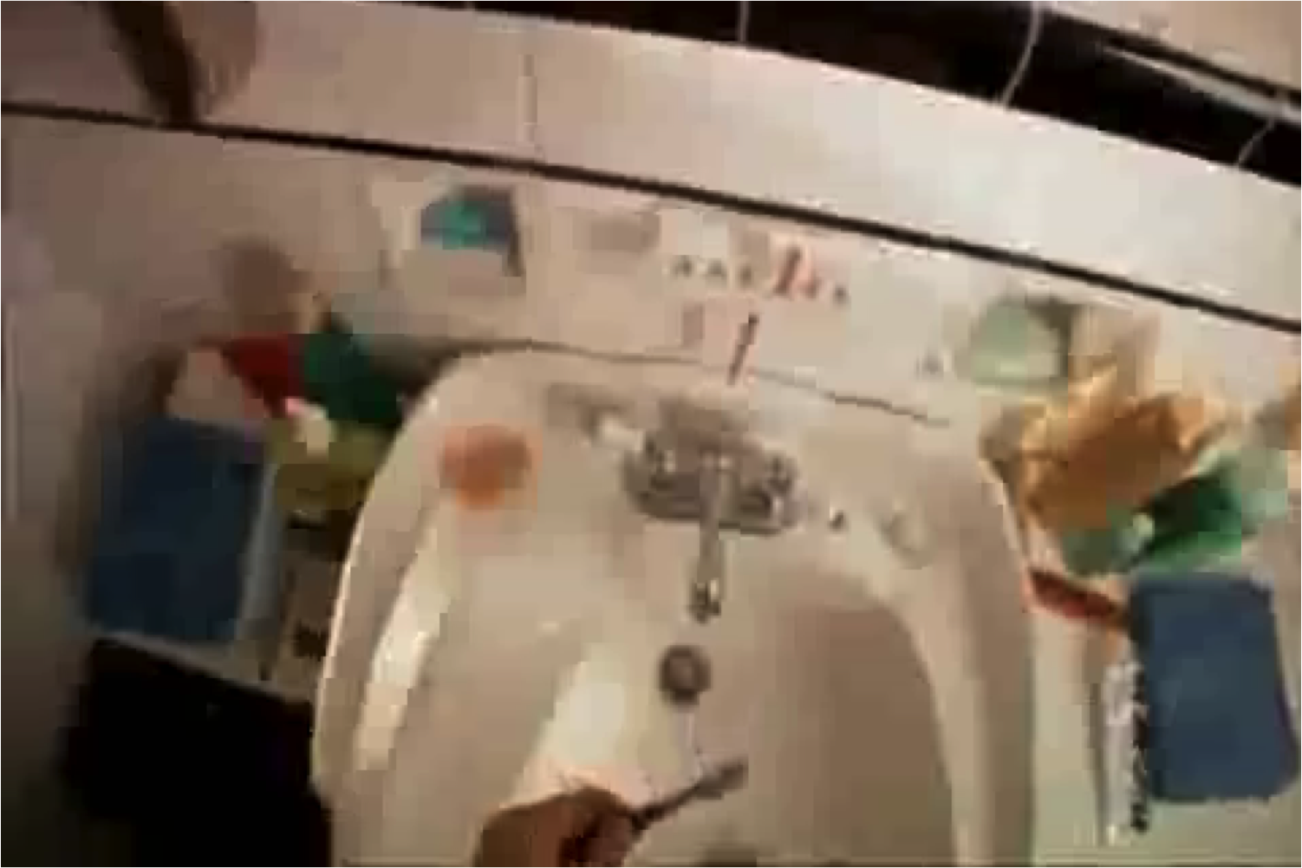
  http://youtu.be/qb8wQjwVu2g?t=39s
Notes:
http://youtu.be/LWYwckFrksg?t=39s

Slide 17
Psychiatric conditions
  What subtype did he have?
    Paranoid (delusions)
    Disorganized (speech)
    Catatonic (automatisms)
    Undifferentiated
    Residual

Slide 18
Psychiatric conditions
Dissociate disorders
  Dissociate identity disorder (multiple personality disorder)
  Depersonalization disorder
  Dissociative fugue

Slide 19
Psychiatric conditions
Mood disorders
  Major depressive disorder
    Episodes lasting 6-12 months
    50% of suicides are committed by those with MDD
    13% of those with MDD attempt suicide
  Bipolar disorder
    Cycling between manic and depressive episodes
    Manic – Distractible, irresponsible, agitated, goal-directed behavior, talkative
    Depressive – similar to those of MDD
    High suicide risk

Slide 20
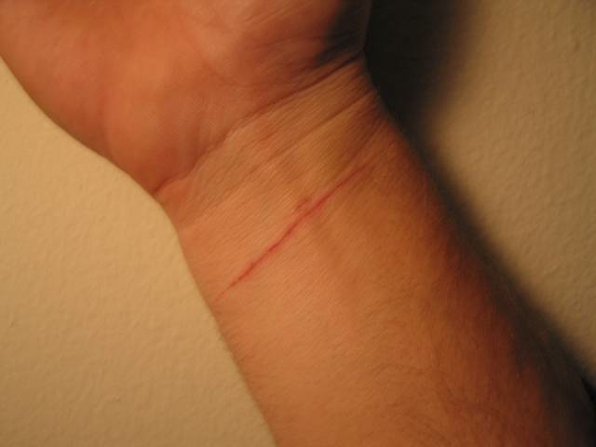
Psychiatric conditions
Suicide
  Risk factors: Drunk, teenage male who is depressed, sick, single, has no social support and who has a plan. Women attempt suicide more often, men “succeed” more often.
  15% MDD → suicide
Parasuicide

Slide 21
Psychiatric conditions
Anxiety disorders
  30% of women, 19% in men
Panic disorders
  Recurrent periods of intense fear peaking within 10 minutes, with:
    Palpitations, paresthesias (tingling), abdominal distress, nausea, fear of dying, chest pain, choking, sweating, shaking, shortness of breath. Hereditary.
Specific phobias
  Unreasonable fear interfering with normal, daily functions.

Slide 22
Psychiatric conditions
Obsessive compulsive disorder
Post-traumatic stress disorder
Malingering
  Patient fakes a disorder for secondary gain (skip work, get pain medications, etc)
Factiticous disorder
  Patient fakes disorder for primary gain of getting attention
Samtoform disorders
  Disorder with no identifiable cause. Not done on purpose. Common in adult women.
    Example: conversion disorder – Sudden loss of motor/sensory function following acute stress. Common in adolescents.

Slide 23
Psychiatric conditions
Personality disorders (Paranoid, schizoid, schizotypal)
  Accusatory, aloof, awkward socially
  Avoidant, dependent, narcissistic
Anorexia nervosa
Bulimia nervosa

Slide 24
Psychiatric conditions
Substance dependence & abuse
  Symptoms of withdrawal are usually opposite of drug effect
    Alcohol is a depressant, calms mood, respiration, heart rate and muscles
    Severe alcohol withdrawal can lead to Delirium Tremens (peaks ~48 hours after last drink)

Slide 25
Medications can be a clue
Antidepressants | Antipsychotics | Mood stabilizers (bipolar, SAD)
Fluoxetine (Prozac) | Haloperidol (Haldol) | Lithium carbonate (Carbolith)
Escitalopram (Lexapro) | Chlorpromazine (Thorazine) | Valproic acid (Depakote)
Sertraline (Zoloft) | Lorazepam (Ativan) | Carbamazepine (Tegretol)
Duloxetine (Cymbalta) | Quetiapine (Seroquel) | Clonazepam (Klonopin)
Generic (trade name)
Patients will most likely remember the trade name.

Slide 26
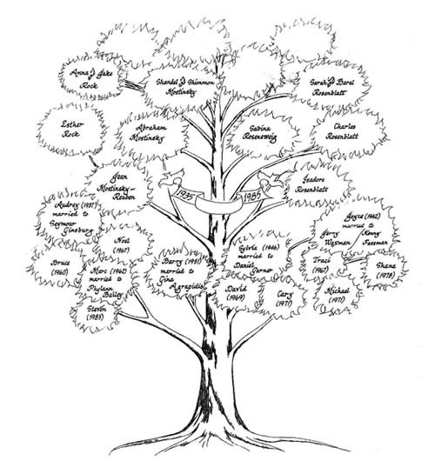
Social aspects of mental illness
Do you know someone with a mental illness?
Depression?
Schizophrenia?

Slide 27
Social aspects of mental illness
Your role as a healthcare provider
  Maintain proper view of patient and illness
  People-first language
    “A schizophrenic man”
    “Psych patient”
  “A man with schizophrenia”
  “A woman suffering from depression”

Slide 28
Social aspects of mental illness
Your role as a healthcare provider
  Be a patient advocate
  Remain non-judgmental. You are there for one reason only: to help someone who needs help

Slide 29
Social aspects of mental illness
Work with the patient to advocate for their health, not against them with conflict

Slide 30
Treatment
The key is safety, identification of the problem, communication, and disposition.
  Does a kid who hit his classmate go to the hospital?
  Does a normally nice, 80 year old male who punches his wife go to the hospital?
  Does a yelling drunk college kid go to the hospital?

Slide 31
Consent
If the patient is not under the influence of drugs, A&O X3, not a minor and is not a danger to him/herself or others, they can give consent.
Otherwise, it’s implied and they must be treated or cleared by medical control.

Slide 32
Consent
If the patient is not under the influence of drugs, A&O X3, not a minor and is not a danger to him/herself or others, they can give consent.
Otherwise, it’s implied and they must be treated or cleared by medical control.

Slide 33

Danger to self or others?
If the patient is suicidal or homicidal, they must be taken to the emergency room for a psychiatric evaluation, or, in some cases, released to the police.

Slide 34
Communication
Identify yourself and your role
Speak slowly and clearly
  Use a calm, reassuring tone
Use active listening – repeat what the patient says back to them.
Do not be judgmental. Show compassion.
  Explain, “This must be stressful for you.” “I’m glad you’re willing to let us help you. We’ll take good care of you.”
  Patients might have trust issues

Slide 35
Communication
Give the patient the sense that they are control
Give patient time to gain control of emotions
Avoid confrontation and conflict
  Work with the patient, not against them
  Do not “play into” delusions, but don’t discount them
Honestly explain things to the patient
  “Someone was concerned about you and called us. We’re just here to chat with you for awhile.”
Stay alert for sudden changes in behavior

Slide 36
Communication
Use positive body language
  Speak with them at eye level
Do not enter the patient’s space
Some “know the system” – be a detective!
Brought to ER
If active threat/acute, put in a “psych hold” room
Evaluated by social worker, psychologist on call (if available). They make a recommendation to the physician.
Physician decides to admit or discharge
If admitted involuntarily, they are “held” for 72 hours and evaluated by a mental health team & psychiatrist. Team must prove the patient is danger to self & others before they can admit indefinitely
Patient can be admitted voluntarily or involuntarily
Then, they can be discharged, or put in an long-term healthcare facility, similar to a nursing home

Slide 37

What happens to them?
Brought to ER
If active threat/acute, put in a “psych hold” room
Evaluated by social worker, psychologist on call (if available). They make a recommendation to the physician.
Physician decides to admit or discharge
If admitted involuntarily, they are “held” for 72 hours and evaluated by a mental health team & psychiatrist. Team must prove the patient is danger to self & others before they can admit indefinitely
Patient can be admitted voluntarily or involuntarily
Then, they can be discharged, or put in an long-term healthcare facility, similar to a nursing home

Slide 38
What happens to them?
Not every hospital has a “psych unit,” and some patients may require transfer to an appropriate facility.

Slide 39

Common causes
Five categories of AMS:
Toxic/metabolic
Structural
Vital sign change
Infectious
Psychogenic
Notes:
Alcohol, epilepsy/environmental (exposure to heat/cold, emotional trauma), insulin (hypoglycemia), overdose (of legal or illegal drugs, poisons, etc), underdose (of medications used to control behavior), trauma (head injury), infection, psychoses, sepsis/stroke/situational

Slide 40
Toxicology

Slide 41
What is a toxin?
A drug or substance that is harmful to a human and causes certain adverse effects that may ultimately lead to death
Most toxins either exert effect by passing into blood steam, affecting CNS or cause local damage

Slide 42

Considerations
Is the scene safe?
What toxin was it?
What is it likely to do?
How long ago was the exposure, and when are signs & symptoms likely to arise?
What immediate treatment does the patient need?
Do I need to call poison control or medical control? What about additional resources?

Slide 43
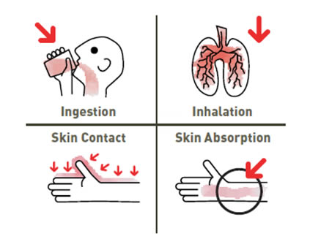
Routes of exposure
Injection
Inhalation
Ingestion
Absorption

Slide 44
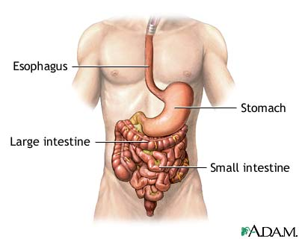
Ingestion
Most common route of poisoning
Most poisons absorbed in small intestine
Notes:
Transit time ~ 6 hours

Slide 45
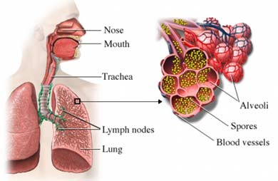
Inhalation
Usually a gas, vapor, fume or aerosol
Can damage entire respiratory tract
Eventually crosses alveolar-capillary membrane and enters the bloodstream

Slide 46
Inhalation
Common inhaled poisons:
  Carbon monoxide
  Carbon dioxide, sulfur dioxide
  Natural gas, industrial gases
  Fumes from chemicals
Effects are usually from:
  Displaced oxygen, leading to hypoxia, leading to a sense of being “high” (CO poisoning)
  Direct action on CNS (Nicotine)

Slide 47
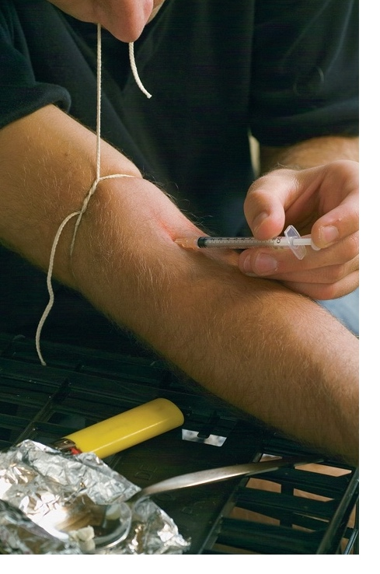
Injection
Can be liquid, or power in suspension
Can be injected into muscle, blood vessel, or under skin

Slide 48
Injection
Anything entering through broken skin
Most common: bites and stings
  Bees, wasps, hornets, yellow jackets, and ants; others include the bites of spiders, ticks, marine animals, and snakes.
  Local reaction, followed by systemic
    What would a systemic reaction to a bee sting be?

Slide 49
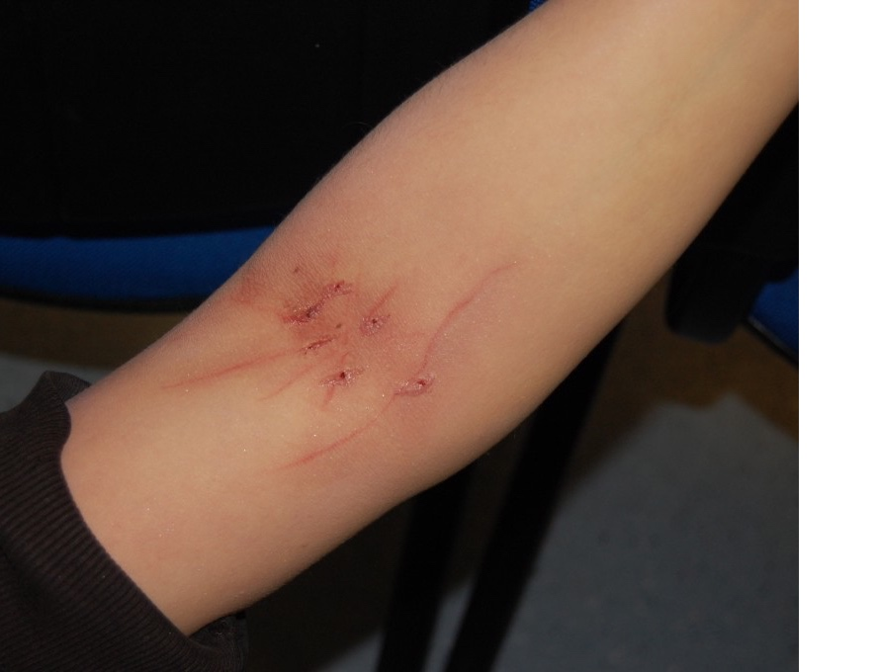
“Track marks” from heroin injections

Slide 50
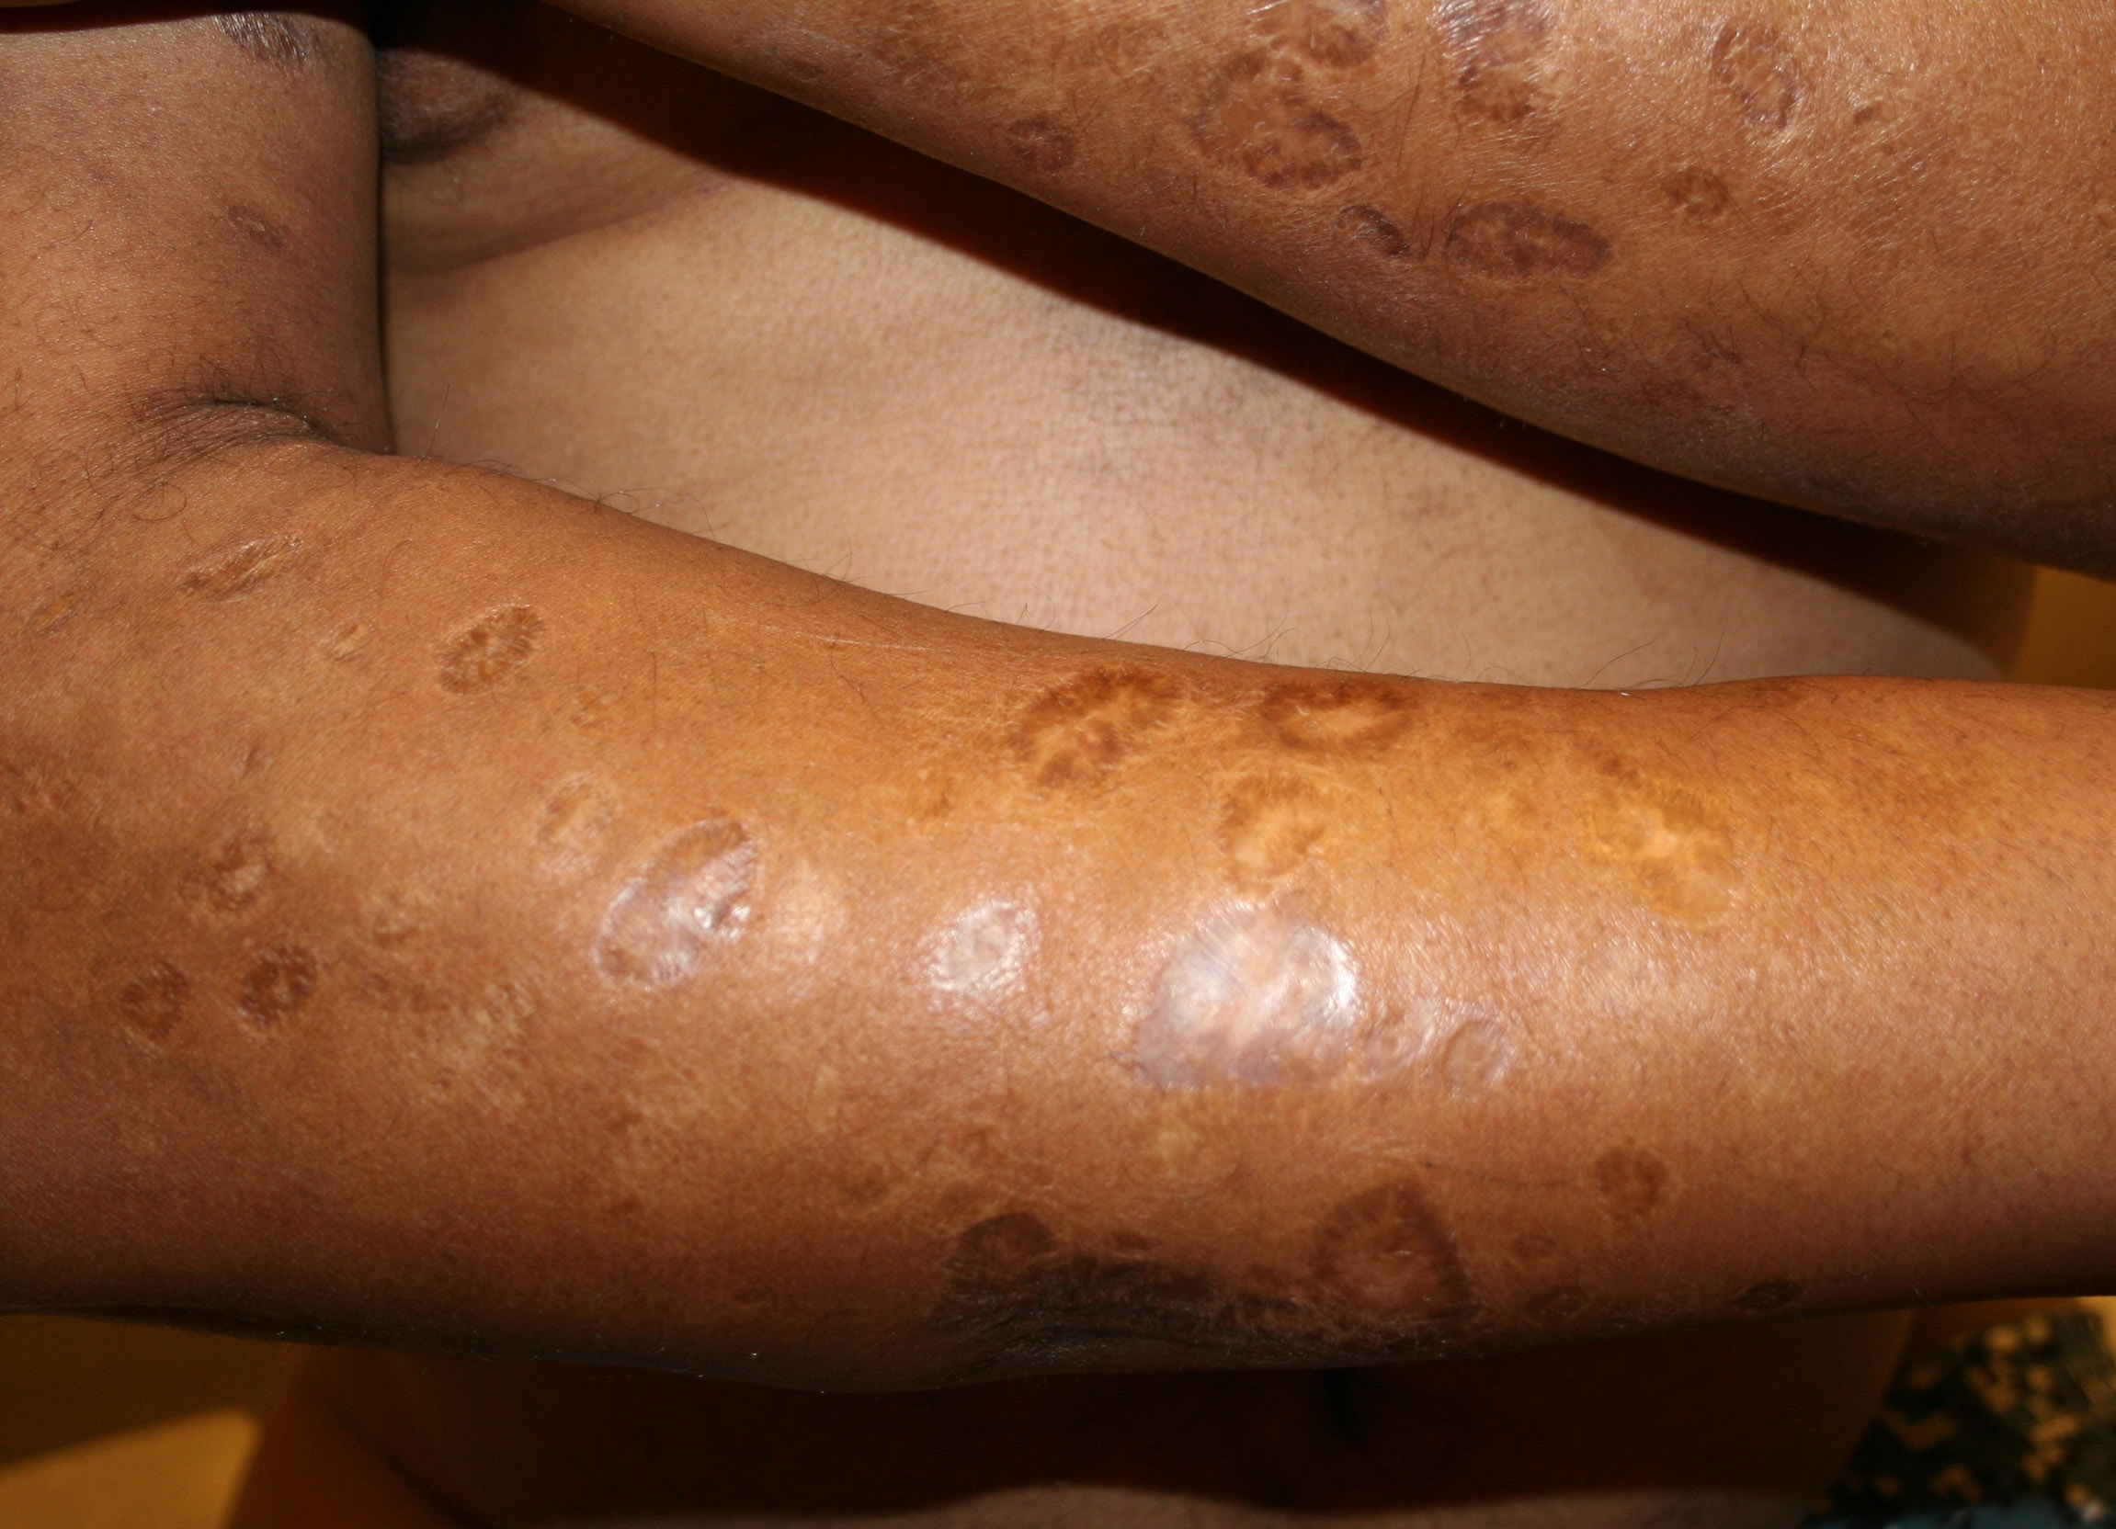
“skin popping”

Slide 51

Absorption
Skin or mucous membranes
Most likely to need decontamination
Make sure you use
proper PPE

Slide 52
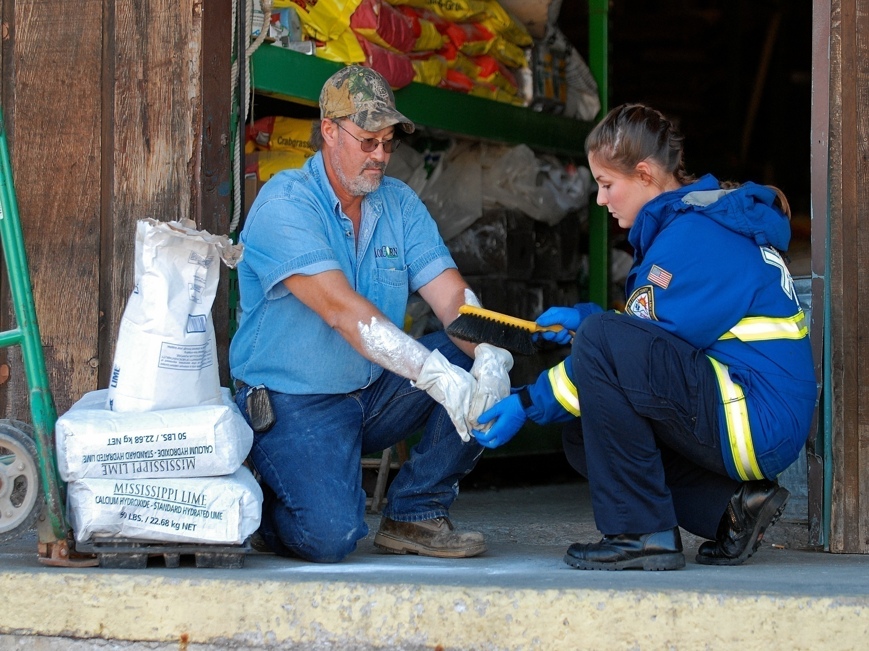
Absorption

Slide 53
Treatment considerations
Eyes: Eye contact with cement (dry or wet) may cause serious and potentially irreversible injuries.
Skin: Strong alkaline solutions in contact with the skin tend to damage the nerve endings first before damaging the skin, therefore chemical burns can develop without pain being felt at the time. Hence, prolonged skin contact with wet cement, fresh concrete or mortar may cause serious burns.

Slide 54
Treatment considerations
move the patient from the source of the poison and remove the patient’s contaminated clothing and jewelry.
Brush any dry chemicals or solid toxins from the patient’s skin.
If the poison is liquid, irrigate all parts of the body with clean water for at least 20 minutes.
If poison has been splashed into the eye, irrigate the affected eye with clean water for at least 20 minutes. Position the patient so water runs away from the unaffected eye

Slide 55
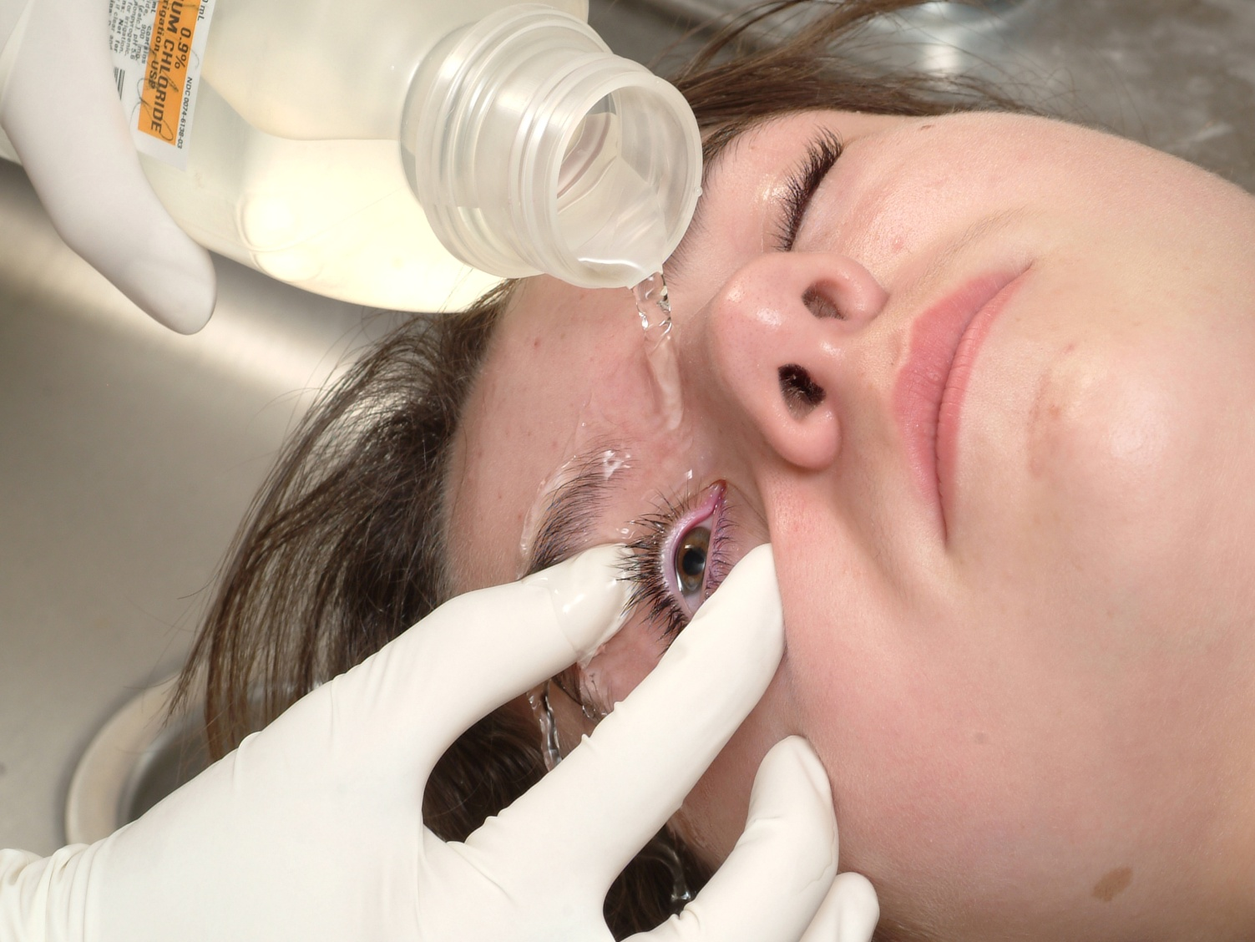
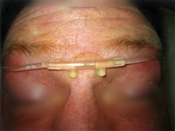
Treatment

Slide 56
Specific toxins & poisons

Slide 57
Food poisoning
Often undercooked meat, unpasteurized or unrefrigerated dairy products
S/Sx: Abdominal cramping, nausea and vomiting, gas, diarrhea, and loud or frequent bowel sounds
Tx: Supportive. Keep them NPO. Monitor v/s, may be volume depleted

Slide 58
Carbon monoxide (CO)
From incomplete combustion of gasoline, coal, kerosene, plastic, wood, or natural gas. It is completely nonirritating, tasteless, colorless, and odorless.
Binds hemoglobin with ~250x affinity as oxygen

Slide 59
Carbon monoxide (CO)
S/Sx: Headaches, tachypnea, nausea, vomiting, an altered mental status, and a high pulse oximeter reading.
Later, the patient may suffer temporary blindness, hearing loss, convulsions, coma, and death.

Slide 60
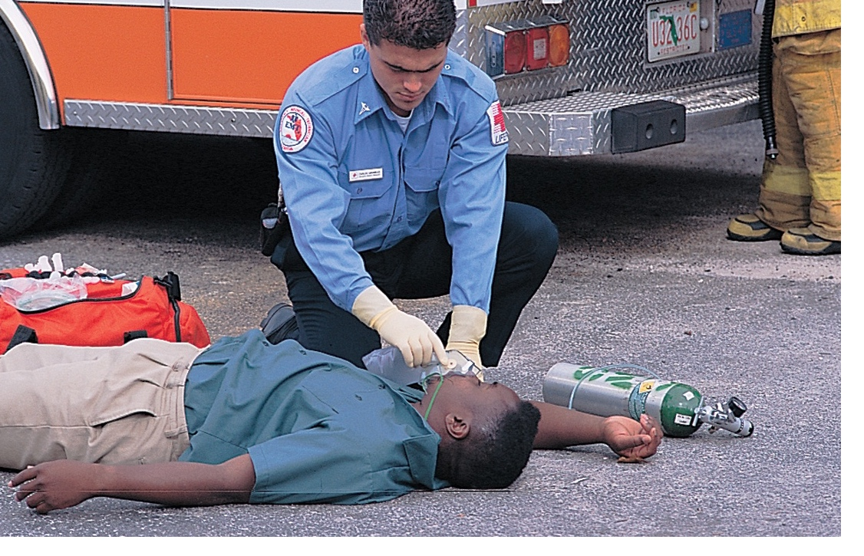
Carbon monoxide
Tx: Evacuate everyone from the enclosed space. Provide oxygen 15 LPM via NRB; do not rely on the pulse oximeter to guide oxygen therapy.
Transport the patient(s) immediately.

Slide 61
Cyanide poisoning (CN⁻)
Cyanide is found in many household products, rodent poisons, silver polish, and cherry and apricot pits.
Cyanide is an extremely dangerous poison because it interferes with the use of oxygen at the cellular level.
Notes:
Electron transport chain in mitochondria!

Slide 62
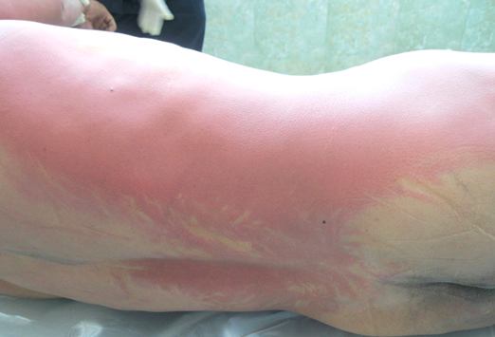
Cyanide poisoning (CN⁻)
S/Sx: Headaches, confusion, agitation, a burning sensation in the mouth or throat, dyspnea, the smell of bitter almonds, coma, hypotension, pulmonary edema, “cherry red skin” and cardiac dysrhythmias.

Slide 63
Acids and bases
Acids will burn on contact and produce severe and immediate pain. If an acid is ingested, most of the chemical burn will occur in the stomach. Abdominal pain, bleeding, and an acidotic state may occur.

Slide 64
Acids and bases
Alkalis have a tendency to burn deeper and longer. They also burn on contact and can cause damage to the esophagus, stomach, and intestinal tract.
General signs and symptoms associated with caustic poisoning are pain and burns to the mouth, lips, and around the face; dysphagia; abdominal pain; stridor; hoarseness or dysphasia; dyspnea; and possibly evidence of shock.

Slide 65
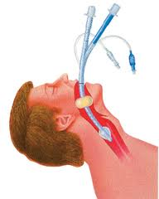
Considerations
What airway device and medication is contraindicated after ingestion of a caustic substance?

Slide 66
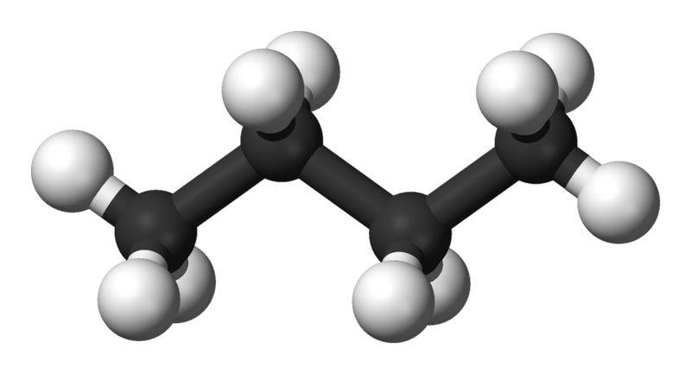
Hydrocarbons
Found in: kerosene, naphtha, turpentine, mineral oil, toluene, and benzene. These can be found in common household products such as lighter fluid, glues, paints, lubricants, cleaning and polishing agents, spot removers, cosmetics, pesticides, solvents, and aerosol propellants.

Slide 67
Treatment?
The same for almost every toxic ingestion.
Scene safety
Monitor ABCs
Remove patient from environment, decontaminate them
Symptomatic treatment
Transport to ED

Slide 68
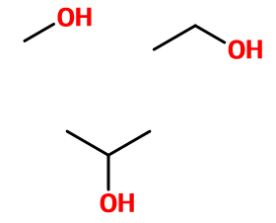
Alcohols
Metabolites are toxic
Ethyl Alcohol --> acetaldehyde -> acetic acid
Methyl alcohol --> formaldehyde ->formic acid
Isopropyl alcohol --> acetone

Slide 69
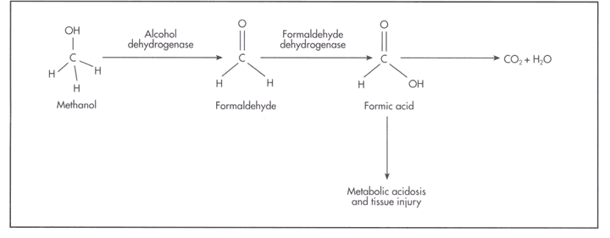
Methanol
Found in gasoline, antifreeze, windshield washer fluid, paints, paint removers, wood alcohol and Sterno.

Slide 70
Methanol
S/Sx: altered mental status, seizures, nausea and vomiting, abdominal pain, seeing spots, dilated sluggish pupils, dyspnea, and tachypnea.
S/Sx may appear 12-18 hours after ingestion

Slide 71
Isopropyl alcohol
Usually found in rubbing alcohol, other cleaning agents. Effect is twice as potent and lasts twice as long as ethanol.
S/Sx: Respiratory depression
Altered mental status
Slow respirations; shallow tidal volume
Abdominal pain and hematemesis
Signs of shock

Slide 72
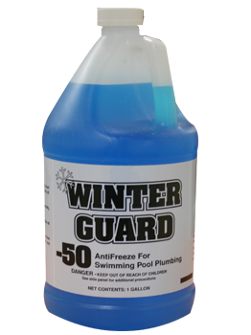
Ethylene glycol
Found in detergents, radiator antifreeze, windshield deicers, and coolants.
Tastes sweet, looks like KoolAid...
S/Sx similar to ethyl alcohol.
  No EtOH smell, may have
  elevated vital signs.

Slide 73
Treatment?
The same for almost every toxic ingestion.
Scene safety
Monitor ABCs
Remove patient from environment, decontaminate them
Symptomatic treatment, consider charcoal
Transport to ED, consider poison control/medical direction

Slide 74
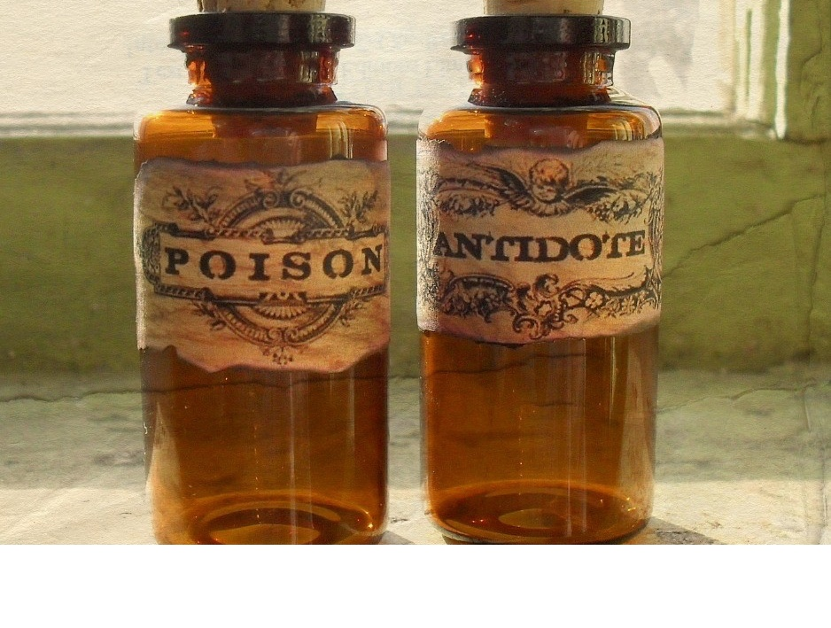
What about antidotes?
Only a few antidotes actually exist...
Most treatment involves supporting the patient’s ABC’s

Slide 75
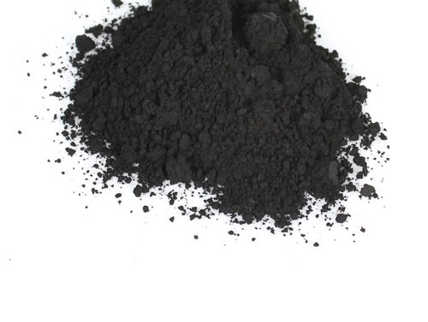
Activated charcoal
Activated charcoal is distilled charcoal treated with superheated steam. The activated charcoal prevents absorption into the body.
A standard 50-gram dose of activated charcoal has roughly the same surface area as ten football fields.
Contraindications: AMS, ingested acids or alkalis, or unable to swallow.

Slide 76
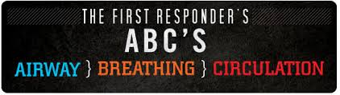
Don’t forget your A B C’s
As always, take note of:
The mental status
  may provide a clue as to the length of time since the patient claims to have ingested the substance.
Open and clear the airway.
  Look for vomit and burns. Insert an oropharyngeal or nasopharyngeal airway if necessary to effectively ventilate the patient.
Assess both the respiratory rate and respiratory quality, paying particular attention to how deeply the patient is breathing.
Assess the circulatory status of the patient. The heart rate and the skin temperature, color, and condition may provide a clue to the type of poison the patient may have ingested.

Slide 77
Secondary assessment:
Vital signs, often, and well
  Trending vital signs is important
  Look for “toxidromes”
Keep heightened suspicion
  Rule out other coingestants/causes of AMS
Look at the environment
  You are the only HCP’s there

Slide 78
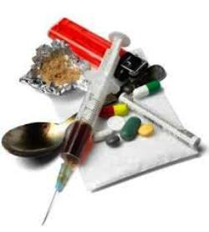
Drugs of abuse
Alcohol
PCP
Cocaine
Amphetamines

Slide 79
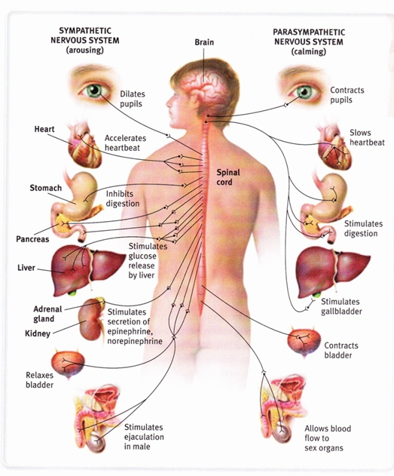
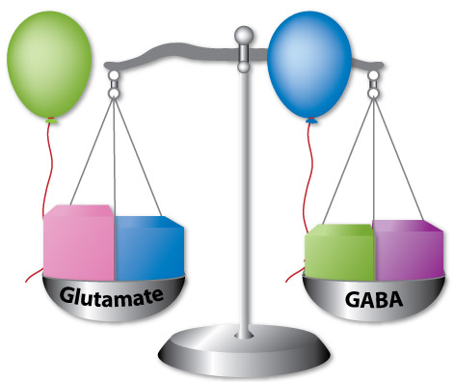
Physiology
Sympathomimetic or
parasympathomimetic?

Slide 80
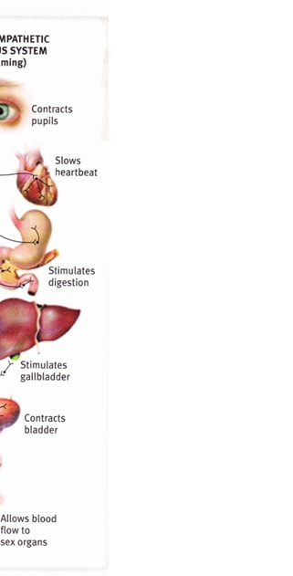
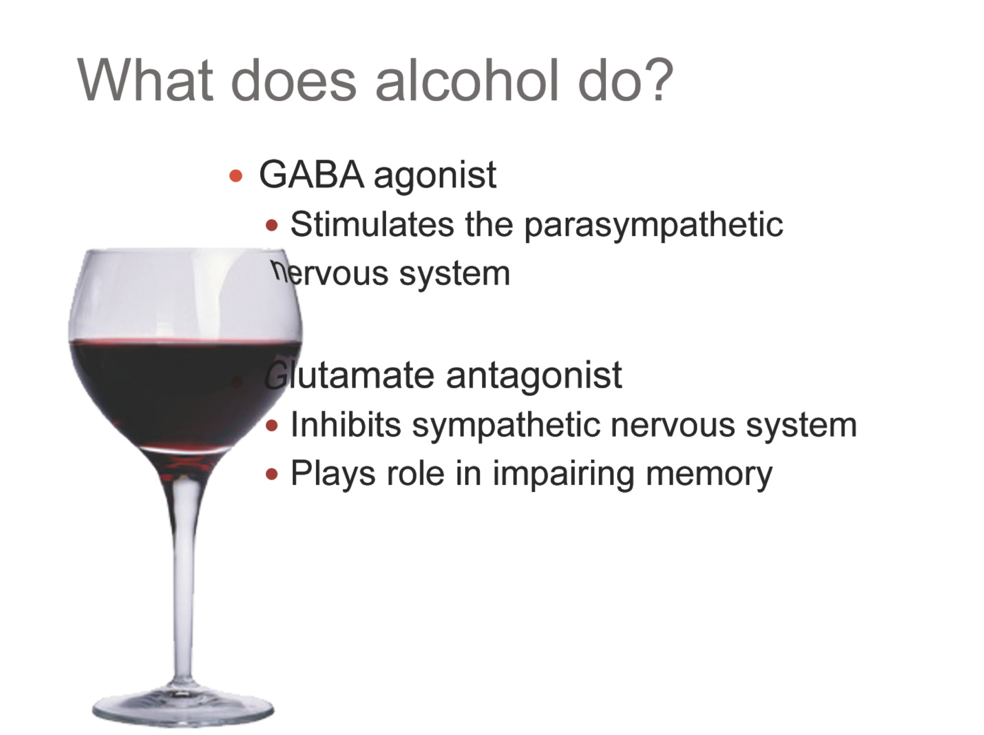
Ethyl alcohol (EtOH)

Slide 81
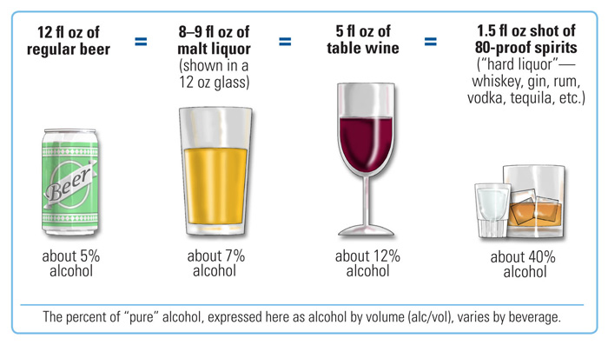
Ethyl alcohol (EtOH)

Slide 82
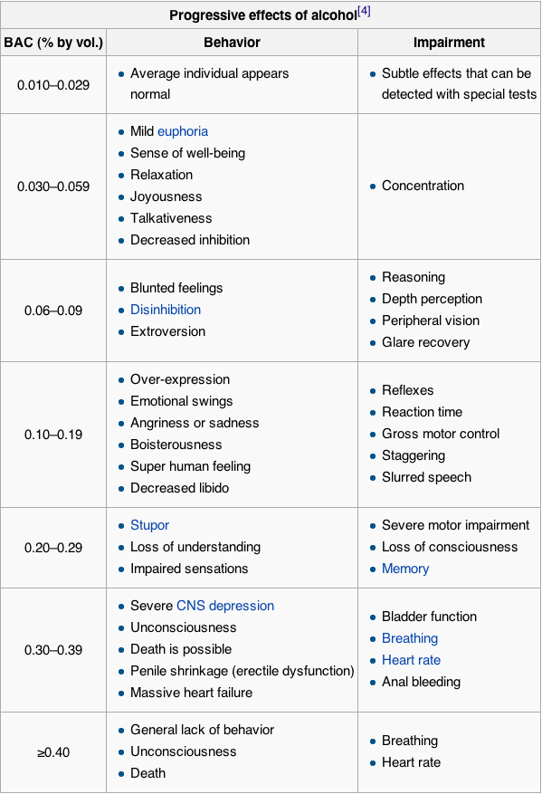
1 drink metabolized per 2 hours
for 160 lb male
(subtract 0.01 for every 40 minutes)
~2 drinks
~9 drinks for 160 lb male
~5 drinks for 120 lb female
~10 drinks for 120 lb female

Slide 83
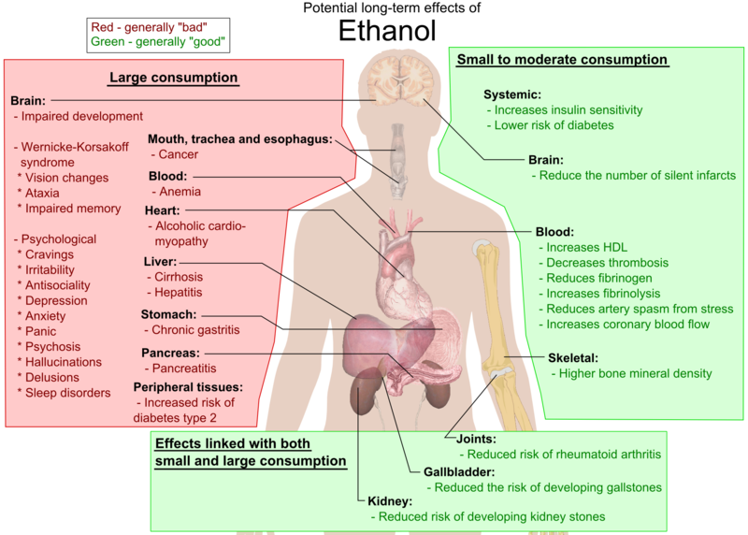

Slide 84
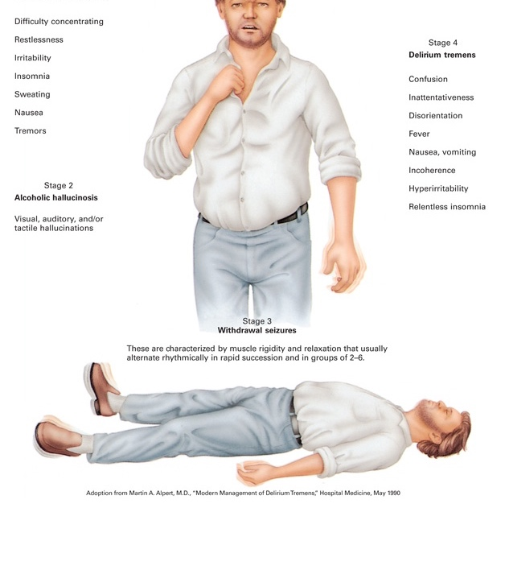
Withdrawal
In absence of normal GABA agonism, glutamate takes over, mimicking the sympathetic nervous system
  Anxiety
  Seizures
  GI upset
  Violence

Slide 85
Careful!
Check blood glucose level and look out for CVAs, they can mimic alcohol intoxication
Check for coingestions – drugs
Scene safety!
Position the patient,
protect airway

Slide 86

Red flags
Unresponsiveness
Inadequate breathing
Fever
Abnormal heart rate (slow, fast, weak, or irregular)
Vomiting with an altered mental status
Seizures

Slide 87
Delirium tremens
Life-threatening condition with a mortality rate of approximately 5 to 15%.
DTs can occur between one and 14 days after the patient’s last drink and most commonly within two to five days.
A single episode of DTs lasts between one and three days. Multiple episodes can last as long as a month.
DTs should be suspected in any patient with delirium of unknown cause.
Signs and symptoms of DTs include severe confusion, memory loss, tremors, high fever, dilated pupils, profuse sweating, insomnia, tachycardia, diarrhea, hallucinations, nausea, and vomiting.
Notes:
“shaking frenzy”

Slide 88
Other issues
While ethanol intoxication can cause respiratory arrest, most injury/death is a result of it predisposing the patient to other medical conditions and trauma.
  Hypoglycemia, medication interactions, diabetic emergencies, trauma from bad decisions
Notes:
“shaking frenzy”

Slide 89
Documentation
Patient is drunk.
  “Patient smells of EtOH”
Notes:
“shaking frenzy”

Slide 90
Other drugs of abuse
PCP (Phencyclidine)
  Cheap, easy to make, easy to take, and produces horrible psychological effects
Cocaine
  Inhaled or injected. An almost-pure form of cocaine known as “crack” is smoked. Another special form of cocaine is heated and inhaled (“free based”). Cocaine is highly addictive, and an overdose can be fatal.
Amphetamines
  Hypertension, hyperthermia, and increased muscle tone that may be life threatening. Methamphetamine use is associated with the sensation of ants or bugs crawling under the skin, or “formication.”
Notes:
“shaking frenzy”

Slide 91
Other drugs of abuse
PCP (Phencyclidine)
  Cheap, easy to make, easy to take, and produces horrible psychological effects
Cocaine
  Inhaled or injected. An almost-pure form of cocaine known as “crack” is smoked. Another special form of cocaine is heated and inhaled (“free based”). Cocaine is highly addictive, and an overdose can be fatal.
Amphetamines
  Hypertension, hyperthermia, and increased muscle tone that may be life threatening. Methamphetamine use is associated with the sensation of ants or bugs crawling under the skin, or “formication.”
All sympathomimetics!
Notes:
“shaking frenzy”

Slide 92
Signs & Symptoms
Extreme agitation or excitation
Unresponsiveness to pain
Severe muscular rigidity
Seizures
Excessive bronchial and oral secretions
Hyperthermia
Respiratory problems, depression, or arrest
Vivid visual or auditory hallucinations
Sensation of bugs or ants crawling under the skin
Myocardial infarction, cardiac dysrhythmias, or sudden death
Aortic dissection
Severe headache, stroke, or intracranial hemorrhage
Neurological or psychiatric problems
Notes:
“shaking frenzy”

Slide 93
Reminders
Reminders
Addiction is considered a medical problem, not a crime.
Don’t get tunnel vision or assume things
Don’t become complacent
Don’t be afraid to ask for police assistance

Slide 94
Reminders
Reminders
Be sure to take patient to hospital or go through proper procedure for refusing
  Patients under the influence of drugs are not competent to make decisions for themselves
    Must be released to ED, police, or to safe, sober company after consulting with medical direction

Slide 95
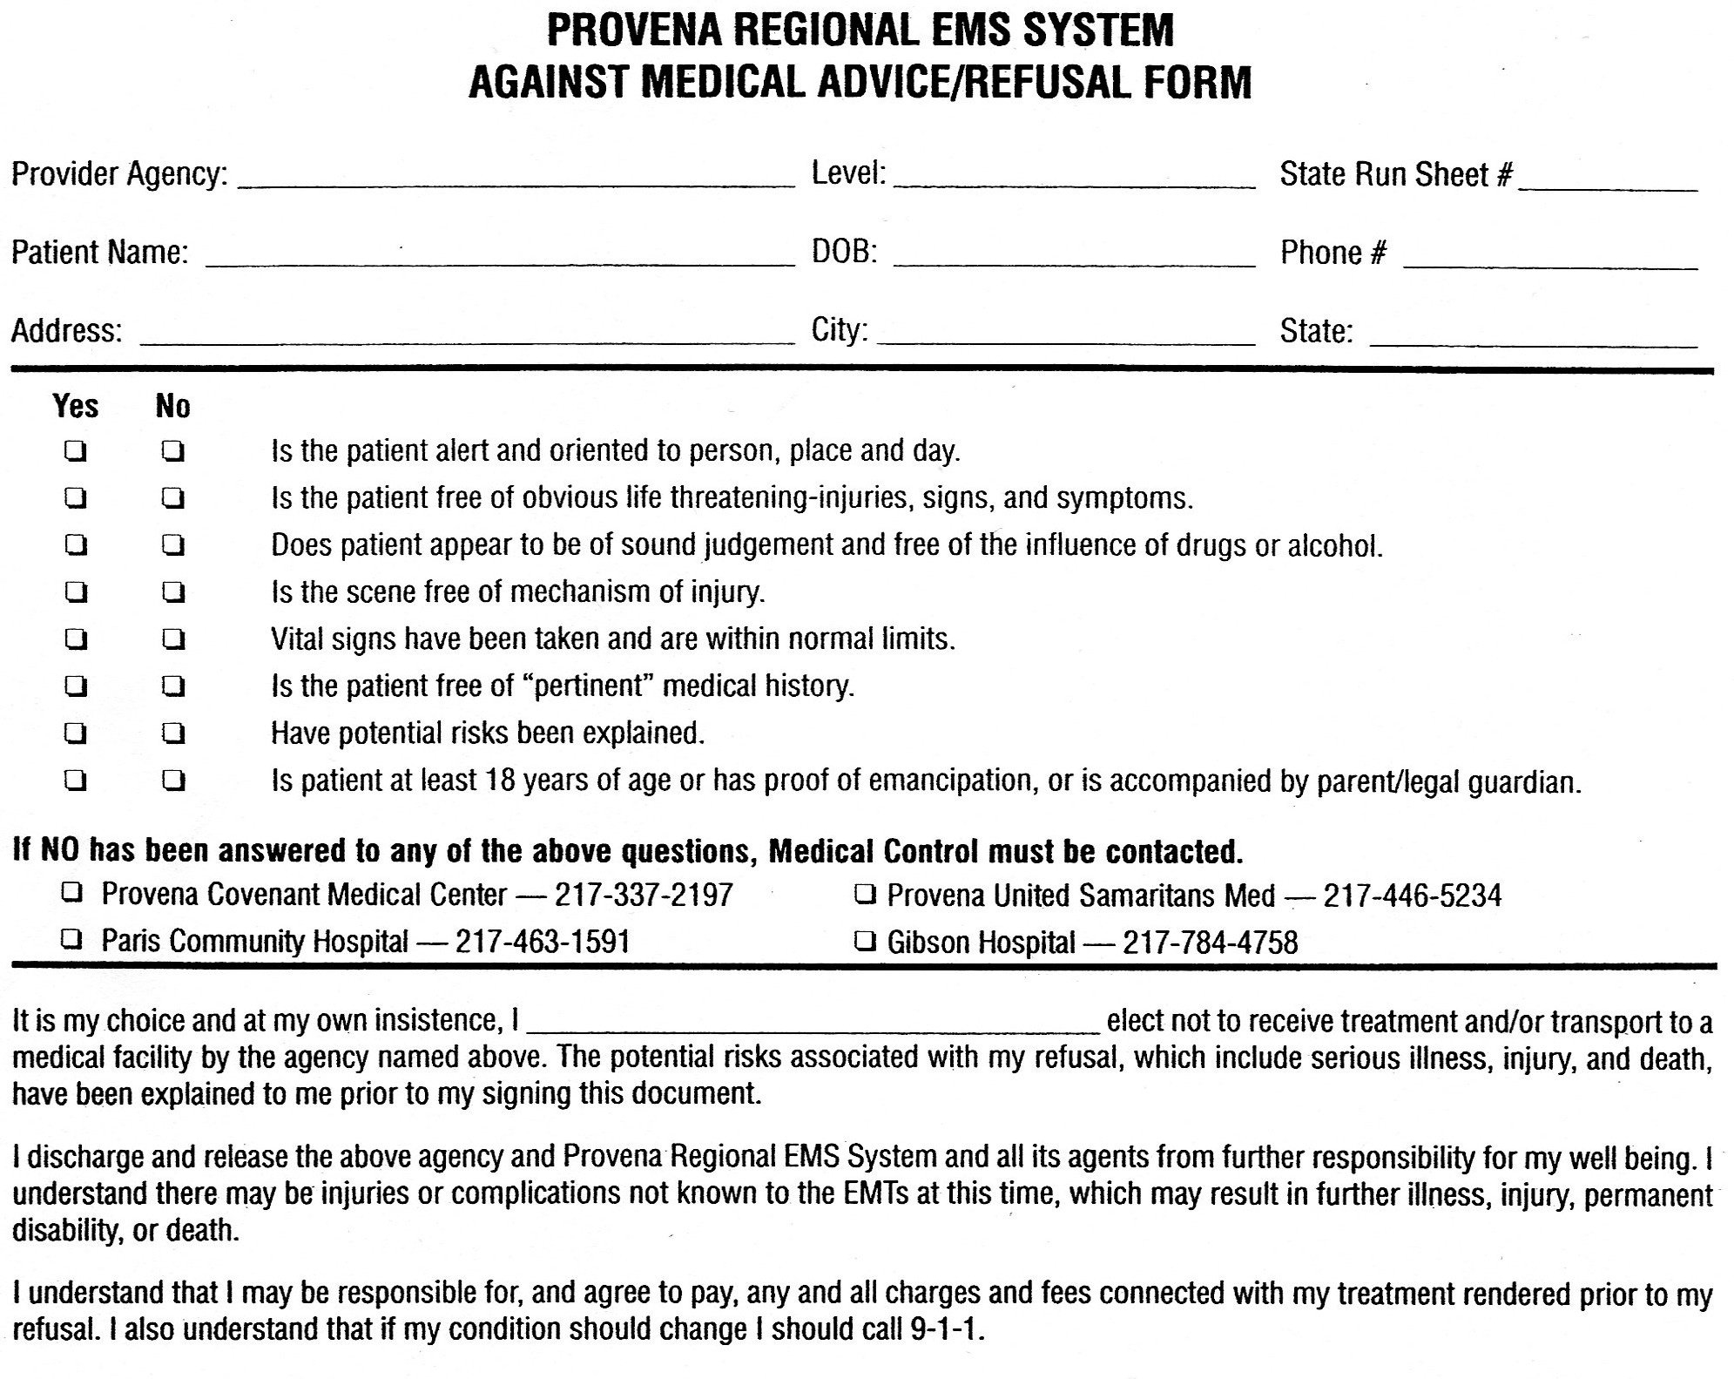
Reminder

Slide 96

Reminder

Slide 97
Scenario 1:
EMS, please respond to 6429 N Magnolia Ave for a sick child,
called in by mom. Patient is conscious and breathing. Time out 1835.

Slide 98



Slide 99
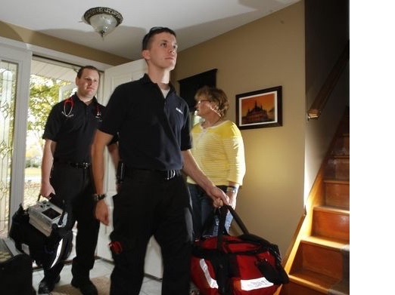

Slide 100
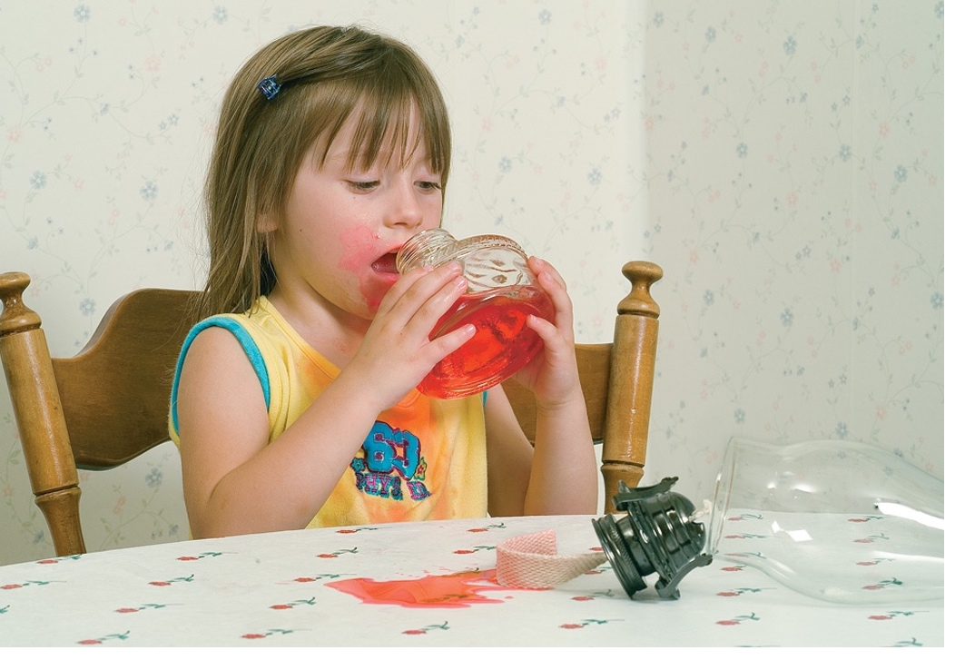

Slide 101
What should you do?
What route is involved?
When did this happen? How much?
What is it?
Any concern with ABCs? Vitals?
Call poison control?

Slide 102


Slide 103
Scenario 2:

Slide 104

58 year old male in assisted living facility
You’re called with police to an assisted living facility because “he got in a fight with his roommate”

Slide 105


He’s normally a little out of it, but he’s always been a nice guy... I don’t know why he’s acting like this. Can you take him in?

Slide 106
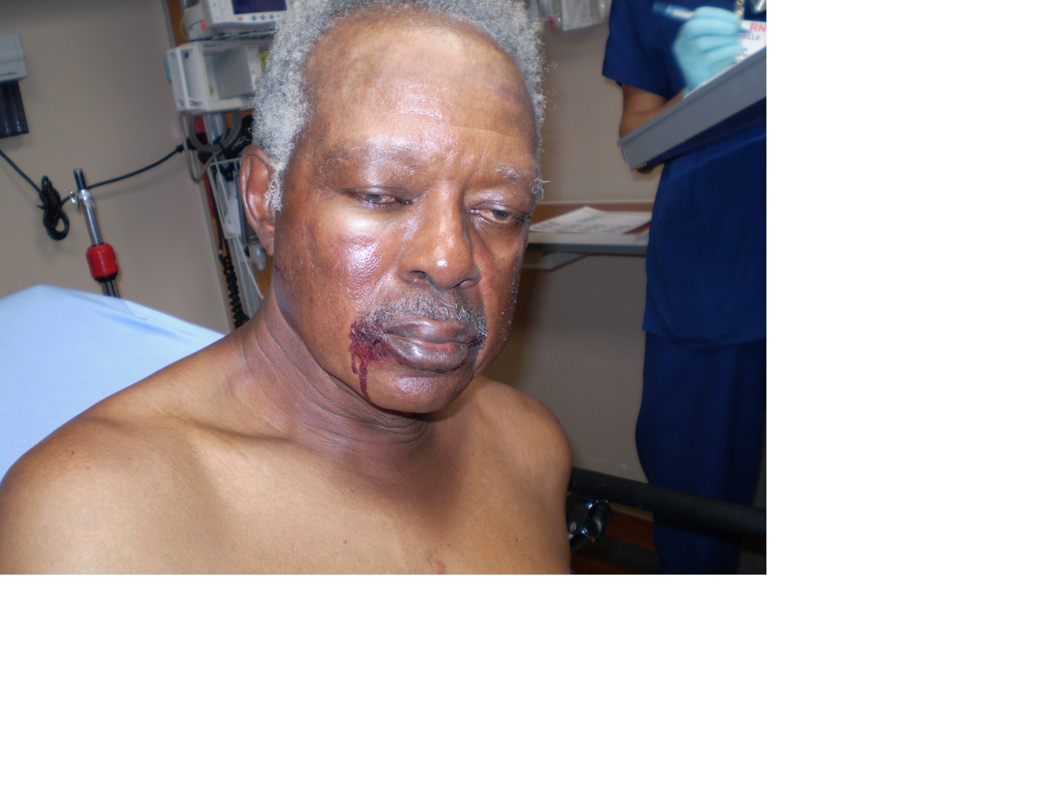
Scenario:
There is minor, if any, trauma from the fight
Police take a report and ask, “why’s he going to the hospital?”

Slide 107
Scenario:
What do you say?
Should he go to the hospital?
Why? Why not?

Slide 108
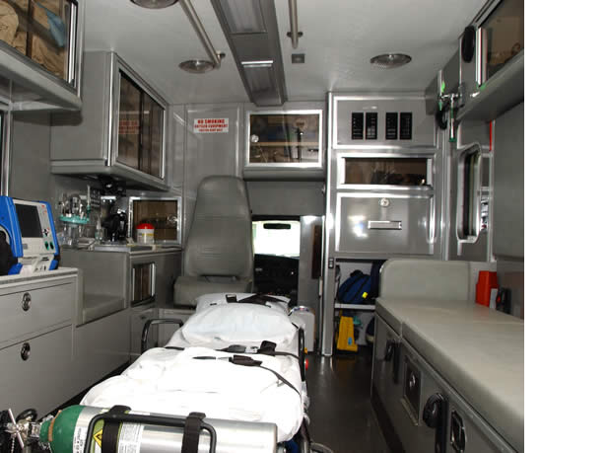
While transporting, your patient starts taking his belts off...
When is the patient most likely to escape or “elope”?
What can you do to prevent this?

Slide 109
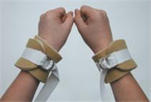
Your options:
When to use soft restraints:
If they must go to the hospital, but refuse to voluntarily, and pose an active risk to themselves or others
Better to play it safe, but remember what you’re doing...

Slide 110
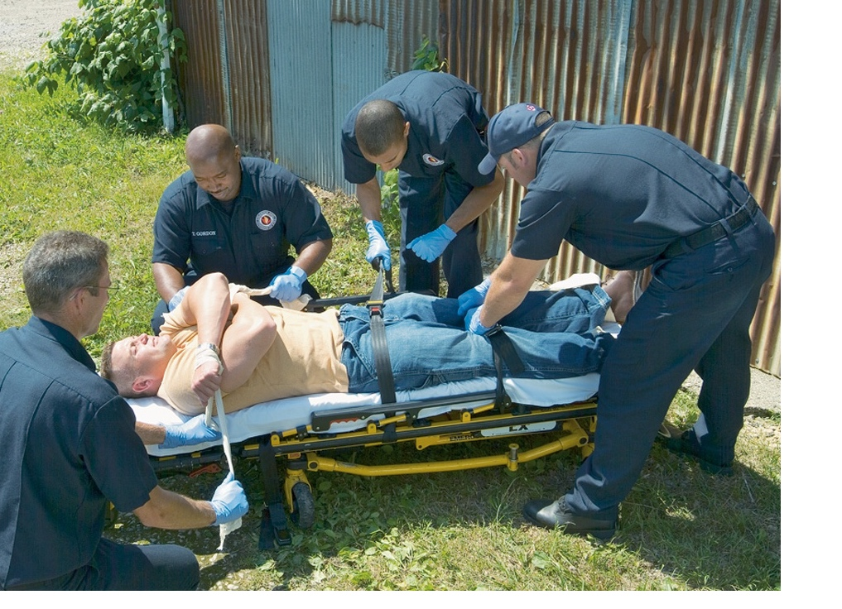

Slide 111

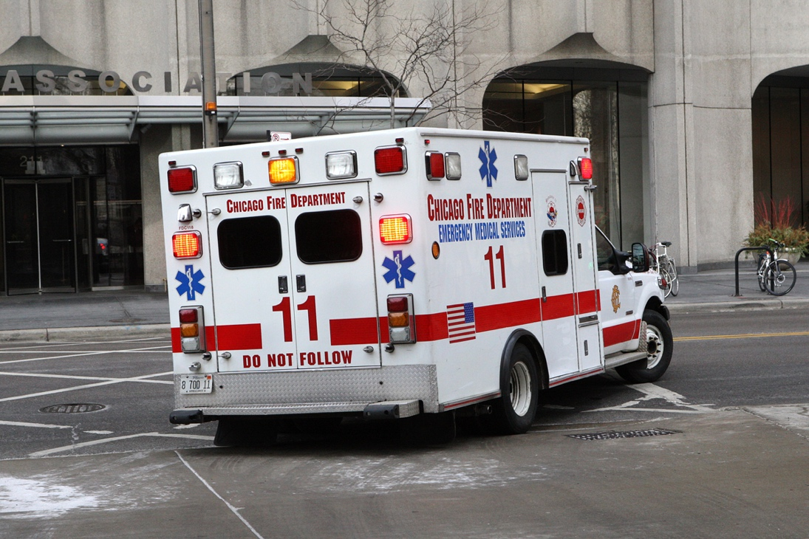
Call in resources!
ALS
Police

Slide 112
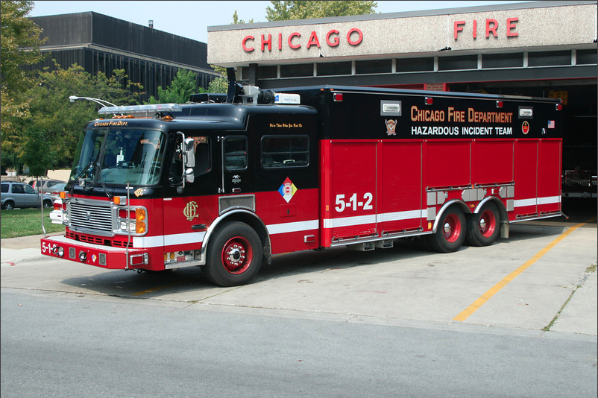
Call in resources!
HazMat

Slide 113
Safety
Scene safety is always your #1 priority
Some agencies automatically dispatch PD with you on calls involving violence, suicide, or behavioral emergencies
Otherwise, keep your eyes peeled. If it’s not safe, stay away. Your safety comes first.
If the scene becomes unsafe, leave until police arrive.

Slide 114
Self defense
You are allowed to use as much force as necessary to defend yourself. At the first available opportunity, you should leave the scene.
The use of pepper spray, pocket knives and other weapons are usually discouraged and not allowed.
This is not a time to protect your dignity...

Slide 115
Relevant law:
Informed consent
Negligence
Abandonment
Assault and battery
False imprisonment
Mandated reporter
Notes:
Informed consent means you inform the patient of the care and the associated risks and consequences prior to performing it.
Expressed consent must be obtained from every conscious, mentally competent adult before you start treatment. The patient must be of legal age and competent. Document the patient’s approval.
Implied consent occurs when you assume that a patient who is unresponsive, incompetent, or unable to make a rational decision would consent to emergency care if he could.
Consent to treat a minor must be obtained from a parent, legal guardian, or other person who has been granted limited rights of decision making by the parent or guardian. If the parent or legal guardian is not present and cannot be reached to provide consent, use the concept of implied consent.
Involuntary consent can be applied when you are dealing with a mentally incompetent adult or with an individual who is in custody of law enforcement or is incarcerated.
Abandonment: When a HCP stops treatment without transferring to an appropriate level of care
Assault is a willful threat to inflict harm on a patient
Battery is the act of touching a patient unlawfully without his consent.
False Imprisonment: If you transport a patient to the hospital without his or her proper consent
Mandated reporter: The legal requirement for you to report abuse, suicidal and homicidal behavior to officials.

Slide 116
Scenario 3:

Slide 117
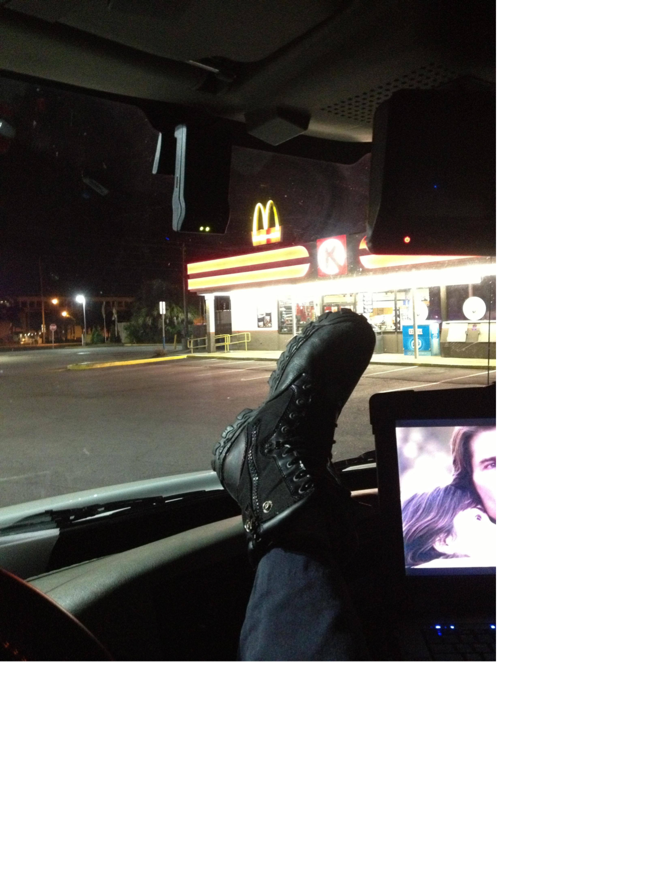
EMS, please respond to Fairfield hall for an adult seizure.

Slide 118
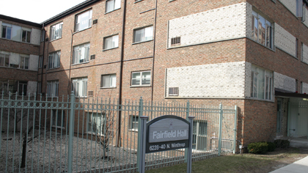
EMS, we have an update.
Neighbors heard a gunshot from the
dorm 2 minutes ago. Previous records
indicate a history of suicidal ideation.

Slide 119
What’s your plan?
Park around the corner until Campus Safety and CPD shows up.

Slide 120


Slide 121
Scenario 4:
Ambulance 8, please respond to 6332 N Lakewood Ave for 40 year old male who is vomiting. Time out 19:03.

Slide 122

I’ve had a headache... It started about an hour after I got here. I have no idea why.

Slide 123
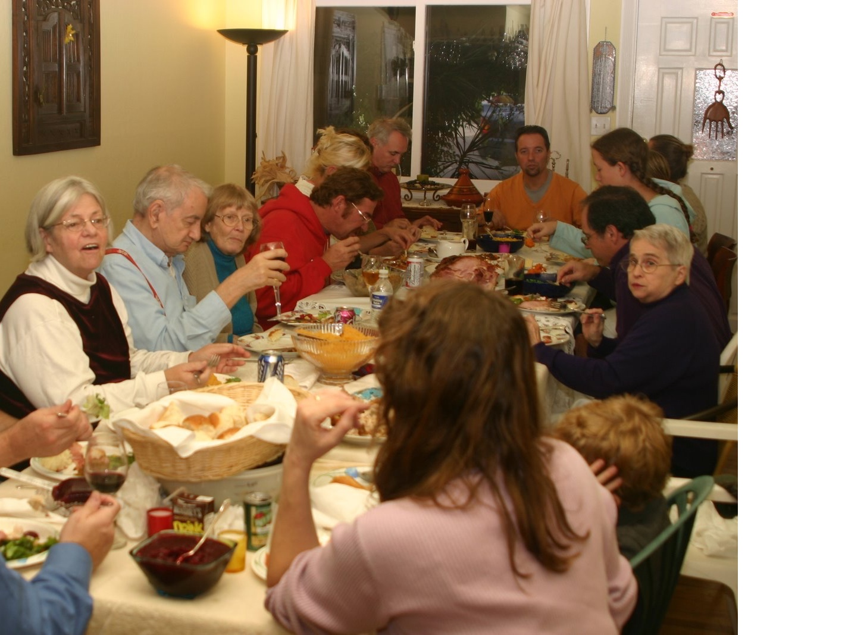
.... Me too
... grhrh

Slide 124
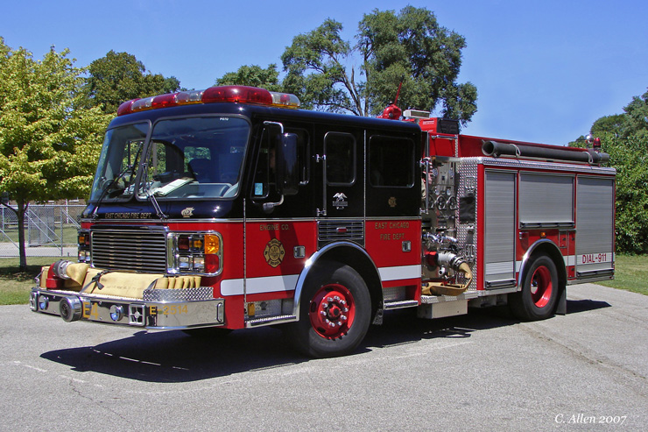
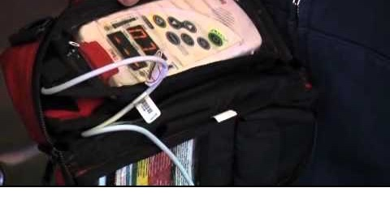


Slide 125
Now what?
Get everyone into fresh air
Request additional resources?
Supplemental oxygen!
Pulse oximeter reads 98%.
  Is that reassuring?

Slide 126
Scenario 5:
Ambulance 8, please respond to Mertz Hall for a 19 year old male with a seizure. Time out 20:29.

Slide 127
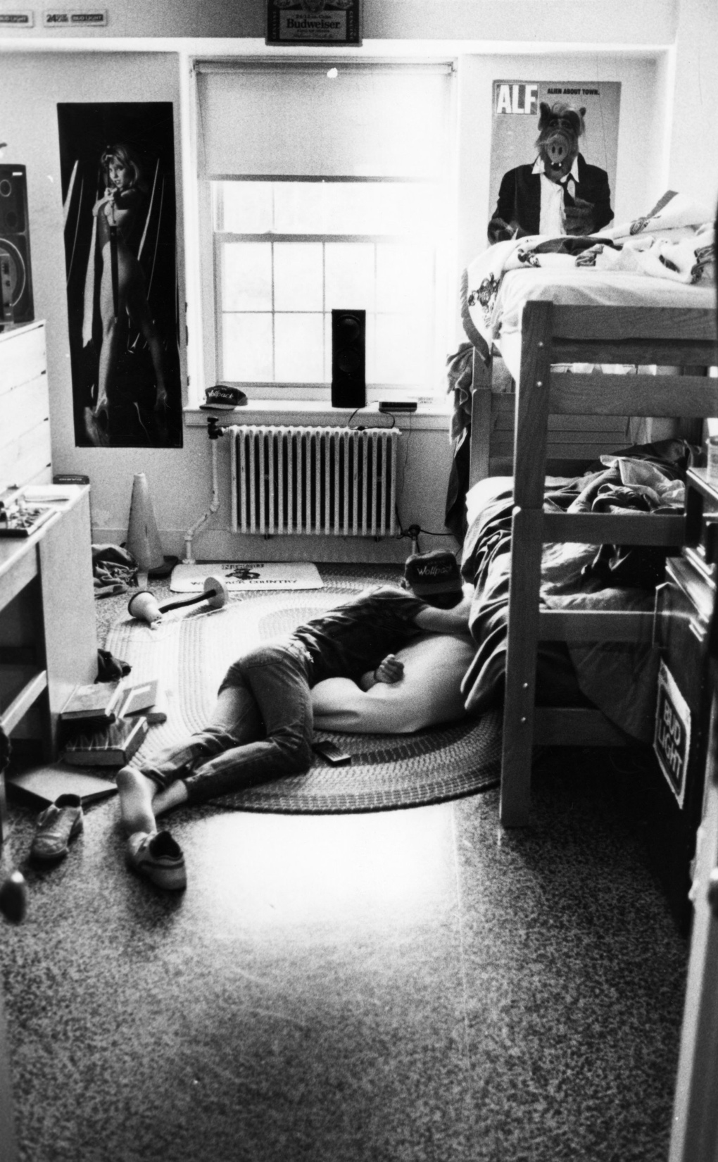


“He’s been studying for like, 18 hours straight. When I get back from class this morning, I saw him shaking on the ground and now he’s like this. I’m scared!!”

Slide 128
What do you do?
Drowsy, but arousable
V/S: BP 152/90, P 110, RR 20
Answers questions appropriately
Says he was just chillin’. Has been studying a lot.
“Bro. I’m fine. Let me go. I’m just tired.”

Slide 129
What do you do?
Safe?
ABCs? Vitals? Coingestants? Other causes?
When?
Treatment?
“I don’t wanna go”

Slide 130
X
X
X
X
X
X
X
X

Slide 131
The big picture:
Patients in a behavioral or psychiatric emergency are sick and need your help.
Your job is to recognize the person’s sickness, assess them, treat them, and transport them to definitive care if needed.
Avoid undue & excessive force, tunnel vision, close-mindedness, and conflict.

Slide 132
It can be frustrating...
A lot of work, for little instant gratification
Hard to control scene
Treatment options limited

Slide 133
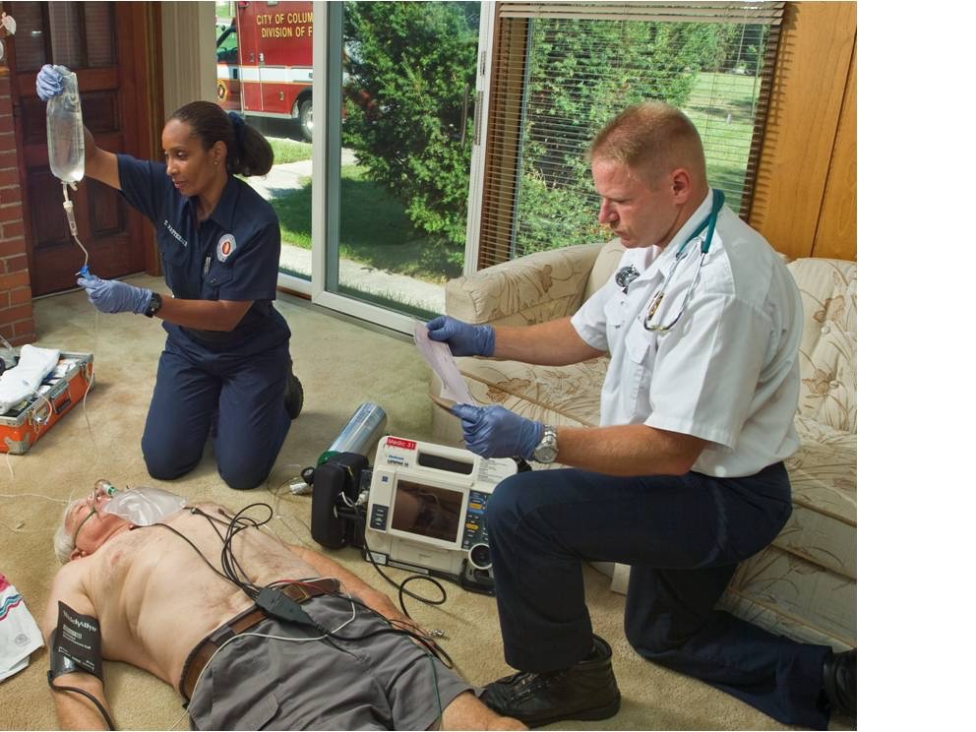
Unlike any other.

Slide 134
  “You treat a disease, you win, you lose. You treat a person, I guarantee you, you’ll win, no matter what the outcome.”
  -Patch Adams

Slide 135
Additional information:
Watch this 15 minute TED talk:
  http://www.ted.com/talks/elyn_saks_seeing_mental_illness.html
Elyn Saks suffers from schizophrenia. She speaks about her work as Dean and Professor at USC Gould Law School and how her disease has affected her.

Slide 136

LAB
>>> Dealing with difficult patients
Notes:
Dealing with difficult patients
Goose neck
Holding patients down
Moving difficult patients
Using soft restraints
Communication
“I’m not going anywhere”
Patient who doesn’t make sense

Slide 137
The End
Jeremy A. Lacocque, DO
jlacocque67@midwestern.edu

Slide 138
References:
Prehospital Emergency Care, Ninth Edition, Joseph J. Mistovich, Keith J. Karren
Jones & Barlett Learning, LLC – jblearning.com
First Aid for the USMLE Step 1, 2012. Le, Bhushman, Hofmann.

