Slide 1
Thermia Jeopardy
The Pen Is
Mightier
Catch These Men
Japan US
Relations
Famous Horsemen
I have a
Chardonnay
The Rapists
200
200
200
200
200
200
400
400
400
400
400
400
600
600
600
600
600
600
800
800
800
800
800
800
1000
1000
1000
1000
1000
1000
Final Jeopardy

Slide 2
What is the definition of a “non-freezing” cold related injury and what are the types?
Exposure to wet conditions when temperatures are > freezing
Trench foot, chilblains/pernio, panniculitis, cold urticaria

Slide 3
What is the presentation and treatment of trench foot?
Pale, mottled, anesthetic, pulseless, immobile
-> Hypermia -> bullae -> sloughing
Supportive treatment
Consider vasodilators, oral prostaglandins (may improve circulation), clean, warm, dry bandaged, elevated

Slide 4
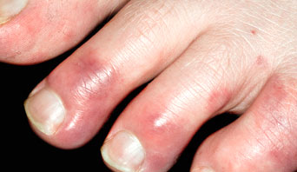
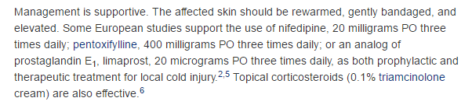
What is characterized by the following?
Chillblains/pernio
inflammatory lesions of the skin caused by long-term intermittent exposure to damp, nonfreezing ambient temperatures
localized edema, erythema, cyanosis, plaques, nodules, and, in rare cases, ulcerations, vesicles, and bullae
Tingling and numbness
Notes:
How do you describe them? What are they?
What are the symptoms and presentation
What can happen to the fingers?

Slide 5
This is observed on the cheeks, thighs and buttocks of patients, often in children or young women of equestrian background.
What is panniculitis?
“Popsicle panniculitis”

Slide 6
A young female complains that every time she goes in the cold, she feels her throat is closing and she is itchy. What is the most likely diagnosis?
Malingering
(Cold urticaria)
Notes:
Cold urticaria is treated similarly to urticarial lesions from other causes. Antihistamines (H1) are recommended for acute cases, although higher than usual dosing may be required.¹¹ Other potential therapies include leukotriene receptor antagonists (zafirlukast, montelukast)^{12,13} and topical capsaicin. For persistent cold urticaria, ketotifen or doxantrazole may be tried, but oral preparations of these mast cell stabilizers are not available in the United States. Prescribe epinephrine autoinjectors for patients with a history of cold-induced anaphylaxis.

Slide 7
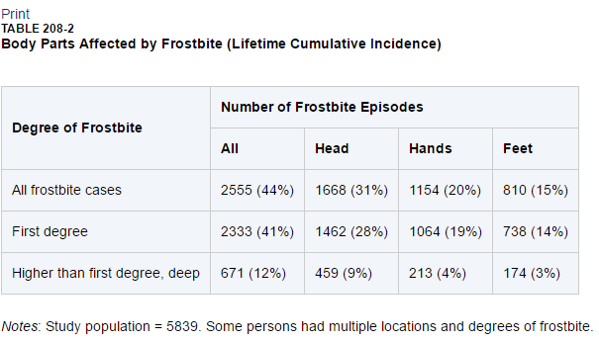
What are the 3 most common areas of frostbite in order?
Head, hands, feet

Slide 8
These ages and gender combinations are the highest at risk for frostbite
Teenage males
Young males in the military

Slide 9
This is the temperature and wind speed at which rate of cold injuries starts to increase
12 deg C (10.4 deg F)
Wind speed > 4.5 m/s (10 mph)

Slide 10
The depth of freezing depends on the following three elements
Temperature
Duration of exposure
Velocity of freezing

Slide 11
These are the three zones of frostbite injury.
Zone of coagulation
Zone of hyperemia
Zone of stasis
Notes:
Frostbite injury can be divided into three zones. The zone of coagulationis the most severe and is usually distal, and the damage is irreversible.
The zone of hyperemia is the most superficial, is typically proximal, has the least cellular damage, and generally recovers without treatment in <10 days.
The zone of stasis is the middle ground and is characterized by severe, but possibly reversible, cell damage. It is this middle zone for which treatment may have benefit if the circulation in the frozen area can be restored.
he least to most sensitive tissues are, in order, cartilage, ligament, blood vessel, cutis, epidermis, bone, muscle, nerve, and bone marrow.

Slide 12
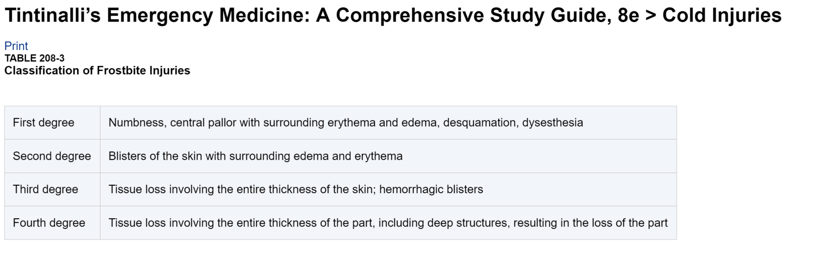
These are the degrees of frostbite injury and what they mean.

Slide 13
These are all of the appropriate frostbite treatment steps in the ED
Rapid rewardming in hot water (100 deg)
Clear blisters?
Ppx abx?
Aloe vera topical cream q6hours
Dry gauze
Thrombolysis? NSAIDS
Methimazole?
Steroids?
Notes:
ocal care is directed toward tissue preservation and infection prevention. Management of clear blisters and the use of prophylactic antibiotics are somewhat controversial. The blister fluid is rich in destructive thromboxane and prostaglandins. Although removal theoretically limits damage from these chemicals and enables access to the underlying tissue for topical therapy, not all experts agree that removal is indicated. Hemorrhagic blisters should not be debrided, because this often results in tissue desiccation and worse outcome. However, there is some controversy as to whether aspiration is helpful.
Because microvascular thrombosis plays a role in tissue injury, thrombolysis has been advocated by some for use in cases at risk for proximal or multiple digit amputations^{32,33} and, when given after rapid rewarming, appears to reduce digit amputations.^{30,34-36} The evidence in support of IV or intra-arterial tissue plasminogen activator is limited to retrospective studies, and bleeding risks must be weighed against potential benefit.
The role of prophylactic antibiotics is unclear. The edema that is present on the first several days after injury does appear to predispose to infection. Staphylococcus aureus, Staphylococcus epidermidis, and β-hemolytic streptococci account for nearly half of infections, but anaerobes,Pseudomonas, and Enterococcus are important pathogens as well. Therapy with penicillin G, 500,000 units IV every 6 hours for 48 to 72 hours, is recommended in several successful protocols and seems to be beneficial. However, infection prophylaxis using topical bacitracin may be as good as or better than IV penicillin. The use of silver sulfadiazinecream also has been advocated by some, but it has not been shown to be consistently beneficial. One disadvantage of using topical antibiotics is that they complicate the concurrent use of aloe vera cream.
Several agents besides aloe vera cream have been recommended to battle the arachidonic acid cascade and thereby limit tissue damage. The most commonly advocated oral medication is ibuprofen, 12 milligrams/kg/d PO in divided doses. Animal studies suggest possible future roles for oral methimazole (a thromboxane synthetase inhibitor) and topical 1% methylprednisolone acetate (a phospholipase A2 inhibitor) in preventing the formation of arachidonic acid.
Another controversial area is the use of sympathetic blockade with either intra-arterial reserpine or surgical sympathectomy to relieve vasospasm and edema. There is no role for early sympathectomy. Prolonged sympathetic blockade using a long-acting anesthetic drug (bupivacaine) may improve blood flow to the hand, relieve pain, and speed recovery. Continuous epidural anesthesia may relieve peripheral vasospasm and perhaps prevent retrograde arterial and venous thrombosis.
Heparin of little valuye

Slide 14
These are risk factors for hypothermia
Burns
Iatrogenic
Impaired shivering
Young
Old
Malnourished
Medications (etoh, beta blockers, sedatives, vasodilators)
Metabolic disorders
Sepsis
Shock
Trauma

Slide 15
These are the stages and temperatures of hypothermia.
Stage 1 – 35-32
Stage 2 – 32 – 28
Stage 3 - < 28
Stage 4 – cardiac arrest

Slide 16
These are the treatments for a patient in moderate hypothermia with a temperature of 30.
Active external warming, minimally invasive rewarming (warm environment, heating packs, hot air, warmed fluids, warm blankets)
Full body insulation, immobilization
Minimal, cautious movements
Core temperature monitoring

Slide 17
These are the indications for ECMO or CPB in hypothermia.
Cardiac arrest
Hemodynamic instability refractory to medical management
Co-morbid patients who are unlikely to tolerate the low cardiac output associated with severe hypothermia

Slide 18
If ECMO/CPB unavailable for hypothermia, these measures may save an arrested patient’s life.
Thoracic Lavage
Bladder Lavage
Peritoneal Lavage
Gastric Lavage
Rectal Lavage

Slide 19
If your hypothermic patient is in cardiac arrest, this is the most appropriate management.
Rewarming
CPR
“May be reasonable to use vasopressors” (AHA)
Up to 3 defib attempts, withhold epinephrine until core temp is > 30, double the frequency of administration until temp > 35 (ERC)
CPR and up to 3 doses of epinephrine and defibrillation (Tintinalli’s)
Notes:
Controversy exists regarding the use of epinephrine and defibrillation in hypothermic cardiac arrest. The European Resuscitation Council 2010 guidelines recommend up to three defibrillation attempts, to withholdepinephrine until the core temperature exceeds 30°C, and to double the dose frequency until the temperature is above 35°C.²⁷ In contrast, the American Heart Association 2010 guidelines state that it may be reasonable to use vasopressors during cardiac arrest.²⁸ Given the conflicting animal and human data that each recommendation is based on, a reasonable approach is to use standard advanced cardiac life support protocols for up to three cycles and, in the absence of clinical response, defer further defibrillation or epinephrine until core temperature increases significantly or the patient's clinical status changes.
BONUS – predictive of death? K > 12 with temp > 32

Slide 20
These are the methods for the body to dissipate heat and how they work
Radiation – electromagnetic transfer from warm to cool
Conduction – heat exchange between two surfaces
Convection – heat transfer from air or liquid moving across an object
Evaporation – heat loss by vaporization of water or sweat

Slide 21
These are the physiologic response to heat stress.
Vasodilation
Increased sweat production
Decreased heat production
Behavioral heat control

Slide 22
These are some of the medications that make patients more susceptible to heat injury.
Anticholinergic
Diuretics
Beta blockers
Calcium channel blockers
Sympathomimetic agents
Phenothiazines
Alcohol
Notes:
Anticholinergic agents impair sweating and the cardiovascular response to heat. Diuretics lead to volume depletion and decreased cardiac output. Phenothiazines have anticholinergic properties and deplete central stores of dopamine, which interfere with the hypothalamic thermoregulatory center. Medications such as β-blockers and calcium channel blockers decrease the cardiovascular response to heat and reduce peripheral blood flow and the ability to sweat. Sympathomimetics cause cutaneous vasoconstriction and inhibit sweating. Alcohol inhibits secretion of antidiuretic hormone, which leads to dehydration, and blunts the psychological heat-avoidance response. Heroin, cocaine, and amphetamines disrupt the function of endogenous endorphins and adrenocorticotropic hormones that are involved in heat adaptation mechanisms. Amphetamines and cocaine increase muscle activity and lead to heat production. Lysergic acid diethylamide and phencyclidine act on the CNS to induce a hypermetabolic state.¹⁰

Slide 23
This is classic heat injury, exertional heat injury and confinement hyperpyrexia.
Classic heat injury – high environmental heat stress
Exertional heat injury – athletic events or jobs under conditions of stress
Confinement hyperpyrexia – “children inside cars”

Slide 24
Orthostatic pooling of interstitial fluid in gravity dependent extremities due to cutaneous vasodilation is known as this.
Heat edema

Slide 25
This is the pathogensis of heat cramps
Deficiency of sodium, potassium or magnesium and fluid at he muscle level.

Slide 26
A 22 year old who has been working outside is complaining of headache, nausea, vomiting, malaise, dizziness, and muscle cramps. He is tachycardic and his temperature is 103.5 deg F. This is his diagnosis.
Heat Stress
Notes:
Laboratory studies almost universally demonstrate hemoconcentration, although the specific electrolyte abnormalities seen depend on the ratio of fluid and electrolyte losses to intake. Patients who have had no fluid intake of any kind exhibit hypernatremia, whereas those who partly rehydrate with salt-containing fluids develop isotonic hypovolemia with normal sodium and chloride levels. Serum potassium and magnesium levels are variable.

Slide 27
Patients suffering from heat stress require these treatment methods
Oral electrolytes
1 – 2L IVF cooled or room temperature
Removal from hot environment
Removal of clothing
Fans

Slide 28
These two features are required for the diagnosis of heat stroke.
Hyperthermia > 40 deg C/104 deg F
Altered mental status
Notes:
Although patients presenting with classic (nonexertional) heat stroke may exhibit anhidrosis, the absence of sweat is not considered a diagnostic criterion because sweat is present in over half of patients with heat stroke.¹⁵

Slide 29
These are the initial resuscitation measures for heat stroke and the heat loss mechanism they utilize.
Removal from environment and remove clothing
Spray patient with water and fans
Wet towels or sheets
Ice
Room temperature IVF
Notes:
What does the data say? None are better than the others

Slide 30
This treatment method has been found to be very effective for cooling and was originally developed for athletes.
Immersion Cooling

Slide 31
In patients with refractory hyperthermia, you should consider the following treatments.
CPB
Cold Water Gastric Lavage
Urinary bladder lavage
Rectal lavage
?peritoneal lavagae

Slide 32
Avoid cooling less than this temperature to avoid overshoot hypothermia.
DAILY DOUBLE
102.2 deg F

Slide 33
FINAL JEAPORDY
Complete this famous SNL quote
Alex Trebec: "The category is "rhymes with dog," and the question is, "It's been a Hard Day's night and I should be sleeping like a ................"
Notes:
Chinese Whore

